Slide 1
Histology of The Skin
Ali M. Gargoom
Professor of Dermatology
Faculty of Medicine
Benghazi University
Libyan International Medical University

Slide 2
Chapter 1 : Histology of the skin
Chapter 2 : History taking and examination ofskin disease
Chapter 3 : Bacterial skin infections.
Chapter 4 : Fungal skin diseases.
Chapter 5 : Viral skin infections.
Chapter 6 : Parasitic skin diseases.
Chapter 7 : Mycobacterial skin diseases.
Chapter 8 : Urticarias and Erythemas.
Chapter 9 : Disorders of sebacous glands.
Chapter 10: Autoimmune vesiculo-bullous diseases.
Chapter 11: Pigmentary disorders of the skin.
Chapter 12: Papulosquamous skin diseases.
Chapter 13: Eczemas.
Chapter 14: Disorders of hairs..
Chapter 15: Connective tissue diseases.
Chapter 16: Genodermatosis.
Chapter 17: Topical formulations and topical steroids.
Chapter 18: Sexually Transmitted Diseases

Slide 3
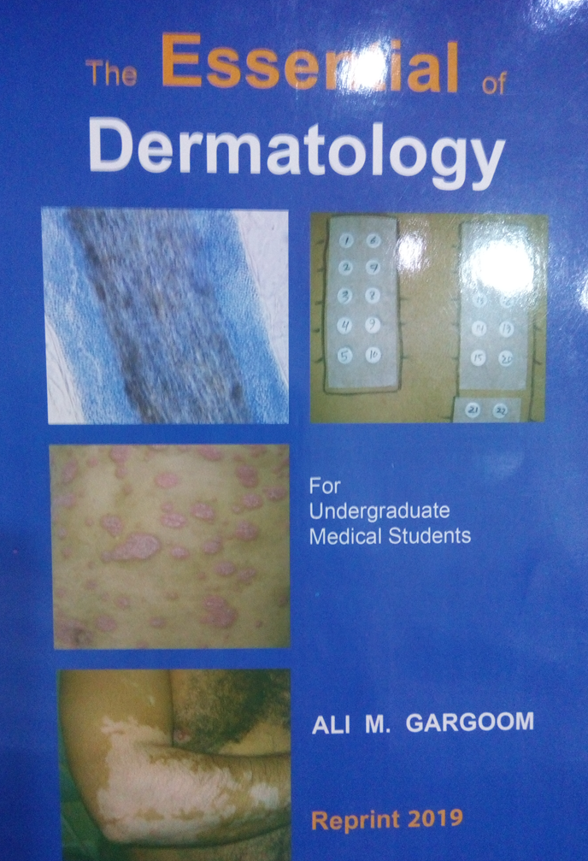

Slide 4
Objectives of the lecture
Layers of the skin.
Layers of epidermis
Cells of epidermis.
Contents of dermis
Skin appendages.
Functions of the skin

Slide 5
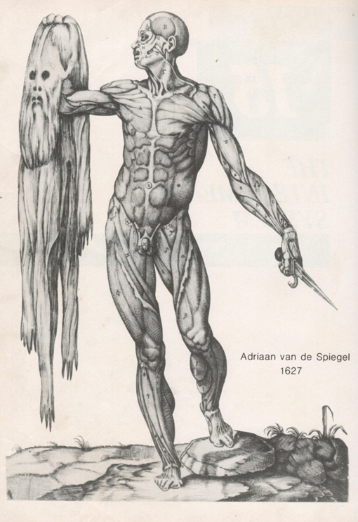
SKIN The largest immunologically active organ, weighting about four kilograms (16% BW) the skin covering a surface area of about 2 square meter. The skin is composed of three layers:
Epidermis.
Dermis.
Hypodermis.

Slide 6
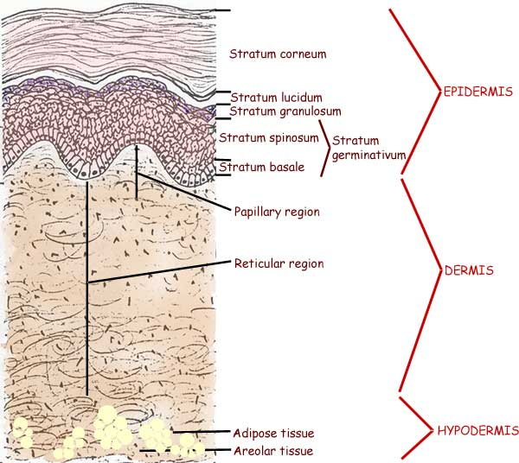

Slide 7
The skin is composed of three layers
Epidermis.
Dermis.
Hypodermis.

Slide 8
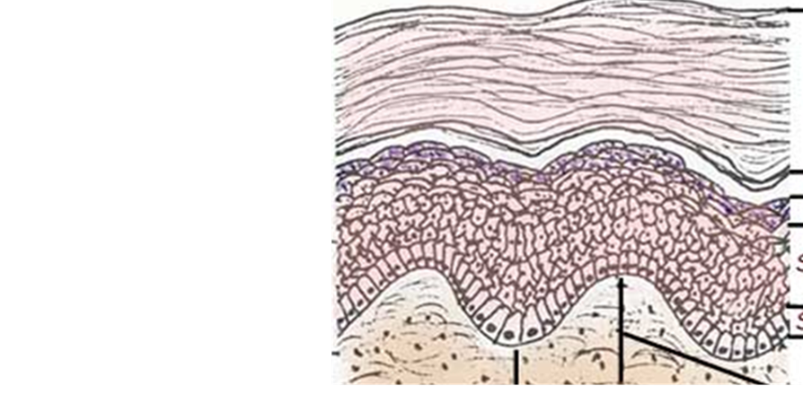
The epidermis is formed of four layers
The horny cell layer.
The granular cell layer.
The spinous cell layer.
The basal cell layer.
The thickness of epidermis vary from 0.1mm to 1.0mm
On palms & soles there is an additional layer known as starum lucidium.

Slide 9
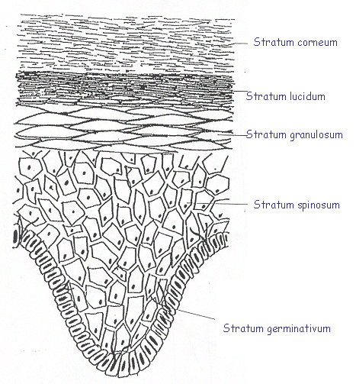

Slide 10
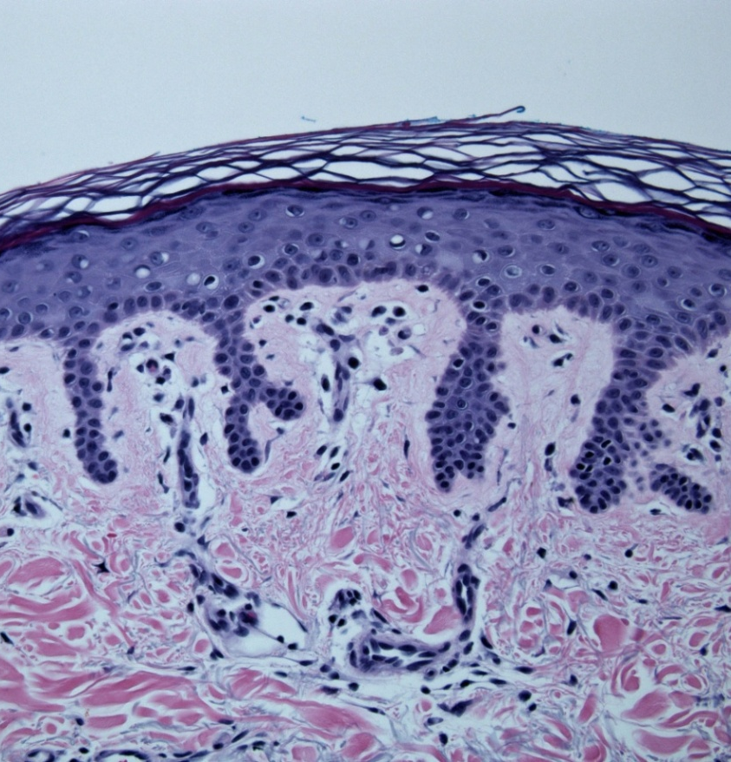
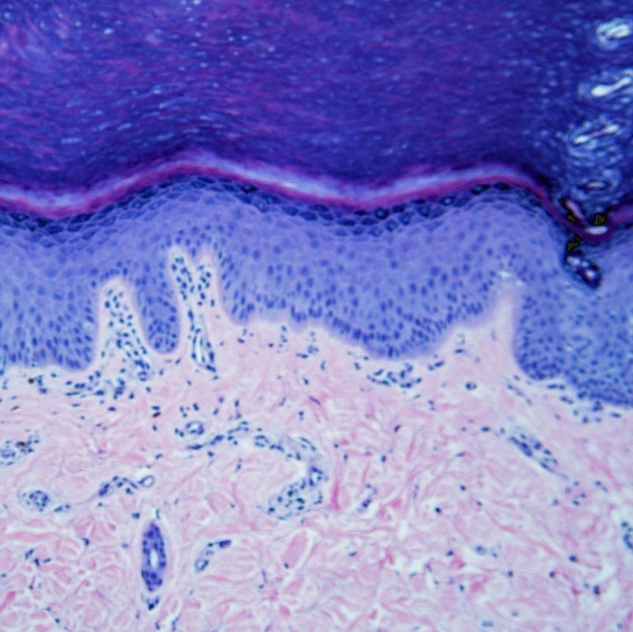
Epidermis : Layers
Stratum Corneum
Stratum Lucidum
Stratum Granulosum
Stratum Spinosum
Stratum Basale
Thin Skin
Thick Skin
Notes:
The keratinocytes of the epidermis are organized into 4 or 5 layers depending on the regional location. The layers can be easily remembered with the pneumonic cancel lab get some beer. From superficial to deep the layers on thick skin are the strum corneum, stratum lucidum, stratum granulosum, stratum spinosum, and the basal most layer the stratum basale. Proliferation of these basal layer cells into the epidermis can result in the common neoplasm, basal cell carcinoma.
The section of thin skin on the left has all the same layers in the same order with the exception of the stratum lucidum. Both types of skin have a relatively flat surface with a convolted underside due to the papillary dermis insertion into the epidermis. The finger like projections of epidermis that extend into the dermis are called rete ridges.

Slide 11
Cells of the epidermis
The epidermis is composed of four types of cells
Keratinocytes.
Melanocytes.
Langerhans' cells.
Merkel cell.

Slide 12
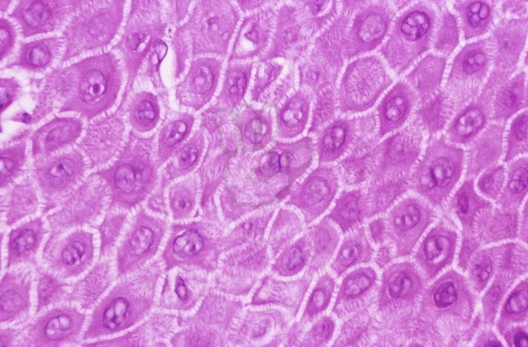
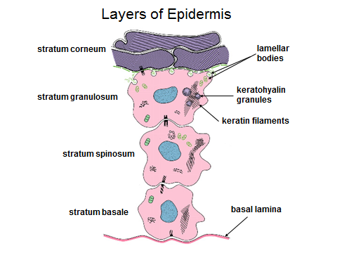
Keratinocytes (90% - 95% )
Desmosome = Intercellular Bridges
Notes:
This is a high power view of the keratinocytes of the stratum spinosum connected to one another by intercellular bridges made up by desmosomal proteins.

Slide 13
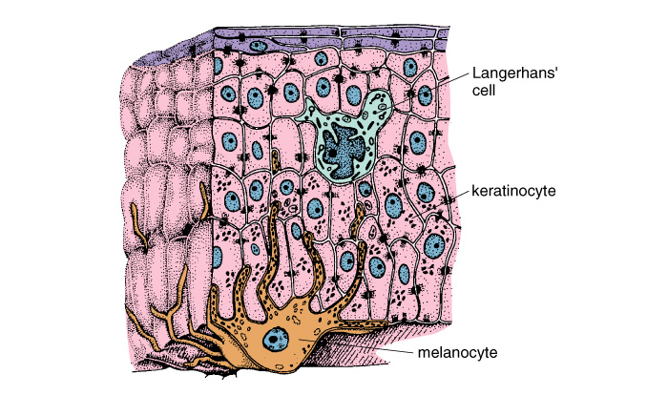
Other cells of epidermis:
Melanocyte & Langerhans cell

Slide 14
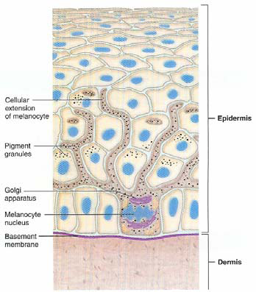
Melanocytes

Slide 15
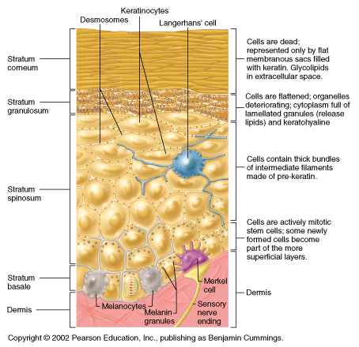

Slide 16
Dermis
The main thickness of the skin is made up by the dermis which vary from 1.0 mm on the eyelids to 5.0 mm on the palms and soles.
The dermis is made up mainly from four components.
1. Collagen fibers.
2. Elastic fibers.
3. Ground substance.
4. Cells.

Slide 17
DERMIS
1. Collagen fibers:
Family of fibrous proteins >15 distinct type in human skin.
Constitutes >70% of the dermis and its responsible for the strength of the skin.
Type I collagen represent (70%) & type III collagen comprising (15%).
2. Elastic fibers:
Elastin constitutes about 1% to 3% of the skin.
Responsible for the elasticity of the skin.
3. Ground substance:
Proteoglycans (primarily hyaluronic acid) is the major component .
Strongly attract and retain water within the dermis.
4. Cells of the dermis:
Fibroblast is the major cell (synthesis of collagen, elastin and ground substance). Other cells include macrophages, histocytes, mast cells, and lymphocytes

Slide 18
DERMIS
Dermis is divided into two components;
1-Papillary dermis:
Upper part of dermis beneath the basal layer of the epidermis
Papillary dermis is thin, cellular and highly vascularized.
Composed of thin haphazardly arranged collagen fibers.
2-Reticular dermis:

Slide 19
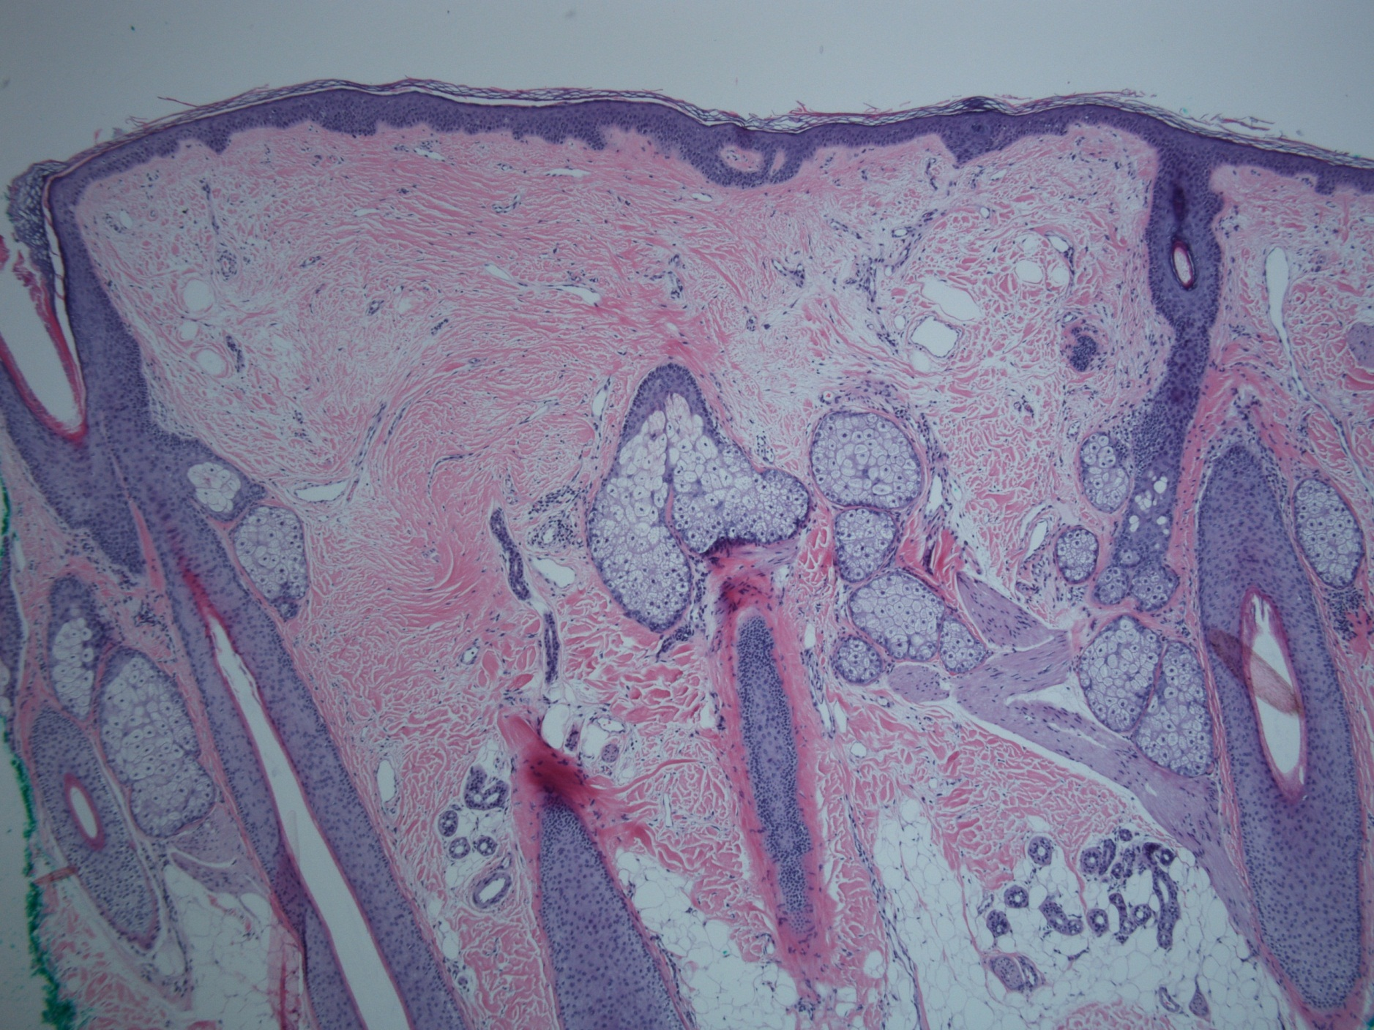
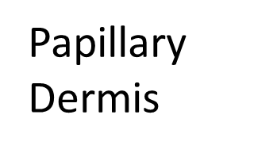
Reticular Dermis
Notes:
Within the reticular dermis reside the adnexal structures which includes Sebaceous glands, hair follicles, eccrine glands, and apocrine glands.

Slide 20
DERMIS
Dermis is divided into two components;
1-Papillary dermis:
The upper part of dermis just beneath the basal layer of the epidermis
Composed of thin haphazardly arranged collagen fibers.
Papillary dermis is thin, cellular and highly vascularized.
2-Reticular dermis:
The major component of dermis.
Extend from papillary dermis to the subcutaneous tissue.
Made from thick collagen fibers arranged parallel to the skin surface.
Reticular dermis is thicker but less cellular than papillary dermis.

Slide 21
Reticular Dermis
Notes:
Within the reticular dermis reside the adnexal structures which includes Sebaceous glands, hair follicles, eccrine glands, and apocrine glands.

Slide 22
Skin Appendages
The skin appendages includes;
Hair.
Nails.
Sweat glands.
Sebaceous glands.

Slide 23
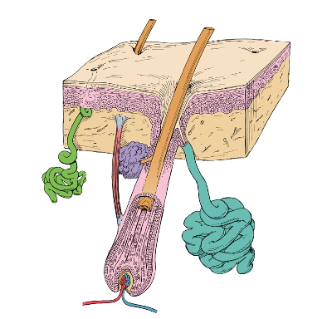
Skin Appendages
Nails
Eccrine
Sweat gland
Apocrine
Sweat gland
Hair follicle
Sebaceous gland

Slide 24
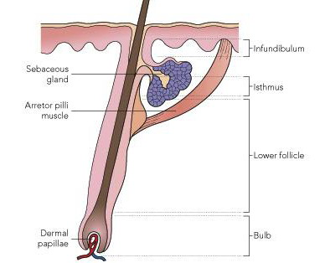
Hair.

Slide 25
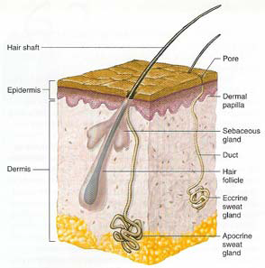
Sweat glands.
Sebaceous glands.

Slide 26
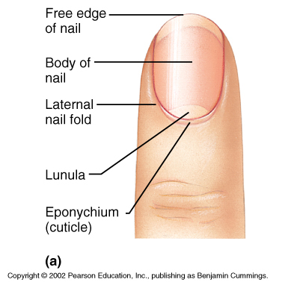

Slide 27
Functions of the Skin
1. Protective barrier
2. Regulation of body temperature.
3. Excretion of certain substances and toxins.
4. Vitamin D synthesis.
5. Socio-sexual communication.
6. Immunological function.
7. Sensory function

Slide 28

Thank you for your attention

