Slide 1



CANCER
LEUKEMIA
Name : LINA SAMI
Student Number : 2718
Block : GBMS
Date : 01/06/2022

Slide 2
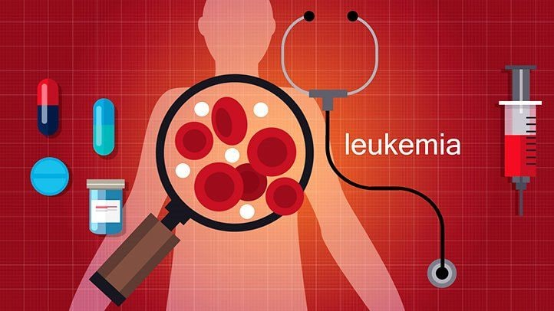
Objectives
Define Leukemia
Out line Types of leukemia
List the Signs and symptoms of leukemia
List the Causes and Risk factors of leukemia
Mention the Diagnosis of leukemia
List the Treatment of leukemia
Describe the prognosis of leukemia
Notes:
The word leukemia, which means 'white blood', is derived from the characteristic high white blood cell count that presents

Slide 3
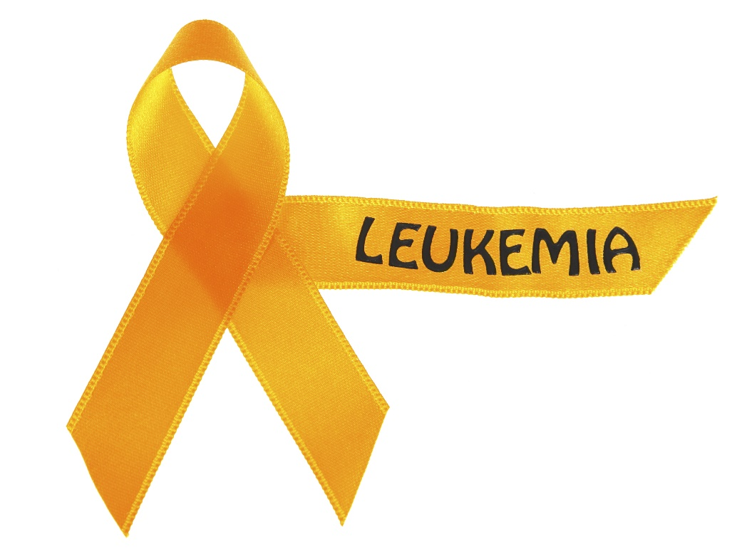
Introduction
Notes:
The word leukemia, which means 'white blood', is derived from the characteristic high white blood cell count that presents

Slide 4
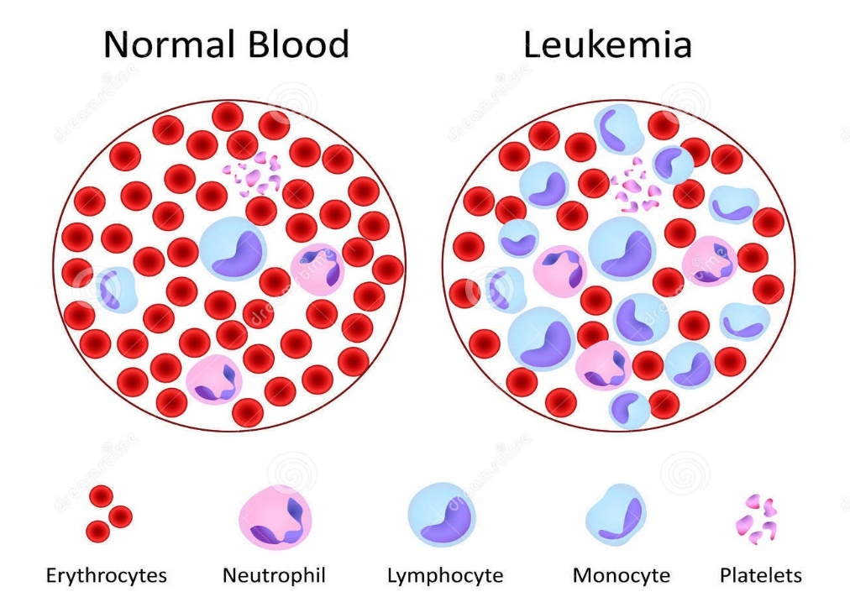
Defination
Leukemia is a cancer of the White blood cells.
There are several broad categories of blood cells, including red blood cells (RBCs), white blood cells (WBCs), and platelets. Generally, leukemia refers to cancers of the WBCs
Notes:
Leukemia is cancer of the white blood cells. White blood cells (also called leukocytes or WBCs) fight infections and other diseases.
In leukemia, the bone marrow (spongy material inside the bones) makes many white blood cells that aren't normal. These abnormal WBCs crowd the bone marrow and get into the bloodstream. Unlike healthy white blood cells, they can't protect the body from infections.
Sometimes leukemia spreads from the bone marrow to other parts of the body, like the chest, brain, or liver.
Leukemia is the most common type of cancer in children

Slide 5

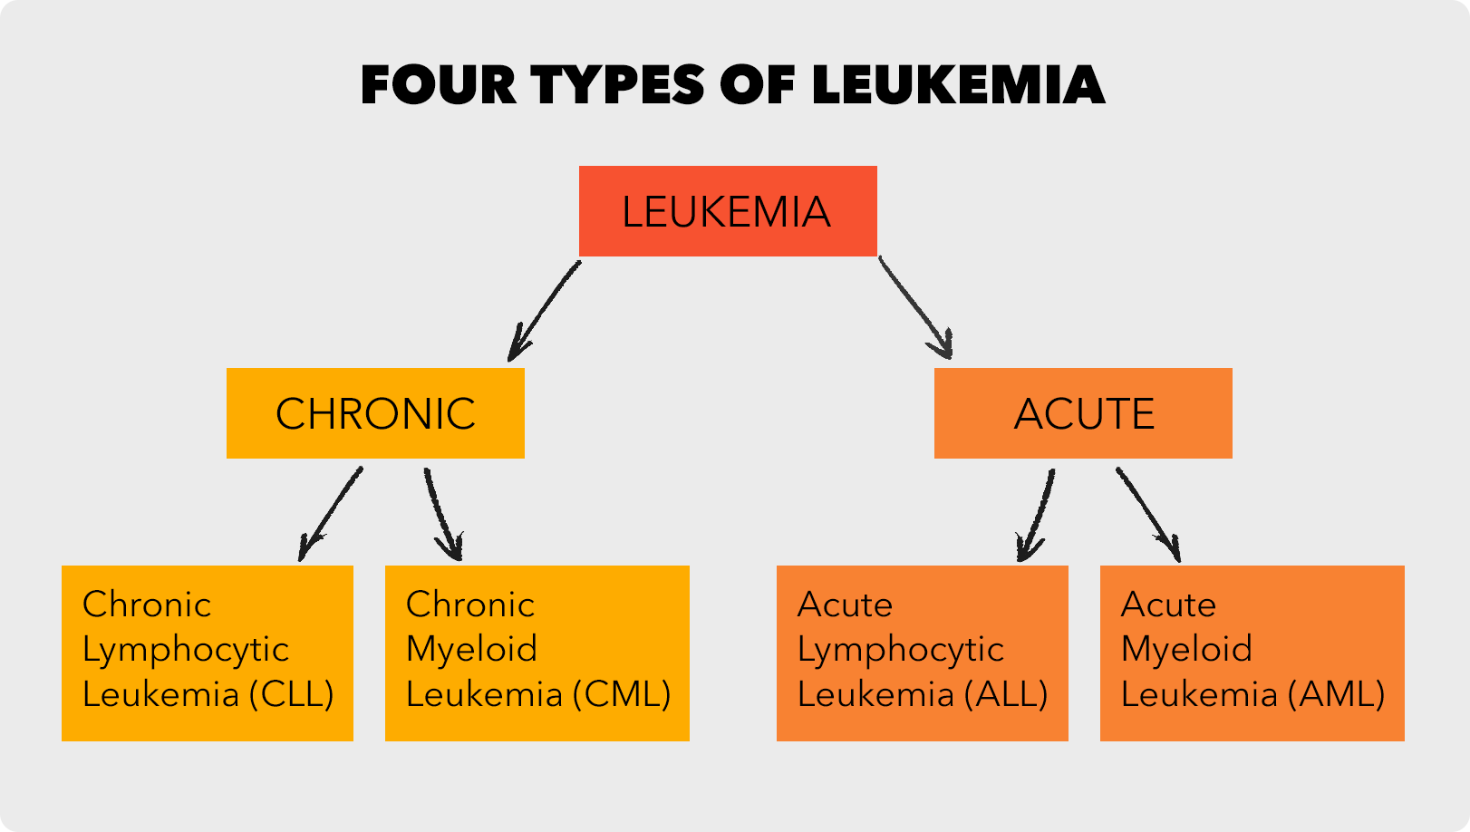
Types of leukemia
There are four main types of leukemia :
1 - acute lymphoblastic leukemia (ALL)
2 - acute myeloid leukemia (AML)
3- chronic lymphocytic leukemia (CLL)
4 - chronic myeloid leukemia (CML)
Notes:
Clinically and pathologically, leukemia is subdivided into a variety of large groups. The first division is between its acute and chronic forms
Additionally, the diseases are subdivided according to which kind of blood cell is affected ( lymphoblastic or lymphocytic leukemias and myeloid or myelogenous leukemias
Pre-leukemia Transient myeloproliferative disease, also termed transient leukemia, involves the abnormal proliferation of a clone of non-cancerous megakaryoblasts. The disease is restricted to individuals with Down syndrome or genetic changes similar to those in Down syndrome, develops in a baby during pregnancy or shortly after birth, and resolves within 3 months or, in ~10% of cases, progresses to acute megakaryoblastic leukemia. Transient myeloid leukemia is a pre-leukemic condition

Slide 6
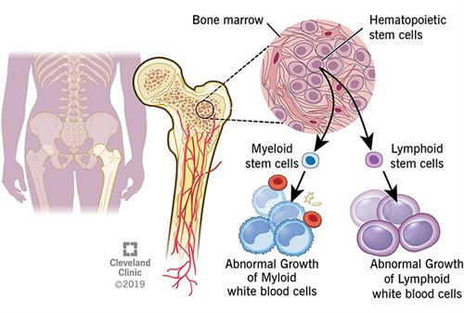
Types of leukemia
1 - Acute lymphocytic leukemia (ALL).
This is the most common type of leukemia in young children. also can occur in adults.
2 - Acute myelogenous leukemia (AML).
AML is the most common type of acute leukemia in adults AML is a common type of leukemia , It occurs in children and adults
3 - Chronic lymphocytic leukemia (CLL).
the most common chronic adult leukemia , you may feel well for years without needing treatment.
4 - Chronic myelogenous leukemia (CML).
This type of leukemia mainly affects adults. A person with CML may have few or no symptoms for months or years before entering a phase in which the leukemia cells grow more quickly.

Slide 7
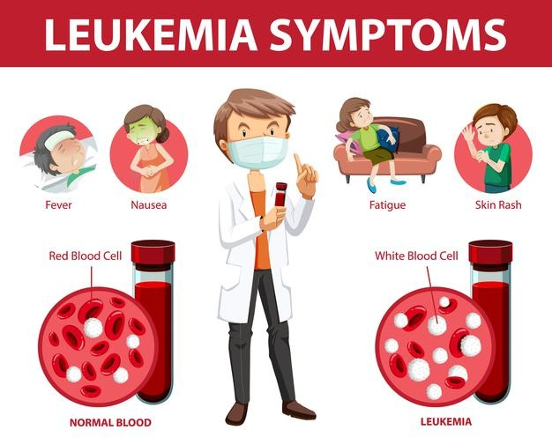
signs and symptoms of leukemia
Leukemia symptoms vary, depending on the type of leukemia
Common leukemia signs and symptoms include:
- Fever or chills
- Persistent fatigue, weakness
- Frequent or severe infections
- Losing weight without trying
- Swollen lymph nodes, enlarged liver or spleen
- Easy bleeding or bruising
- Recurrent nosebleeding
- Tiny red spots in your skin (petechiae)
- Excessive sweating, especially at night
- Bone pain or tenderness
Notes:
The most common symptoms in children are easy bruising, pale skin, fever, and an enlarged spleen or liver

Slide 8
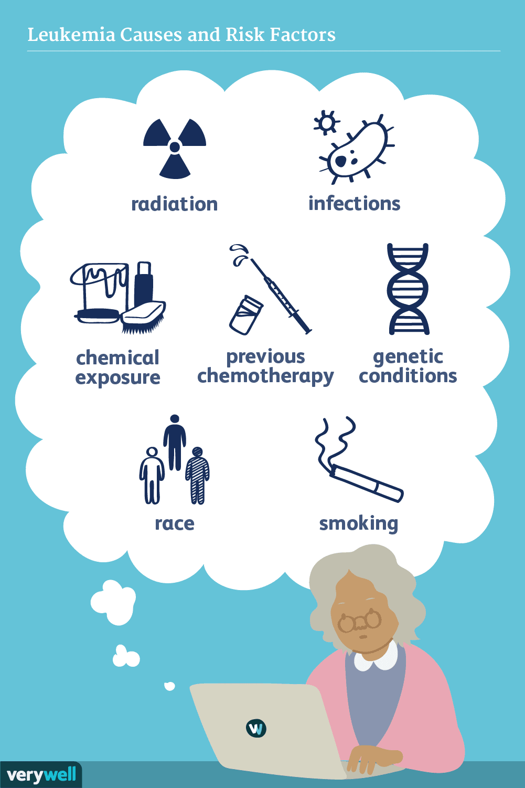
Causes and Risk factors of leukemia
Leukemia, like other cancers, results from mutations in the DNA.
Certain mutations can trigger leukemia by activating oncogenes or deactivating tumor suppressor genes
Common leukemia Causes and Risk factors include:
- Previous cancer treatment.
- Genetic disorders.
- Exposure to certain chemicals or medication
- Smoking.
- Family history of leukemia.
- Obesity

Slide 9
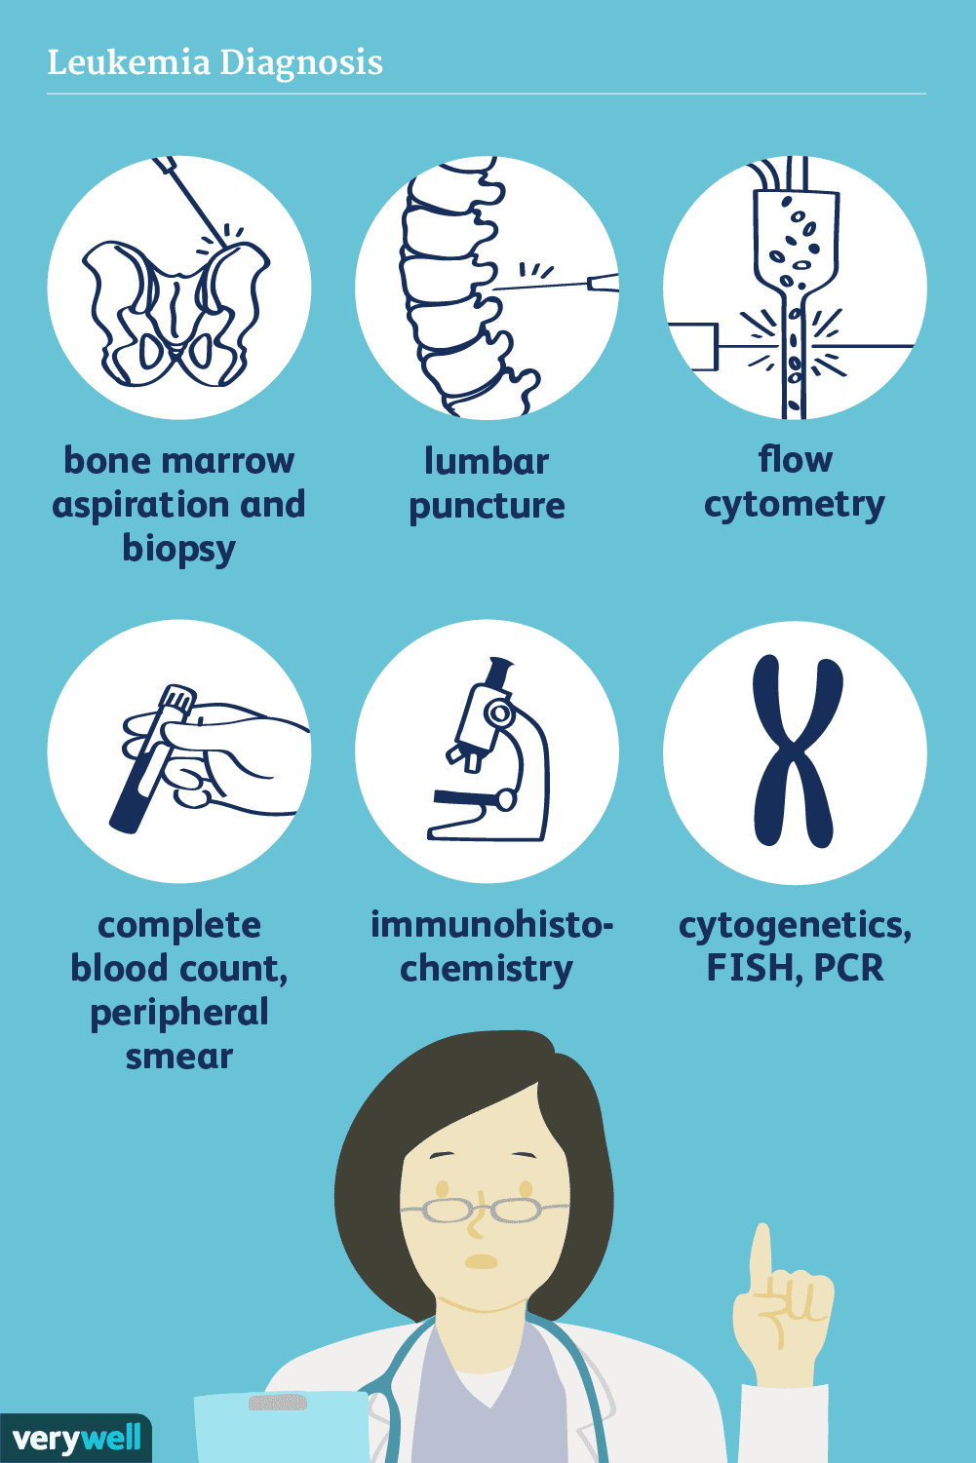
Diagnosis of leukemia
- complete blood counts .
- bone marrow examination (biopsy , Spinal tap)
- lymph node biopsy .
- Cytogenetic
- X-ray, CT ,MRI, or ultrasound .
Notes:
Diagnosis is usually based on repeated complete blood counts and a bone marrow examination following observations of the symptoms.
Sometimes, blood tests may not show that a person has leukemia, especially in the early stages of the disease or during remission.
A lymph node biopsy can be performed to diagnose certain types of leukemia in certain situations.[55]
Following diagnosis, blood chemistry tests can be used to determine the degree of liver and kidney damage or the effects of chemotherapy on the person, doctors may use an X-ray, MRI, or ultrasound. These can potentially show leukemia's effects on such body parts as bones (X-ray), the brain (MRI), or the kidneys, spleen, and liver (ultrasound).
CT scans can be used to check lymph nodes in the chest, though this is uncommon

Slide 10
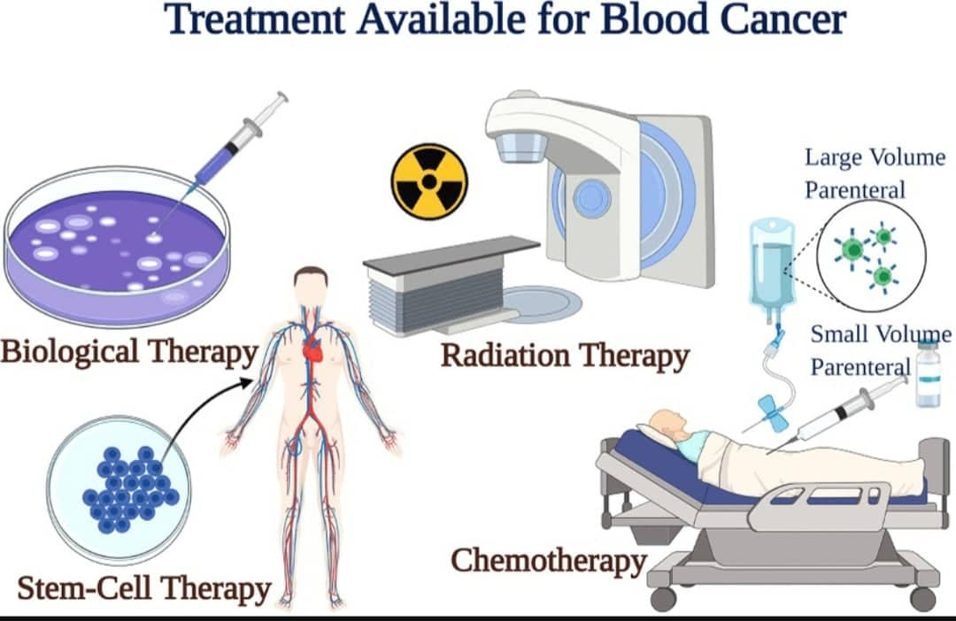
Treatment of leukemia
Most forms of leukemia are treated with pharmaceutical medication,
typically combined into a multi-drug chemotherapy regimen. Some are also treated with radiation therapy.
In some cases, a bone marrow transplant is effective or Surgery .
Notes:
The treatment you get depends on the type of leukemia you have, how far it’s spread, and how healthy you are

Slide 11
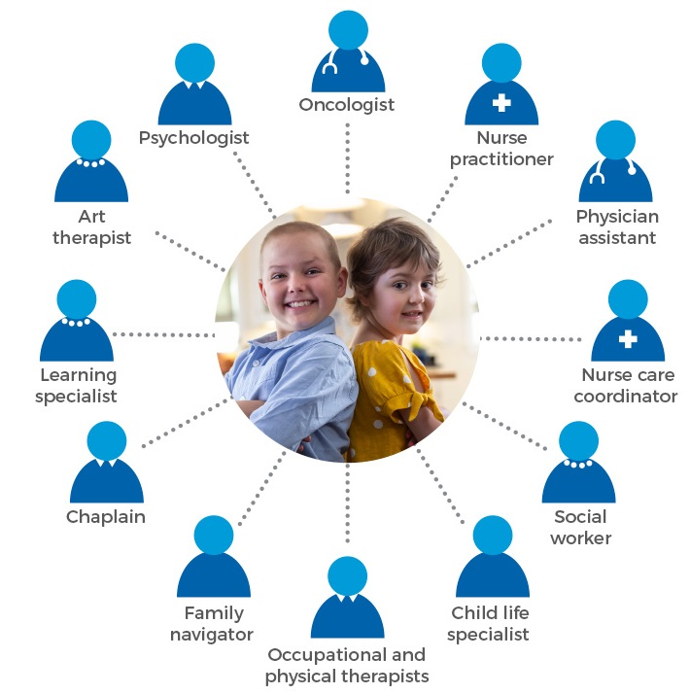
The success of treatment depends on the type of leukemia and the age of the person
Notes:
leukemia was the 12th most common class of neoplastic disease and the 11th most common cause of cancer-related death.[72] Leukemia occurs more commonly in the developed world.
In 2010, globally, approximately 281,500 people died of leukemia

Slide 12
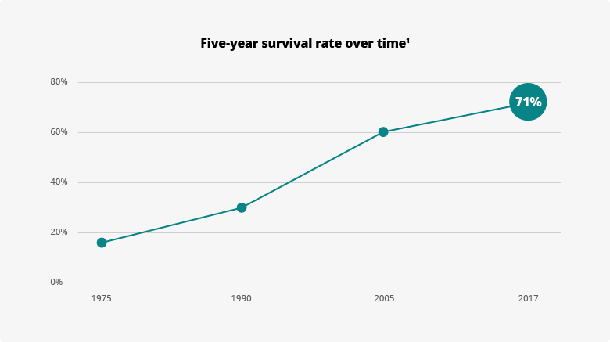
Prognosis of leukemia
Outcomes depend on whether it is acute or chronic, the specific abnormal white blood cell type, the presence and severity of anemia or thrombocytopenia, the degree of tissue abnormality, the presence of metastasis and lymph node and bone marrow infiltration, the availability of therapies and the skills of the health care team. Treatment outcomes may be better when people are treated at larger centers with greater experience
Notes:
leukemia was the 12th most common class of neoplastic disease and the 11th most common cause of cancer-related death
Leukemia occurs more commonly in the developed world.
In 2010, globally, approximately 281,500 people died of leukemia

Slide 13
Conclusion
Medical stuff , Family members , friends , society and health care systems
all play an important role in taking care in leukemia
Notes:
leukemia was the 12th most common class of neoplastic disease and the 11th most common cause of cancer-related death
Leukemia occurs more commonly in the developed world.
In 2010, globally, approximately 281,500 people died of leukemia

Slide 14
References
1. Testa U, Lo-Coco F. Prognostic factors in acute promyelocytic leukemia: strategies to define high-risk patients. Annals of hematology. 2016 Apr;95(5):673-80.
2. Udensi UK, Tchounwou PB. Dual effect of oxidative stress on leukemia cancer induction and treatment. Journal of Experimental & Clinical Cancer Research. 2014 Dec;33(1):1-5.
3. Papaemmanuil E, Gerstung M, Bullinger L, Gaidzik VI, Paschka P, Roberts ND, Potter NE, Heuser M, Thol F, Bolli N, Gundem G. Genomic classification and prognosis in acute myeloid leukemia. New England Journal of Medicine. 2016 Jun 9;374(23):2209-21.
4. Bielorai B, Fisher T, Waldman D, Lerenthal Y, Nissenkorn A, Tohami T, Marek D, Amariglio N, Toren A. Acute lymphoblastic leukemia in early childhood as the presenting sign of ataxia-telangiectasia variant. Pediatric hematology and oncology. 2013 Sep 1;30(6):574-82.
5. Döhner H, Weisdorf DJ, Bloomfield CD. Acute myeloid leukemia. New England Journal of Medicine. 2015 Sep 17;373(12):1136-52.
Battaglini CL, Hackney AC, Garcia R, Groff D, Evans E, Shea T. The effects of an exercise program in leukemia patients. Integrative cancer therapies. 2009 Jun;8(2):130-8.
Notes:
leukemia was the 12th most common class of neoplastic disease and the 11th most common cause of cancer-related death
Leukemia occurs more commonly in the developed world.
In 2010, globally, approximately 281,500 people died of leukemia

Slide 15

Notes:
leukemia was the 12th most common class of neoplastic disease and the 11th most common cause of cancer-related death
Leukemia occurs more commonly in the developed world.
In 2010, globally, approximately 281,500 people died of leukemia

