Slide 1


The Scope of Business Ethics Management
Libyan International Medical University
Faculty of Business Administration
By: Mohammed Alfaitory
ID: 3695
Email: mohamed_3695@limu.edu.ly

Slide 2
Table of Contents
01.
02.
03.
Definition
Interdiction
The Scope of Business Ethics Management
04.
05.
06.
Conclusion
Reflection
References
The Scope of Business Ethics Management
2

Slide 3
Introduction
3
Foreign language listening comprehension is an unpredictable, intricate, and urgent process in the improvement of foreign language competence; yet, the credibility of listening in language learning has just been perceived approximately recently

Slide 4
Cultural and Gender Differences in Listening
Communication is viewed differently by every culture. Here are a few examples of cultural differences.
Some cultures view interruptions, corrections and direct questions rude while some cultures conclude from these actions that the listener is active in the conversation and is therefore more likely to have understood the message.
Some countries begin their meetings with conversations not relevant to the event while others see this as a waste of time.
Even simple words such as “yes” and “no” can be misinterpreted due to their different meanings in different parts of the world.
4

Slide 5
The importance of cross-cultural communication that drives success
Good communication has always been a cornerstone of successful businesses. But now, with improved technology allowing more businesses to expand their reach across international boundaries, it’s even more prevalent.
The ability to communicate effectively with diverse cultures has become of paramount importance.
These same technologies enable businesses to employ talent from anywhere in the world and to integrate them into effective and productive teams.
5

Slide 6
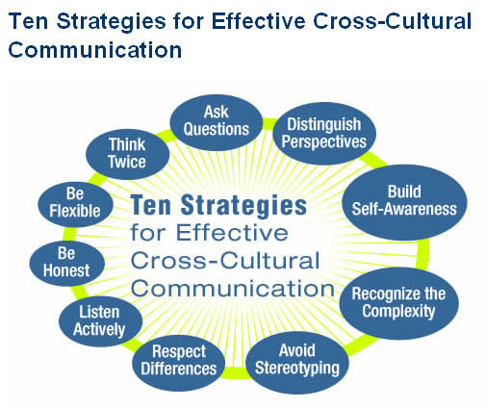
Here are ten strategies for improving cross-cultural communication.
6

Slide 7
Gender Differences in Listening
7
“Men are from Mars, Women are from Venus” is more than the cover of the American bestseller.
When men and women listen, they do so for different reasons.
For men: Be patient. Women feel the need to express everything in order to provide you with the most information about the situation.
For women: Be realistic. You can’t expect people to always react the way you want them to. If their reaction frustrates you, don’t get mad simply say their reaction confuses you.
For both: Establish ground rules. For example, before starting a serious subject, establish how much time you want to talk about it.

Slide 8
Ethics in Marketing
8
Marketing ethics is the area of applied ethics that deals with the moral principles behind the operation and regulation of marketing.
The ethical issues confronted in this area include:
price-fixing, price-discrimination, and price-skimming.
anti-competitive behavior such as supply-side manipulation, exclusive business deals, tying agreements, etc.
misleading commercials

Slide 9
Conclusion
As expressed at the beginning of this paper, culture and language are relentlessly connected and accordingly cannot be isolated. Various authors
10

Slide 10
Reflection
In my opinion, business ethics requires a prior consideration of the domain of ethics, per se. This, unlike mathematics, is not an exact science. Resolving an ethical problem requires the analysis of particular circumstances and the study of specific facts.
11

Slide 11
References
Kumar, A. (2020, August 12). Business ethics: Nature and scope. amit's Blog. Retrieved November 23, 2022, from https://amitiitism.wordpress.com/2015/03/25/business-ethics-nature-and-scope-college-assgn-01/ Unesdoc.unesco.org. (n.d.). Retrieved November 23, 2022, from https://unesdoc.unesco.org/ark:/48223/pf0000182184
Twin, A. (2022, September 30). Business ethics: Definition, principles, why they're important. Investopedia. Retrieved November 23, 2022, from https://www.investopedia.com/terms/b/business-ethics.asp#:~:text=Business%20ethics%20studies%20appropriate%20business,fiduciary%20responsibilities%2C%20and%20much%20more. Unesdoc.unesco.org. (n.d.). Retrieved November 23, 2022, from https://unesdoc.unesco.org/ark:/48223/pf0000182184
12

Slide 12
Thanks!
Do you have any questions?

