Slide 1


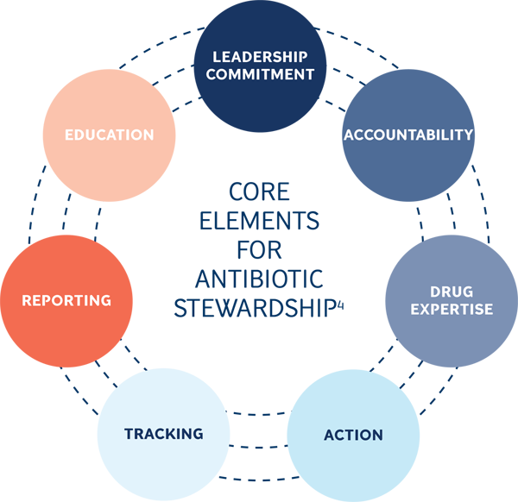
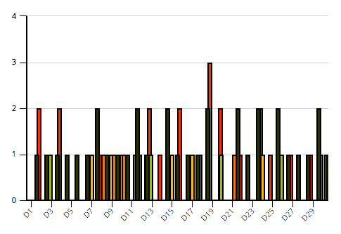
Understanding the antibiotics prescribing pattern among dental practitioners in Benghazi, Libya – a cross-sectional survey.
Fatima Idris Founas, 2nd year BMS dentistry
Libyan International Medical University
Introduction
Dentists are reported to prescribe different types of antibiotics in oral diseases. Antibiotics over consumption by unnecessary prescriptions can lead to generation of new antibiotic resistant microbial strains.^{(3,4)} Antibiotics overuse is becoming a growing issue that threatens the general population. The emerging of the Superbug threat and its subsequent economic waste become the focus of researchers and health professionals investigating the antibiotics prescribing pattern in dental practice.⁽³⁾
Results
The most common dental indications of antibiotics among dentists was dental extraction, attributing to 25.9%, followed by dental abscess 12.7% and 61% prescribed antibiotics after most surgical procedures, without using local measures first. Regarding the spectrum of usage, 85% preferred broad spectrum instead of narrow spectrum. Furthermore, only 2 dental practitioners know about the Antimicrobial Stewardship and only 2 attended courses regarding antibiotic prescriptions.
Causative micro-organisms | Cases (%)
Total Streptococci | 60
1. Viridan group | 35
2. Enterococcus faecalis | 13
Total Staphylococci | 25
1. Staphylococcus aureus | 20
2. Staphylococcus epidermidis | 5
Others | 15
What are the indications of antibiotics prophylaxis?
Antibiotics for odontogenic infections
Antibiotics for non-odontogenic infections
Antibiotics prophylaxis to prevent Infective Endocarditis
Antibiotics prophylaxis to treat local infections.⁽⁴⁾
Management of antibiotic prophylaxis use
Antimicrobial Stewardship is a coordinated program that promotes the appropriate use of antimicrobials, improves patient outcomes, reduces microbial resistance and decreases the spread of infection, caused by multi-drug resistant organisms.⁽³⁾
Figure 3
What is Infective Endocarditis (IE)?
Inflammation of the endocardium of the heart valves, and sometimes the endocardium around congenital defects, resulting from an infection.⁽¹⁾
Risk factors of IE
American Heart Association guidelines
1997 | 2007 | 2015
Prosthetic heart valves including biprosthetic/homograft valves | Prosthetic heart valves | Prosthetic heart valves
Bacterial Endocarditis | IE | IE
All procedures that involve the manipulation of gingival tissue or the periapical region of teeth or perforation of the oral mucosa | All procedures that involve the manipulation of gingival tissue or the periapical region of teeth or perforation of the oral mucosa | Not applicable.
Moderate and high risk complex cyanotic congenital heart disease. | Serious conditions of congenital heart disease. | Unrepaired/repaired congenital heart disease
Non-cardiac risk factors | Cardiac risk factors
Dental procedures | Cardiovascular pathology
Prior vascular/urinary catheters | pre-existing rheumatic fever
Diabetes Mellitus | Prosthetic heart valve
Intravenous drug use | Congenital heart disease
Figure 1
Figure 4
Understanding the antibiotics prescribing pattern among dental practitioners in Benghazi, Libya
Method:
A questionnaire was designed and conducted to examine the general dental practitioners prescribing patterns. The study sample consists of registered oral healthcare practitioners (n=30) working in different dental clinics in Benghazi. The questionnaire included socio-demographic factors and questions that elicited responses regarding antibiotic prescriptions. The information is kept confidential by eliminating all the possible personal identifiers.
The X axis represents the 30 doctors and the Y axis represents the amount of drug
Figure 6
Conclusion
In Benghazi, we found poor knowledge, attitude and practice regarding antimicrobial use in dentistry thereby conferring increasing potential for the development of more serious antimicrobial resistance. Immediate constitution of antibiotic committees and scrutinizing the prescription of antibiotics is mandatory in dental clinics as well.
Figure 2
Figure 5
References
Samaranayake, Lakshman P. Essential microbiology for dentistry. Elsevier Health Sciences, 2012.
APIC. Antimicrobial stewardship.. https://apic.org/Professional-Practice/Practice-Resources/Antimicrobial-Stewardship. Published 2019. Accessed April 16, 2019.
Antibiotic prophylaxis update. Aae.org. https://www.aae.org/specialty/wp-content/uploads/sites/2/2017/06/aae_antibiotic-prophylaxis-2017update.pdf. Published 2019. Accessed April 18, 2019.
Daly CG. Antibiotic prophylaxis for dental procedures. Aust Prescr. 2017;40(5):184–188. doi:10.18773/austprescr.2017.054

