Slide 1


Ethical Behavior in the work place
Adim Saleh
ID 3199
adim_3199@gmail.com
1

Slide 2

Table Of Contents
Introduction
Workplace Ethics
Examples Of Ethical Behaviors In The Workplace
Respect your colleagues
Work smarter
Unethical Workplace Behaviors
Verbal harassment/Abuse
Theft/Embezzlement
Conclusion
Refrences

Slide 3



Slide 4
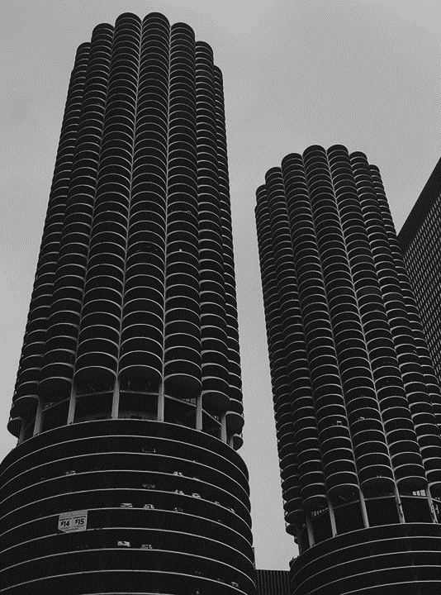
Introduction
Workplace ethics are a dynamic set of values that vary with people and their definition of a workplace. For some, it is a physical office they go to every day.

Slide 6

Workplace ethics are the set of values, moral principles, and standards that need to be followed by both employers and employees in the workplace. It is the set of rules and regulations that need to be followed by all staff of the workplace.

Slide 7
Examples Of Ethical Behaviors

Slide 8

Title
Respect your colleagues
Work smarter
It does not matter whether you are dealing with the intern, a junior, janitor, etc. they should all be treated with respect. As a manager, treating your team members with respect will help improve their productivity.
Do not just work hard, work smarter. The reason why you see an employee promoted to the post of manager after just 2 years and a hardworking employee who has been with the company for 10 years failed to get a promotion is smart work.

Slide 10
Title
Theft/Embezzlement
Verbal harassment/Abuse
Employees need to stay away from using foul language on coworkers in and out of the workplace. This is very important when dealing with customers.
Some employees are known for diverting company funds into their bank accounts—padding project quotations, invoices, etc. to deceive the company on how much was spent on particular projects.

Slide 11

Title:
Conclusion

Slide 12
Blog, F. (2019, November 20). 23 ethical &amp; unethical behavior examples in Workplace. Formplus. Retrieved November 2, 2021, from https://www.formpl.us/blog/workplace-ethics.

Slide 13
THANK YOU

