Slide 1


SITUATIONAL
Libyan International Medical University
Faculty of Business Administration
APPROACH
Module: Leadership Theory
Instructor: Dr. Zuhir Busneina
Submitted by: Farah Elsaite 2914
Email: Farah_2914@limu.edu.ly

Slide 2
CONTENTS
01
02
03
04
INTRODUCTION
DEFINING
SITUTATIONAL APPROACH
LEADERSHIP STYLES
STRENGHTS AND CRITICISMS
05
CONCLUSION
06
1
REFERENCE

Slide 3
INTRODUCTION
One of the more widely recognized approaches to leadership is the situational approach, which was developed by Hersey and Blanchard (1969a) based on Reddin’s (1967) 3-D management style theory. The situational approach has been refined and revised several times since its inception (see Blanchard, Zigarmi, & Nelson, 1993; Blanchard, Zigarmi, & Zigarmi, 1985; Hersey & Blanchard, 1977, 1988), and it has been used extensively in organizational leadership training and development.
2

Slide 4
DEFINING SITUATIONAL APPROACH
Situational Leadership is a prescriptive approach to leadership that suggests how leaders can become effective in many different types of organizational settings involving a wide variety of organizational goals. This approach provides a model that suggests to leaders how they should behave based on the demands of a particular situation.
3

Slide 5
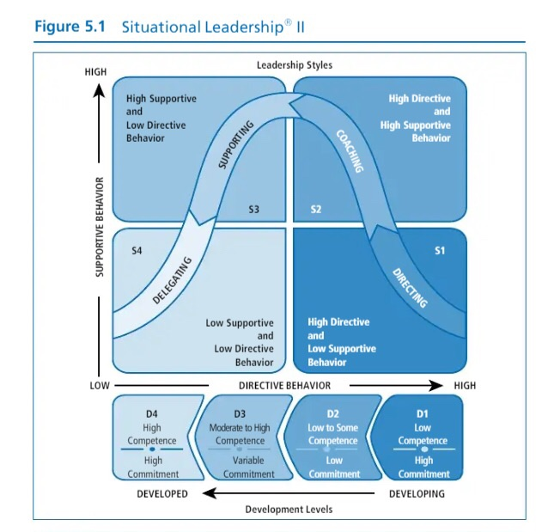
LEADERSHIP STYLES
4

Slide 6
LEADERSHIP STYLES
The first style (S1) is a high directive–low supportive style In this approach, the leader focuses communication on goal achievement, and spends a smaller amount of time using supportive behaviors. Using this style, a leader gives instructions about what and how goals are to be achieved by the followers and then supervises them carefully.
The second style (S2) is called a coaching approach and is a high directive– high supportive style. In this approach, the leader focuses communication on both achieving goals and meeting followers’ socioemotional needs.
5

Slide 7
LEADERSHIP STYLES
The third style (S3) is a supporting approach that requires that the leader take a high supportive–low directive style. In this approach, the leader does not focus exclusively on goals but uses supportive behaviors that bring out followers’ skills around the goal to be accomplished
The fourth style (S4)is called the low supportive–low directive style, or a delegating approach. In this approach, the leader offers less goal input and social support, facilitating followers’ confidence and motivation in reference to the goal.
6

Slide 8
STRENGHTHS
It is recognized by many as a standard for training leaders.
It is a practical approach, which is easily understood and easily applied.
This approach sets forth a clear set of prescriptions for how leaders should act if they want to enhance their leadership effectiveness.
Situational Leadership recognizes and stresses that there is not one best style of leadership; instead, leaders need to be flexible and adapt their style to the requirements of the situation
7

Slide 9
CRITICISMS
Suggests that it has limitations. Unlike many other leadership theories, this approach does not have a strong body of research findings to justify and support the theoretical underpinnings on which it stands.
It is not clear in explaining how followers move from developing levels to developed levels, nor is it clear on how commitment changes over time for followers.
The model does not address how demographic characteristics affect followers’ preferences for leadership.
The model does not provide guidelines for how leaders can use this approach in group settings as opposed to one-to-one contexts.
8

Slide 10
CONCLUSION
As the name of the approach implies, the situational approach focuses on leadership in situations. The premise of the theory is that different situations demand different kinds of leadership. From this perspective, to be an effective leader requires that a person adapt his or her style to the demands of different situations. In brief, the essence of the situational approach demands that leaders match their style to the competence and commitment of the followers.
9

Slide 11
REFERENCE
Northouse, P. G. (2015b). Leadership: Theory and Practice, 7th Edition (Seventh). SAGE Publications, Inc.
10

Slide 12
THANK YOU!
Please keep this slide for attribution

