Slide 1

Type 2 diabetes mellitus and increased risk for malaria infection
Libyan International Medical University
Faculty 0f AMS
2022_2023
Student Name DANIA AHMED
Student Number 3078
Block professional Transitional Skills

Slide 2
OBJECTIVEs
01
02
Presentation of malaria in dm2 patients
What is the relation between diabetes and malaria
03
Outline The prevention of Malaria

Slide 3
Malaria is a Life-threatening disease caused by parasites that are transmitted to people through the bites of infected female anopheles mosquitoes. It is preventable and Curable

Slide 4
Malaria in the world
2020
2019
The estimated number of Malaria deaths Stood at 627 000 In 2020 – an Increase Of 69 000 Deaths Over The Previous Year. While about Two Thirds Of These Deaths
(47 000) Were Due To Disruptions During The COVID-19 Pandemic.
241 Million Cases Compared To
227 Million Cases

Slide 5
The relation between Diabetes and Malaria

Slide 6
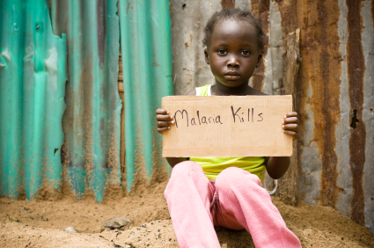
The relation between Diabetes and Malaria
Both malaria and Diabetes are More Common in The Developing World, and Are Major Public Health Challenges.
A Direct Relationship Between These 2 Conditions Has Not Been Evaluated

Slide 7
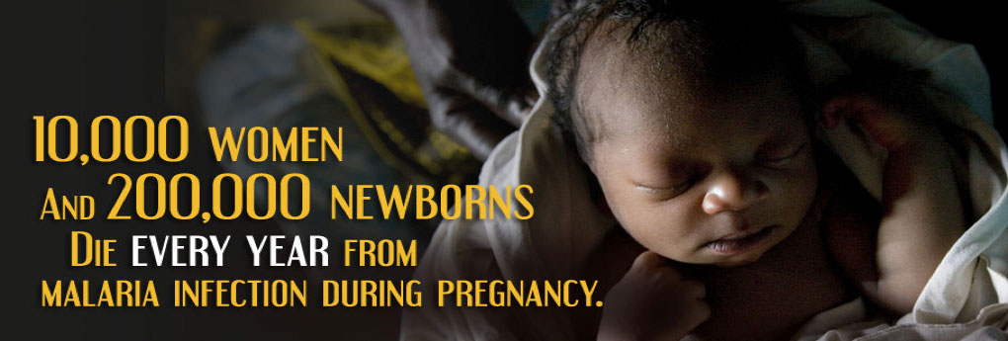
The relation between Diabetes and Malaria
Malaria Has been documented to be more common in Diabetes, in Several Studies From Africa.
Malarial infection During Pregnancy is an Important Cause Of Low Birth Weight and Anemia and May Contribute To the Intra-Uterine Hypothesis

Slide 8
The relation between Diabetes and Malaria
Patients with diabetes have atypical malaria presentations.
Glucose-6-phosphate dehydrogenase deficiency,
which is associated
with primaquine failure for radical cure is also associated with dysglycaemia

Slide 9
02
Presentation of malaria in dm2 patients

Slide 10
Presentation of malaria in dm2 patients
Even a lower Parasitic Count Can Lead To Severe
manifestations of malaria in people with Diabetes.
Relative Bradycardia and Ketoacidosis Were More Frequent in Diabetes , while black water fever and Hypoglycaemia Were Encountered more Often in non-Diabetes Controls
Blood urea , Serum Creatinine and Bilirubin Were Sgnificantly HIgher in Dabetics , Haematocrit was higher in diabetics , while parasite count was significantly lower

Slide 11
Case study
In sub-Saharan Africa, Infectious Diseases Remain The Predominant Cause Of Illness and Death .. Faces The World’s Highest Increase In Type 2 Diabetes Mellitus
1.466 Urban Adult in Ghana Founded That Patients With DM2 46% Increased Risk For Infection With Plasmodium falciparum

Slide 12
Case study
People With diabetes may be More susceptible to infection with malaria.
There have also been studies done show that persons with diabetes may be
Actually smell different to mosquitoes than people without dabetes,
Malaria transmission is patchy In The Area Where they did the study, for example it
May have been coincidence that more people with diabetes lived in high
Transmission Neighborhoods than people without diabetes

Slide 13
03
Discuses the prevention of malaria

Slide 14

DISCUSIS THE PREVENTION OF MALARIA
The ABCD approach could save your life!
Awareness of the risk
Bite prevention
Chemoprophylaxis
Diagnosis

Slide 15
CONCLUSIONS
The actual reasons for the increase
p. falciparum infection are unclear, the risk increase with rising glucose concentration is a Sign 0f Biological Plausibility , Increased glucose availability may feed
p. falciparum

Slide 16
references
Eurosurveillance editorial team, C., 2016. WHO launches World health report 2013. Eurosurveillance, 18(33).
Christensen, D., Kapur, A. and Bygbjerg, I., 2012. Physiological adaption to maternal malaria and other adverse exposure: Low birth weight, functional capacity, and possible metabolic disease in adult life. International Journal of Gynecology &amp; Obstetrics, 115, pp.S16-S19.
Mohapatra, M., Bariha, P. and Mohapatra, A., 2019. Adrenal Insufficiency in Severe Falciparum Malaria: Its Outcome and Prediction by Discriminant Score. International Journal of Contemporary Medical Research [IJCMR], 6(9).

Slide 17
Thank you

