Slide 1
CLINICAL TEATCHING IN UVEITIS
By Dr Hala A. Buzakouk MD.

Slide 2
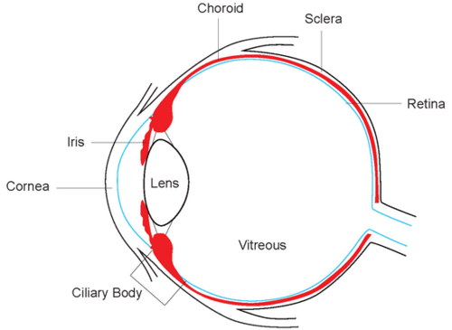
Uveal tract

Slide 3
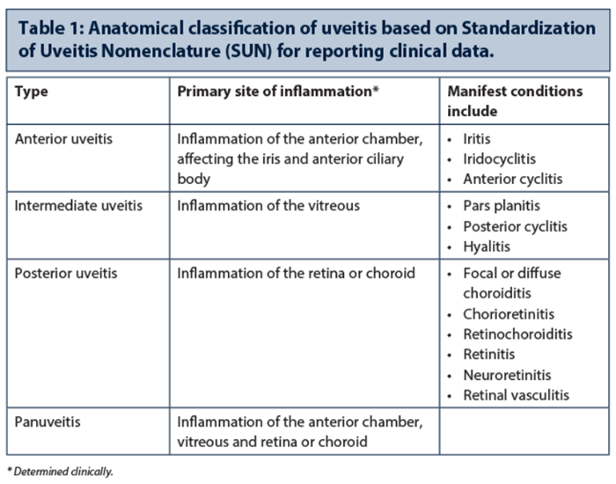

Slide 4
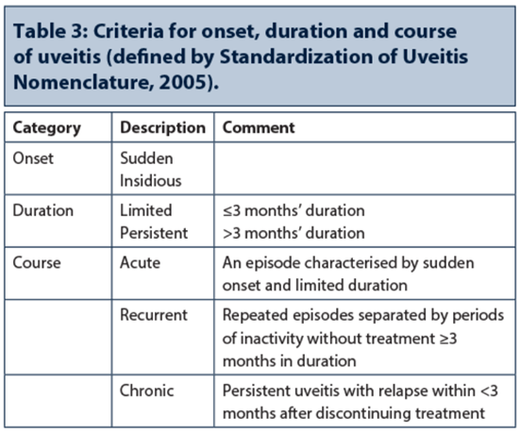

Slide 5
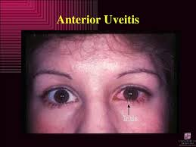
Symptoms
Pain
Redness
Photophobia
Lacrimation
Defective Vision

Slide 6
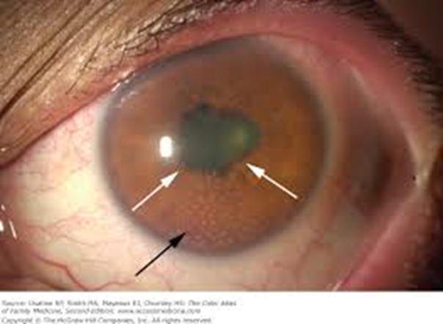
SIGNS
Ciliary injection
Inflammatory cells and flares
Keratic precipitate KP
Posterior synechia PS
Iris nodules
Koeppe /Busacca

Slide 7
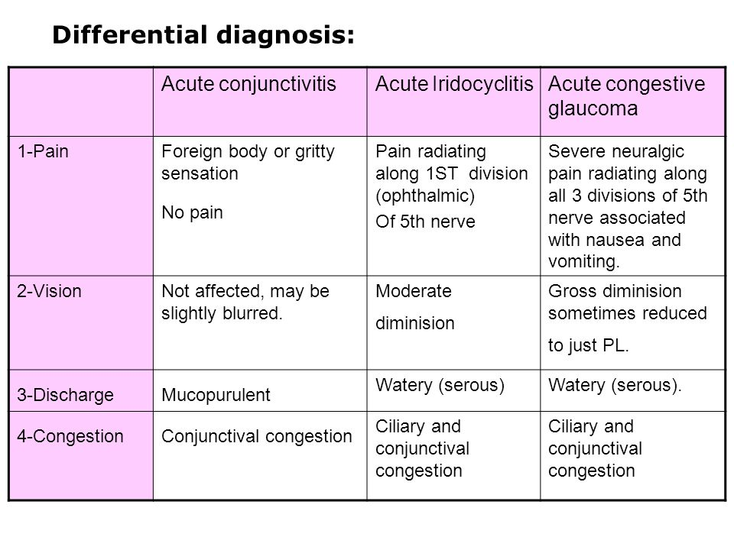

Slide 8
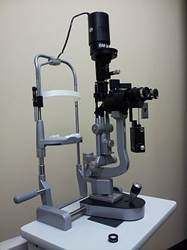
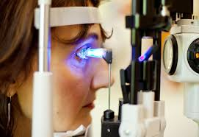
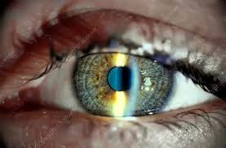
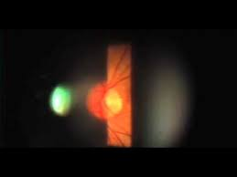
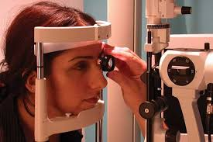
Slit lamp biomicroscopy
IOP measurement
Anterior segment
Fundus examination
Posterior segment

Slide 9
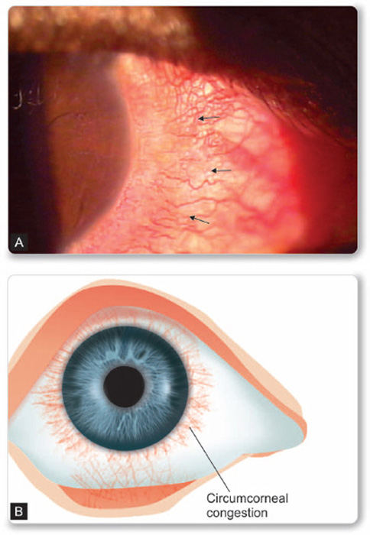
Ciliary injection
Circumcorneal

Slide 10
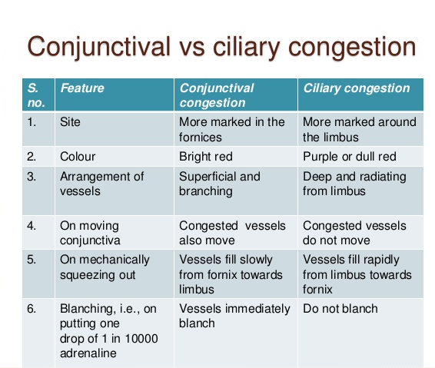
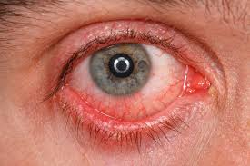
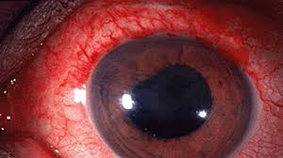

Slide 11
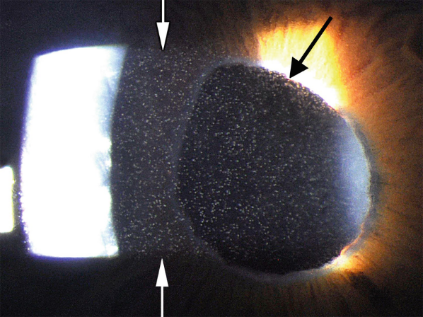
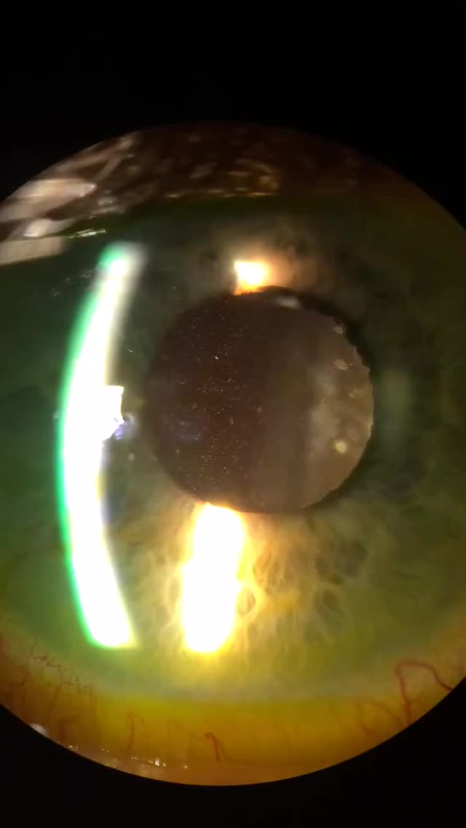
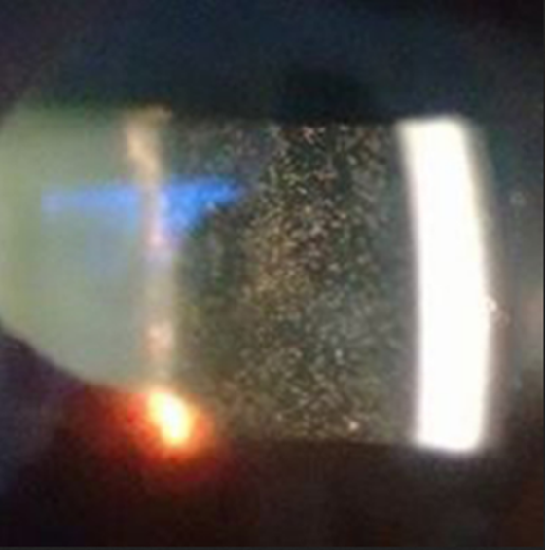
Flares
leakage of proteins
Cells
White blood cells

Slide 12
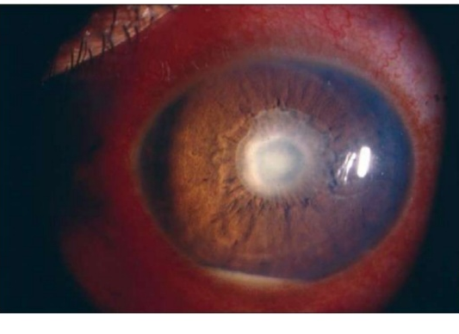
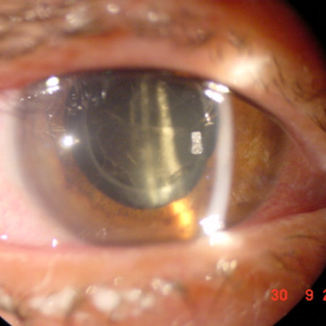
Fibrious exudate
Occlusio pupillae
hypopyon

Slide 13
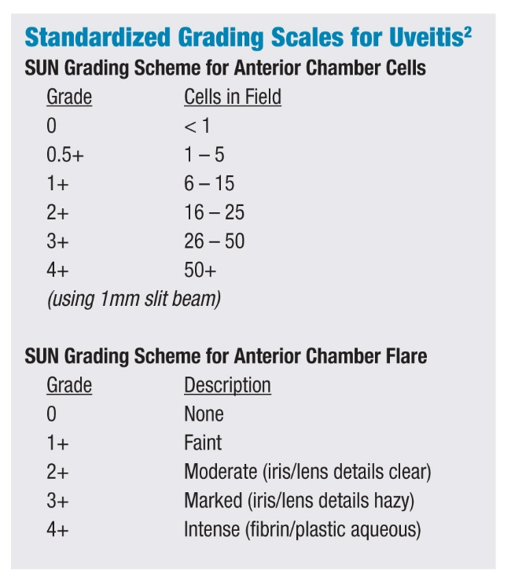

Slide 14
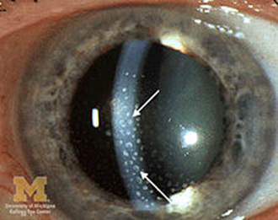
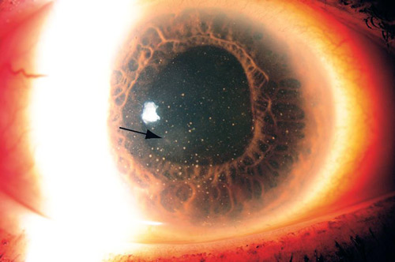
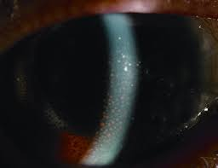
Keratic precipitate KP
Small granular
Lymphocytes
Non- granulomatous
Large fluffy greasy
Motton-fat KPs
Epitheloid/macropages
Granulomatous
Old pigmented KPs

Slide 15
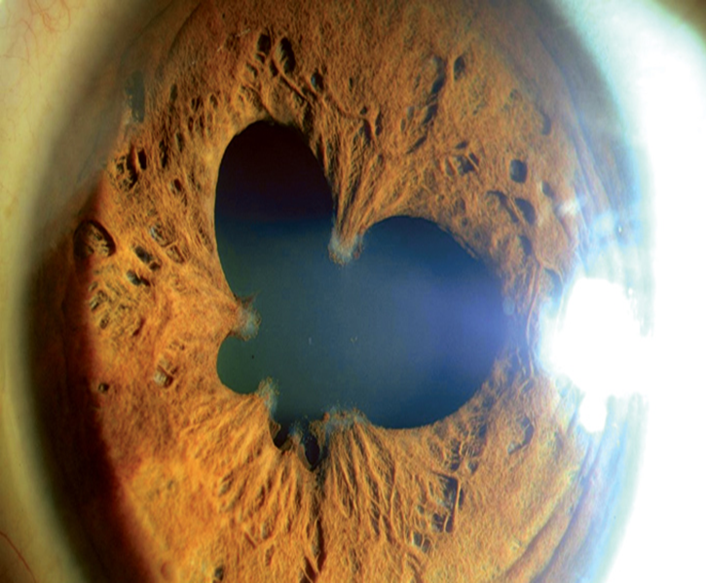
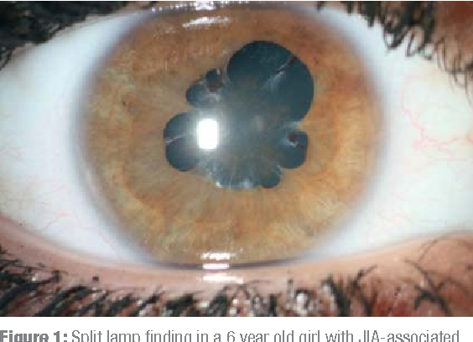
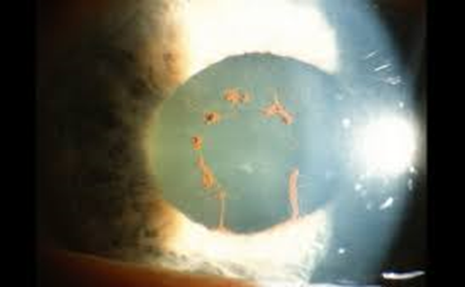
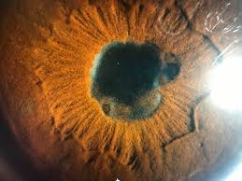
Posterior synechia
Festooned pupil
Secclusio pupillae
Broken synechia

Slide 16
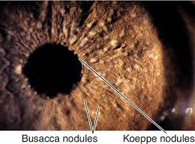
Iris nodules
Aggregates of epitheloid cells and multinuclear cells

Slide 17
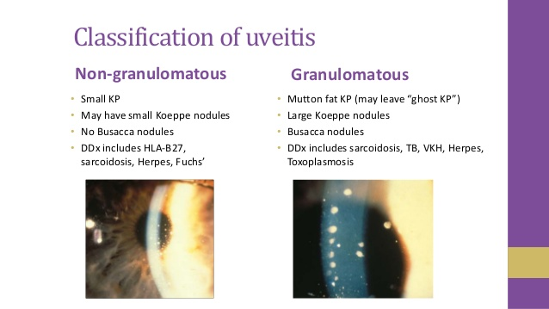
Pathological classification

Slide 18
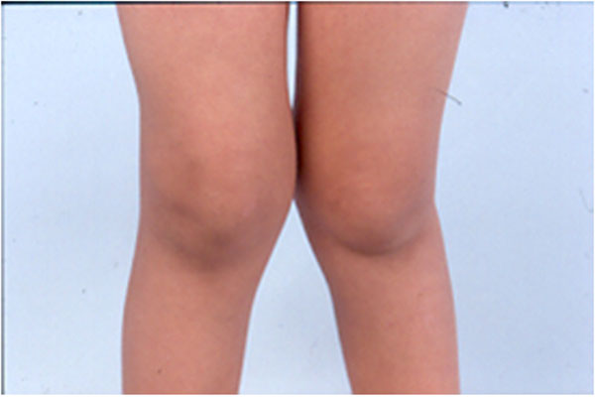
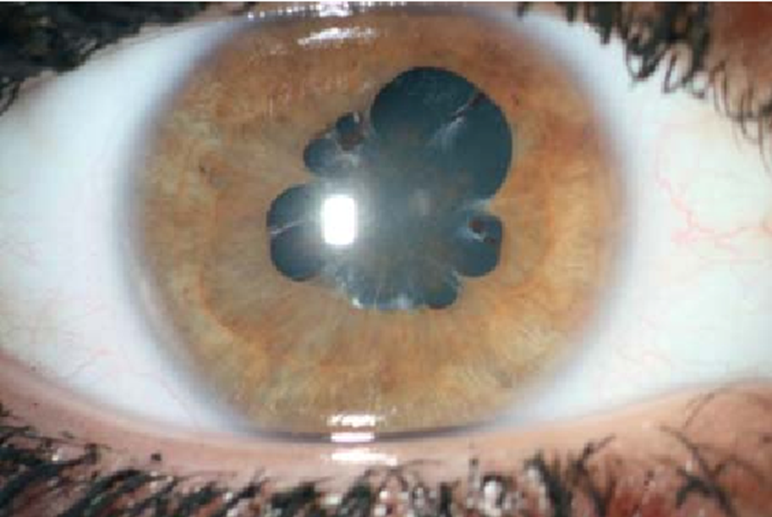
Juvenile idiopathic arthritis
Pauciarticular /polyarticular
Signs?
Chronic anterior uveitis

Slide 19
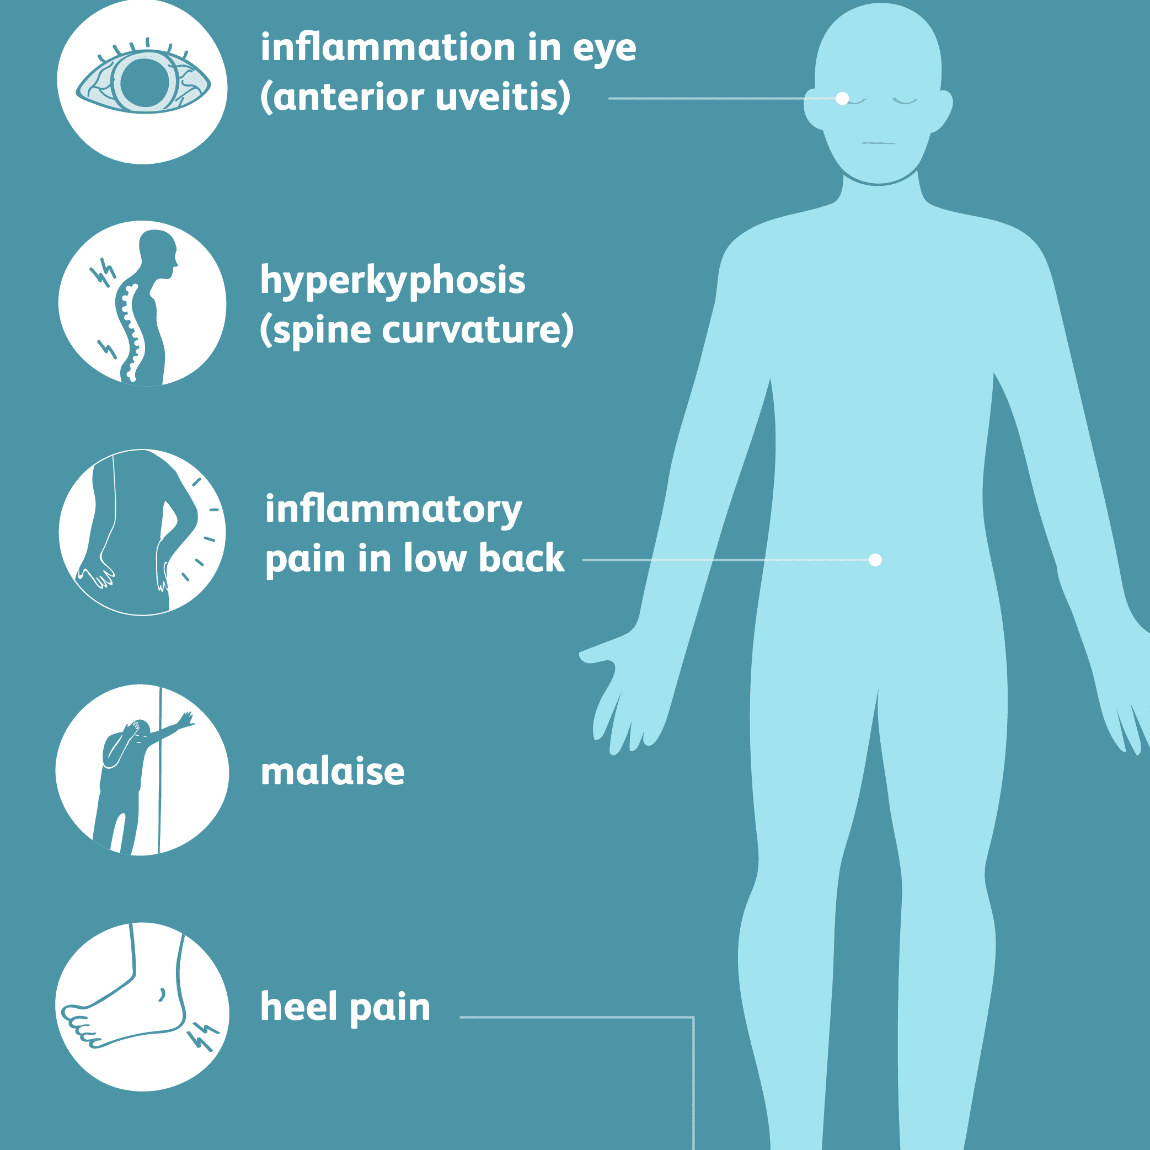
Spondyloarithropathies
Ankylosing Spondylitis
Males
95% HLA
Acute iridocyclitis

Slide 20
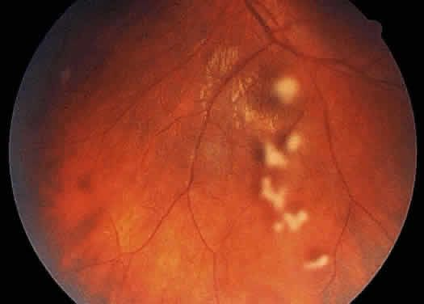
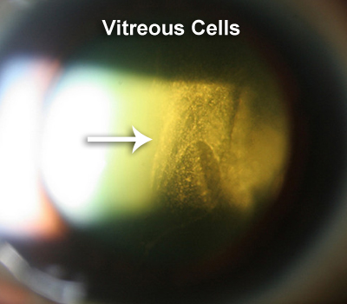
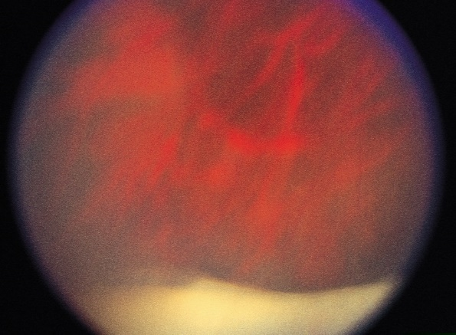
Intermediate uveitis - parsplanitis
Snow balls
Snow banking

Slide 21
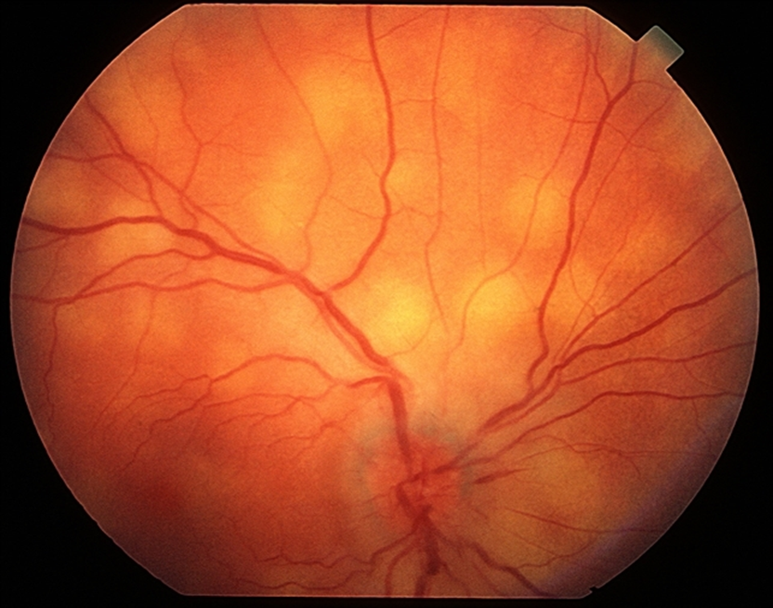
Posterior uveitis
Choroiditis
Focal/multifocal
TB
Syphilis
Sarcoidois

Slide 22
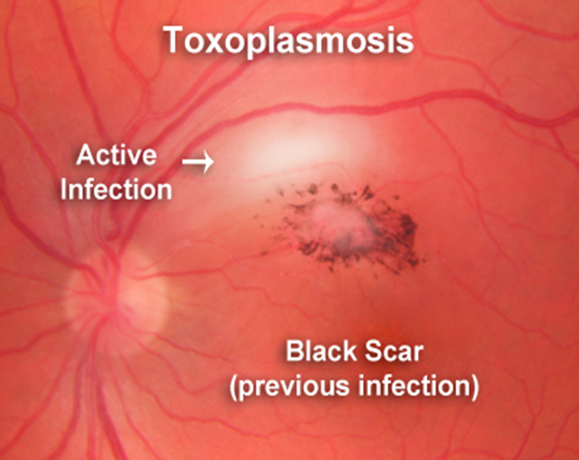
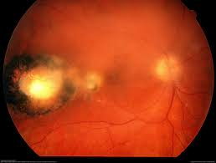
Toxoplasmosis
Toxoplasma gondii
Retinitis
Satellite lesion
Vitritis
Headlight in fog

Slide 23
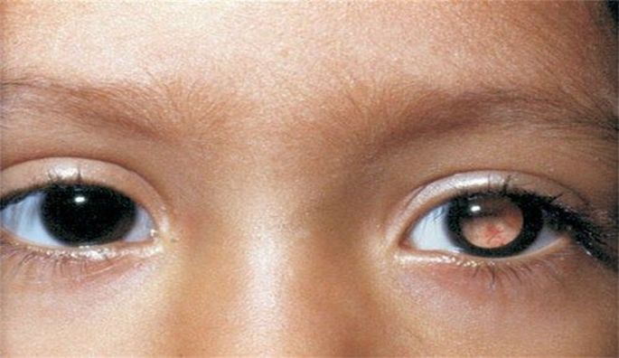
Toxocariasis
“Toxocara canis”
1.Chronic Endophthalmitis
2-9yrs
Anterior uveitis/vitritis
Leukocoria
D/D
Congenital cataract
Retinoblastoma
Toxocariasis
Persistent hyperplastic vitreous (PHPV)
Retinopathy of prematurity (ROP)

Slide 24
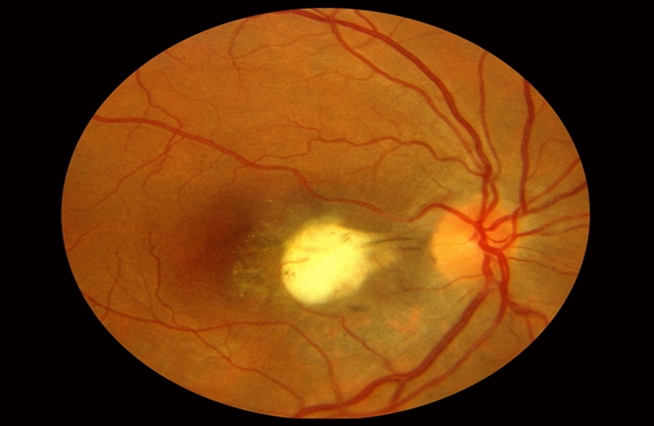
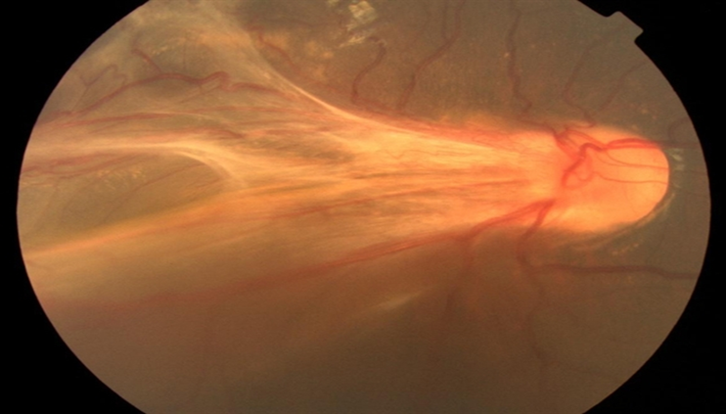
Posrerior pole granuloma
6-14yrs
Peripheral granuloma
Older age
No intraocular inflammation
Tractional RD

Slide 25
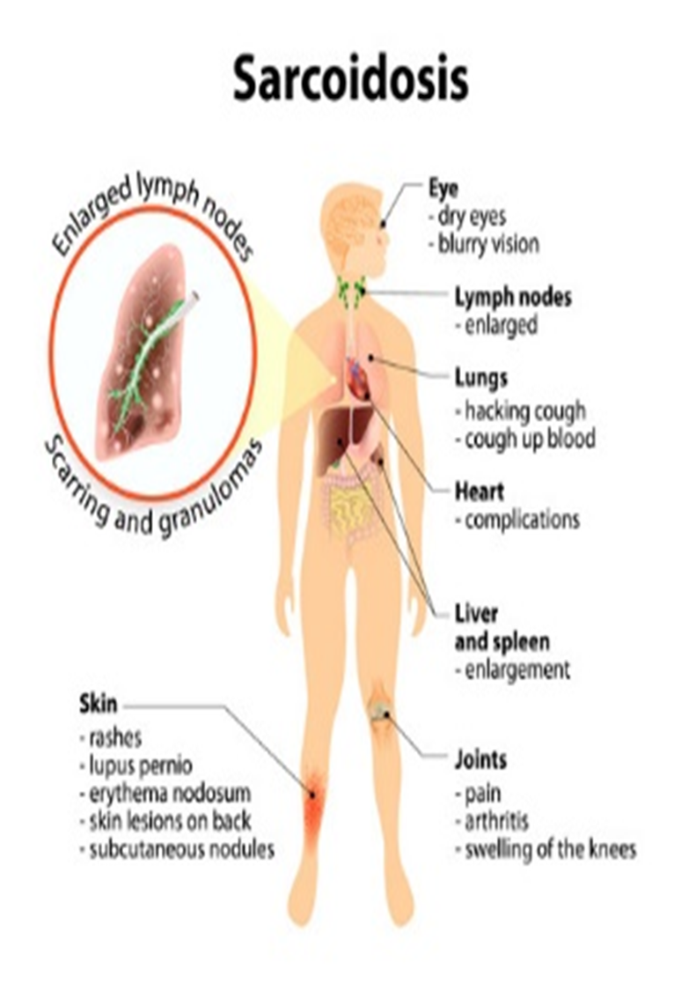
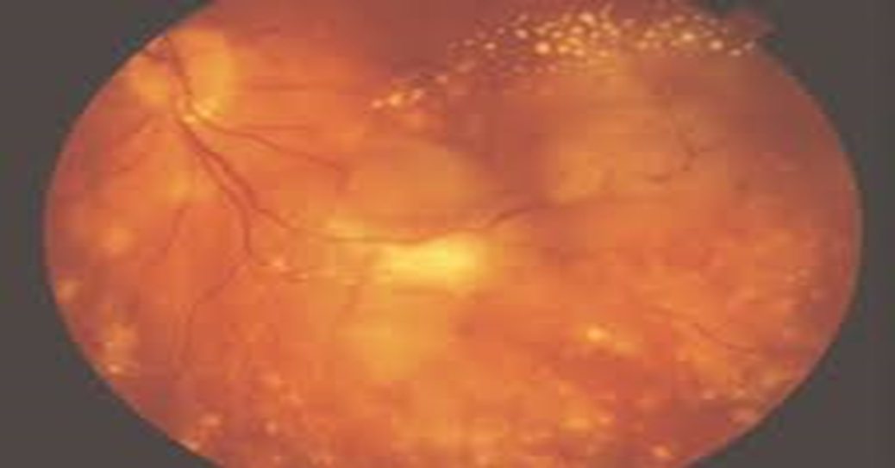
Sarcoidosis
Multifocal choroiditis
Disc swelling
Periphlepitis

Slide 26
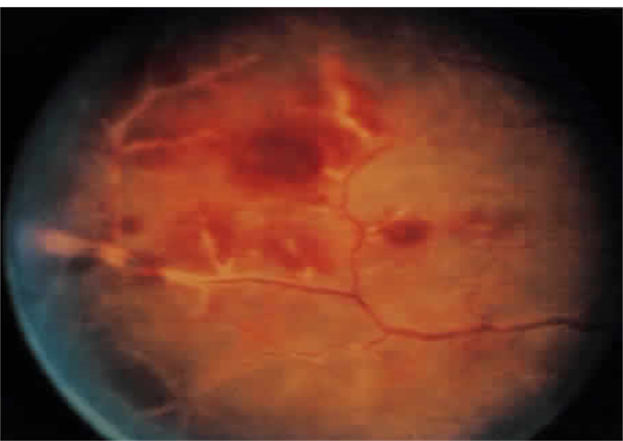
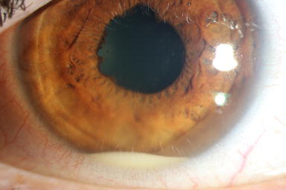
Panuveitis
Iritis
Vitritis
Retinitis
vasculitis

Slide 27
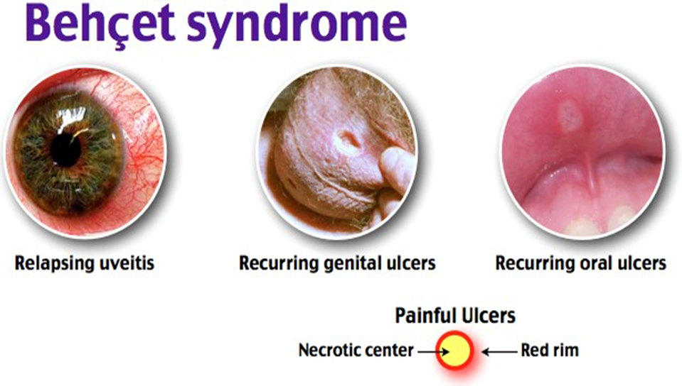
Non-granulomatous Panuveitis

Slide 28
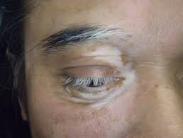
VOGT-KOYANAJI-HARADA SYNDROME VKH
Skin
Alopecia
Vitiligo
Poliosis
Auditory
Deafness
Vertigo
tinnitus
CNS
Encephal-opathy
Granulomatous Panuveitis

Slide 29
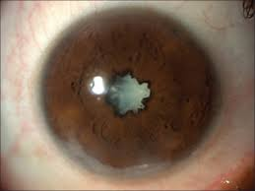
Complications of uveitis
Visual loss
Complicated Cataract

Slide 30
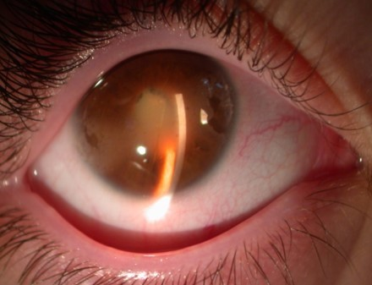
Band keratopathy

Slide 31


PAS
Goniolens
Anterior chamber angle

Slide 32

PS
Secclusio pupillae
Iris-bombe’

Slide 33


Secondary glaucoma
In uveitis
Normal eye

Slide 34


Cystoid macular oedema CMO

Slide 35

Retinal detachment RD

Slide 36

Treatment of uveitis
Steroids

Slide 37




Slide 38


Cycloplegic /mydriatic drops

Slide 39

Non-steroidal anti-inflammatory drugs
NSAID
Drops /systemic

Slide 40


Antiglaucoma drugs
Beta blockers Timolol
Combined + dorzolamide Cosopt
Pilocarpine + latanoprost (prostaglandin analogue)
are contraindicated

Slide 41
THANK YOU

