Slide 1


الجامعة الليبية الدولية للعلوم الطبية
كلية العلوم الطبية التطبيقية
Covid _19
Keep Safe Distance
Marwan Abdulsalam Salem
ID: 3339
First year Applied Medical Science Student
GBMS 2 Block

Slide 2
Objectives
Discuss How Covid_19 has Affected The world
List The Symptoms Of Covid_19
Outline The Risk Factors Of Getting Covid_19
Discuss The Available Solution To Covid_19
1
2
3
4

Slide 3
Introduction
The disease caused by the virus named as SARS-CoV-2 started in Wuhan, China at the end of 2019.
It spread throughout the globe at an alarming pace and became the first pandemic of the twenty-first century. After seeing some signs of slowing with worldwide measures, it is evident that the disease (COVID-19) will continue to spread due to the reduction in strict measures

Slide 4
Discuss How Covid 19 has Affected The world
1

Slide 5
The COVID-19 pandemic has led to a dramatic loss of human life worldwide and presents an unprecedented challenge to public health, food systems and the world of work.
The economic and social disruption caused by the pandemic is devastating: tens of millions of people are at risk of falling into extreme poverty, while the number of undernourished people, currently estimated at nearly 690 million, could increase by up to 132 million by the end of the year.

Slide 6
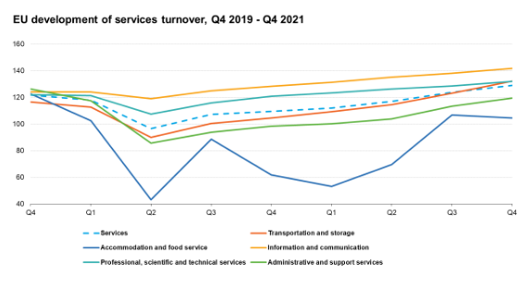
Impact Of Covid_19

Slide 7
List The Symptoms Of Covid_19
2

Slide 8
In general, studies on COVID symptoms indicate fatigue, cough, headache, fever, myalgia, arthralgia, and diarrhea. Recently , the symptoms of ENT were examined in more detail, and the highest percentage of ENT was cough (43.8%), and sore throat, and anosmia (35.4%).
Based on studies , we can say the most significant predictive symptoms are cough, anosmia, and sore throat.

Slide 9
In addition to the literature, the least common ENT symptoms were tinnitus in two patients, hoarseness in eight, and gingivitis in two patients. It is not known whether they are symptomatic of the disease or seen as an incidentally additive to the disease.

Slide 10
Outline The Risk Factors Of Getting Covid_19
3

Slide 11
COVID-19 can affect anyone, and the disease can cause symptoms ranging from mild to very severe.
CDC is conducting disease surveillance and field investigations to better understand why some people are more likely to develop severe COVID-19 illness.

Slide 12
Because COVID-19 is a new disease, more work is needed to better understand the risk factors for severe illness or complications. Potential risk factors that have been identified to date include:
Age
Race/ethnicity
Gender
Some medical conditions
Use of certain medications
Poverty and crowding
Certain occupations
Pregnancy

Slide 13
Discuss The Available Solution To Covid_19
4

Slide 14
Globalization justifies why diseases become global at an unprecedented rate. The freedom and speed with which we travel on a global scale are one of the most efficient vehicles of contagion and foster the exponential growth of the virus worldwide.
The Action must be taken by continuously call out messaging based in fear and misinformation for the racist, xenophobic,

Slide 15
For countries not currently known to be experiencing community transmission of COVID-19.
The organizers and their national or local health authorities should recognize that the risk of imported cases of COVID-19 is naturally linked to international travel.

Slide 16
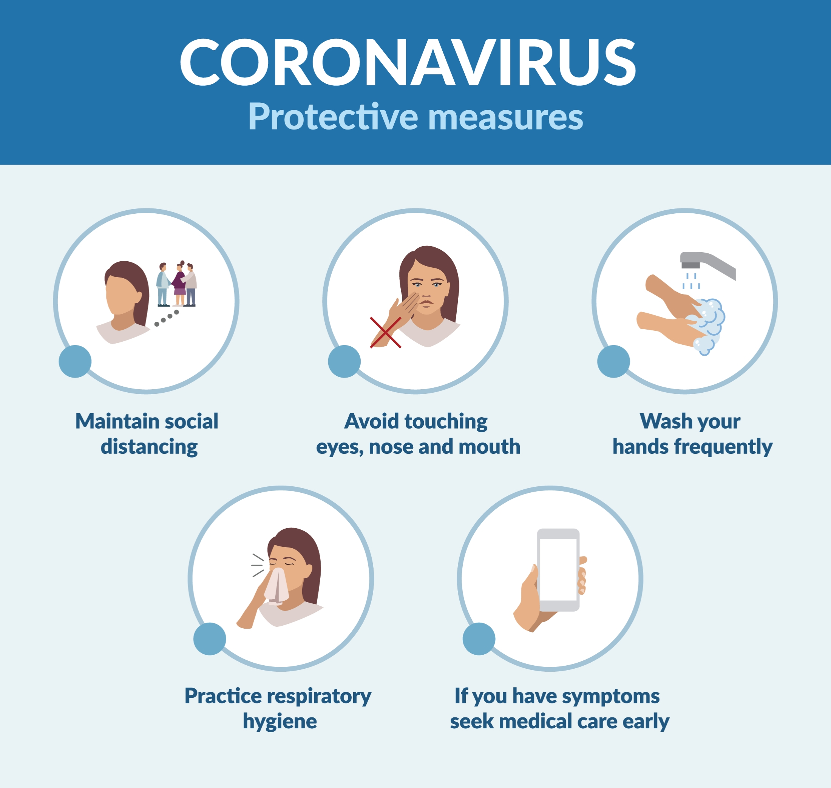

Slide 17
Conclusion
The coronavirus disease continues to spread across the world following a trajectory that is difficult to predict.
The health, humanitarian and socio-economic policies adopted by countries will determine the speed and strength of the recovery.

Slide 18
References
1-The impact of COVID-19 on globalization - PubMed. (n.d.). PubMed. https://pubmed.ncbi.nlm.nih.gov/33072836/
2-Official list of covid-19 symptoms must be updated - PubMed. (n.d.). PubMed. https://pubmed.ncbi.nlm.nih.gov/35045966/

Slide 19
Thanks

