Slide 1

Diabetes
Diabetes type 1
Name :Afaf Albanouni
Student roll: 3321
Block :Gbms 2
Supervisor : Dr fatma Elsaity
Academic year : Year 1
Date:2022/6/1

Slide 2
Objectives
Definition
Dicuss Symptoms
List treatment

Slide 3
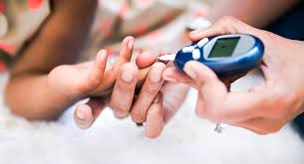

Introduction

Slide 4
Definition of diabetes t1
Which the immune system destroys beta cells .
5.8
Glucose doesn’t move into the cells because insulin isn’t there to do the job. Instead, it builds up in your blood, This causes high blood sugar.
%
Notes:
insulin-making cells in your pancreas These are called beta cells. insulin is a hormone that helps move sugar, or glucosensulin deficiency caused by autoimmune destruction of the pancreatic beta cells

Slide 5
Symptoms of diabetes t1
polyuria
glycosuria
Polydipsia
Polyphagia

Slide 6
Treatment for diabetes type 1
Insulin
Blood sugar monitoring
Balanced diet
Treatment
Notes:
insulin in the form of multiple daily injections or continuous subcutaneous insulin infusion.

Slide 7
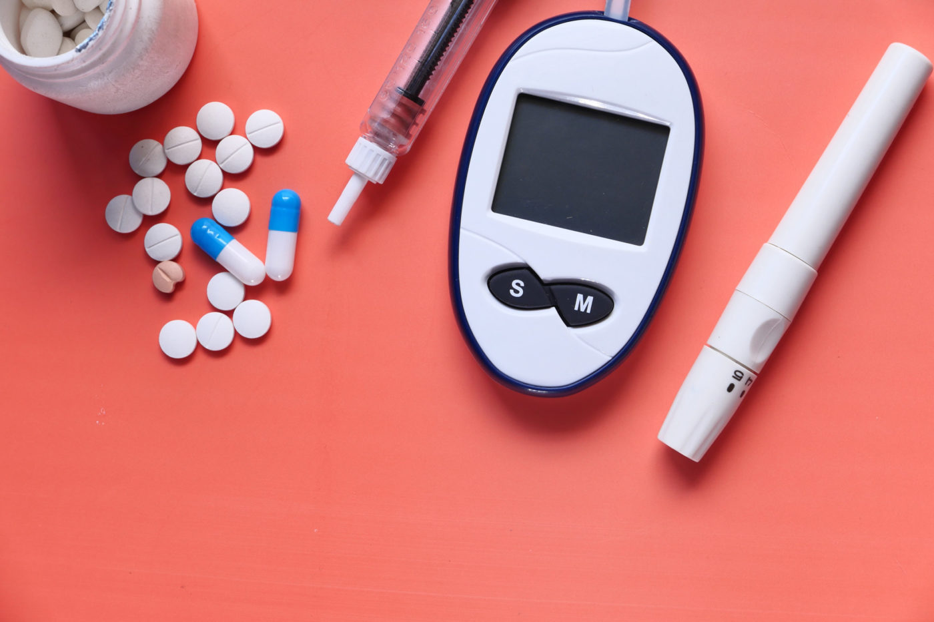
Conclution
Diabetes is a disease that souuld be taken seiously

Slide 8
Refrences
PubMed. 2022. PubMed. [online] Available at: <https://pubmed.ncbi.nlm.nih.gov

Slide 9
Thank you

