Slide 1


Early Detection Saves Lives
الجامعة الليبية الدولية للعلوم الطبية
كلية العلوم الطبية التطبيقية
Presented by :
Faraj Makhlouf
R.NO : 3442
Academic year : 2021-2022
Date : 18/5/2022

Slide 2
Objectives
Over review about breast cancer .
Discuss diagnosis of breast cancer .
Outline treatments of breast cancer .
Discuss how we can prevent .

Slide 3
Overview
Breast cancer is the most common in women ,The breast cancer are the second cause leading to death of women .
About 255,000 women and 2,300 men are diagnosed with breast cancer each year in the United States, and about 42,000 women and 500 men die from breast cancer each year in the United States.

Slide 4
How does breast cancer diagnosed ?
Breast ultrasound .
Diagnostic mammography .
Breast magnetic resonance imagind ( MRI ) .
Biopsy .

Slide 5
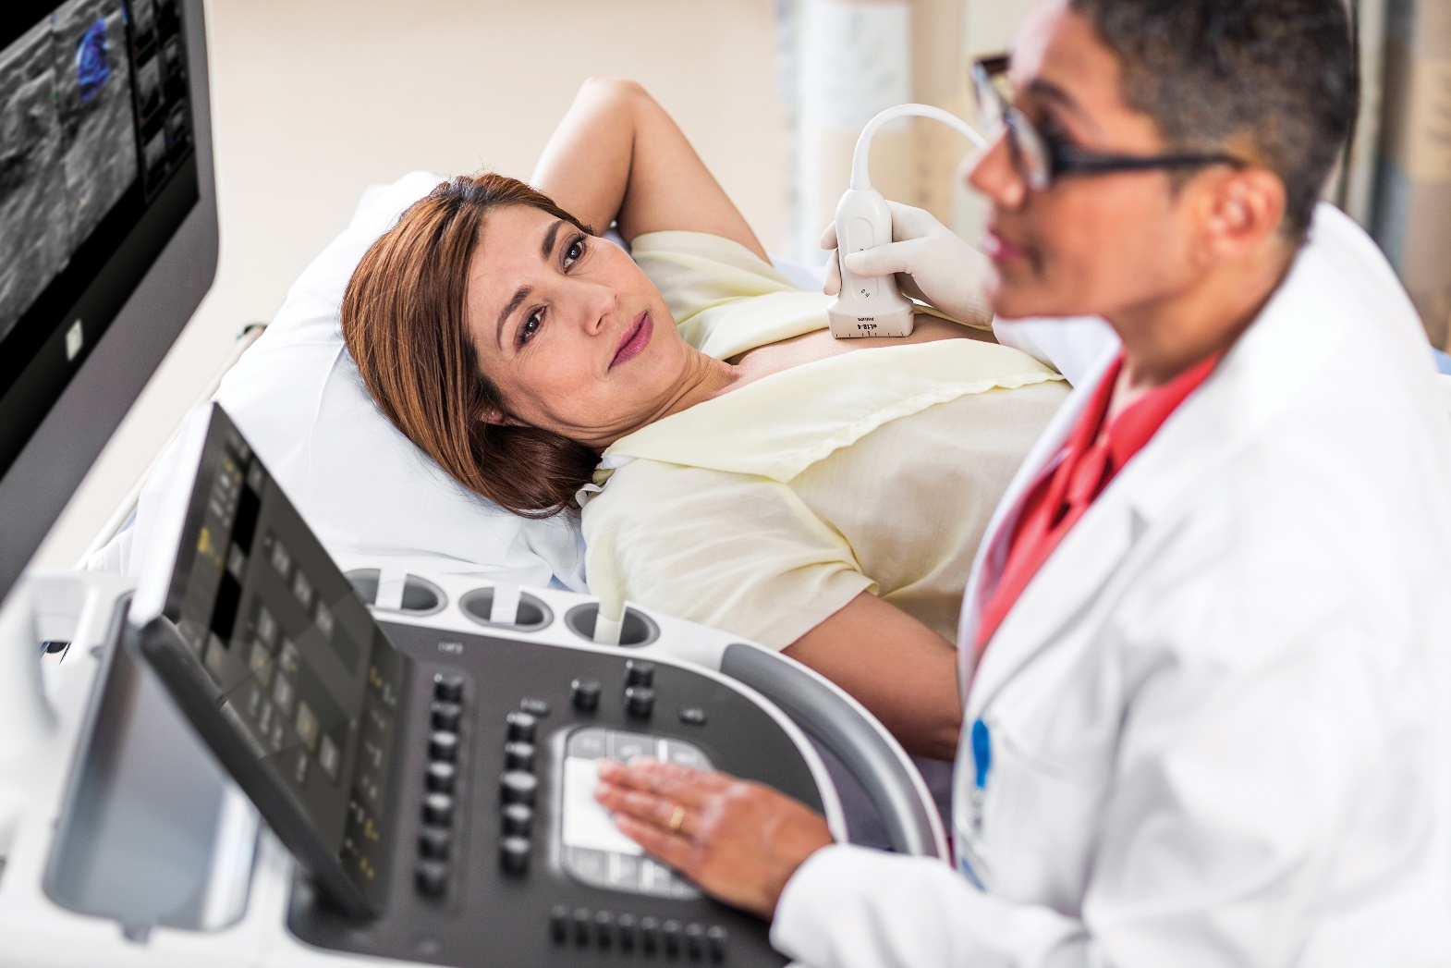
Breast ultrasound

Slide 6
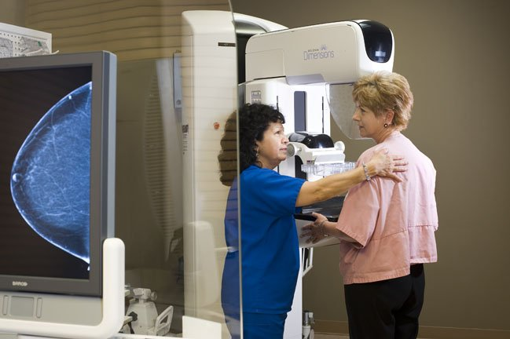
Diagnostic mammography

Slide 7
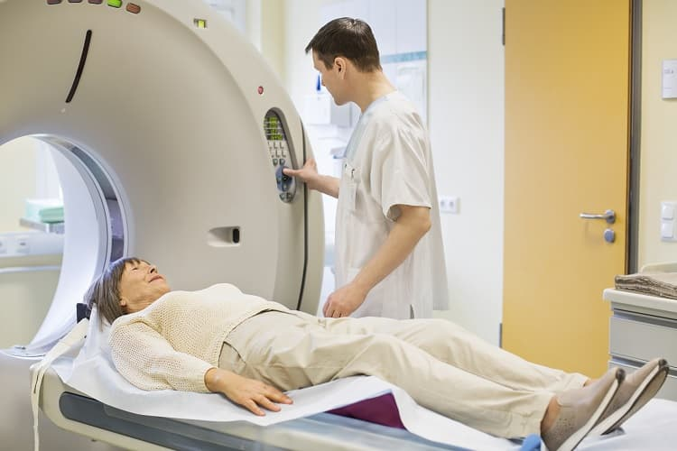
Breast magnetic resonance imagind ( MRI )

Slide 8
Biopsy

Slide 9
How is breast cancer treated ?
Surgery
Chemotherapy
Hormonal therapy
Radiation therapy

Slide 10
Preventions of breast cancer
Losing weight , that is some certain type of diets may be help to prevent .
2. Some hormonal medicine , such as
Tamoxifen .
3. Vaccine , may be help to prevent from breast cancer .

Slide 11
Conclusion
Breast cancer is the second cause leading to death of women in the world .
When we are understood the risks and diagnosis and treatment so we must be prevent us from this type of cancer .

Slide 12
References
Centers for diseases control and prevention
<https://www.cdc.gov/cancer/breast/basic_info/> [Accessed 21 April 2022].
Centers for diseases control and prevention
<https://www.cdc.gov/cancer/breast/basic_info/diagnosis.htm> [Accessed 22 April 2022].
American Cancer Society
Cancer.org. 2022. About breast cancer. [online] Available at: <https://www.cancer.org/content/dam/CRC/PDF/Public/8577.00.pdf> [Accessed 11 May 2022].
Centers for diseases control and prevention
2022. [online] Available at: <https://www.cdc.gov/cancer/breast/basic_info/treatment.htm> [Accessed 11 May 2022].

Slide 13

Thank you for attention

