Slide 1




Ethics of Duties and Rights

Slide 2


Introduction.
Duties.
Rights.
Conclusion.
References.
2

Slide 3
Introduction
Rights are moral claims of individuals recognized by society. Duties are moral debts or obligations of individuals recognized by society.
(John Tasioulas 2019)
Rights are what we want others to do for us whereas the duties are those acts which we should perform for others.
3

Slide 4
Duties
A duty is something that a citizen is required to do, by law. Examples of duties is: obeying laws, paying taxes, defending the nation and serving on juries.
(John Tasioulas 2019)
4

Slide 5
Rights
Rights are legal, social, or ethical principles of freedom or entitlement; that is, rights are the fundamental normative rules about what is allowed of people or owed to people according to some legal system, social convention, or ethical theory. (Taylor and Francis)
An example of a legal right is the right to vote of citizens.
5

Slide 6
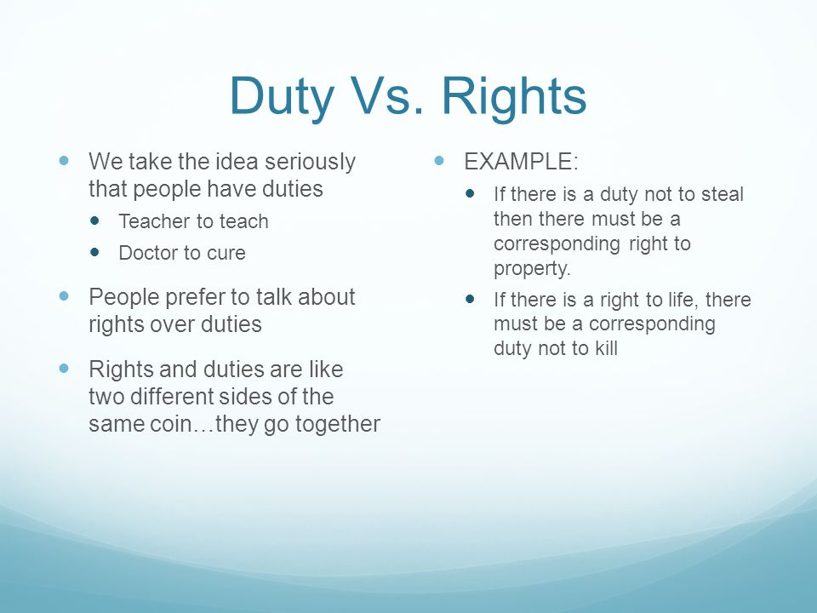
6

Slide 7
Conclusion
Rights are lawful, social, or ethical rights principles that are granted by a governing body. In contrast, the duties of the person, the governing body, are obligations in which must be undertaken by the same person.
Rights and duties are closely related in the absence of one the other become meaningless.
7

Slide 8
References
Yadav, P. (2022, October 16). Difference Between Rights and Duties. Ask Any Difference. https://askanydifference.com/difference-between-rights-and-duties/ .
An Introduction to Human Rights | Australian Human Rights Commission. (n.d.). https://humanrights.gov.au/our-work/education/introduction-human-rights .
BBC - Ethics - Introduction to ethics: Duty-based ethics. (n.d.). https://www.bbc.co.uk/ethics/introduction/duty_1.shtml .
The rights and duties of external citizenship. (n.d.-b). Taylor & Francis. https://www.tandfonline.com/doi/abs/10.1080/13621020903174647?cookieSet=1 .
8

Slide 9

Any Questions ?

