Slide 1


Libyan International Medical University
Faculty of Business Administration
The Nature of Interpersonal Communication
Presented By: Ihda Nabbous
Student No.: 3732
Email:ihdaa_3732@limu.edu.ly

Slide 2
Content
1
4
2
5
3
6
Introduction
The Elements of IC
Nature in IC
Conclusion
Reference
The 4 Natures of Communication
2

Slide 3
Introduction
Interpersonal communication is the process of exchange of information, ideas and feelings between two or more people through verbal or non-verbal methods.
3

Slide 4

The Nature of IC
Interpersonal communication is transactional in nature and it is a process in which transmission and reception occur simultaneously and source and receiver continually influence one another.
4

Slide 5




The 4 Natures of Communication
1
Verbal
Written
3
Non-verbal
4
Visual
2
5

Slide 6
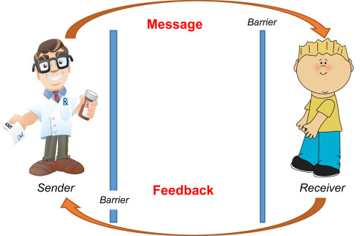
The Elements of IC
Sender
Message
Information conveyed (verbal and nonverbal)
Person conveying the message.
Receiver
Feedback
The person receiving the message.
6
Receiver communicates their understanding of the sender's message.

Slide 7
Conclusion
In conclusion, nature has a powerful transformative power which is responsible for the functioning of life on earth .It is essential for mankind to flourish so it is our duty to conserve it for our future generations.
6

Slide 8
Reference
Interpersonal Communication. Interpersonal Communication - an overview | ScienceDirect Topics. (n.d.). Retrieved October 31, 2022
Enquire solutions - director of information technology. recruiting.paylocity.com. (n.d.). Retrieved October 31, 2022
8

Slide 9
Thank you !!

