Slide 1


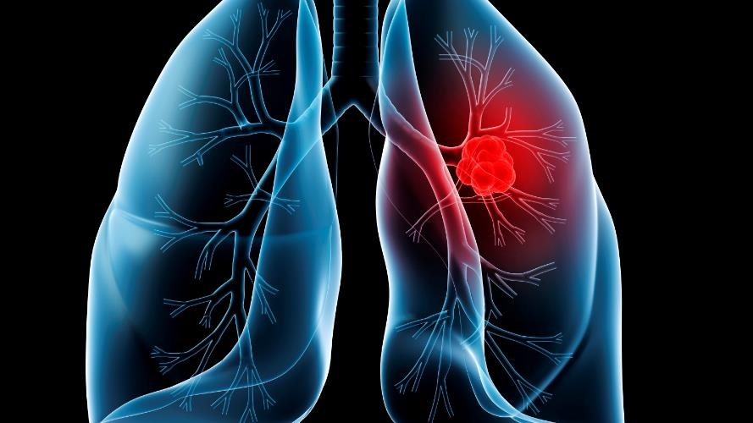
Lung cancer
Name : Abdalmalek
Year 1
2021\2022
GBMS 3
4/6/2022
Notes:
To use this title animation slide with a new image simply 1) move the top semi-transparent shape to the side, 2) delete placeholder image,
3) click on the picture icon to add a new picture, 4) Move semi-transparent shape back to original position, 5) Update text on slide.

Slide 2

Introduction
. One of the most common cancer, Lung cancer is the deadliest cancer worldwide, Accounting for 1.79 million deaths in 2020.
. the average five-year survival rate is approximately 18.6 percent.

Slide 3

Objective:
Define the lung cancer and list the types of it ?
Outline the symptoms of the lung ?
Discuss the risk factor?
How to prevent against to lung cancer?
The techniques Diagnosis of lung cancer
How to treat lung cancer?

Slide 4
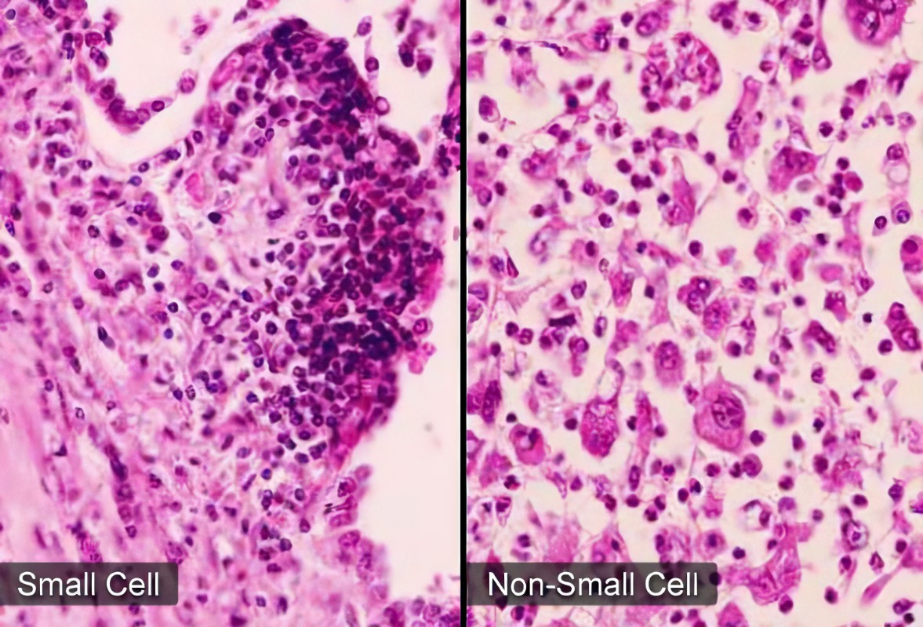
What is lung cancer?
It’s a type of cancer, It is beginning when cells start in uncontrollable growth
Types of lung cancer
Small cell lung cancer (SCLC)
Non-small cell lung cancer (NSCLC)

Slide 5
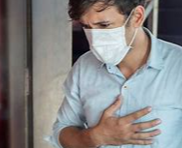
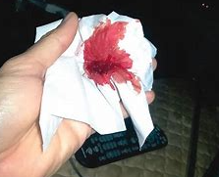

Symptoms
Shortness of breath
Changes to the voice such as hoarseness
Chest pain
Coughing up blood
A new cough that does not go away “chronic cough”
Unexplained weight loss
Tiredness.
5

Slide 6




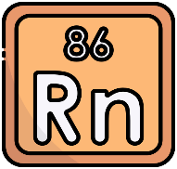
Risk factor of lung cancer
1
2
3
4
5
Smoking
Radon
Particle pollution
Genes
Hazardous chemicals
Reference : The basics you can find anywhere 5 Steps To Successful Storytelling Published on April 5, 2014 Featured in: Marketing & Advertising

Slide 7



Prevent from lung caner
Stay away from tobacco
. Eat a healthy diet2
3. Exercise regularly
4. Avoid radon exposure

Slide 8
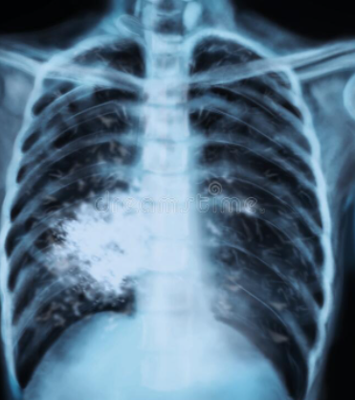
Diagnosis lung cancer
X ray
Use X-rays to create sectional area images of the test

Slide 9
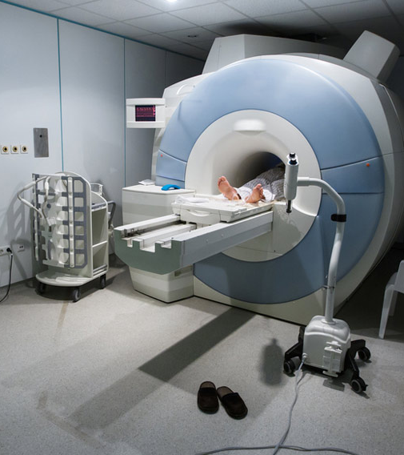
MRI SCAN
Which use radio waves and strong magnets to create detailed images of soft tissue of lung

Slide 10
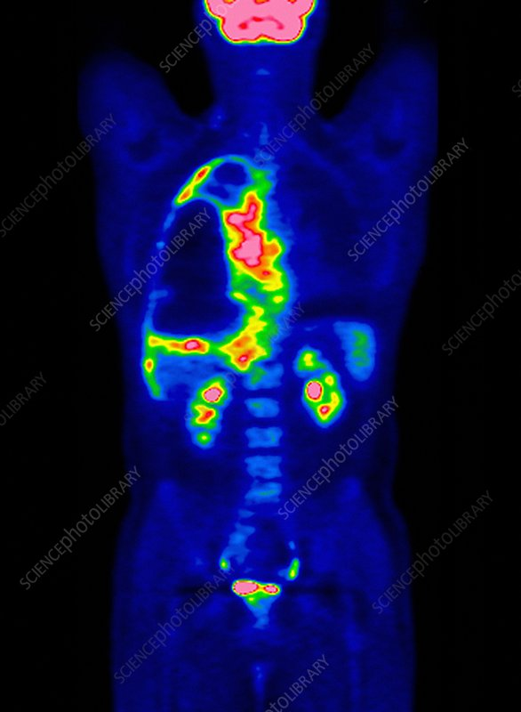
PET SCAN
Which use fluorodeoxyglucose (FDG) injected into the body to illuminate cancer cells

Slide 11
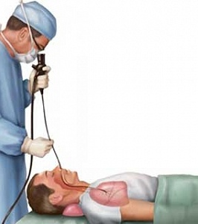
Bronchoscopy for lung cancer
Is a test to look at the inside of the breathing tubes (airways) in your lungs

Slide 12
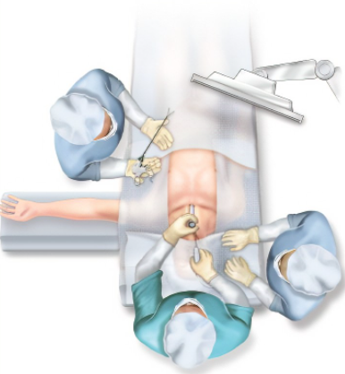
Mediastinoscopy
An incision is made in the neck so that a lighted instrument can be inserted to examine the area between the lungs known as the mediastinum

Slide 13
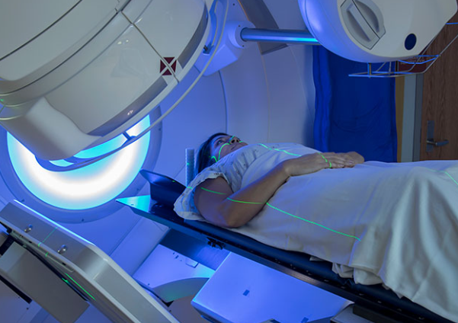
Lung cancer treatment
Surgery
  Types :
  Wedge resection
  Lobectomy
  Pneumonectomy
  Sleeve resection
Radiation Therapy
  High energy radiation to kill cancer cell
Chemotherapy
  Chemotherapy works by interfering with the cancer cells’ ability to grow or reproduce

Slide 14
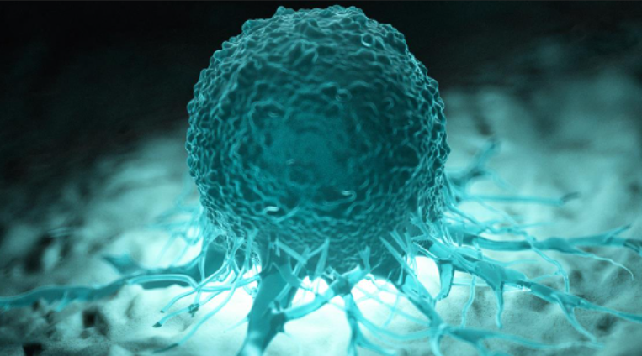
continuous:
Treatment of lung cancer
Immunotherapy
Uses drugs, vaccines and other therapies to activate the immune system’s natural defenses

Slide 15

Conclusion
Lung cancer is the leading cause of cancer death in both men and women. Lung cancer is a disease in which malignant (cancer) cells form in the tissues of the lung.
People with lung cancer can be treated with surgery-, chemotherapy, radiation therapy, targeted therapy.
Smoking starts with pleasure and ends with pain

Slide 16
References <https://www.citethisforme.com/?msclkid=40dc2165d0b011ecbb6955e32c5f61a5> [Accessed 10 May 2022]. https://www.cancerresearchuk.org/about-cancer/lung-cancer https://pubmed.ncbi.nlm.nih.gov/
THANK YOU

