Slide 1

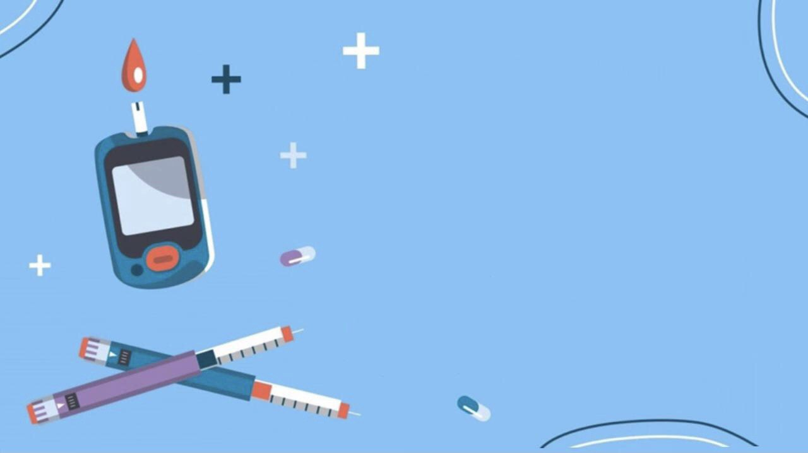

All about diabetes mellitus
All about Diabetes Mellitus
Aseel Othman Tajoury
3647
Date: may 18/2022
1st Year
PTS Block

Slide 2

objectives
Objectives
Define diabetes mellitus
Compare between type I and type II diabetes
Distinguish the differences between hypoglycemia and hyperglycemia
List the possible symptoms of diabetes
Sate the possible risk factors for diabetes
Discuss the methods of diagnosing diabetes

Slide 3

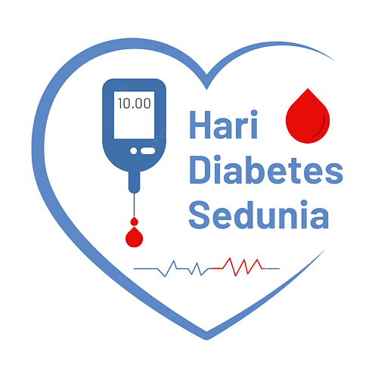
Introduction
To Diabetes
3

Slide 4

Define diabetes mellitus (robbins)
Define Diabetes Mellitus
Diabetes mellitus is a group of metabolic disorders sharing the common feature of hyperglycemia caused by defects in insulin secretion, insulin action, or, most commonly both
Diabetes mellitus is a group of metabolic disorders sharing the common feature of hyperglycemia caused by defects in insulin secretion, insulin action, or, most commonly both

Slide 5
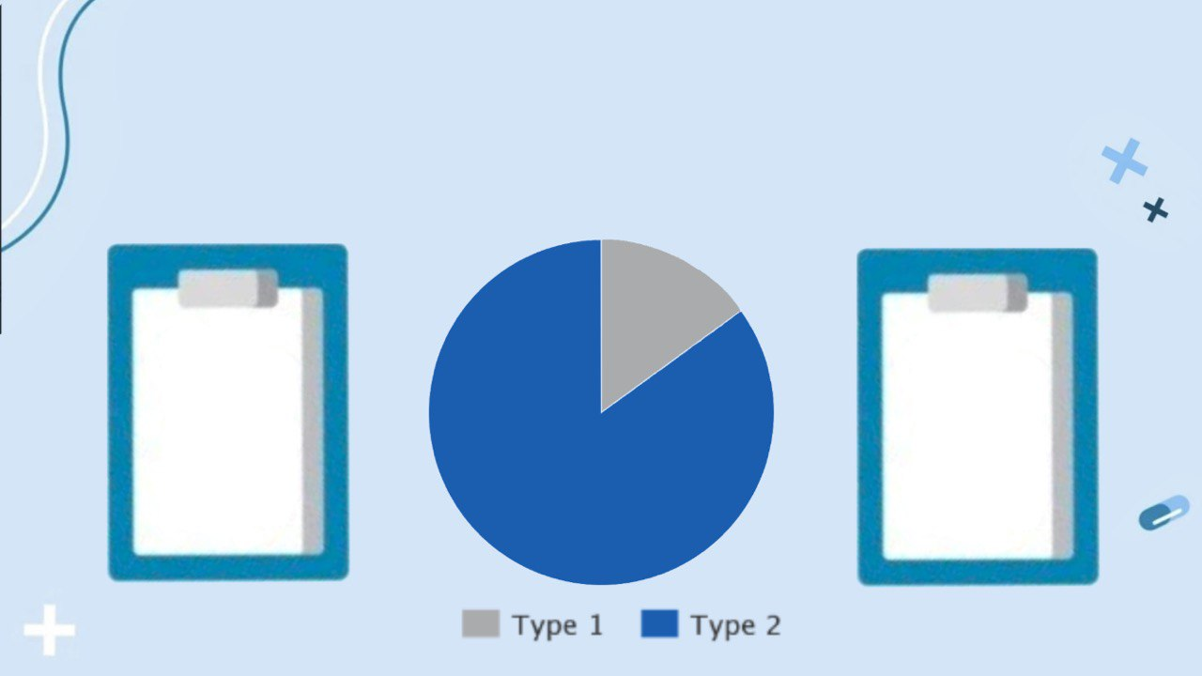
Did you know !
15%
About 400 million people in the world have diabetes
Type 2 diabetes is curable but type 1 is chronic
85%
5

Slide 6
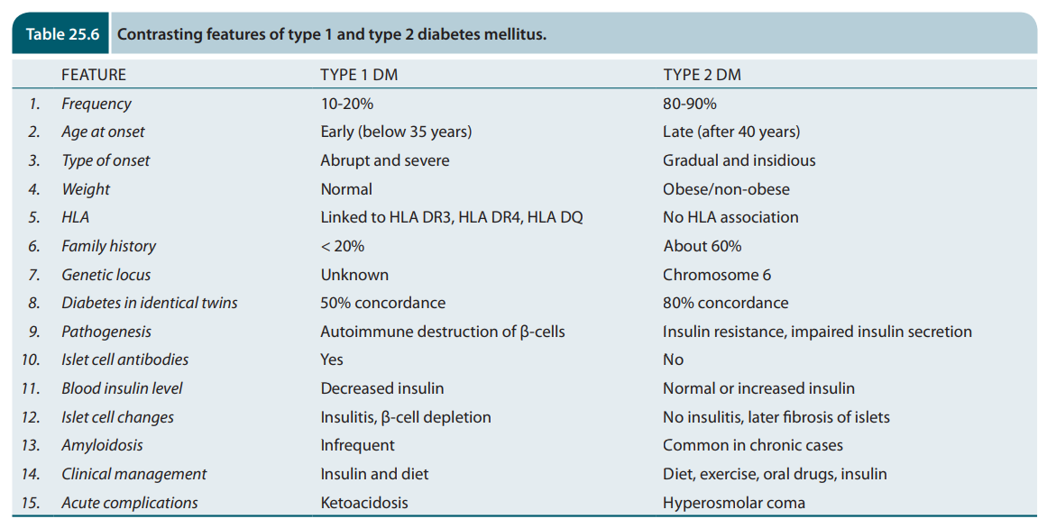
differentiate between type I and type II diabetes (Harsh Mohan)
Compare between type I and type II diabetes
 | features | Type 1 DM | Type 2 DM
1. | Frequency | 10-20% | 80-90%
2. | Age at onset | Below 35 years old | after 40 years old
3. | weight | Normal | obese
4. | Blood insulin level | Decrease insulin | Normal/increase insulin
5. | Clinical management | Insulin + diet | Diet + exercise + oral drugs + Insulin

Slide 7

Difference’s between hypoglycemia and hyperglycemia
Hypoglycemia
• in blood sugar levels
•Intake of too MUCH insulin
•Symptoms: pale, blurred visions and dizzy
Hyperglycemia
• in blood sugar levels
•Intake of too LITTLE insulin
•Symptoms: tired, very thirsty and needing to urinate often
7

Slide 8
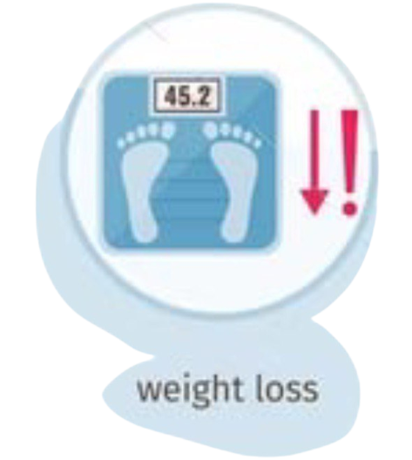

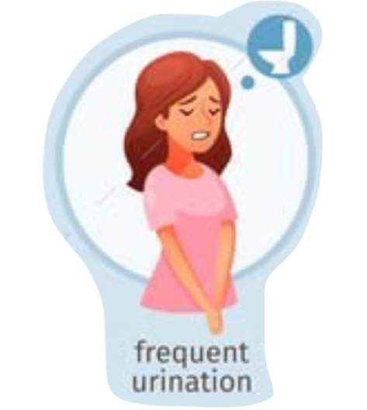

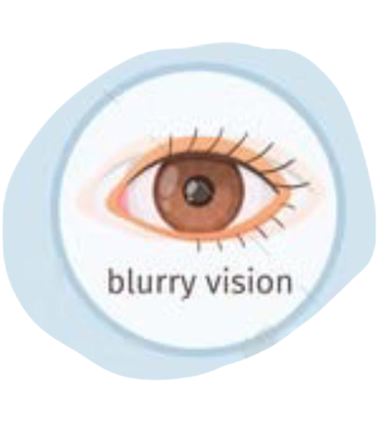
Possible symptoms of diabetes
8

Slide 9
Possible risk factors for diabetes
Risk factor of T2D is obesity(BMI +30), there are two key abnormalities:
• Insulin resistance • β-cell dysfunction
Risk factor for T1D is an autoimmune disease
9

Slide 10
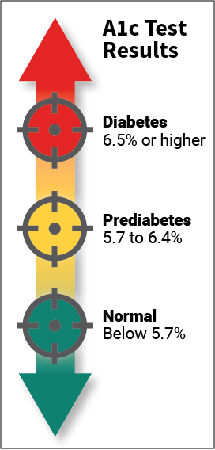
Methods of diagnosing diabetes
Hyperglycemia remains the fundamental basis for the diagnosis of diabetes mellitus
URINE TESTING:
FASTING GLUCOSE TEST: above 126 mg/dl
HbA1c TEST: average level of blood sugar over the past 2 to 3 months.
10

Slide 11

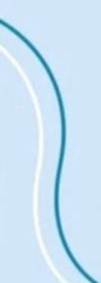
Question
Tom is a diabetic
•He forgot to take his insulin injections this morning before he went to work
•He ate a big sugary breakfast
•An hour later Tom feels very thirsty and tired.
Is Tom Hypo or Hyper glycemic?
Anna is a type 1 diabetic
•She took some insulin this morning but she didn’t check her blood sugar levels
• She also skipped breakfast
• By 1pm Anna had blurred vision and was feeling dizzy
Is Anna Hypo or Hyper glycemic?
11
11

Slide 12
Answer
Tom is hyperglycemic
Why!
He did not take insulin but ate too many carbohydrates. His blood glucose levels increased and there was no insulin to balance the levels
Therefore Tom is hyperglycemic
Anna is hypoglycemic
Why!
She took too much insulin and had no breakfast. This means that her blood glucose levels were low and the insulin further decreased her blood glucose levels.
Therefore Anna is hypoglycemic
11
12

Slide 13

conclusion
Conclusion
Diabetes affects around 400 million people in the world. It is a serious life threating disease and must constantly be monitored and effectively subdued with proper medication, as well as adapting a healthy lifestyle.
13

Slide 14
reference
Reference
Mohan H. Pathology quick review and mcqs: Based on harsh Mohan's textbook of pathology 7th edition. New Delhi: Jaypee Brothers Medical Publishers (p) Ltd; 2015.
Klatt EC, Robbins SL, Cotran RS. Robbins & COTRAN Atlas of Pathology. Elsevier; 2021.
Gillick L, Healy L. Complete Home Economics: Leaving certificate higher and ordinary levels. Castleisland: Educate.ie; 2016.
14

Slide 15

Thank you!
Do you have any questions?
15

