Slide 1

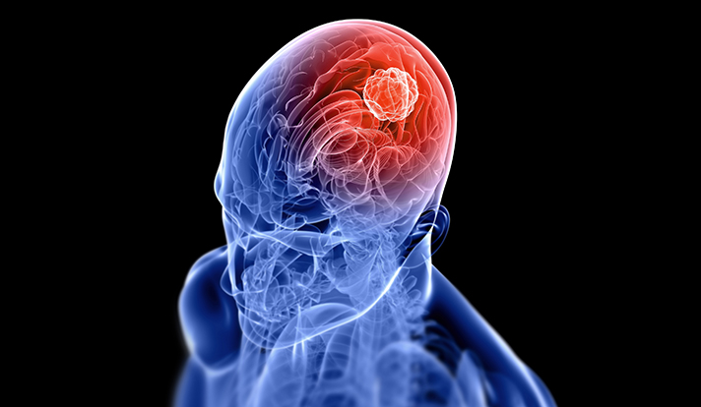
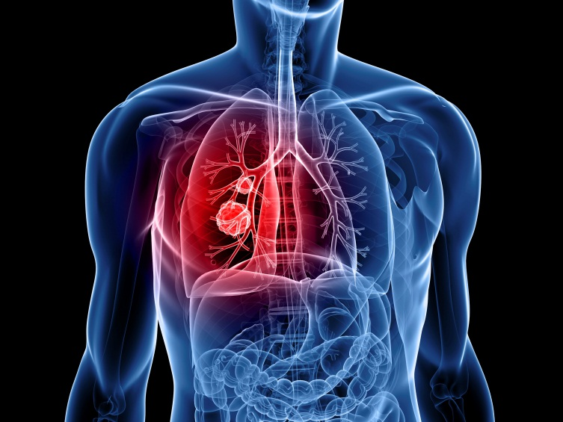


TUMORS
HAITHAM R. ELMEHDAWI

Slide 2

Definitions
TUMORS
TUMOR
Autonomous
Excessive
Purposeless
Pathological Proliferation of cells.
This growth continues in the absence of physiological stimuli &
without regard to its effects to the surrounding tissue

Slide 3
Definitions
TUMORS
Neoplasia
Hyperplasia
Hypertrophy
Dysplasia
Carcinoma “in situ”
Invasive Carcinoma
Metaplasia

Slide 4
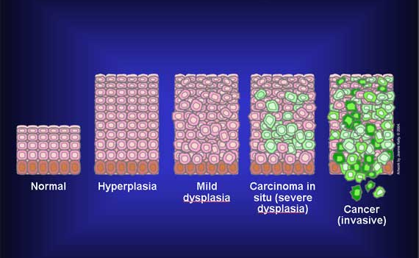
TUMORS

Slide 5
TUMORS
Hyperplasia
proliferation of cells within an organ that may result in gross enlargement in response to a physiological stimulus, remains under normal regulatory control (mechanisms. (breast during pregnancy
Hypertrophy
increased in cell size. (weight training & steroid therapy)

Slide 6
TUMORS
Dysplasia
Literally means abnormal growth
In dysplasia some but not all of the features of malignancy are present, microscopically
Dysplasia may develop into malignancy (Premalignant condition)
Uterine cervix
Colon polyps
Graded as low-grade or high-grade, often prompting different clinical decisions
Dysplasia may NOT develop into malignancy
HIGH grade dysplasia often classified with CIS

Slide 7
TUMORS
Metaplasia
changes in response to chronic physical or chemical irritation such as cigarette smoking that causes the mucus secreting Ciliated epithelium to be replaced by Simple Squamous epithelium; the change is benign and reversible to certain limit
Some cells go from:
Metaplasia-Dysplasia-Neoplasia

Slide 8
TUMORS
Carcinoma “in situ”
Epithelial neoplasm with features of malignancy
altered cell growth
cytological atypia
altered differentiation
BUT-no invasion through basement membrane

Slide 9
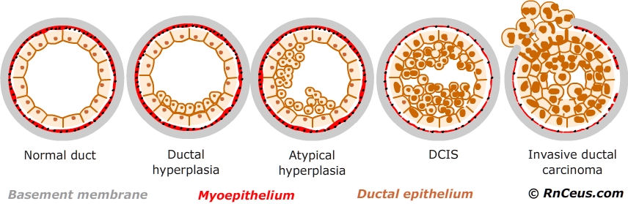
TUMORS

Slide 10
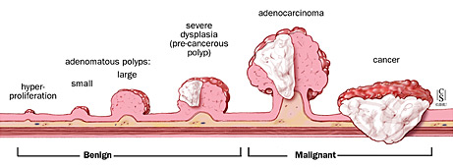
TUMORS

Slide 11
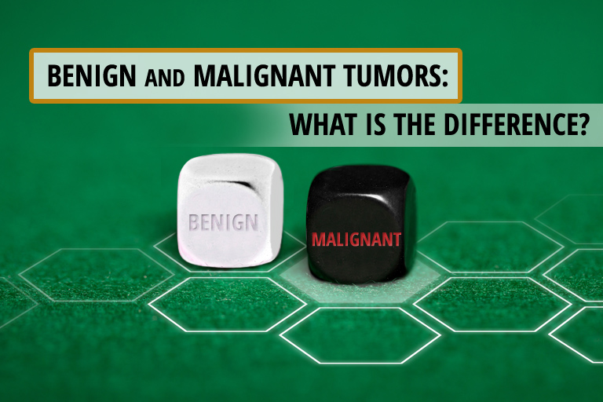
TUMORS
TAYPES OF TUMORS

Slide 12
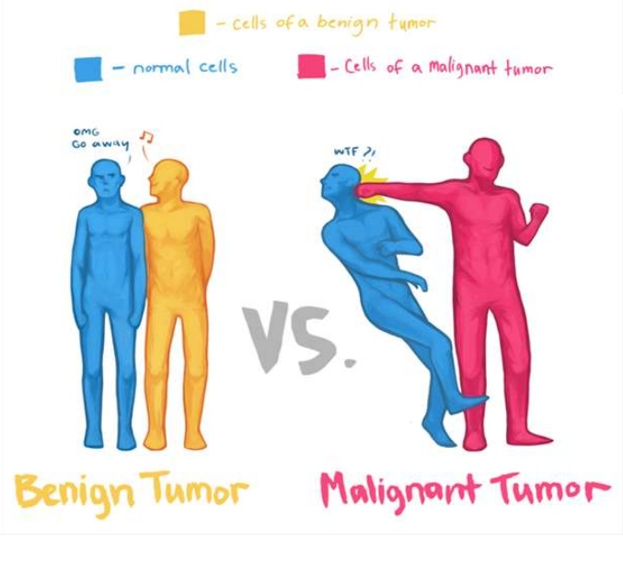
TUMORS

Slide 13
TUMORS
MACROSCOPIC FEATURES
Characteristics | Benign | Malignant
Boundaries | Encapsulated /circumscribed | Irregular
Rate of growth | Usually progressive & slow | may be slow to Rapid
Local invasion | not invade or infiltrate surrounding normal tissues | Locally invasive, infiltrating the surrounding normal tissues
Metastasis | Absent | Frequently present

Slide 14
TUMORS
MICROSCOPIC FEATURES
Characteristics | Benign | Malignant
PATTERN | structure may be typical of tissue of origin | structure is often atypical
Nucleo/cytoplasmic ratio | Normal | Increased
pleomorphism | Absent | present
Hyperchromatism | Absent | present

Slide 15
TUMORS
POSSIBLE EVENTS
Benign Benign
Benign Dysplasia
Benign Dysplasia In-situ
Benign Dysplasia In-situ Invasive
Dysplasia In-situ Invasive
In-situ Invasive
Invasive Invasive

Slide 16
TUMORS
NOMENCLATURE
Tissue | Benign | Malignant
Epithelial tissue | Papilloma Adenoma | Squamous cell carcinoma adenocarcinoma
Connective tissue | Lipoma Osteoma Leiomyoma | Liposarcoma Osteosarcoma Leiomyosarcom
Nerves tissue | Neurofibroma | Neurofibrosarcoma
Lymphoid /blood | Haemangioma | Haemagiosarcoma

Slide 17

TUMORS
NOMENCLATURE
HEMATOMA
TERATOMA
SEMINOMA
LYMPHOMAS
MALIGNANT MELANOMA
HEPATOMAS

Slide 18

TUMORS

Slide 19
TUMORS
Epidemiology of cancer
Cancer is one of the most common diseases in the developed world.
1.4 million new cases diagnosed.
1 in 4 deaths are due to cancer
1 in 17 deaths are due to lung cancer

Slide 20
TUMORS
Most common tumors in men
Lung
Prostate
Colorectal
Most common tumors in women
Breast
Lung
Colorectal

Slide 21
TUMORS
Etiology of cancer
Exposure to environmental carcinogens
Dysregulated DNA repair
Random replication errors
Hereditary germline mutations in a cancer gene

Slide 22
TUMORS
Genes responsible for cancer
Oncogenes
Tumor-Suppressor Genes
Genes regulating apoptosis
Gene regulating DNA repair

Slide 23
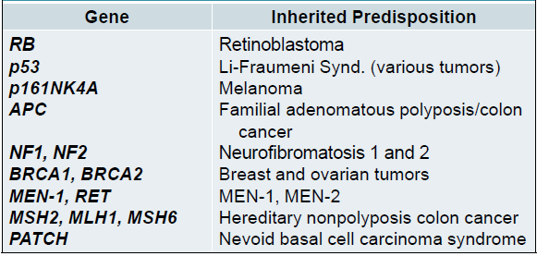
TUMORS
Genes responsible for cancer

Slide 24
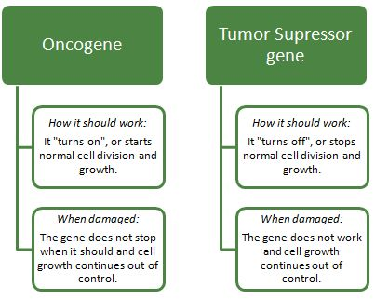
TUMORS

Slide 25
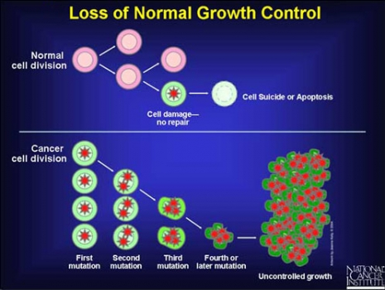
TUMORS

Slide 26
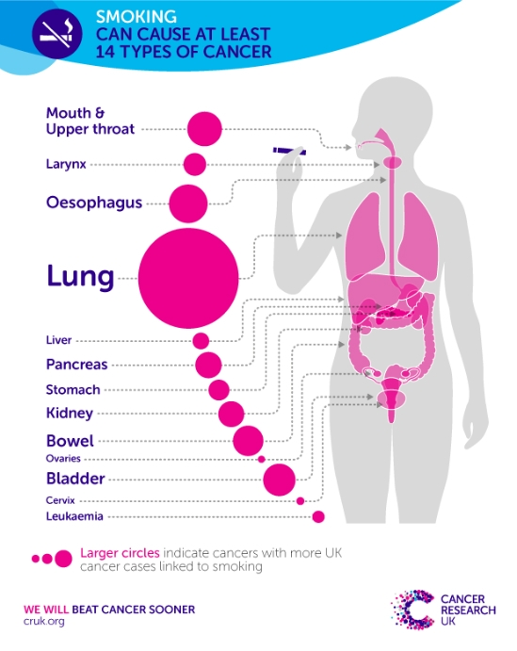
TUMORS
Cancer Etiologic factors
Smoking
30% of all cancer deaths
87% of lung cancer deaths

Slide 27
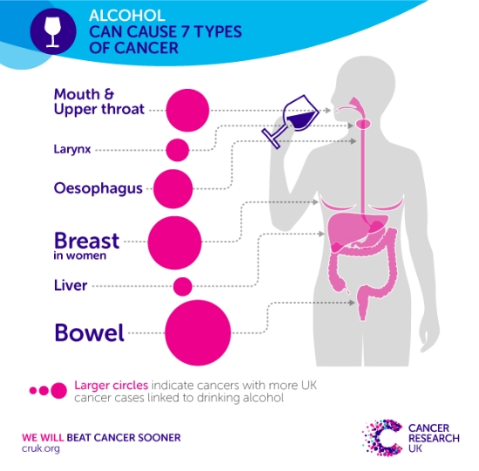
TUMORS
Cancer Etiologic factors

Slide 28
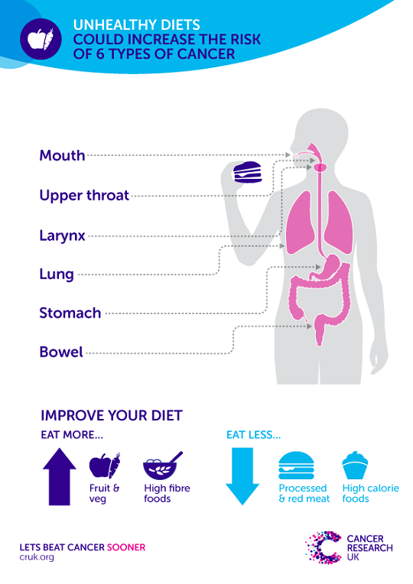
TUMORS

