Slide 1



IDENTIFY THE DIFFERENT POLITICAL IDEOLOGIES IN THE POLITICAL SPECTRUM
By Ghadi Dreza
ID-2830
ghudai_2830@limu.edu.ly
14th December 2020

Slide 2
Content
What is Political Ideology?
What is Political Spectrum?
Origins of the words left and right wing.
Different political ideologies.
Conclusion
References

Slide 3
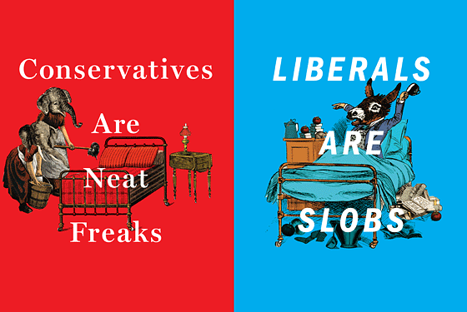
What is Political Ideology?
It is the set of beliefs, teachings, and ideas that guide a certain group of political activists or a single-individual.
Examples of Political Ideology are; Conservatism and Liberalism (politically based)or capitalism and socialism (economically based).

Slide 4
“From the sublime to the ridiculous is but a step”
—Napoleon Bonaparte

Slide 5
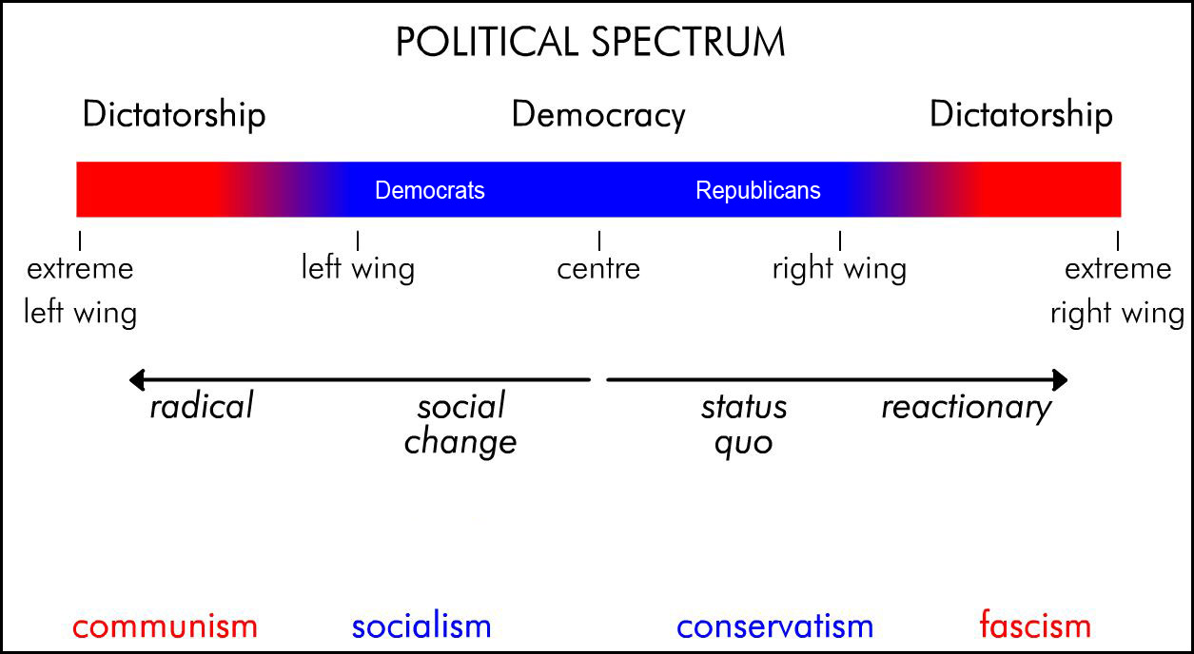
What is a Political Spectrum?
Political Spectrum is the way by which seeks to define and systemizes the different ideologies and political parties, in relation to one another.

Slide 6
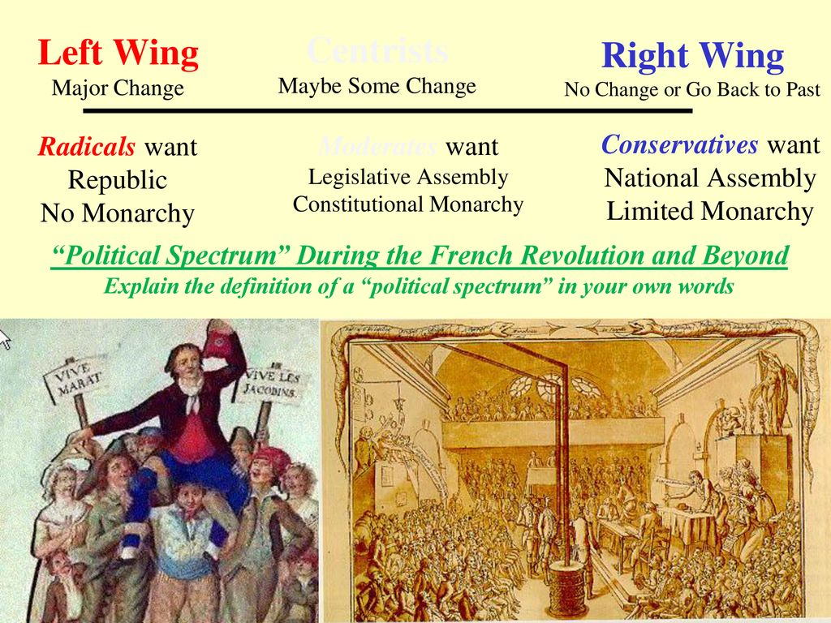
Origins of the term Left and Right- Wing
The term Left-Wing and Right-Wing, originated after the French Revolution in 1789-1799. The seating arrangements in the French parliament were as explained;
The left were the radicals (who claimed a Revolution), whilst the rights where the aristocrats and leaders of the country (who forced to keep the monarchy and reinforce power over the French people).

Slide 7
The different Political Ideologies
Anarchism
Socialism
Liberalism
Absolutism
Conservatism
LEFT
RIGHT
Anarchism
socialism
Absolutism
Liberalism
Conservatism

Slide 8

Anarchism
The belief that governments must be abolished.
This is because anarchists believe that governments are corrupt and therefore oppressive/authoritarian.
Anarchism and Nihilism are both alike because nihilist would believe in nothing and have no purpose, perhaps, other than the motivation to cause destruction.

Slide 9

Socialism
It is a political and economical ideology that insists on the idea that economy must be control by one organisation e.g. government. But, it also imposes the idea of equality before the law.
Socialism and capitalism have always been in a conflict.
Capitalism (competition) vs socialism (cooperation)

Slide 10
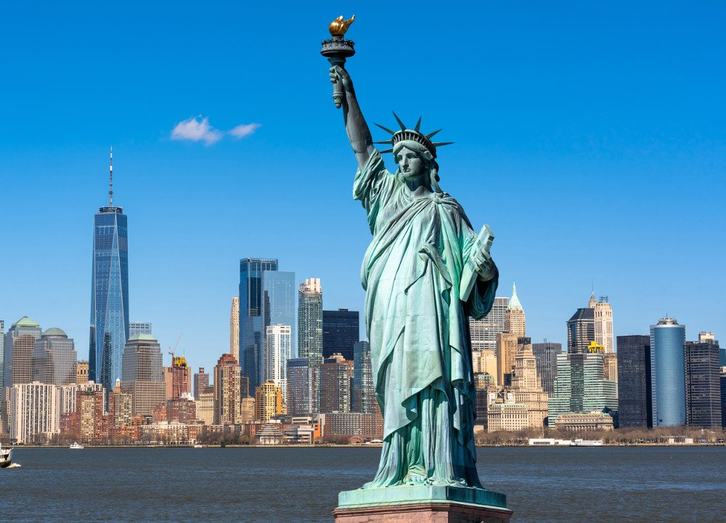
Liberalism
Liberalism in simple terms; equality before the law.
In the 1600 a chap named John Lock, had rethought about the relationship between the people and the society.
Liberalism emphasises upon; freedom of choice, individualism, equality, free-market etc.

Slide 11
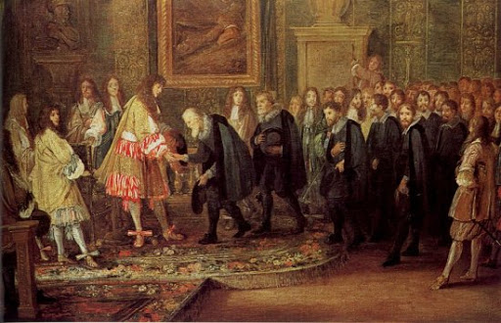
Absolutism
The belief that a single ruler most control both the government and the people.
Most of the western countries powers such as; France, England, and Spain etc. have been controlled by absolute monarchists.

Slide 12
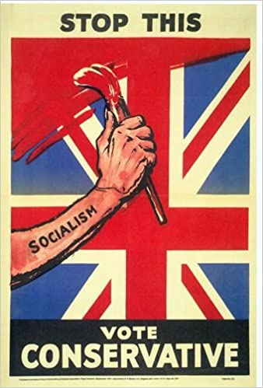
Conservatism
The belief that traditions must be kept the same and oppositions to any new reforms.
Conservatism has a clear purpose of what they oppose rather than what they are there for.
Liberals and conservatives are always in a disagreement because one party insists on a change, whilst the other opposes the changes.

Slide 13
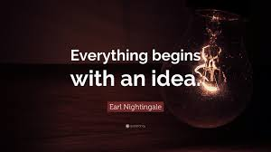
Conclusion
Ideology is important both in politics and outside of the political environment. It is the science of ideas. It also serves as a compass for the purpose of giving direction to a group of people or especially political activists whom seek to preach certain ideologies within society, through the living ideas and beliefs of other individuals.
‘Ideas are bulletproof’ and therefore they are a powerful tool mainly used to change the course of history. Why? Because they have the power to live on for centuries.

Slide 14
References
https://www.youtube.com/watch?v=0DLjzp645is What is the Political Spectrum? | Left Vs Right, YouTube, September 21, 2020 https://www.sparknotes.com/us-government-and-politics/political-science/political-ideologies-and-styles/section2/page/3/ SparkNotes, google.

Slide 15
THANK YOU!

