Slide 1
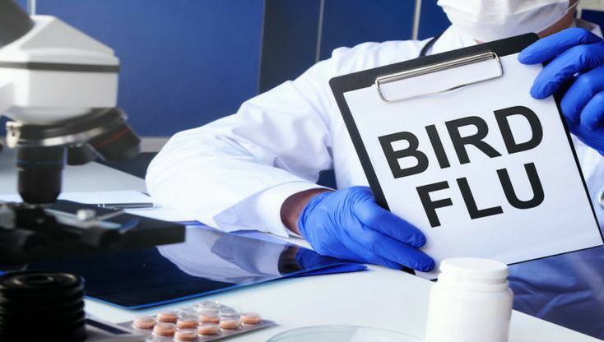


Influenza H5N1 and its relation with human
Retaj Nouh
AMS 1st year
3462
June 4th 2022

Slide 2
1- Define H5N1
2- List types of influenza
3- Discuss the pathophysiology of H5N1
4- Compare between Covid-19 and H5N1
Objectives
5- Prevention and control the H5N1

Slide 3
Introduction
Ancestors of the H5N1 bird flu viruses emerged in southern China in 1996,
and caused large poultry outbreaks in Hong Kong in 1997, which resulted in 18 human infections.
The bird outbreak was controlled, but H5N1 bird flu viruses re-surfaced in 2003 to spread widely in birds throughout Asia, and later in Africa, Europe, and the Middle East, causing poultry outbreaks and human infections

Slide 4
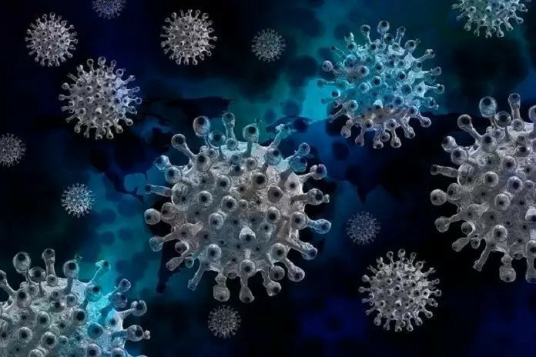
01
Define H5N1

Slide 5
Bird flu is a virus that infects birds including
chickens and other poultry and can poses health
risks to people.
The WHO received reports from 19 countries of
more than 860 humans infections with H5N1
virus, with 53% results in death.

Slide 6
02
List types of influenza

Slide 7
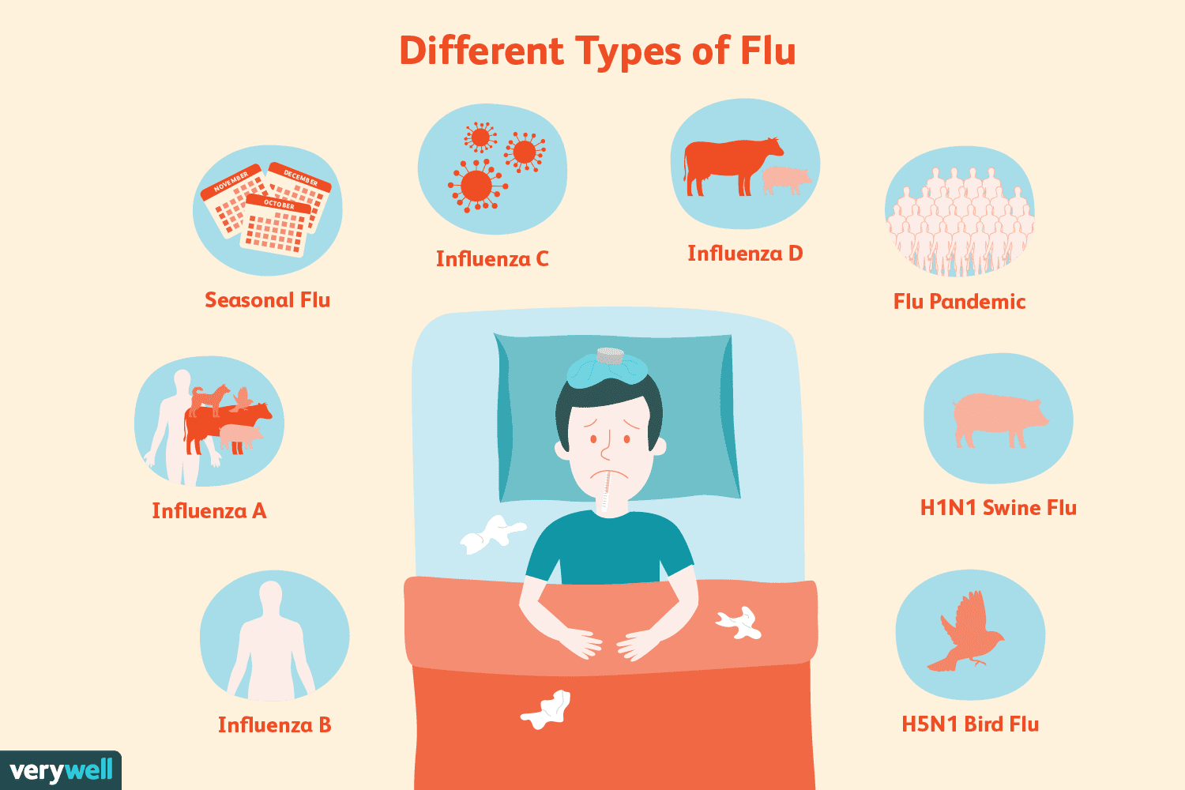
Influenza A and B are the most common causes of seasonal flu and can cause major outbreaks and sever diseases.
Influenza C can cause illness in children that’s similar to the common cold.
Some types don’t infect humans like influenza D which infect pigs and cattle.

Slide 8
03
Discuss the pathophysiology of H5N1

Slide 9
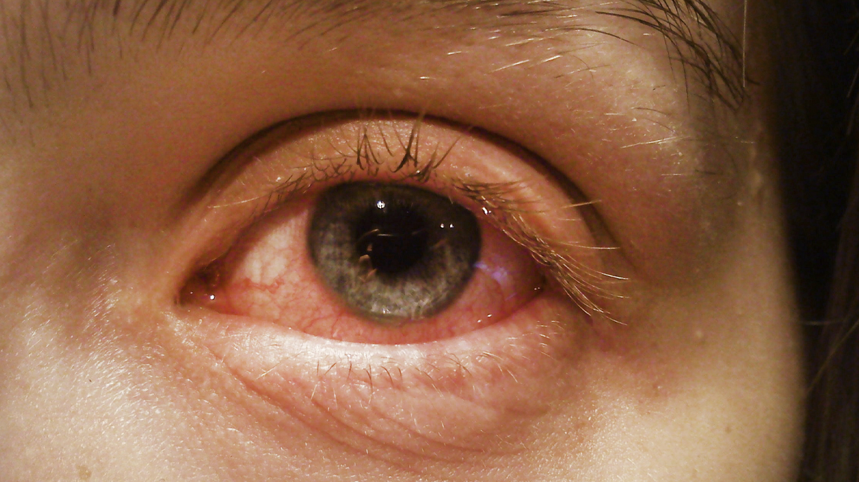
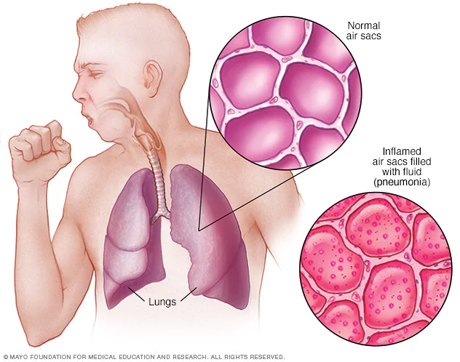
Infected birds shed bird flu viruses in their saliva, mucous and feces.
Bird flu infections among people are rare; however, human infections can happen when enough virus gets into a person’s eyes, nose, or mouth, or is inhaled.
bird flu virus symptoms range from mild (eye infection, upper respiratory symptoms) to severe illness (pneumonia) that can result in death.

Slide 10
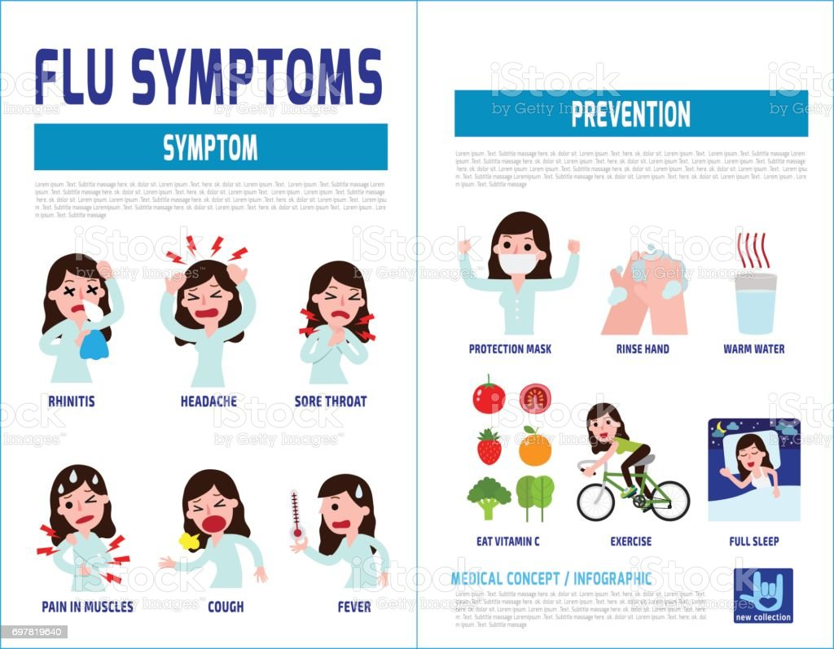
Symptoms
Runny nose
Fever
Headaches
Cough
Diarrhea
Vomiting
Respiratory difficulty
Muscle pain

Slide 11
04
Compare between Covid-19 and H5N1

Slide 12
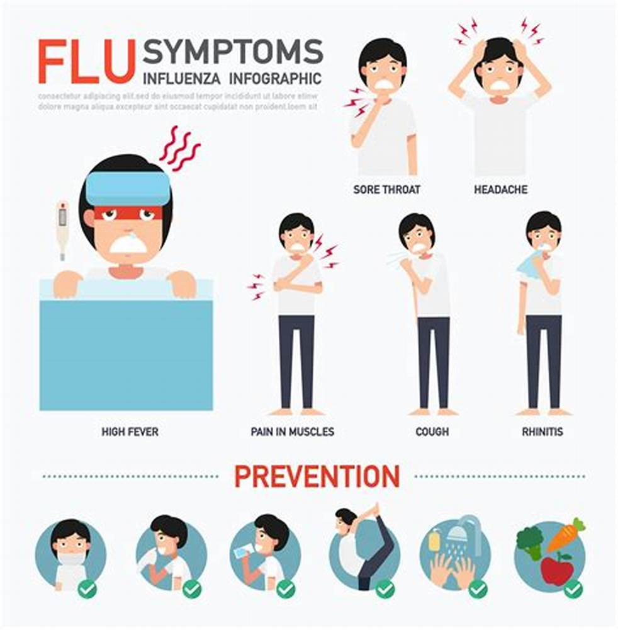
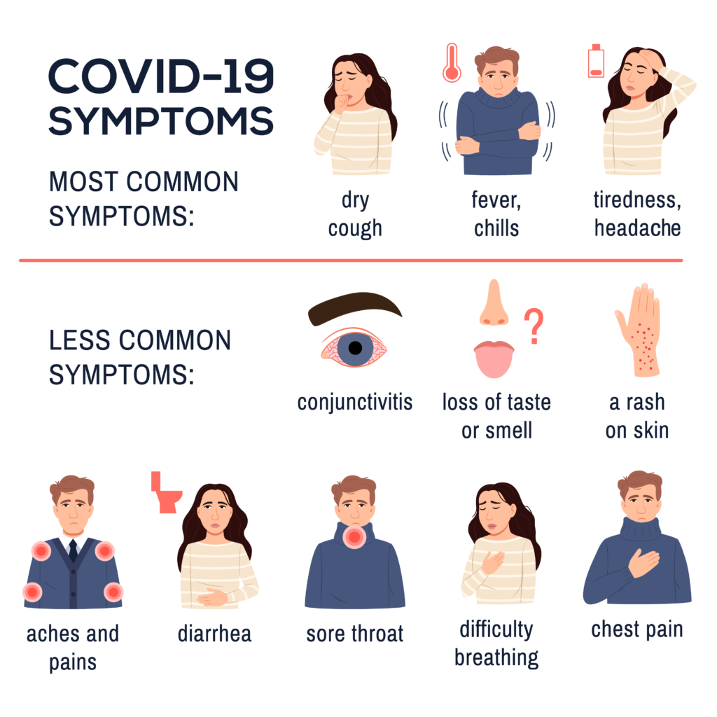

Slide 13
The main difference between Covid-19 and H5N1 is the spreading method
COVID-19 spread faster due to the fact that it’s particles once shed by the host can live on different surfaces from hours to days.
Meanwhile in H5N1 the human must come in contact with the feces or saliva of the infected creature to get the virus

Slide 14
05
Prevention and control the H5N1

Slide 15
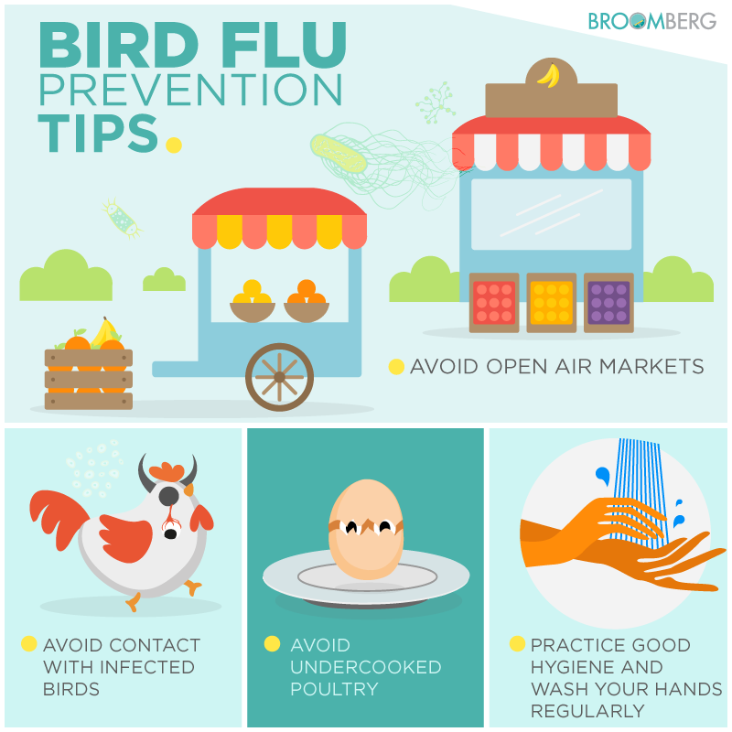
We should avoid direct contact with wild birds and observe them only from a distance.
Wild birds can be infected with avian (bird) influenza (flu) A viruses even if they don’t look sick.
Avoid unprotected contact with domestic birds (poultry) that look sick or have died.
Do not touch surfaces that may be contaminated with saliva, mucous or feces from wild

Slide 16
Treatment
If the infection already occurred:
Antivirals: To treat specific viral infections.
Antihistamines: It helps to relieve symptoms
such as nasal discharge and sneezing.
Cough suppressants: To relieve cough, in the
form of cough drops or cough syrup.

Slide 17
References
1- Levinson, Warren. Review of medical microbiology and immunology. 23rd ed.
2- https://www.cdc.gov
3- Tiensin, T., Chaitaweesub, P., Songserm, T., Chaisingh, A., Hoonsuwan, W., Buranathai, C., Parakamawongsa, T., Premashthira, S., Amonsin, A., Gilbert, M., Nielen, M., & Stegeman, A. (2005). Highly pathogenic avian influenza H5N1, Thailand, 2004. Emerging infectious diseases, 11(11), 1664–1672.

Slide 18


