Slide 1


OBESITY & it’s EFEECT in CARDIOVASCULAR DISEASE
Name: Rema Ahmed Zidan. Roll no: 3557
The supervisor: Fatima Altarhoni.
Block: PTS Date:2022/5/18
0

Slide 2
OBJACTIVES
Define the overweight and obesity.
Define the BMI and outline it’s classification.
Outline the main causes of obesity.
List the risk factors of obesity.
Discuss CVD related to the obesity.
01
2

Slide 3
INTRODUCTION
Obesity is one of the most common disorders is a public health and policy problem because of its increase prevalence, costs and health effect.
- It is a complex condition, with serious social and psychological dimensions that affect virtually all age and socioeconomic groups and threatens to both developed and developing countries.
-It is also one of the preventable causes of many diseases e.g. : (Coronary Heart Disease) and death.
02

Slide 4
Is overweight and obesity have the same meaning?
Overweight :-
refer to body weight that is greater than what considered normal or healthy for a certain height. overweight may also be due to extra muscle, bone, or water.
Obesity:-
defined as abnormal or excessive fat accumulation that may impair health.
03

Slide 5

BMI is a measurement of a person's leanness or corpulence based on their height and weight
04

Slide 6
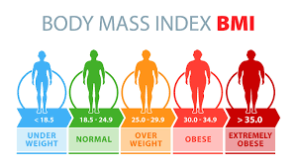
Am I Obese ??
05

Slide 7
causes that leads to overweight and obesity
1
2
3
4
5
Genetic
Metabolic
Behavioral
Environmental
Culture influence.
06

Slide 8
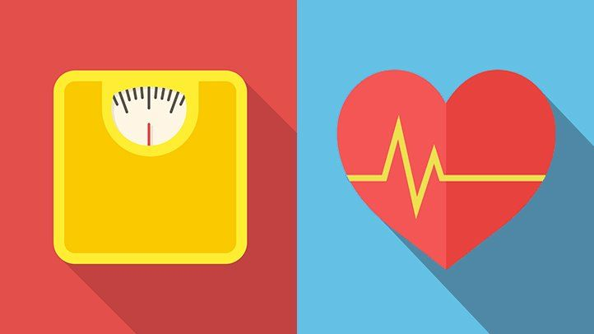
Obesity and Overweight Increase the Risk of
Hypertension.
Diabetes mellitus, type 2.
CV mortality.
Cancer – breast, prostate, and colon.
Gallbladder disease.
Respiratory diseases.
07

Slide 9
Obesity and its effect in the CVD!
1
2
3
Obesity is associated with an increased risk of developing cardiovascular disease (CVD):
heart failure (HF).
coronary heart disease (CHD).
Atrial fibrillation (AF).
08

Slide 10
PREVENTION
Limit energy intake from total fats and sugars.
Increase consumption of fruit and vegetables.
Engage in regular physical activity.
09

Slide 11
CONLCUSION
Obesity is associated with several cardiovascular diseases and is not only linked to coronary heart disease, but also to abnormalities in heart rate and ventricular function. The diagnosis of obesity should include measurements of total body fat content and its distribution.
10

Slide 12
REFERENCES
Loos R. Genetic determinants of common obesity and their value in prediction. Best Practice &amp; Research Clinical Endocrinology &amp; Metabolism. 2012;26(2):211-226.
Who.int. 2022. Obesity and overweight. [online] Available at: <https://www.who.int/news-room/fact-sheets/detail/obesity-and-overweight> [Accessed 10 May 2022].
Obesity, D. and Health, N., 2022. Definition & Facts for Adult Overweight & Obesity | NIDDK. [online] National Institute of Diabetes and Digestive and Kidney Diseases. Available at: <https://www.niddk.nih.gov/health-information/weight-management/adult-overweight-obesity/definition-facts#:~: [Accessed 10 May 2022].
11

Slide 13

THANK YOU
12

