Slide 1

Epidemiological Studies
Dr. Amina Elsaid
Community Medicine

Slide 2
Learning objectives
To understand
1- Types of epidemiological studies
2- Design of each type
3- Steps of each type
4- Uses of each type
5- Advantages & Disadvantages of each study

Slide 3
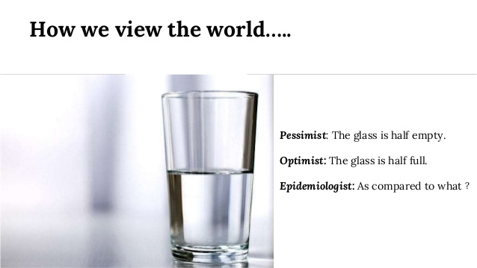

Slide 4
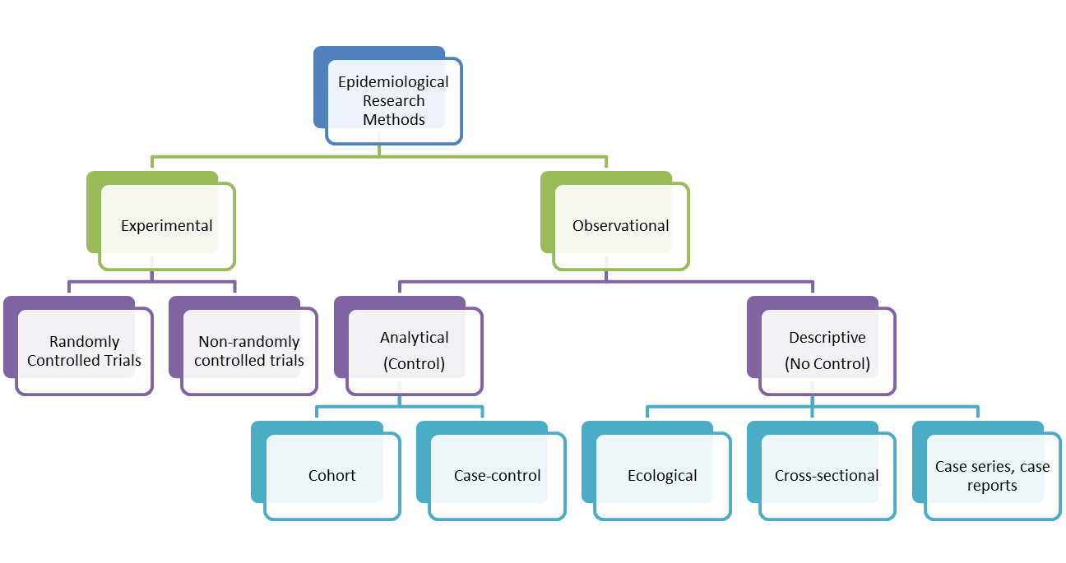
Type of Epidemiological Studies

Slide 5
Observational study
Is one in which information is collected without changing the environment
(i.e. nothing is manipulated).
It may be 1- Descriptive
2- Analytic

Slide 6

1-Descriptive
Studies entail the Collection, Describing and Interpretation
of data.

Slide 7

The distinctive feature of this approach is that its primary concern is with Description rather than with the testing of hypotheses or proving causality.
By descriptive study we can
generate hypothesis or add further information.

Slide 8
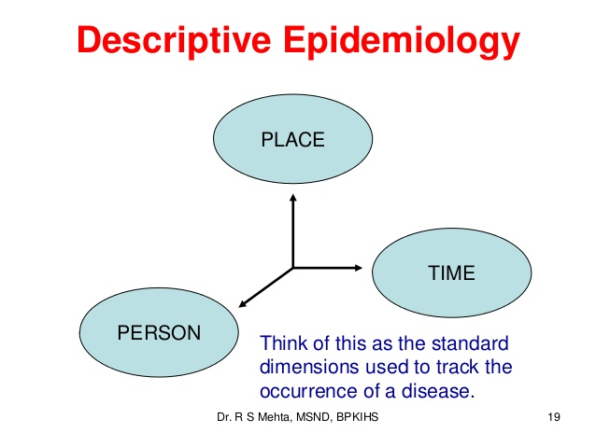
These studies basically ask the questions:
1- Who is getting the disease? (Person distribution)
2- Where is it occurring? (Place distribution)
3- When is the disease occurring? (Time distribution)

Slide 9
Describing the disease in terms of person, place and time
(Some characteristics):
Person |  | Place | Time
Age | Birth order | Climatic zones | Year, season
Sex , race | Family size | Country, region | Month, week
Marital status , immunity | Height, weight | Urban, rural | Day & hour of onset
Occupation, addictions, social status, education | Blood pressure, blood cholesterol personal habits like brushing of teeth, smoking | Towns, cities, institutions | Duration of illness

Slide 10
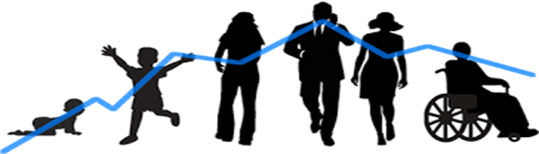
Person distribution
Age: Age is probably the single most important person’s attribute because almost every health-related event or state varies with age.
Certain diseases are more frequent in certain age groups than others- e.g. Measles in childhood, Cancer in middle age, Atherosclerosis in old age etc.
“Bimodality “means a particular disease is common at two age groups e.g. Hodgkin's disease, leukemia and female breast cancer.

Slide 11
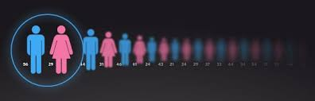
b. Sex: Some diseases are more common in women than men
e.g. chronic diseases such as hyperthyroidism & obesity
and others in men such as lung cancer and coronary heart disease.
This may be due to differences in life style and behavioral factors

Slide 12

C.Marital status (single, married , divorced ?)
It has been found that mortality rates were lower for married males and females than unmarried of the same age and sex.
Marital status may be the risk for some disease.

Slide 13

D. Occupation
Occupation may alter the habits of employees
e.g. sleep, alcohol, smoking, drug addiction, etc.
It is obvious that persons working in a particular occupation are exposed to particular types of risks
e.g. Workers in coal mines are more likely to suffer from silicosis,
Sedentary workers face the risk of heart disease, etc
Tennis elbow. Allergy. Hearing loss. Asthma.

Slide 14

E. Social class
Individuals in the upper social classes have longer life expectancy and better health and nutritional status than those in the lower social classes,
Certain diseases (e.g CHD, hypertension, diabetes) have shown a higher prevalence in upper classes than in the lower classes.

Slide 15

F. Life style
Risk factors in non-communicable diseases such as CHD, cancer, obesity and accidents are commonly due to change in behavior
e.g. cigarette smoking, sedentary life, over-eating and drug abuse.
This leads to increase in the disease frequency.

Slide 16
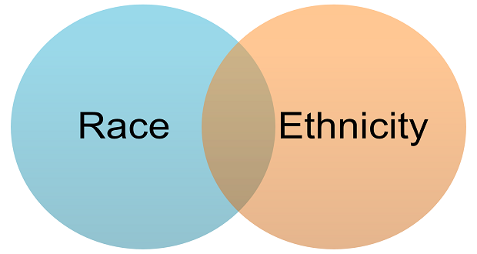
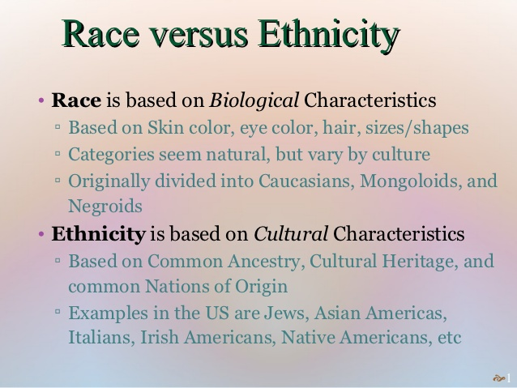
G. Ethnicity (Race)
Differences observed in racial, ethnic, or other groups may be due to their susceptibility or exposure, or other factors that might have increased the risk of developing disease(s), such as socioeconomic status and access to health care.

Slide 17
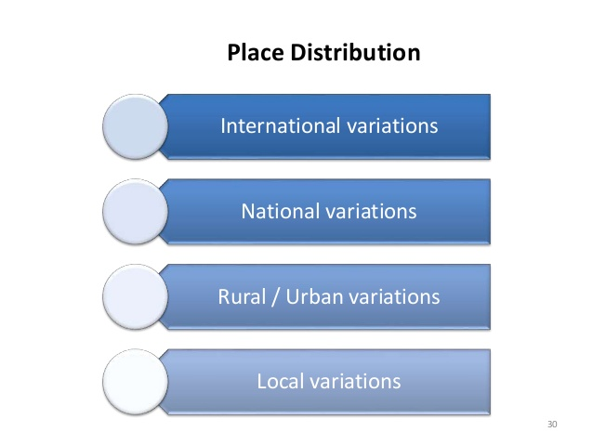

Slide 18
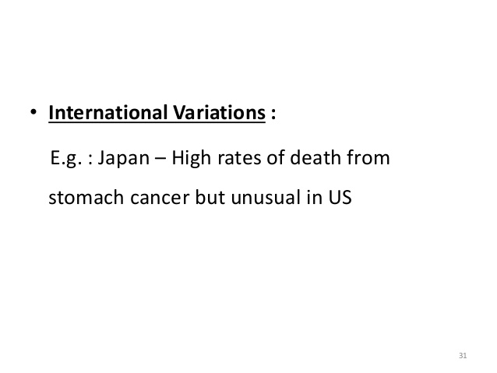

Slide 19
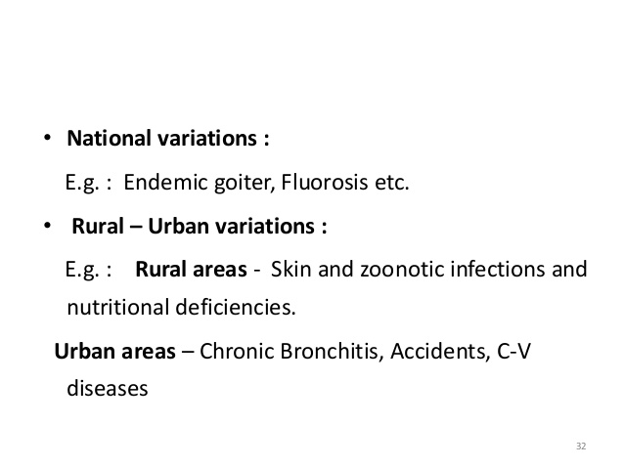

Slide 20
Local variation
These variations can be studied with the help of
“spot or shaded “ maps
If the map showed clustering it may suggest a common source of infection.
e.g. Study of cholera epidemic by John Snow in 1854

Slide 21
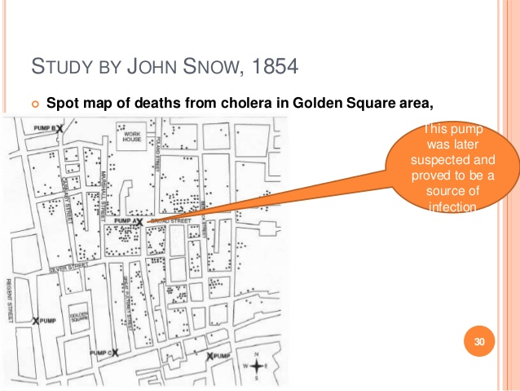

Slide 22
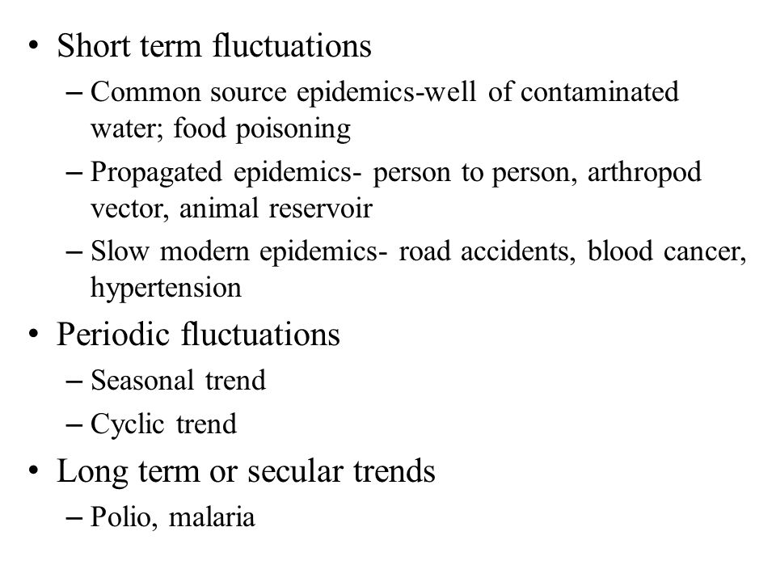
Time Distribution

Slide 23
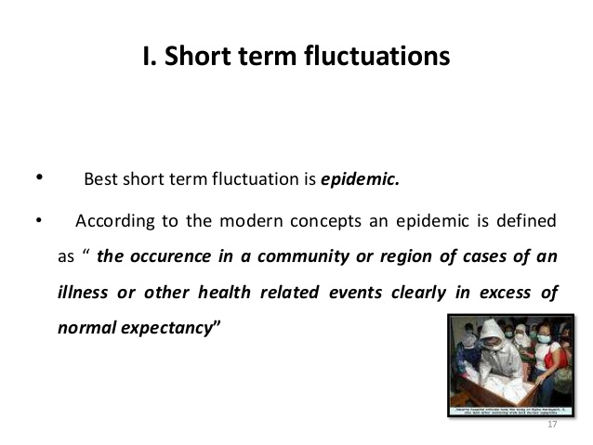

Slide 24
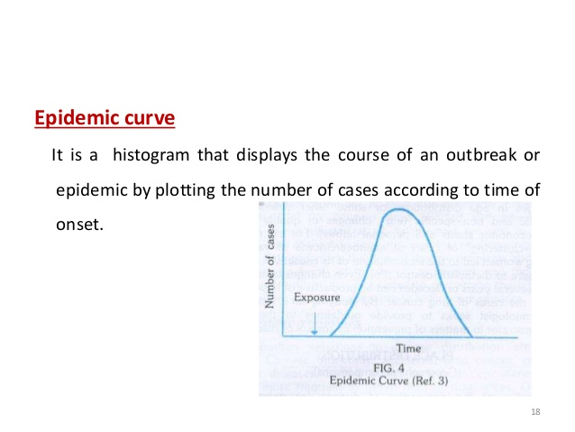

Slide 25
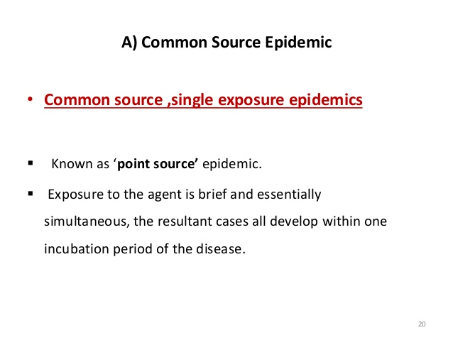

Slide 26
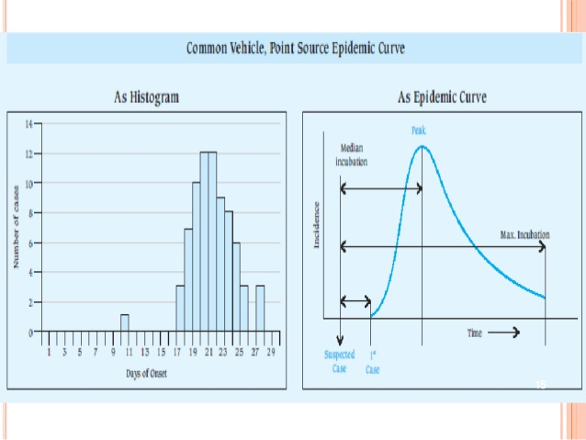

Slide 27
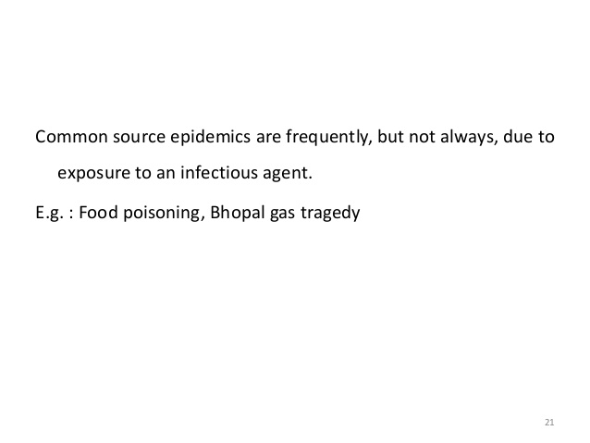

Slide 28

The Bhopal disaster,, was a gas leak incident on the night of 2–3 December 1984 at the Union Carbide India Limited pesticide plant
in Bhopal.
It is considered to be the world's worst industrial disaster.

Slide 29
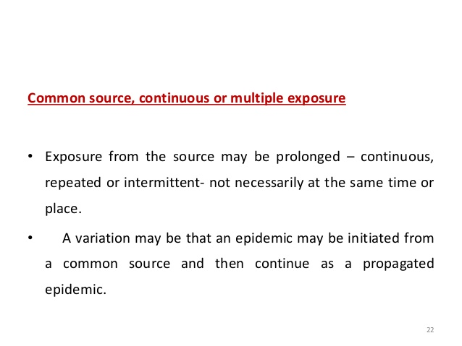
e.g. water from contaminated well

Slide 30
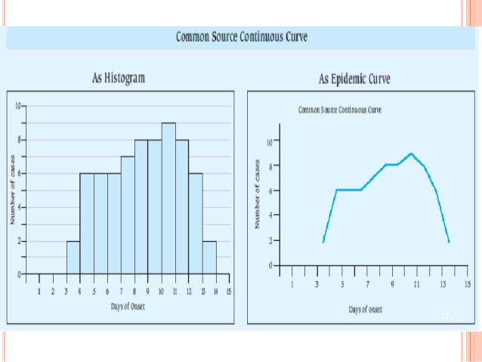

Slide 31
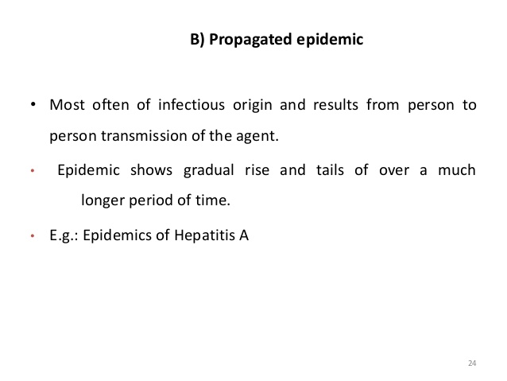

Slide 32
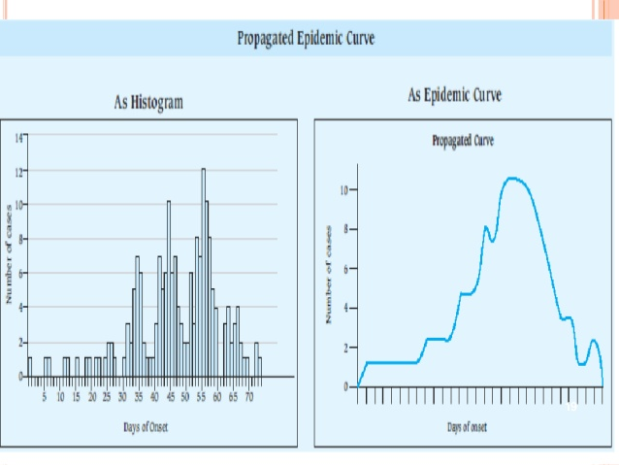

Slide 33
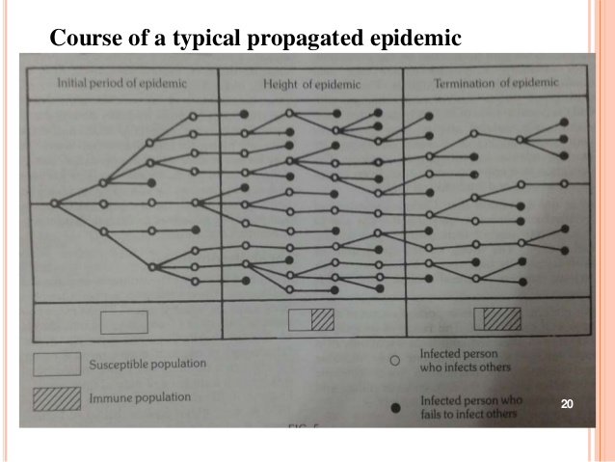

Slide 34
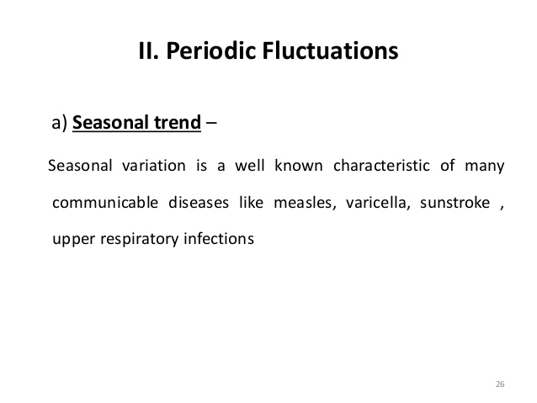

Slide 35
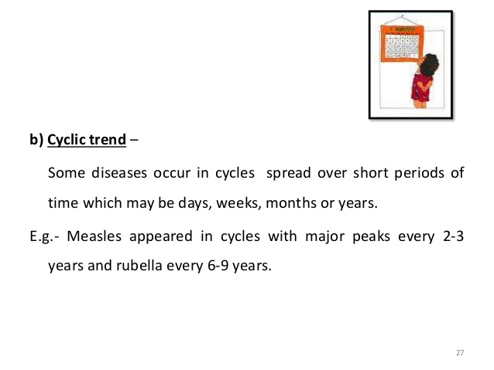

Slide 36
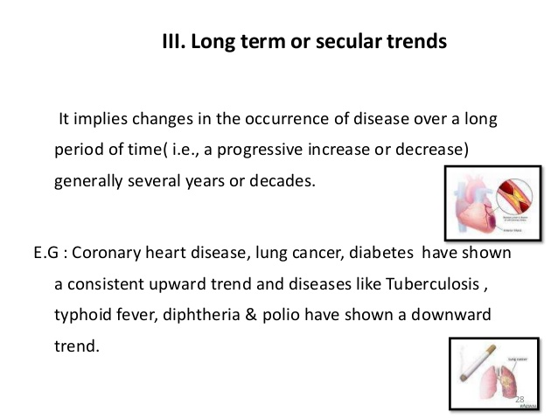

Slide 37
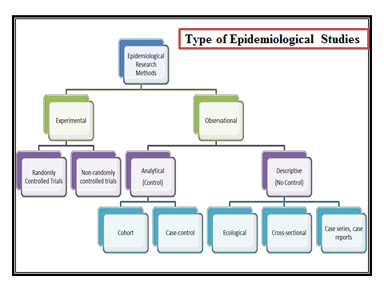

Slide 38
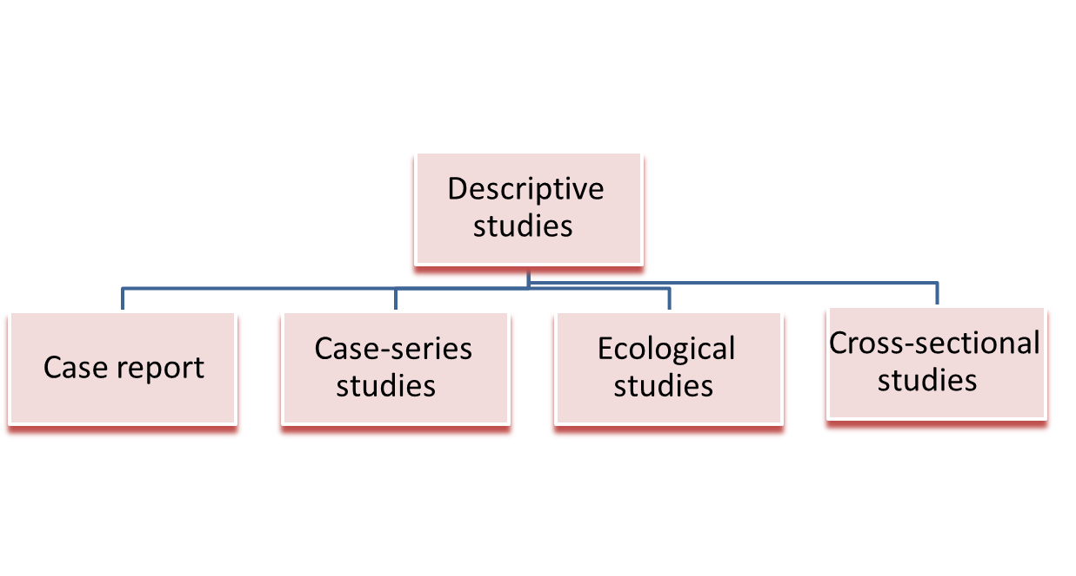
Types of Descriptive Studies

Slide 39
1-Case report
Detailed presentation of a single case
Generally report a new or unique finding
e. g Previous undescribed diseases
Unexpected link between diseases
Unexpected new therapeutic effect
No statistical analysis or comparison group is included in the design

Slide 40
2-Case series
Experience of a group of patients with a similar diagnosis
Cases may be identified from a single or multiple sources
A realistic design for rare disorders
A case-series is, effectively, a register of cases.
Analyse cases together to learn about the disease.
Studying symptoms, signs, complications, management ..etc.
Used in clinical education, audit and research

Slide 41
3-Cross sectional study
Cross-sectional study is also known as
“Prevalence study".
Is a type of observational study that analyzes data from a population, at a specific point in time
- Is the simplest of all the observational studies.
- The results can be projected on the whole population provided the sampling has been done correctly.
- Is more useful for chronic than acute disease
- It tells us about the distribution of a disease in population rather than its etiology

Slide 42
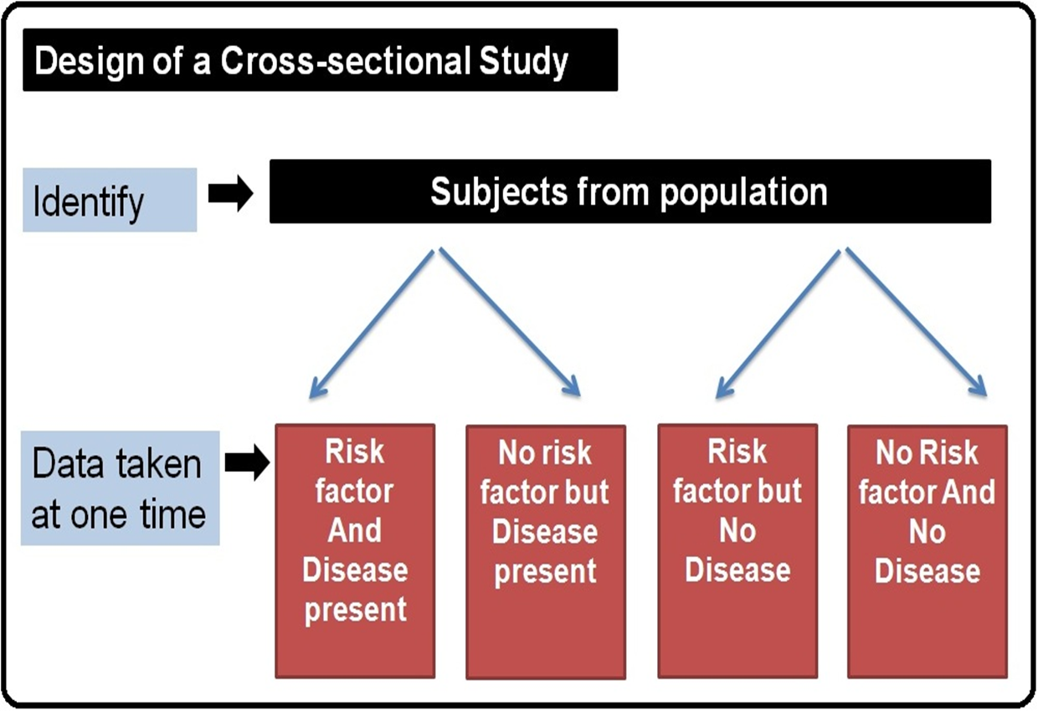

Slide 43

4- Correlation studies
Study uses data from entire populations to compare disease frequency between different groups during the same period of time or in same population at different
points in time
e.g. No. of cigarettes smoked per day
and annual lung cancer deaths

Slide 44
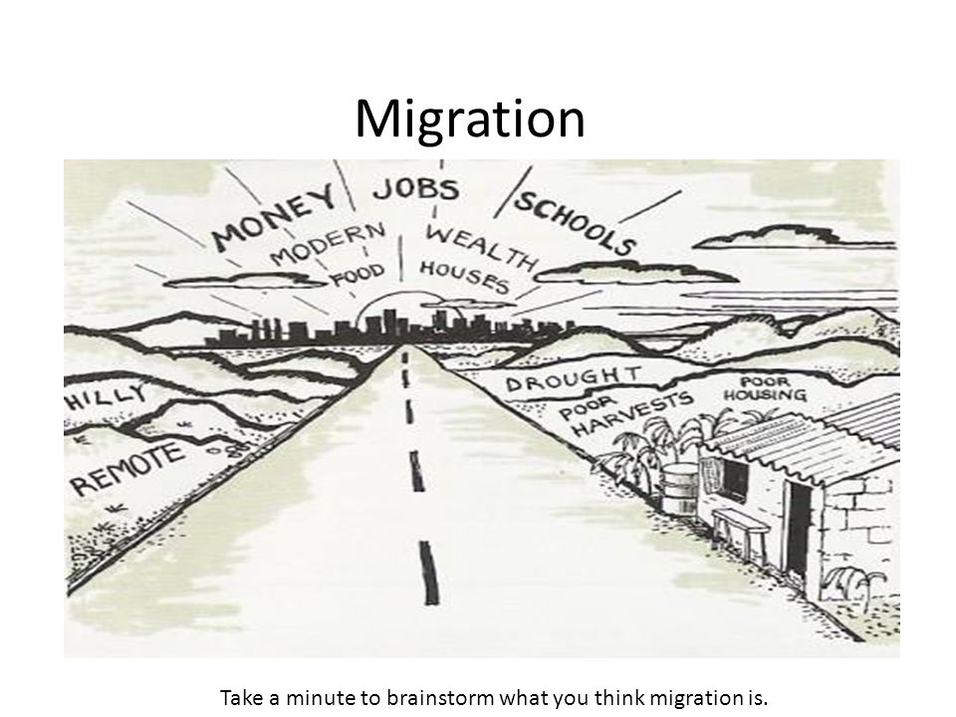
5- Migration studies
Is to study the effects of migration on the frequency of disease occurrence.
These studies help clarify whether a disease of unknown cause is determined principally by genetic inheritance or by
environmental exposure.
e.g. Japanese immigrants to USA
Notes:
e.g Japanese immigrants to USA

Slide 45

Thank you

Slide 46
Case – Control study
Dr. Amina Elsaid
Community Medicine

Slide 47

2- Analytical Epidemiology
Second major type of epidemiology
Objective not formulate hypothesis but to test
hypothesis
1- case control study
2- cohort study

Slide 48
Case – control study
- It called retrospective study
- A study that compares patients who have a disease or outcome of interest (cases) with patients who do not have
the disease or outcome (controls),
- It looks back retrospectively to compare how frequently the exposure to a risk factor is present in each group to determine the relationship between the risk factor and the disease.

Slide 49
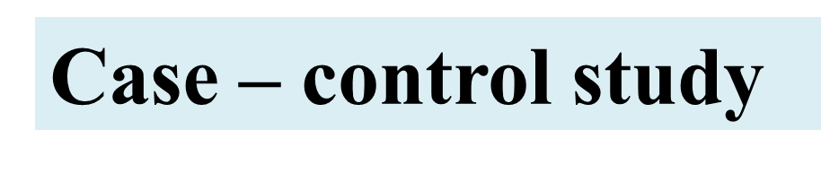
The objective is to test causal hypothesis
-Both cause and outcome (disease) have occurred before doing the study
-Proceeds backwards from effect to cause

Slide 50
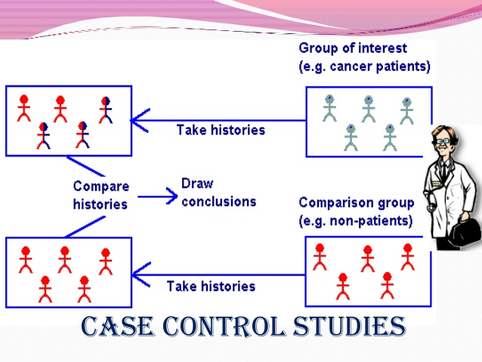

Slide 51
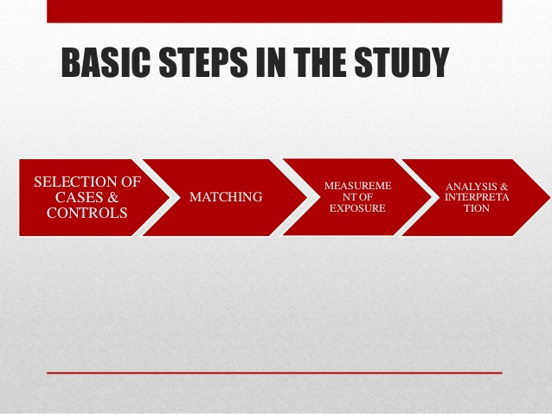
Steps in a Case Control study

Slide 52
I- a- Selection of Cases
- Cases selected should have the correct diagnosis
- Only cases with the confirmed diagnosis should be included
General population
Sources of cases
Hospitals

Slide 53
I- b- Selection of Controls
Control must be ideally matching with the cases by age, sex and other characteristic except the control must not be suffering from disease
Hospitals (patients having other disease)
Sources of controls
Neighborhood controls
Relatives
General population
How many controls will you take for a case?
In large studies generally 1
In small studies (below 50) 2 to 4 for each case

Slide 54
II-Matching
- Matching is a process by which we select controls in a such a way that they are similar to cases in important variables
Age, Sex, Occupation etc.

Slide 55
Matching - examples
For studying Lung cancer the Controls should be males and not females
For studying Lung cancer the Controls should be adult males and not young boys
For studying Breast cancer the controls should be females and not males!
For studying Breast cancer the controls should be adult females and not young girls

Slide 56
III-Measurement of exposure to cause
-There must be a clear definition for the risk factor.
-That should be same for Cases and Controls
e.g. Smoking
No. of cigarettes,
Duration of smoking
Type of cigarette etc.

Slide 57
IV-Analysis
Calculate exposure rates among cases and controls
Calculate the disease risk associated with exposure (Odds ratio)
2x2 design | Cases (Disease+) | Control (Disease-)
Risk factor present(+) | a | b
Risk factor absent (-) | c | d
 | a+c | b + d

Slide 58
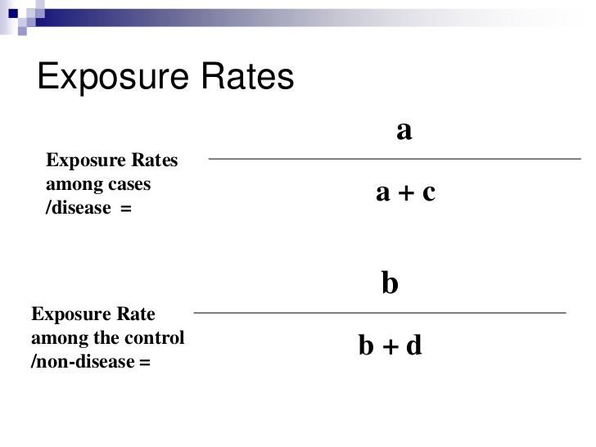

Slide 59
Analysis
Cases (Lung cancer +)
Controls ( No lung cancer)
Smoking +
33(a)
55(b)
Smoking -
2(c)
27(d)
35(a+c)
82(b+d)
Exposure rate to smoking
Cases = a / a+c 33/35 = 94.2%
Controls = b / b+d 55/82 = 67%

Slide 60
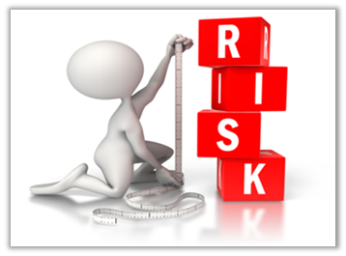
Estimation of risk
Those who are having lung cancer are smoking more(94.2%)
However it does not mean that 94.2% of all smokers will develop lung cancer.
We estimate risk to develop lung cancer in smokers by calculating ‘Odds ratio’

Slide 61
Odds ratio
Odds ratio is calculated to estimate the risk of disease among those who are exposed to the cause
Odds ratio = ad / bc
33 x 27 / 55 x 2
= 8.1
Those who smoke have 8.1 times the risk of developing Lung cancer than those who do not smoke
If the odds ratio is (1) means No risk

Slide 62
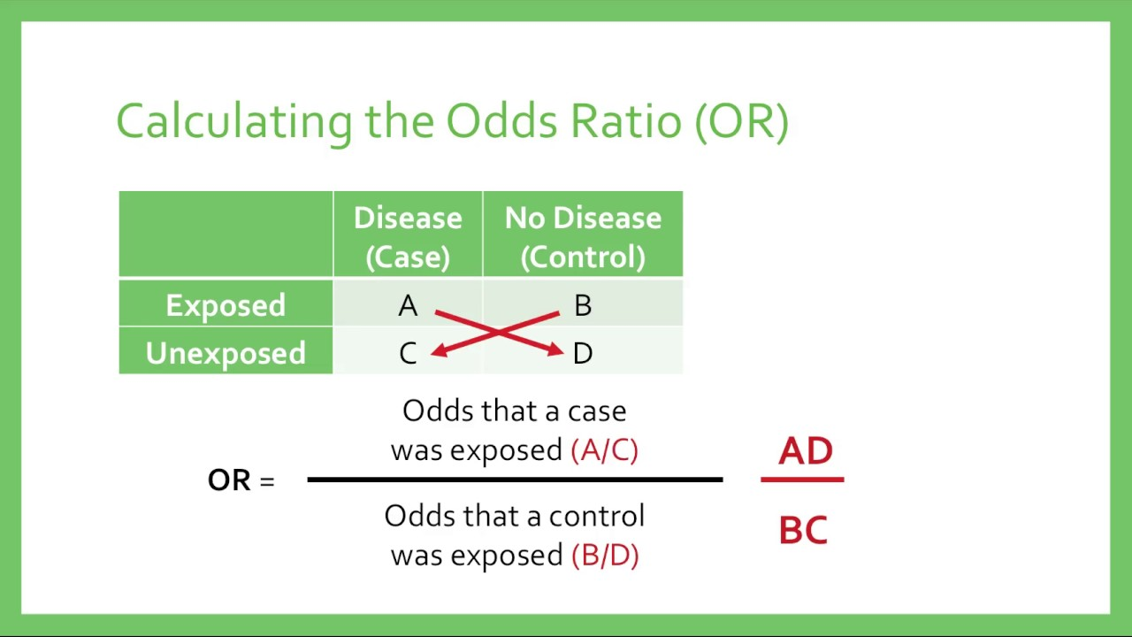

Slide 63
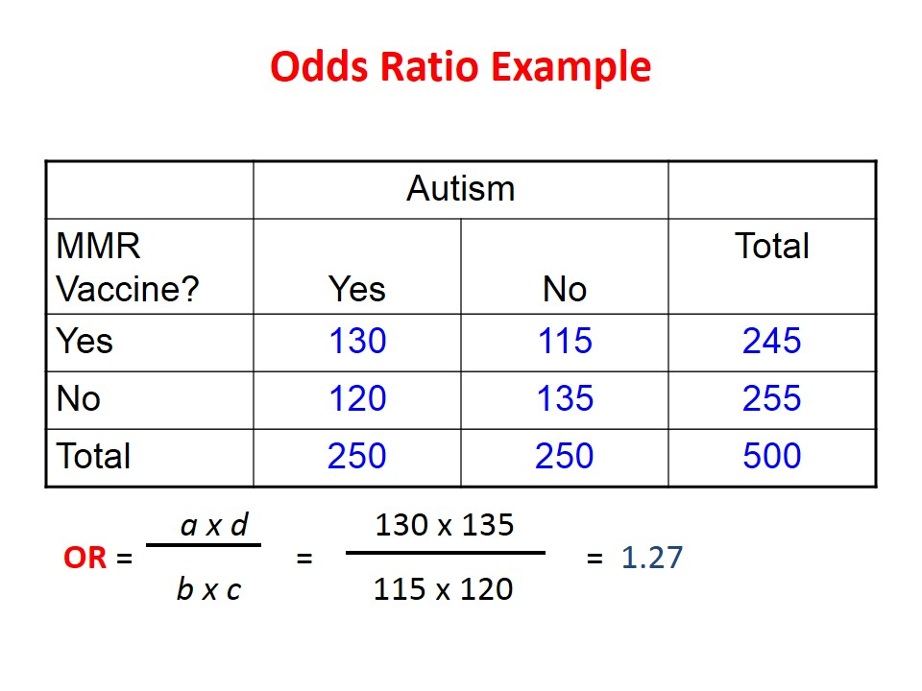

Slide 64
Thank you

Slide 65
Cohort Study
Dr. Amina Elsaid
Community M edicine

Slide 66
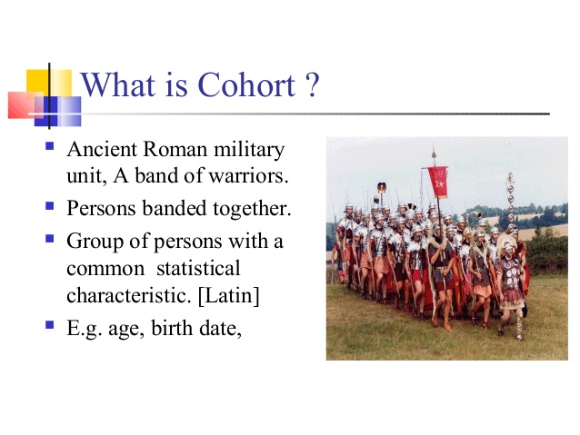
Cohort
Is a group of people who share a common characteristic or experience
People born on a same day
Students who joined college in a year
Students from Benghazi, students from Albida
People doing same work e.g. doctors

Slide 67
2-Cohort study
- Also called Prospective study or Incidence study or longitudinal study.
The study is done on people before the disease occurs
The study group are observed over a period of time to determine the frequency of disease among them
Proceeds from cause to effect

Slide 68
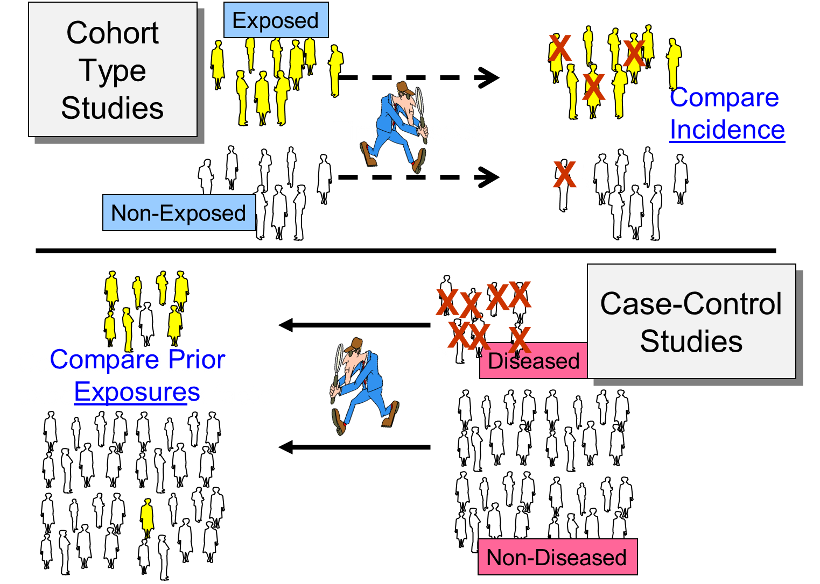

Slide 69
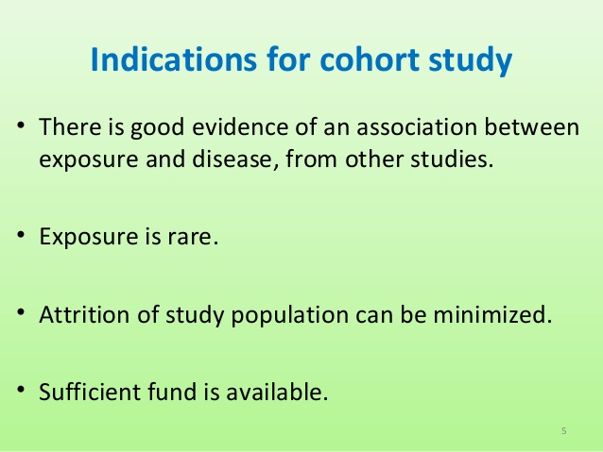

Slide 70
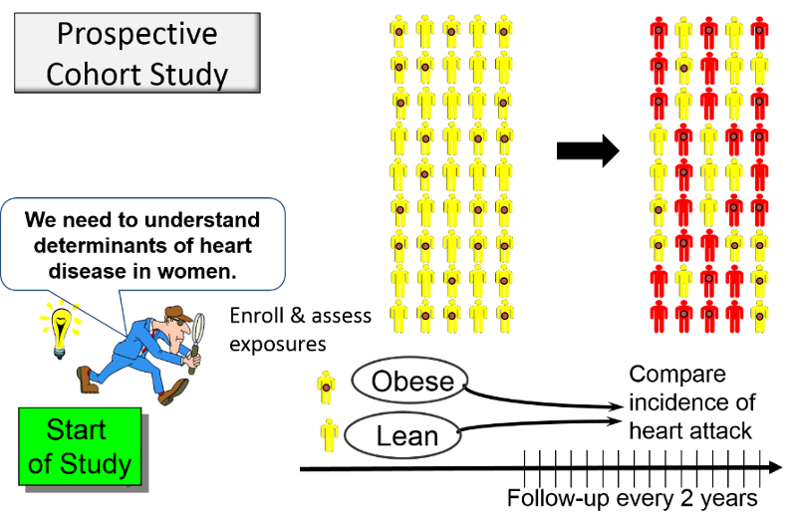

Slide 71
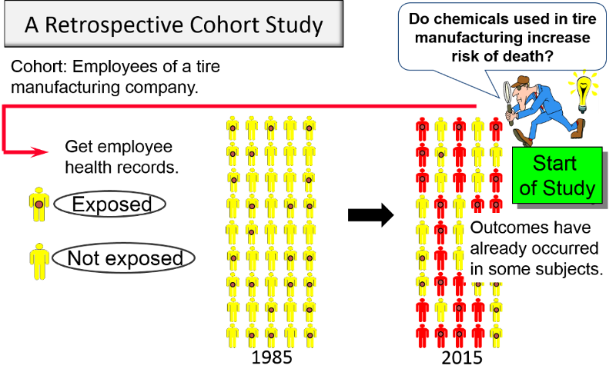

Slide 72
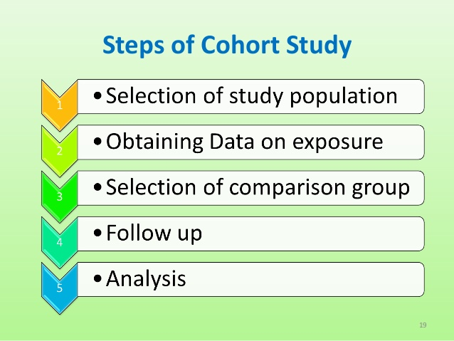

Slide 73
1-Selection of Study Cohort
They are selected from general population or from specific groups e.g. Doctors, students etc.
Members of the study cohort must NOT have the disease
Members of the study cohort must be exposed to the risk factor
General population e.g Framingham heart study
Special groups
* Select groups e.g doctors,nurses ,lawyer
*Exposure groups e.g radiologists exposed to X rays

Slide 74
2- Obtaining data on exposure
Cohort members: interviews or mailed questionnaires e.g Doll &Hill.
Review of records: Information can be obtained from medical records
Medical examination or special tests: e.g BP, ECG
Environmental surveys: exposure levels of suspected factors in environment where the cohort lived or worked.

Slide 75
3-Selection of control group
- Members of the control cohort must NOT have the disease
- Members of the control cohort must NOT be exposed to the risk factor
Members of the control cohort must be similar to the study cohort in age, sex etc.

Slide 76
4-Follow up
- Both the Study cohort and Control cohort is followed up to see how many develop the disease
This is done by
Medical examination
Personal visit, Phone call etc.
Follow up is difficult because some persons will not respond, or losses to follow –up (Attrition)

Slide 77
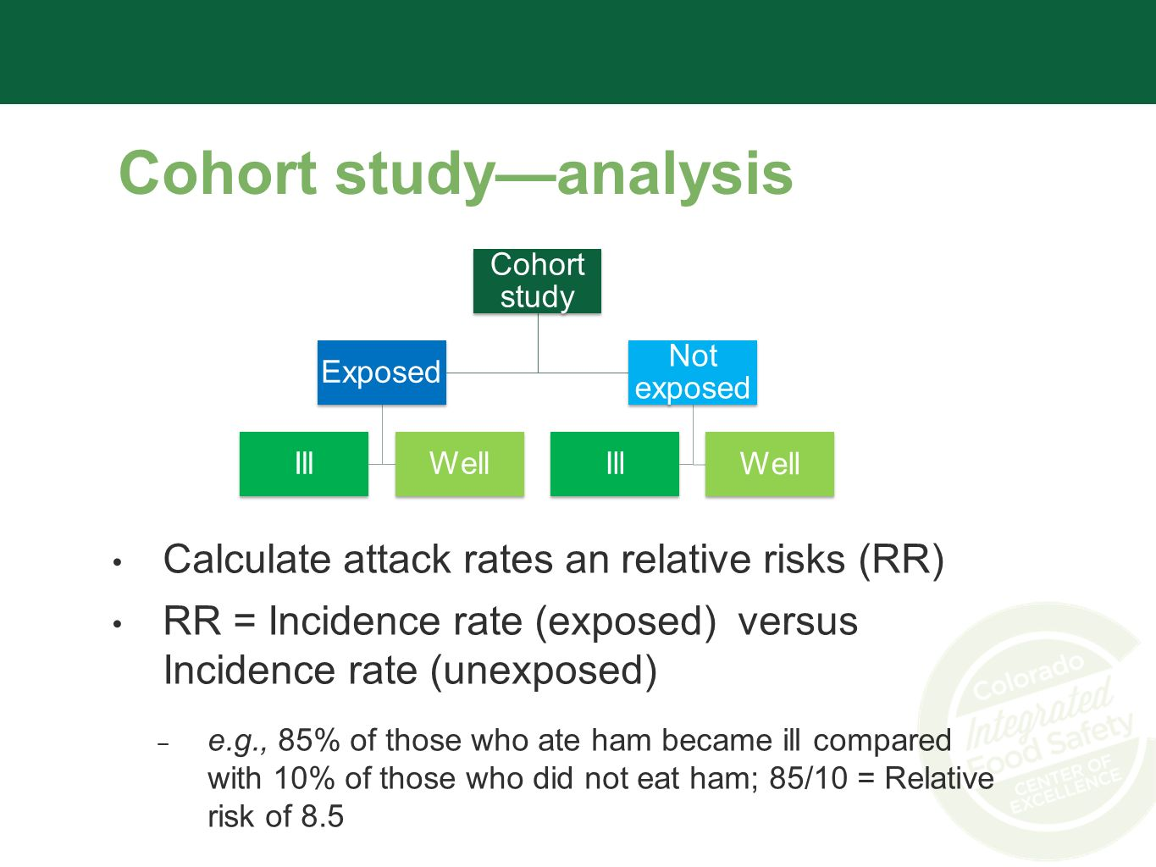
5-Analysis
A- Incidence rates of outcome among exposed and non- exposed
B- Estimation of risk

Slide 78
Smoking and Lung cancer
 |  |  | 7000 a+b
 |  |  | 3000 c+d
 | a+c | b+d
Disease +
Lung cancer +
Disease –
No Lung cancer
Study Cohort
Smoking +
70
(a)
6930
(b)
Control Cohort
Smoking -
3
(c)
2997
(d)
Incidence rate among smokers = 70/7000 = 10 per 1000
Incidence rate among non-smokers = 3/3000 = 1 per 1000

Slide 79

Incidence of disease among exposed
Incidence of disease among non-exposed
10/1= 10
Relative risk of 10 means that those who smoke have 10 times more risk of developing lung cancer than those who are not smoking
If relative risk is 1 that means there is No risk
Relative risk =
Relative risk

Slide 80
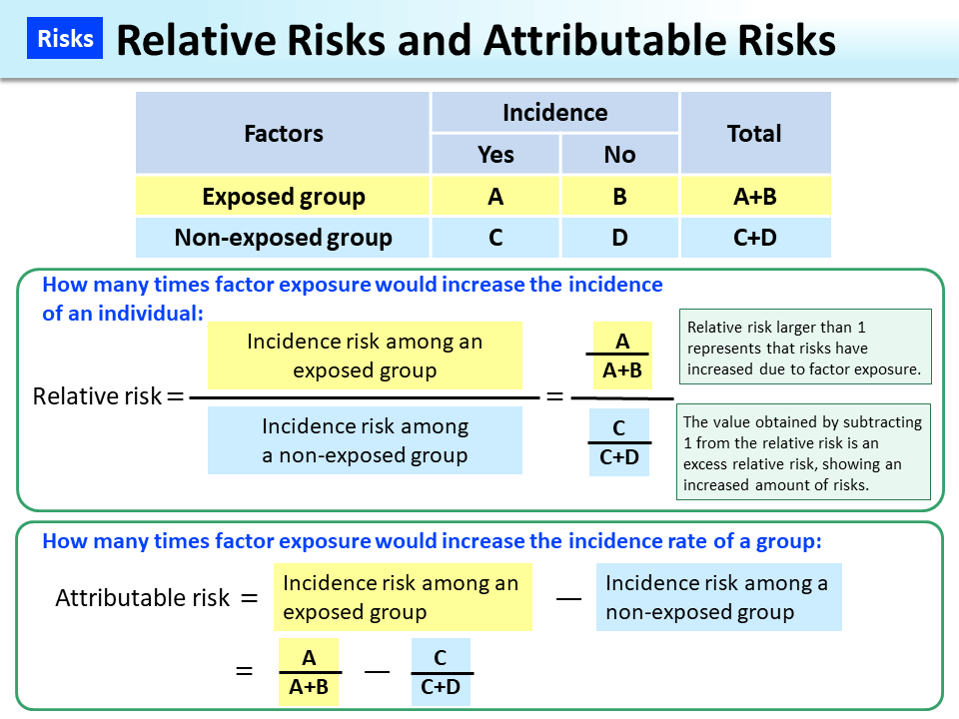

Slide 81
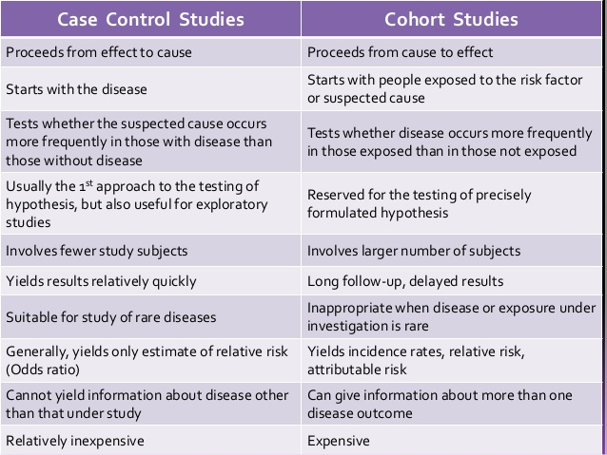

Slide 82
Thank you

Slide 83
Experimental Epidemiology
Dr.Amina Elsaid
Community Medicine

Slide 84
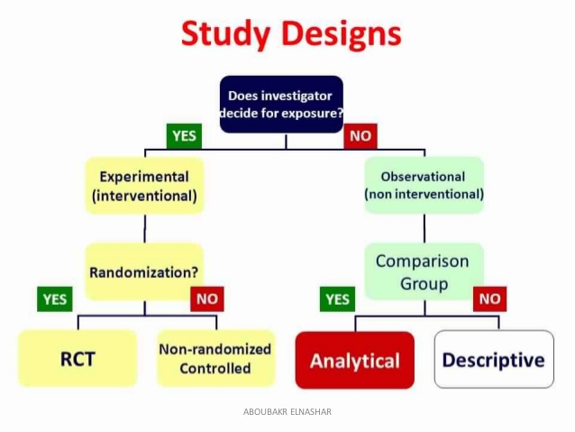

Slide 85
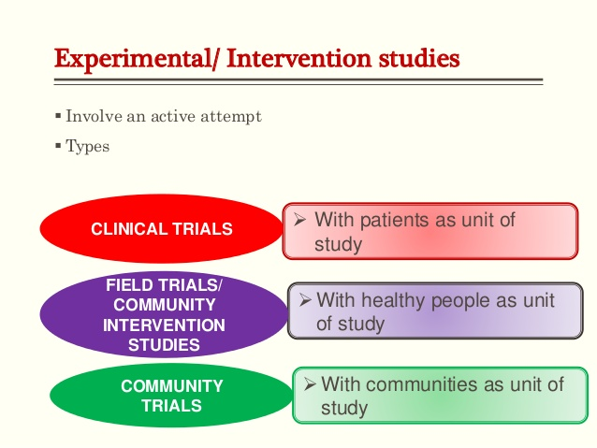

Slide 86
Clinical trial
You select two groups of patients and give the new medicine to study group and the old medicine to control group
You see how many patients of the study group got cured and how many of the control group got cured
Then do analysis to see whether the new drug is better than the old one

Slide 87
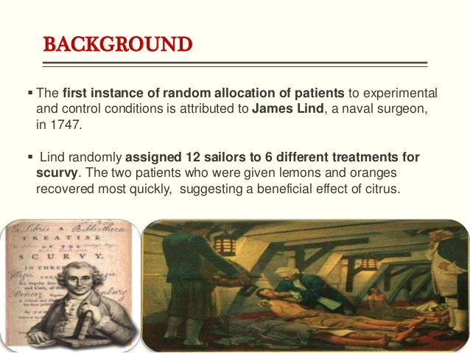

Slide 88
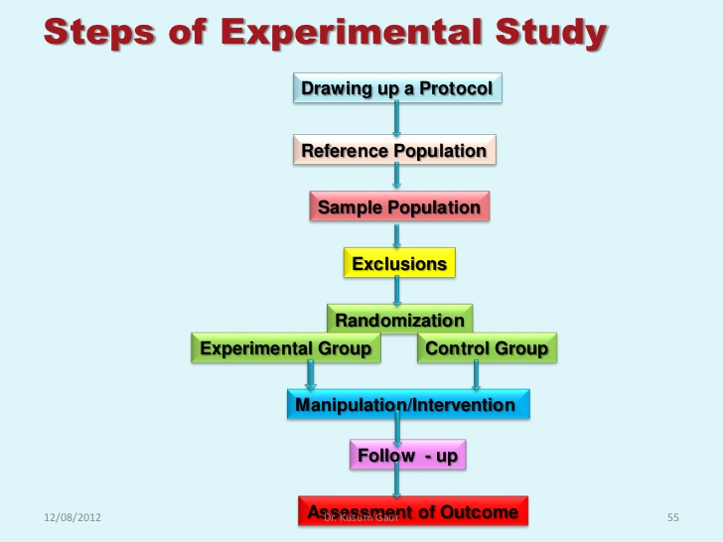

Slide 89
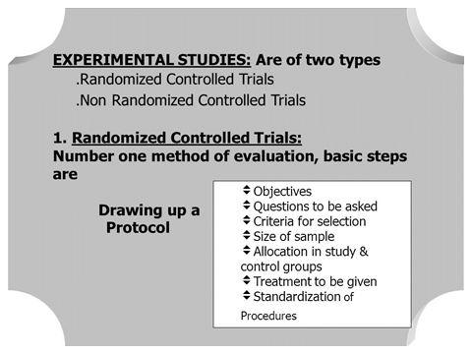

Slide 90


Slide 91


Slide 92


Slide 93


Slide 94


Slide 95


Slide 96


Slide 97

Bias in RCT
Subject variation : participants may feel better or report improvement if they knew they were receiving a new form of treatment
Observer bias : investigator measuring the outcome of a trial may be influenced if he knows beforehand the particular
procedure to which the subject has been subjected
Bias in evaluation: investigator may subconsciously give a favorable report of the outcome of the trial

Slide 98
Binding
The best way to protect a trial against biases is by keeping the people involved in the trial unaware of the identity of the interventions for as long as possible
Single Blind:- participant does not know which treatment received
Double Blind:- Doctor and participant, both do not know which treatment received
Triple Blind:- person analyzing the data, Doctor and participant, all do not know which treatment received

Slide 99

Meta-analysis
a quantitative, epidemiological study design used to systematically assess the results of previous
research to derive conclusions about that body of research.
You can definitely do a meta-analysis using 9 studies, as long as you've exhausted your search.
Theoretically you can do a meta-analysis with
only 2 or 3 studies

Slide 100
Is meta analysis better than RCT?
The primary difference between a randomized controlled trial and meta-analysis is that the former “provide the highest level of evidence because they contain the least amount of bias. Randomized controlled trials reduce bias, while meta-analyses increase bias,”

Slide 101


Slide 102
Thank you

