Slide 1


Types of Self Perception Concepts and It’s Stages
By:Mahmoud Fathi Gargoum
Mahmoud_2859@limu.edu.ly
2859
1
Notes:
Links:
https://www.pexels.com/photo/view-of-high-rise-buildings-during-day-time-302769/

Slide 2

CONTENT
Introduction
Self Concept
Self Awareness
Self Esteem
The five stages of perceptions
2
Conclusion
References

Slide 3

INTRODUCTION
Self-Perception is an image we hold about our self and our traits and the judgements we make about those traits.
Self-perception includes Self-concept self-esteem and self awareness
3

Slide 4

Self Concept
Self-concept is the image that we have of ourselves.
It’s is how you perceive your behavior, abilities, and unique characteristics .
4
Notes:
Links:
https://www.pexels.com/photo/photo-of-people-near-wooden-table-3184418/

Slide 5


6
Self Esteem
Self-esteem (also known as self-worth) refers to the extent to which we like, accept or approve of ourselves, or how much we value ourselves.
5

Slide 6

Self Awareness
Self-awareness is how an individual knows and understands their own character, feelings, motives, and desires.
People who are self-aware recognize their strengths and their challenges.
6

Slide 7
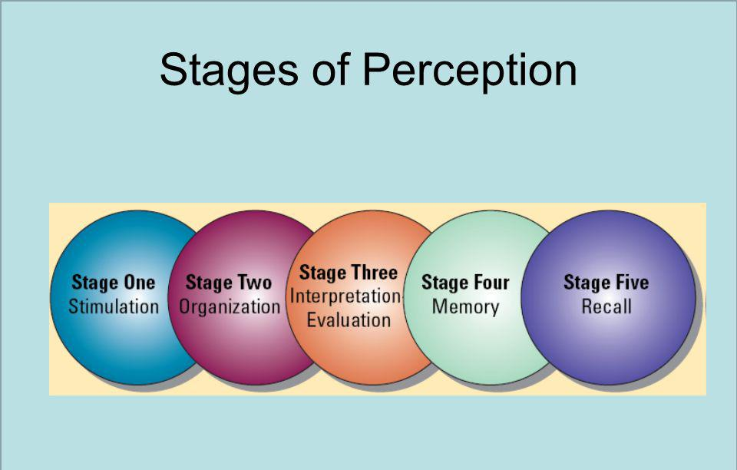
The five stages of perceptions
Perception refers to the way individuals experience or give meaning to information and events, and perception differs from person to person.
There are five states of perception which are: -
Stimulation.
Organization.
Interpretation.
Memory.
Recall.
7

Slide 8
CONCLUSION
As you age and learn who you are and what's important to you, these self-perceptions become much more detailed and organized.
8

Slide 9
REFERENCES
Mcleod, S. (2008, January 1). Self Concept | Simply Psychology. Self-Concept. Retrieved November 3, 2021, from
https://www.simplypsychology.org/self-concept.html
1
Morin, A. (2021, July 9). What is self-awareness? . Retrieved November 3, 2021, from https://www.understood.org/articles/en/the-importance-of-self-awareness
2
All Answers Ltd. (2021, August 12). The Five Stages of Perception. Retrieved November 3, 2021, from https://www.ukessays.com/essays/psychology/definition-and-the-five-stages-of-perception-psychology-essay.php
3
9
Notes:
Links:
https://www.pexels.com/photo/photo-of-people-holding-each-other-s-hands-3184434/

Slide 10
THANK YOU!
10
Notes:
Links:
https://www.pexels.com/photo/view-of-high-rise-buildings-during-day-time-302769/

