Slide 1


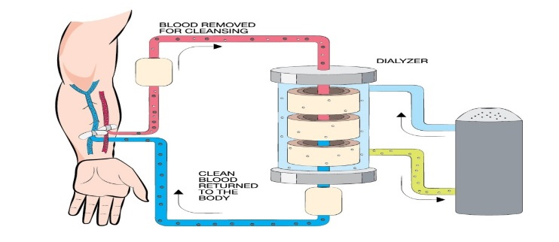
Serologic Evaluations of Hepatitis B and C Among Hemodialysis patients Nephrology Center of Benghazi
Libyan International Medical University
Abdulkhaliq Omer Alzwei Second Year of Basic Medical Science
Abstract
Recommendations
Hepatitis B (HBV) and C (HCV) viruses are the most important infections transmitted within the dialysis units, The present study was undertaken to estimate the prevalence of HBV and HCV among hemodialysis patient, After informing patients retrospective study was done on them between 11th February and 22nd August 2009 a number of 50 patients attending hemodialysis unites where applied to. serological testes for the presence of HBV and HCV markers by the third generation of ELISA (enzyme linked immunosorbent assay) automated System.
Table (1)
Concerning HBV infections ,the insertion of HBV vaccine is ultimately decreases the statistic no of infections and significantly optimize the control of the HBV infections Regarding HCV infections prevention, 2 approaches may be recommended: the first is decrease of duration of the hemodialysis period by possible early transplantation of suitable patients. The next is a strictly enforced isolation policy for HCV-positive patients, which may play a role in limiting HCV transmission in HD units^{1,2}
HD patients (n=50) | HBsAg | Anti-HCV
15 | + | -
25 | - | +
10 | - | -
Conclusion
Methods and Materials
The introduction of HBV vaccination ,isolation of HBV seropositive patients and the use of dedicated dialysis machines and regular procedure for controlling the HBV infections dramatically reduces the spread of HBV infections among HD patients The prevalence of HCV infections among HD is high and varies between countries (2% to 60%) and even between dialysis units within a single country ,Dual infections more aggressive liver disease there are very few reports on the prevalence of such dual infections in hemodialysis patients.
50 patients (receiving hemodialysis regularly ( rang from 8 to 12 ) months were enrolled in this study, 25 were men ,25 were women , with an average age of 41 ,HBV markers were measured in these patients and in healthy controls in order to compare the incidence of HBV and HCV infection in hemodialysis patients versus normal healthy people .All patients were then divided into three groups ,Patients have seropositive for HBV markers ( positive HBsAg , Anti HBc N=15) Patients have seropositive for HCV markers ( positive Anti-HCV N = 25) Patients have seronegative for both Anti-HCV, HBsAg( N= 10). ^{1,2,3}
Figure (1) Mechanism Of Dialysis³
References
Results
1- Fabirizi F, Lunghi G, Raffaele L, Guarnori I, Bacchini G, Corti M, et al. Serologic survey for control of hepatitis C in hemodialysis patients: Third-generation assays and analysis of costs. Nephrol Dial Transplant. 1997;12:298–303
2- Fissell RB, Bragg-Gresham JL, Woods JD, Jadoul M, Gillespie B, Hedderwick SA, et al. Patterns of hepatitis C prevalence and seroconversion in hemodialysis units from three continents: The DOPPS. Kidney Int. 2004;65:2335–42
3-Pereira BJ, Levey AS. Hepatitis C virus infection in dialysis and renal transplantation. Kidney Int. 1997;51:981–99
All of the 50 patients were screened for serologic testes and monitored for a consequent 6 months in order to determine any seroconversion during their dialysis session ,Our study shows three seroconversion cases during dialysis sessions and this is due to not restricting to the safety protocols recommended by world health organization as well as not applying the isolation protocols among those patients ,table (1) will reveal comparison results before and after this study was carried out

