Slide 1


Covid-19 and Chronic Diseases
Libyan International Medical University
Applied Medical Science
Hajer Salem Abdullah 3345
Professional and Transferbale Skills Y1
2021/2022

Slide 2
Objectives :
Define the covid-19.
List the symptoms of covid-19.
List complications of covid-19.
Describe the effect of covid-19 on chronic diseases.

Slide 3

INTRODUCTION TO CORONAVIRUS
The causative pathogen for the covid-19 first emerged in China, in December 2019, and by March 2020, it was declared a global pandemic.

Slide 4
DEFINITION TO CORONAVIRUS
Covid-19 is a disease caused by severe acute respiratory syndrome coronavirus 2 ( SARS-CoV-2 ).
Diagnostic tests for covid-19 fall into two main categories: molecular tests and serological tests.
There is no effective vaccine or specific anti-viral drug to treat serve covid-19 patients.

Slide 5
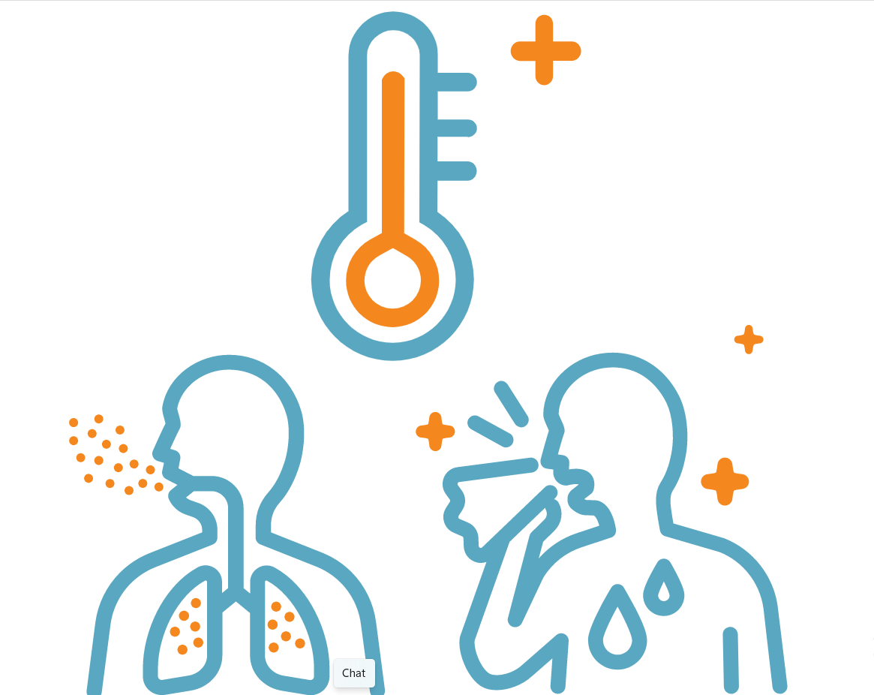
THE SYMPTOMS OF COVID-19
Common symptoms include:
Fever
Cough
feeling tired
sore throat
Runny nose
Headache

Slide 6
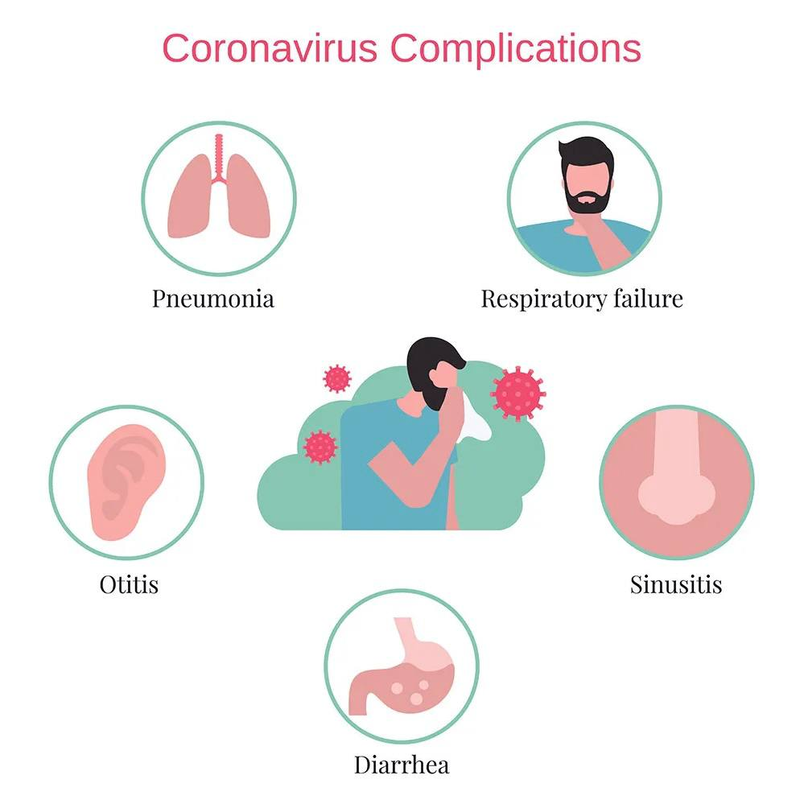
THE COMPLICATIONS OF COVID-19
The covid-19 can cause severe medical complications and even death for some people.

Slide 7
THE COMPLICATIONS OF COVID-19
Complications can include:
Lung infection and breathing problems.
Heart problems.
Blood clots.
Acute kidney injury.
Additional viral and bacterial infections.

Slide 8
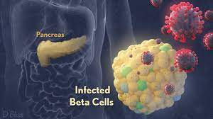
EFFECT COVID-19 ON CHRONIC DISEASES
The risk of the disease increases in people with other medical conditions (such as patients with diabetes).

Slide 9
EFFECT COVID-19 ON DIABETES
Covid-19 patients with diabetes have been observed to be more prone to developing severe infections and a higher risk of mortality compared to non-diabetics.
Diabetes is one of the most frequent comorbidities in people with COVID-19 with a prevalence that varies between 7 and 30%.

Slide 10
REFERENCE :
Taylor & Francis. 2022. Lessons learned 1 year after SARS-CoV-2 emergence leading to COVID-19 pandemic. [online] Available at: <https://www.tandfonline.com/doi/full/10.1080/22221751.2021.1898291> [Accessed 10 May 2022].
Coronavirus disease 2019 (COVID-19) - Symptoms and causes. Mayo Clinic. https://www.mayoclinic.org/diseases-conditions/coronavirus/symptoms-causes/syc-20479963. Published 2022. Accessed May 10, 2022.
article. Infezmed. it. https://www.infezmed.it/index.php/article?Anno=2021&numero=1&ArticoloDaVisualizzare=Vol_29_1_2021_20. Published 2022. Accessed May 10, 2022.
Pal R, Bhasin MK, Bhadada SK. COVID-19 and Type 2 Diabetes Mellitus: HCQ may be the Holy Grail. Infect Disord Drug Targets. 2021;21(5):e270421186842. doi:10.2174/1871526520666201013160803

Slide 11


