Slide 1




LIBYAN INTERNATIONAL MEDICAL
UNIVERSITY
FACULTY OF BISIC MEDICAL SCIENES
TYPE ONE
A b d a l k a r e m R a b e e a h 3516
MAY 2022 18
1

Slide 2
CONTENTS
Introduction
Symptoms and signs Risk Factors
Who to avoid Treatment Conclsion
2

Slide 3
"The only way to keep health to eat and drink what you donot like anddo things you often hate doing
them"
Mark Twain
3

Slide 4

Introduction
It caused by high level of glucose in the blood and it is happening when the body cannot produce insulin Harmon.
4

Slide 5
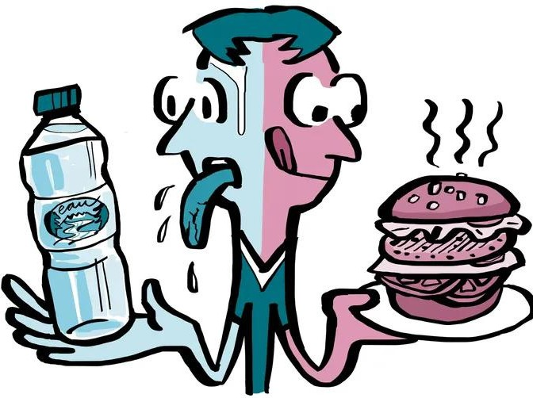




Symptoms and signs
Increased thirst Frequent urination
Bed wetting for children during the night Extreme hunger
Unintended weight loss
Irritability and other mood change Fatigue and weakness
Blurred vision

Slide 6

Risk Factors
Family hastory: If your parent or siblings affected with Type oneincreased the risk factores to get it
Age :Develops in young adults and children it is one of most common chrone disease condition although it is may occur at any age.

Slide 7
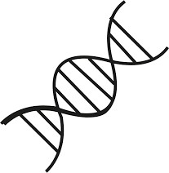
Risk Factors
Genetics: When you have specific gene type one may increase the risk factor of type and you get it .

Slide 8


Who to avoid ?
Unfortunately there no way to prevent type one diabetes but good idea to avoid Sugar drink, Fruit juice
Because they usually put blood glucose level up very hight and quicklys.

Slide 9
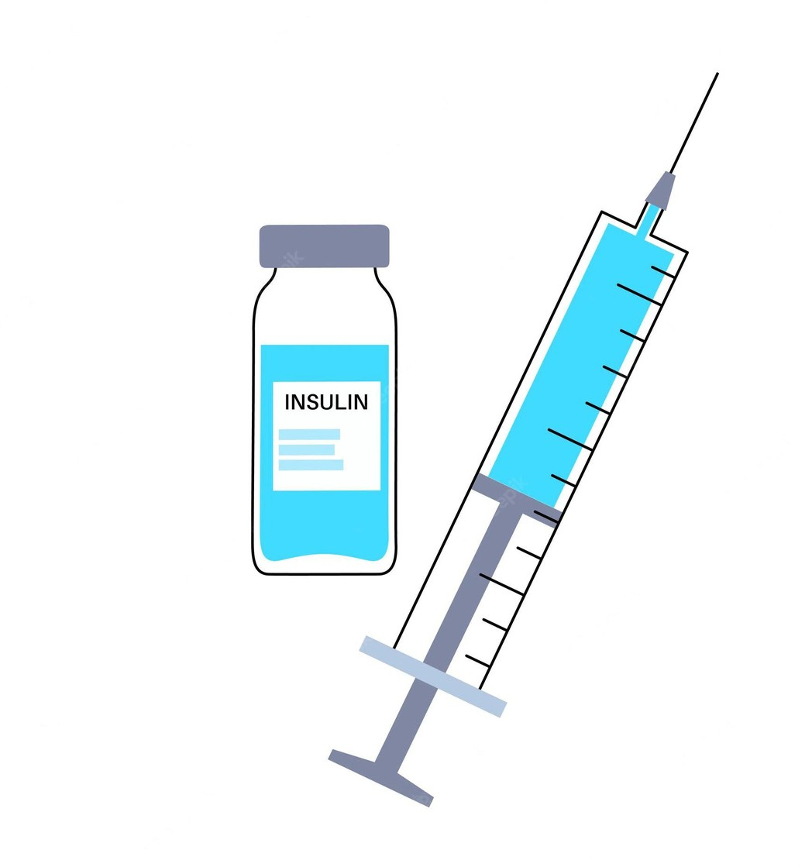
Treatment
You can make controlled by:
Managed with in insulin. Exercises.
Diet.
You most be leader for healthy life style

Slide 10

Conclusion
Today we are covering most common interisting disease (diabates type one) every one from you dr because you know
symptomes and signs risk factors
avoid
Although there is not treatment the key is between our hand
( prevention is better than thousand treatment ).
10

Slide 11
References
Mayoclinic.org. 2022. Type 1 diabetes - Diagnosis and treatment - Mayo Clinic. [online] Available at:
<https://www.mayoclinic.org/diseases-conditions/type-1-diabetes/diagnosis-treatment/drc-20353017? fbclid=IwAR1EvXdqeybw46mmDZLpa04PzoojC3bwsFq4JGwHb_Y5zlrsh2f4k7eLU7I> [Accessed 17 May 2022].
Mayoclinic.org. 2022. Type 1 diabetes - Diagnosis and treatment - Mayo Clinic. [online] Available at:
<https://www.mayoclinic.org/diseases-conditions/type-1-diabetes/diagnosis-treatment/drc-20353017? fbclid=IwAR1EvXdqeybw46mmDZLpa04PzoojC3bwsFq4JGwHb_Y5zlrsh2f4k7eLU7I> [Accessed 17 May 2022].
11

Slide 12
12

