Slide 1



Libya International University Faculty Of Business Administration
The Nature of Interpersonal Communication

Slide 2
TABLE OF CONTENTS :
01
Introduction
02
Company Culture
03
04
Change Management
Problem Solving
05
Conclusion
06
References

Slide 3

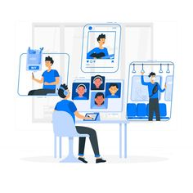


Introduction :
Interpersonal communication is the process of exchange of information, ideas and feelings between two or more people through verbal or non-verbal methods.

Slide 4
Learning Objectives:
Discuss the Nature of Interpersonal Communication

Slide 5

Company Culture:
When employees possess good interpersonal communication skills, organizational culture becomes more synergic and positive.

Slide 6


Change Management:
Good interpersonal communication is very important during change management efforts within organizations.
Effective employee communication helps employees better understand the change, align with it and collaboratively work towards implementing the change successfully.

Slide 7


Problem Solving:
Interpersonal communication skills are necessary because they allow people to discuss problems and weigh the pros and cons of alternatives before coming up with the final solution.

Slide 8
Conclusion:
Communication is the process of transmitting information and common understanding from one person to another.
Every organization, regardless of industry or country, seeks to be more effective and achieve superior results.

Slide 9
References:
Interpersonal Communication. (2020, July 2). Google. Retrieved October 19, 2021, from https://blog.smarp.com/interpersonal-communication-definition-importance-and-must-have-skills

Slide 10


