Slide 1


Immunization (vaccines)
Presented by :Nour yahia elfalah
3582
Date: 4th/6/2022
1St Year
PTS Block
Instructor : Muataz mazwghi

Slide 2
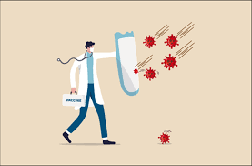
Objectives
Define
vaccine.
List
the types of vaccines.
Discuss
how does the vaccine work.
Discuss
the importance of vaccination.
Discuss
how the vaccines developed
Discuss
the side effect of vaccine

Slide 3



Slide 4

Vaccination
Vaccination : is a method of giving antigen to stimulate the immune response through active immunization.
A vaccine is an immuno-biological substance designed to produce specific protection against a given disease.
A vaccine is antigenic but not pathogenic.

Slide 5
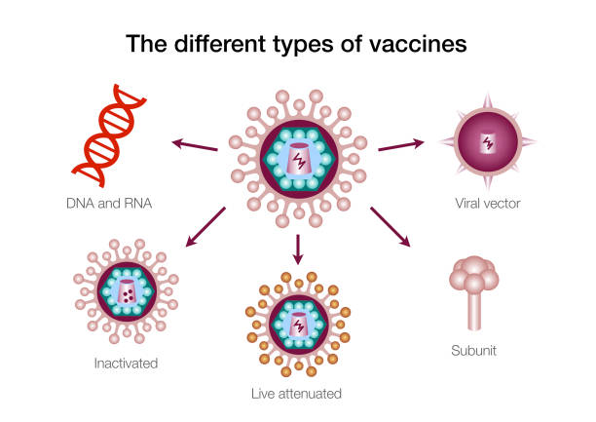

Slide 6
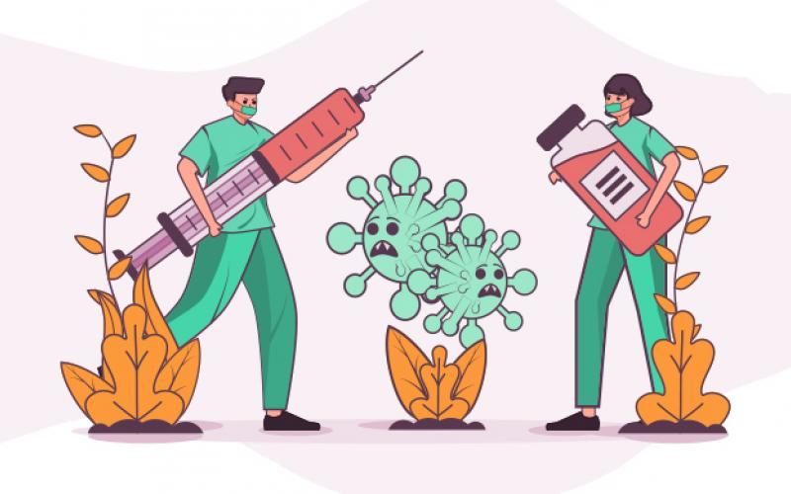

How does the vaccine work?

Slide 7
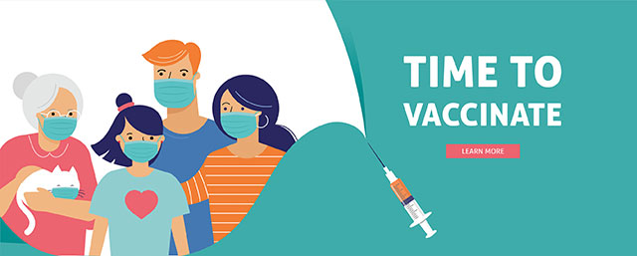
What is the importance of vaccination?
Vaccination protects children from serious illness and complications of vaccine-preventable diseases which can include amputation of an arm or leg, hospitalization, pneumonia, hearing loss, convulsions and brain damage.
Vaccination is safe and effective.
protect other people in your community.
Other diseases like measles and diphtheria have been reduced by up to 99.9% since their vaccines were introduced.
Vaccines help in the long run .

Slide 8
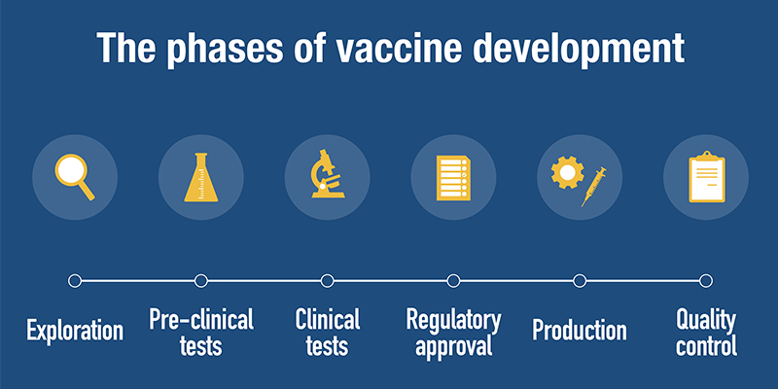

Slide 9
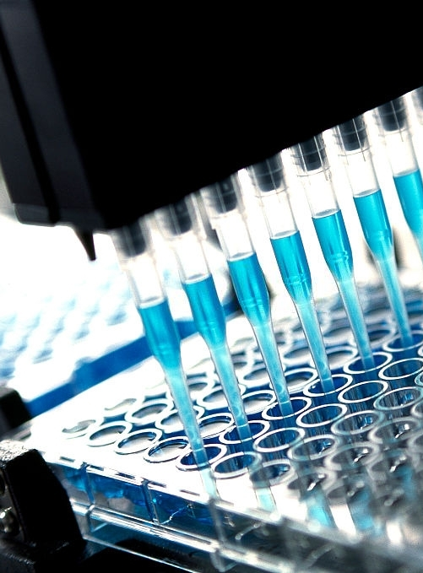
Exploratory: This is the research phase of the vaccine development process in which scientists identify natural or synthetic antigens that might help treat disease.
Pre-clinical: In this phase medical professionals use cell-culture or tissue-culture systems and animal testing to determine whether the candidate vaccine will produce immunity.
Clinical development: Now, a sponsor, usually a private company, applies for approval of the vaccine. Only the institution that will host the clinical trial can approve the application.
Regulatory Review and approval: Once a vaccine passes all the phases, the vaccine developer submits a license application to the regulatory authority.
Production: After the license approval, drug manufacturers provide personnel, infrastructure, and equipment necessary to create mass quantities of vaccines.
Quality control: These quality control measures are taken to monitor the safety, performance, and effectiveness of an approved vaccine.

Slide 10
Side effect of vaccination
Most people do not have any serious side effect from vaccines.
The most common side effects- like soreness where the shot was given- are usually mild and go away quickly on their own.
The most common side effects of vaccination include:
Pain, swelling
Mild fever, chills
Feeling tired , Headache and muscle and joints aches.
Babies or young children feeling a bit unwell or developing a high temperature for 1 or 2 days.

Slide 11

Vaccination is very important for people from all ages.
For over two centuries, vaccines have safely reduced the scourge of disease like polio, measles and smallpox, helping children grow up healthy and happy.
Remember, vaccine are continually monitored for safety, and like any medication, vaccines can cause side effect.
People must get vaccinated to the infectious diseases to stop them from spreading again.

Slide 12

Canouï, E. and Launay, O., 2022. Histoire et principes de la vaccination.
Haviari, S., Bénet, T., Saadatian-Elahi, M., André, P., Loulergue, P. and Vanhems, P., 2022. Vaccination of healthcare workers: A review.
Paterson, P., Meurice, F., Stanberry, L., Glismann, S., Rosenthal, S. and Larson, H., 2022. Vaccine hesitancy and healthcare providers.

Slide 13


