Slide 1
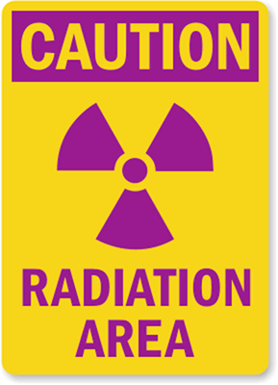
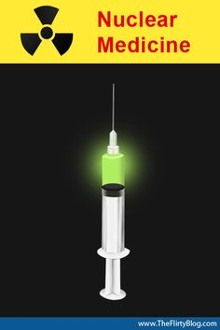

Slide 2
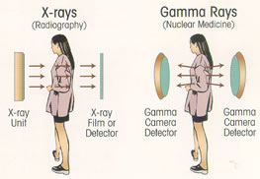
Nuclear Medicine Applications

Slide 3
Nuclear medicine
The radioactive isotopes used in diagnostic imaging emit gamma-rays as they decay. Gamma-rays are electromagnetic radiation, similar to x-rays, produced by radioactive decay of the nucleus.
Many naturally occurring radioactive isotopes, e.g. potassium-40 and uranium-235, have half lives of hundreds of years and are, therefore, unsuitable for diagnostic imaging.
The radioisotopes used in medical diagnosis are artificially produced and most have short half lives, usually a few hours or days.
To keep the radiation dose to the patient at a minimum, the smallest possible dose of an isotope with a short half life should be used.

Slide 4
Clearly, the radiopharmaceuticals should have no undesirable biological effects and should be rapidly excreted from the body following completion of the investigation.
technetium-99m (⁹⁹ᵐTc). It is readily prepared, has a convenient half life of 6 hours and emits gamma-radiation of a suitable energy for easy detection. Other radionuclides that are used include indium-111, gallium-67, iodine-123 and thallium-201.

Slide 5
Technetium-99m ⁹⁹ᵐTc can be used in ionic form (as the pertechnetate) to detect ectopic gastric mucosa in Meckel’s diverticulum, but it is usually tagged to other substances. For example, a complex organic phosphate labelled with ⁹⁹ᵐTc will be taken up by the bones and can be used to visualize the skeleton .
Particles are used in lung perfusion images; macroaggregates of albumin with a particle size of 10–75 µm when injected intravenously are trapped in the pulmonary capillaries. If the macroaggregates are labelled with ⁹⁹ᵐTc , then the blood flow to the lungs can be visualized.

Slide 6
. It is also possible to label the patient’s own red blood cells with ⁹⁹ᵐTc to assess cardiac function, or the white cells with indium-111 or ⁹⁹ᵐTc for abscess detection. Small quantities of radioactive gases, such as xenon-133, xenon-127 or krypton-81m, can be inhaled to assess ventilation of the lungs. All these radiopharmaceuticals are free of side-effects.
The electrical pulse is further amplified and analyzed by a processing unit so that a recording can be made. computer is linked to the gamma camera to enable rapid serial images to be taken and to perform computer enhancement of the images when relevant

Slide 7
-In selected cases emission tomography is performed
Emission tomography can detect lesions not visible on the standard views. Because only one usable photon for each disintegration is emitted, this technique is also known as single photon emission computed tomography (SPECT).
-Nuclear medicine techniques are used to measure function and to produce anatomical images. Even the anatomical images are dependent on function; for example, a bone scan depends on bone turnover.

Slide 8
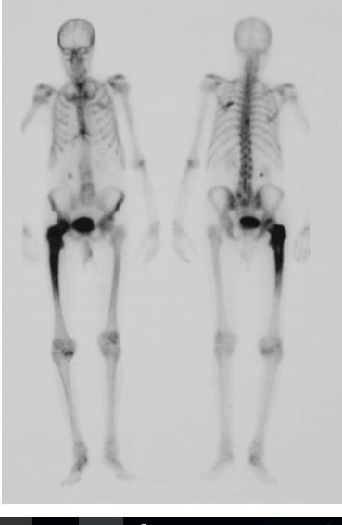
Radionuclide bone scan. The patient has received an intravenous injection of a 99mTc-labelled bone-scanning agent (a complex organic phosphate). This agent is taken up by bone in proportion to bone turnover and blood flow. The increased uptake in the femur in this patient was due to Paget’s disease.

Slide 9
Positron emission tomography
Positron emission tomography (PET) uses short-lived positron-emitting isotopes, which are produced by a cyclotron immediately before use. Two gamma-rays are produced from the annihilation of each positron and can be detected by a specialized gamma camera. The resulting images reflect the distribution of the isotope .

Slide 10
The most commonly used agent is 18- F fluorodeoxyglucose (FDG). This is an analogue of glucose and is taken up by cells in proportion to glucose metabolism, which is usually increased in tumor cells “pt. blood sugar must be optimized before scan”
Because Muscle & Brown adipose tissue activity results in the uptake of FDG, the patient should rest quietly& worm in the interval between injection of the FDG and scanning

Slide 11
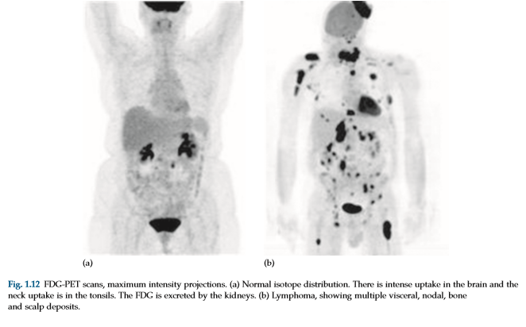

Slide 12
The images must be interpreted carefully as noncancerous conditions may show uptake resembling cancer.
PET using FDG is the most sensitive technique for staging solid tumors , and in the follow-up of malignancies “restaging after chemo/radio therapy, particularly lymphoma , where other imaging techniques may be unable to distinguish active disease from residual fibrosis. -also used in the evaluation of ischaemic heart disease and in brain disorders such as dementia, epilepsy and Parkinson’s disease.
Positron emission tomography PET/CT scan : PET demonstrates biological function while CT gives anatomical information

Slide 13
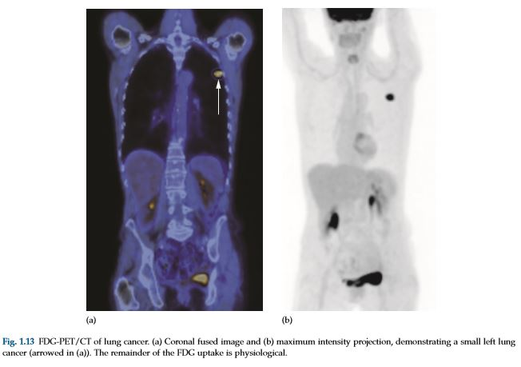

Slide 14

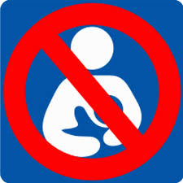
no pregnancy no breast feeding

Slide 15




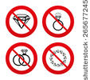

STOP

Slide 16
Thyroid radionuclide scan
The use of Uss & FNA with cytological examination of the aspirate has become the mainstay of diagnosis of thyroid cancer; scinitigraphy now has a limited role, reserved for the investigation of abnormal thyroid function and inpatients with known thyroid carcinoma.
Thyroid radioactive Iodine uptake (RAIU) scan used to examine the size, shape, location , function , diagnose & treat disease & tumors of thyroid gland (local residual tumor, tumor recurrence or mets).
-Disease of thyroid like: Hyper or hypo thyroidism, nodules & inflammation.
after 4-6 days of treatment with RAIU :Whole body Iodine scan must be done for pt. with thyroid cancer = Metastatic survey.
- I 123, Tc-99m pertechnetate : for diagnosis
I 131 for treatment after thyroid ca. surgery
salivary gland, pharyngeal, stomach, bowel & U.B activity is noted

Slide 17
Tc-99m pertechnetate i.v : used to evaluate Thyroid function, start images 20 mints after radioactive administration.
I 123 (diagnostic, if TFT , T3, T4 normal scan is not done) & I 131 are Oral capsule
I 131 used as therapeutic radioactive iodine after thyroid cancer ablation & stay for several days ,
first exam: 4-6 hours after drug ingestion.
Second exam: after 24 hours to know the amount of hormones produced between the two exams in diagnostic purpose
( No I.V iodine-contrast study 3 months before scan)

Slide 18
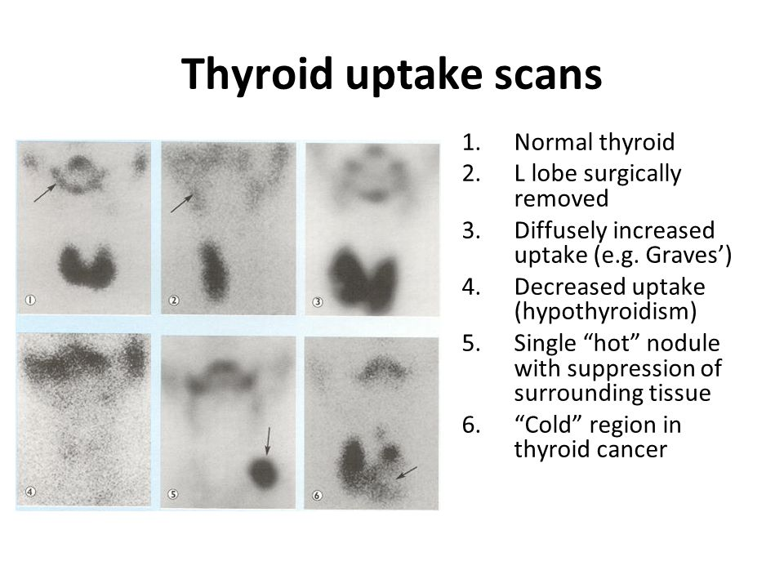

Slide 19
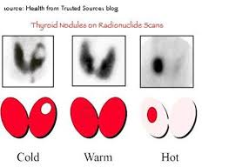
Cold nodule has 20% to be malignant nodule Hot nodule has hyperactivity function

Slide 20

Special precautions after finishing I-131 treatment
-Use private toilet & flush twice after each use.
- Bath daily & wash hands frequently
- Drink normal amount of fluids.
- Use disposable eating dishes & cups.
- Sleep alone, avoid contact with intimate for 3-4 days
- Wash the cloths separately from the family member
- Stop breast feeding for several days
-Don’t get pregnant 6months to 1year after treatment

Slide 21
Pt. undergone thyroidectomy b/c of ca. thyroid , I 131 used as therapeutic dose after ablation: ant. view “Lt. image”, post. view “Rt. Image” shows residual uptake in thyroid bed with multiple bone mets.

Slide 22
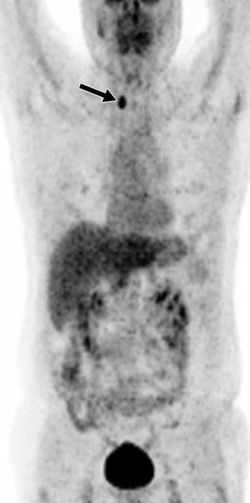
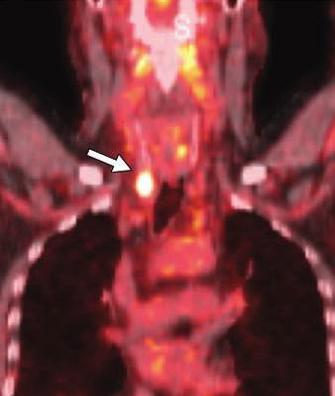
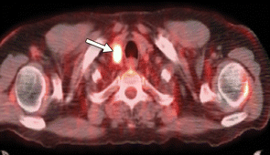
Staging PET scan & PET/CT Case of bronchioalveolar ca. Focal Rt. Lobe thyroid FNA/cytology PTCa

Slide 23
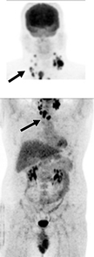
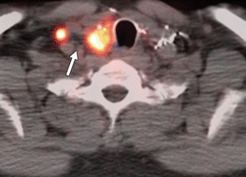
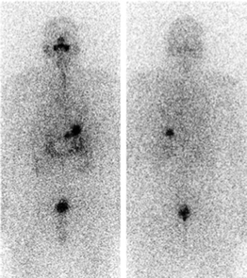
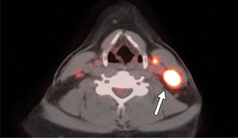
Pt. with PTC post thyroidectomy & radioiodine ablation with elevated thyroglobulin level ¹³¹I-WBS FDG-PET/CT ant. & post. –ve scan recurrent PTC in thyroid bed & L.nodes mets

Slide 24
Parathyroid Scan
Tc-99m Sestamibi Planar and SPECT Scintigraphy
& Thallium -201
Localization of a parathyroid adenoma prior to surgery for hyperparathyroidism is important because about 10% of adenomas are multiple or occur in an ectopic position.
Thallium-201 accumulates in both the thyroid and the parathyroid glands. Therefore, the thyroid activity should be subtracted from the image to allow for the identification of the parathyroid activity

Slide 25
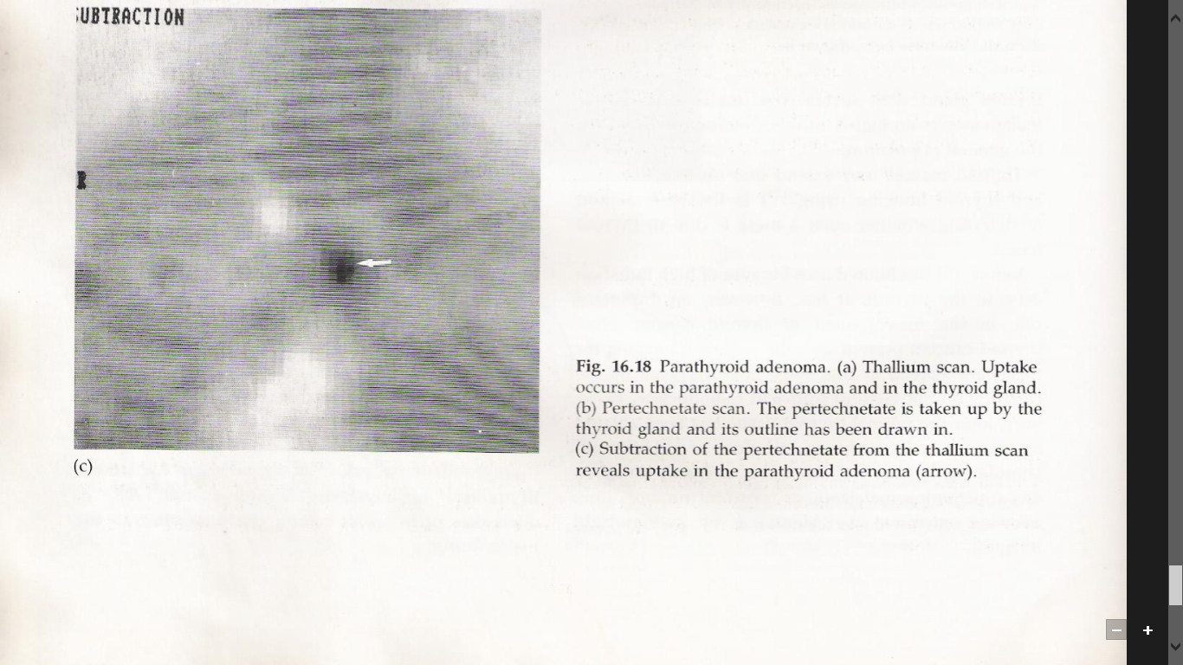

Slide 26
Radionuclide bone scan
Technetium-99m labelled phosphate complexes (⁹⁹ᵐTc- MDP) methylene diphosphonate given as an intravenous injection are the agents used for bone scintigraphy. They are taken up selectively by the bones and are also excreted in the urine.
- pt. must Remove all metallic objects & wear pt. gown
- Void immediately , the full filled radionuclide UB before study to avoid blocking view to pelvic bone
- No GIT Barium study 4 days before exam

Slide 27
Indications of Bone scintigraphy scan:
1. malignancy: primary bone tumor & metastasis
2. assess the age of fracture (important in child abuse)
3 stress #
4. osteomylitis
5. hip joint replacement: for infection or loosening
6. Paget’s disease
7. osteoid osteoma

Slide 28
Increased uptake “hot uptake” on the radionuclide bone scan is seen in conditions where there is an increased blood supply and high bone turnover with new bone formation.
Phases of the scan “ Triphasic” :
1. Flow phase: 60 sec. after injection.
2.Blood pooling phase: 5 mints after injection.
Phase 1 & 2 (for bone infection & #)
3. Delayed phase: 2-4 hours after injection. (for bone tumors)
4.Delayed/Delayed phase: after 24 hours.

Slide 29
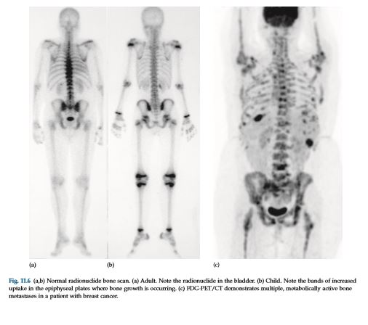

Slide 30
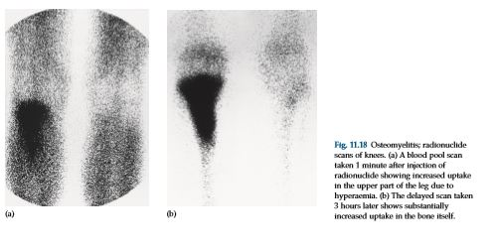

Slide 31
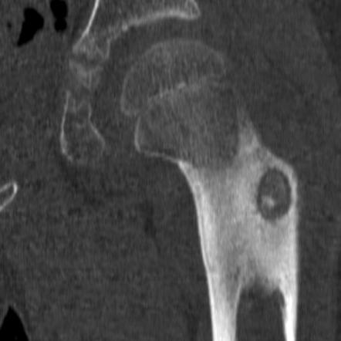
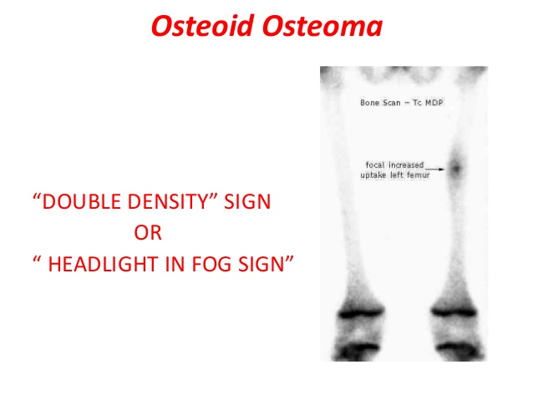

Slide 32
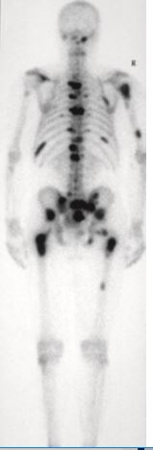
Bone metastasis from ca. prostate

Slide 33
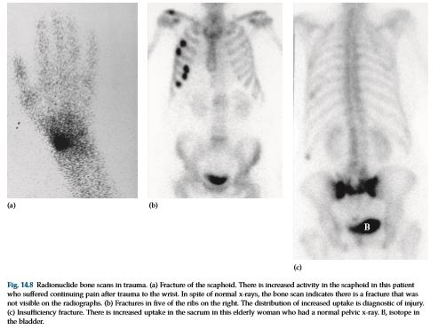
Scaphoid # post truama
Ribs # with callous
Sacral bone # post trauma (old lady)

Slide 34
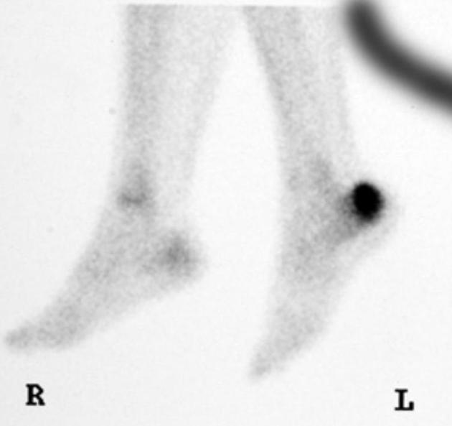
Stress # calcaenus

Slide 35
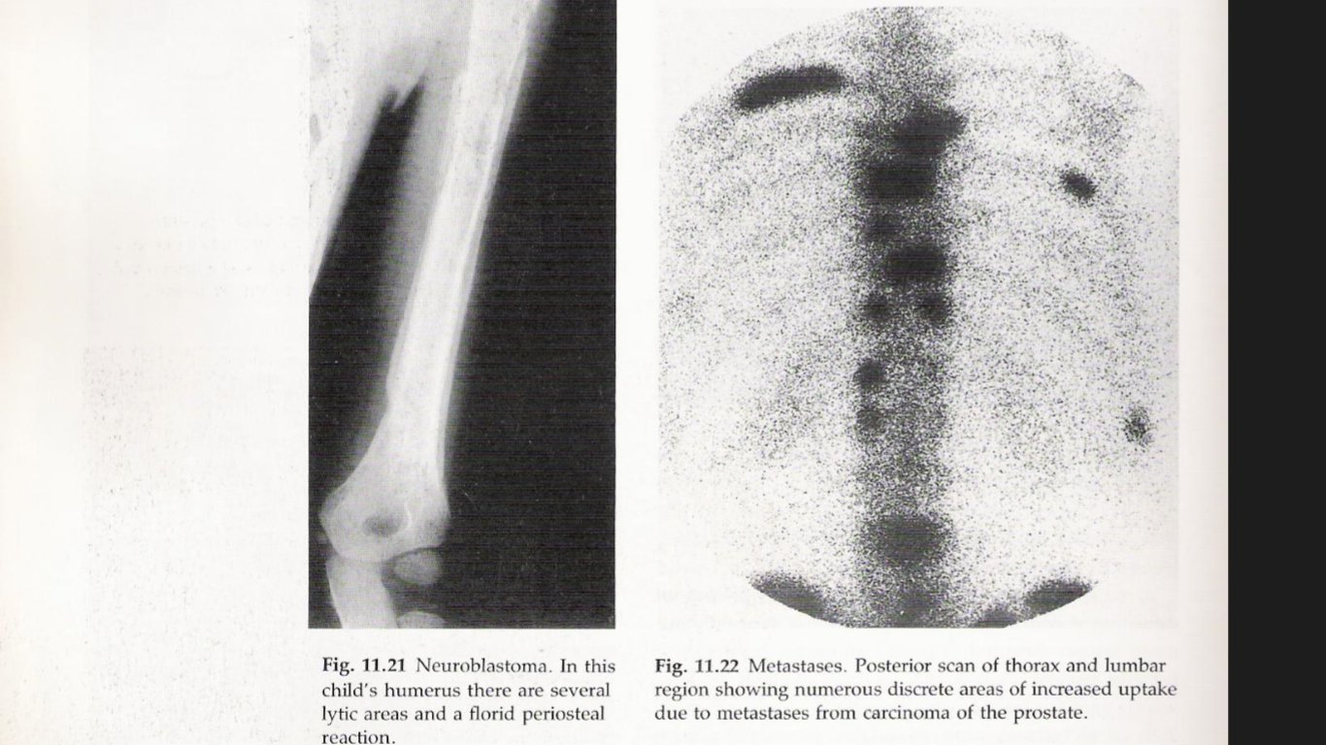

Slide 36
Radionuclide lung scans v/Q scan
Perfusion scan : Radionuclide ⁹⁹ᵐTc- MAA = Macro Aggregated Albumin lung scans for diagnosing pulmonary embolism have largely been replaced by CT angiography.
The diagnosis on radionuclide lung scanning depends on observing the distribution of radionuclide particles in the lungs following intravenous injection
The radionuclide particles do not reach the under-perfused portions of the lungs, and, therefore, one or more defects are seen in the perfusion scan. A normal perfusion scan for practical purposes excludes pulmonary embolism.

Slide 37
Ventilation scan is also required in patients with perfusion defects in order to differentiate between the various other causes of perfusion defects, which include pneumonia, pulmonary edema, tumors, bronchiectasis and emphysema to determine the affected segment for pneumonectomy or after lung transplantation.
Gaseous radionuclide in aerosol form Xenon –133m , Tc-99m DTPA & Krypton- 81 m

Slide 38
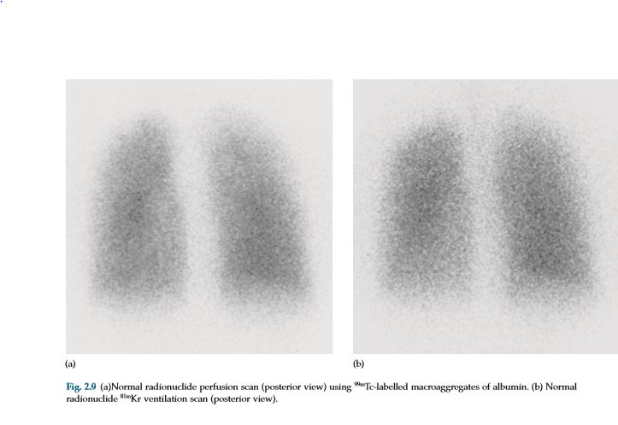

Slide 39
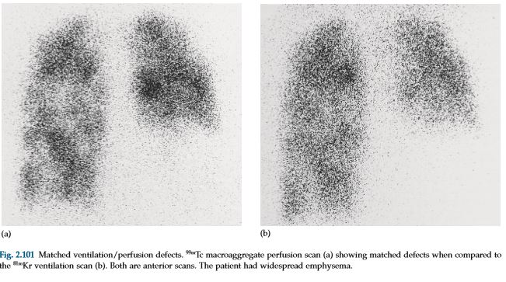

Slide 40
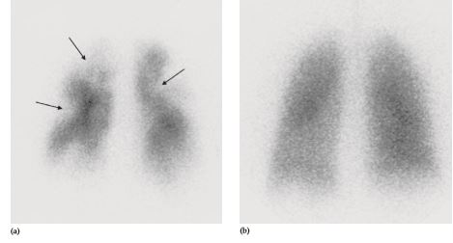
Pulmonary emboli. (a) 99mTc macroaggregate perfusion scan (posterior view) showing multiple wedge-shaped defects. The more obvious ones have been arrowed. (b) The ventilation scan, using 81mKr (also a posterior view), is normal. (c) CT pulmonary angiogram showing bilateral filling defects due to emboli in the central pulmonary arteries (arrow).

Slide 41
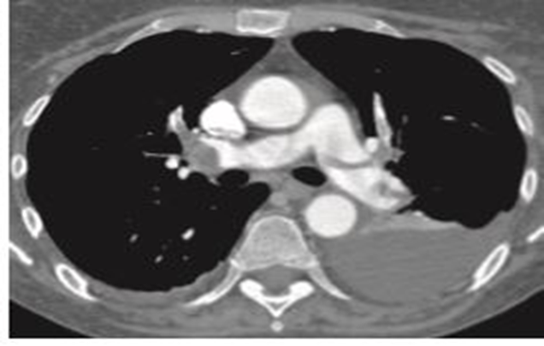
Pulmonary embolism

Slide 42
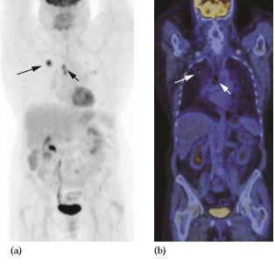
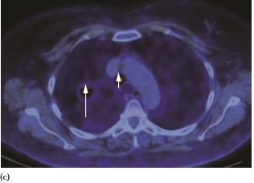
FDG-PET scan of the chest and abdomen showing a focus of high activity in a lung cancer (large arrow) and mediastinal lymph node metastasis (small arrow). (a) Maximum intensity projection (MIP). (b) Coronal fused PET/CT. (c) Axial fused PET/CT. No other abnormality is seen on any of the images. High activity in the myocardium, kidneys and bladder is normal.

Slide 43
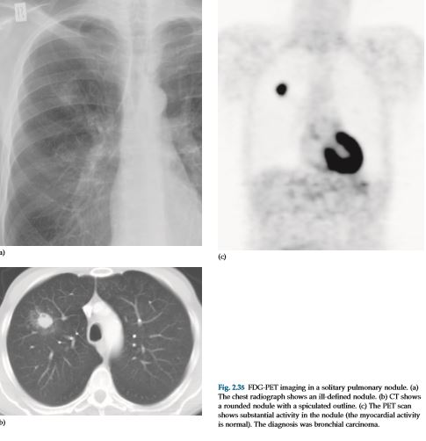

Slide 44
Cardiac scan
Positron emission tomography can provide cross­ sectional images of the patient’s anatomy after injection of either a flow tracer or a radionuclide, which is an analogue of glucose (18F­fluorodeoxyglucose), thus providing information on the myocardial metabolism. PET can identify areas of viable, non­viable and hibernating myocardium

Slide 45
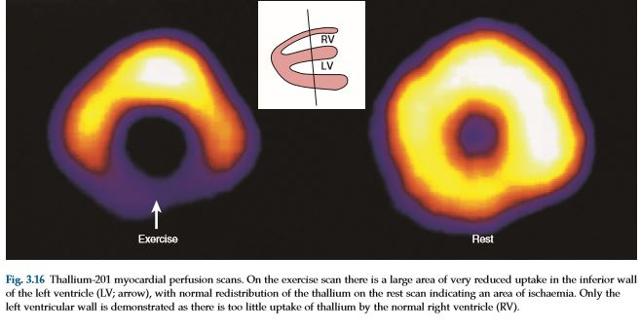
Cardiac scan

Slide 46
Hepatobiliary radionuclide scanning HIDA SCAN
Tc-99m IDA analogues are used in the study. ( PIPIDA , DISIDA )
ParaIsoPropyl IDA, DiIsoPropyl IDA.
Iminodiacetic acid pharmaceuticals labelled with technetium-99m are excreted by the liver following intravenous injection and may be used for imaging the bile duct system.
All that is required is that the patient fasts for 4 hours prior to the injection of the radionuclide. Normally, the gall bladder, common bile duct, duodenum and small bowel are all seen within the first hour, confirming the patency and integrity of both the cystic duct and the common bile duct.

Slide 47
The main use of this technique :
. in children, when biliary atresia is suspected.
in patients with suspected biliary leak following biliary surgery. Excretion of the radionuclide tracer from the biliary tree into the peritoneal cavity is diagnostic of a leak.
The technique may also be used in acute cholecystitis (with non-filling of the gall bladder in cases of an impacted stone in the cystic duct.

Slide 48
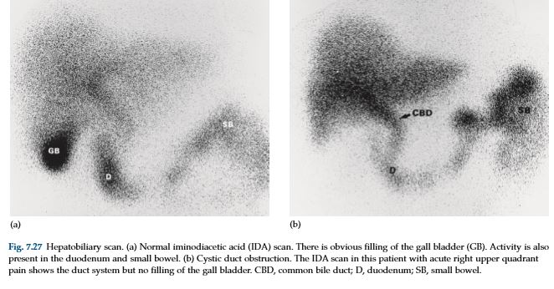

Slide 49
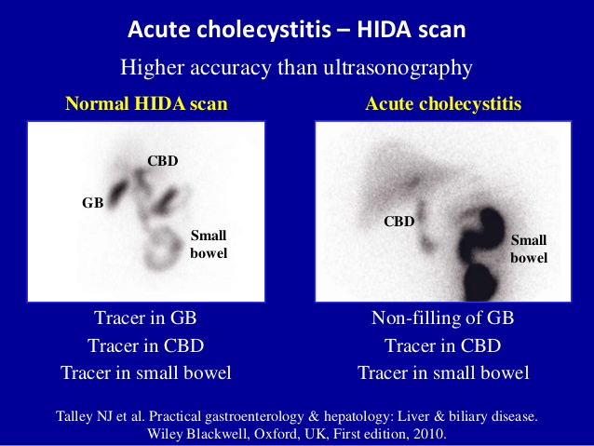

Slide 50
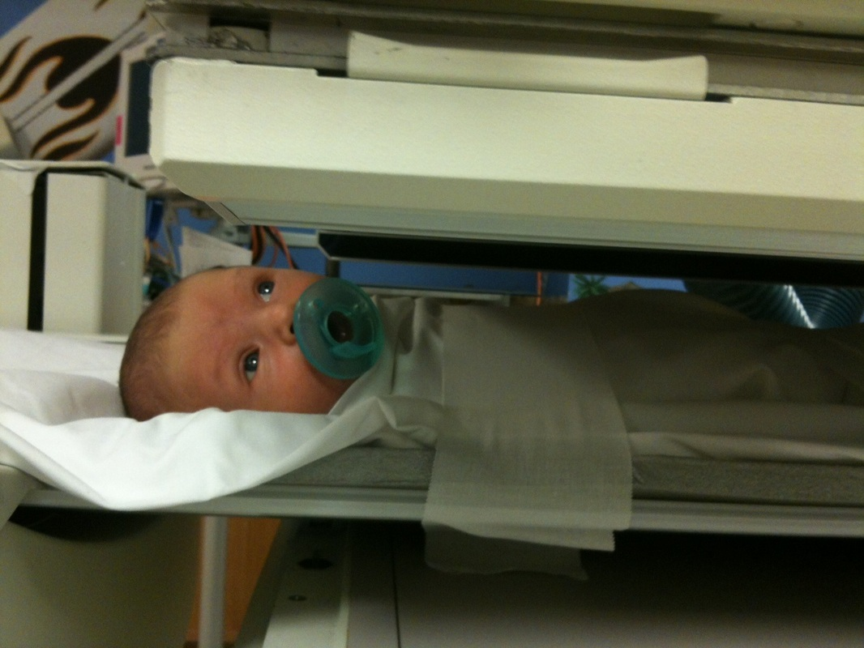

Slide 51
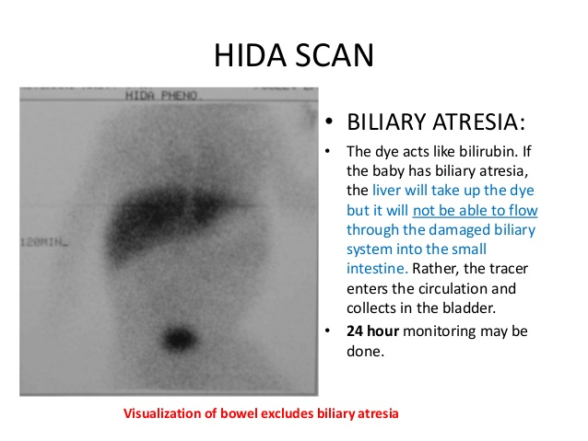

Slide 52
RENAL radionuclide examination
Radionuclide techniques for studying the kidneys include:
• Dynamic renal scintigraphy: study the renal function & hydronephrosis for surgical purpose .
• Static renal scinitgraphy: study the morphology structure & shape (renal scar, kidney anomalies as horseshoe & ectopic kidney), although the advent of CT and ultrasound has reduced the need for such scans.
• Radionuclide cystography: study of VUR reflux in children.

Slide 53
Dynamic renal scintigraphy renogam
The two radionuclides of choice are:
Tc-99m DTPA= Diethylene Triamine PentaAcetate, filtered by the glomeruli and is not absorbed or secreted by the tubules , used in adult with normal RFT.
Tc-99m MAG3 = Mercapto Acetyl triGlycrine, filtered by the glomeruli and secreted by the tubules, used in children & adult with poor function RFT .
given intravenously, their passage through the kidney can be observed with a gamma camera.

Slide 54
The gamma camera is positioned posteriorly to the kidneys & a rapid injection of the radioactive drug is given.
Early images show the major blood vessels and both kidneys, at 1st minute, activity is then seen in the renal parenchyma and by 5 minutes the collecting systems should be visible. Serial images over 20 minutes show progressive excretion and clearance of activity from the kidneys. Computerized quantitative assessment enables a renogram curve to be produced and the relative function of each kidney to be calculated.

Slide 55
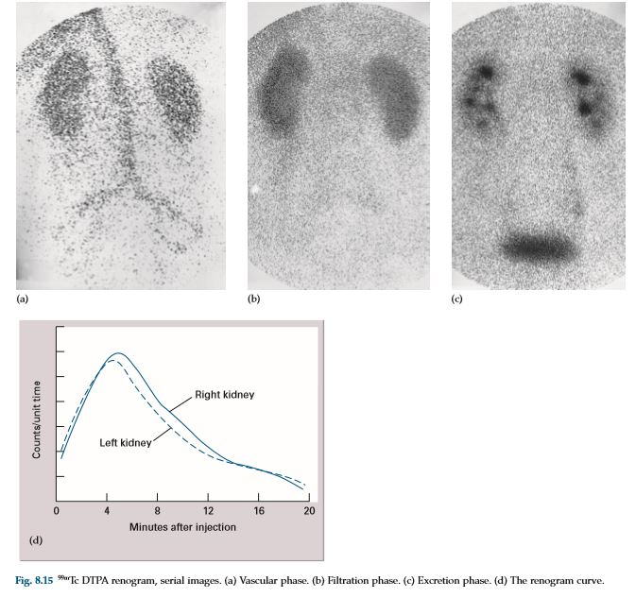

Slide 56
Static renal scintigraphy
The radionuclide of choice is
Tc-99m DMSA =Di Mercepto Sussinic Acid
static study of renal structure & renal shape
given intravenously, their passage through the kidney can be observed with a gamma camera.
Uptake by renal cortex, no or very small amount are excreted by U.bladder.
Start scan 2 hours after injection.
Gamma camera & SPECT scan are used.

Slide 57
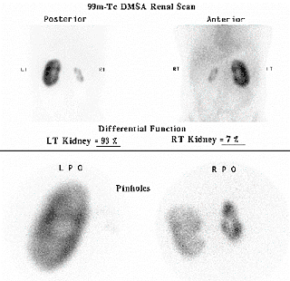

Slide 58
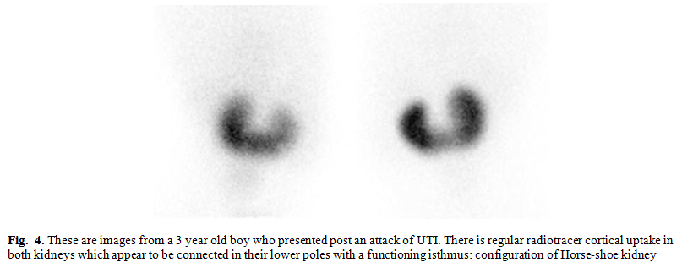
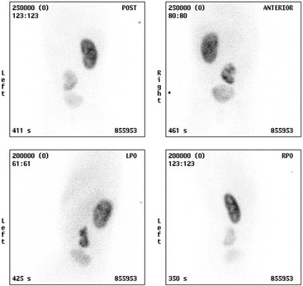
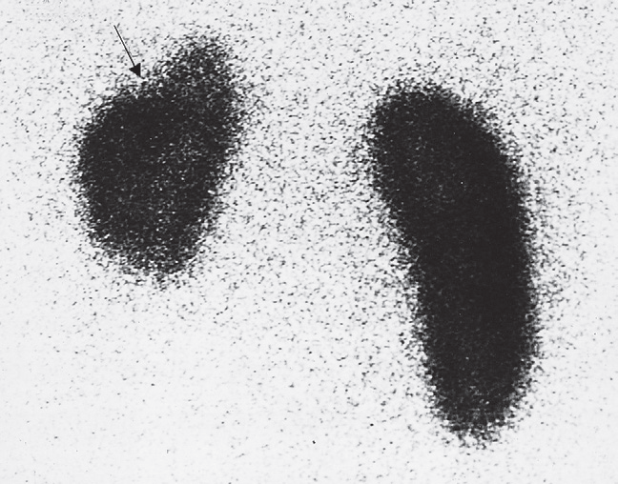
Rt. Renal scaring post reflux nephropathy “chronic Pyelonephritis”

Slide 59
radionuclide cystography
The radioactive Tc-99m DTPA or Tc-99m sulfer colloid more frequently use.
study used for :
1. initial screening test for recurrent urinary tract infection UTI specially in children to diagnose the vesicu-uretric reflux VUR.
2. Follow up exam for pts with VUR.
3. Assessment of neuropathic bladder who at risk to develop VUR.
4. Assess the result of reflux surgery.

Slide 60
Procedure :
- the pt. must be lie supine on a scanner table
- the health care cleans the urinary opening, then insert the catheter through urethra & into the bladder.
- the (mixed radionuclide+saline liquid ) bag is placed 1 meter above the scanner table.
- flow the liquid into the bladder until the bladder is full or the pt. says that he/she feels full bladder.
- bladder filling volume formula is:
Volume= (age in years + 3) X 30 ml

Slide 61
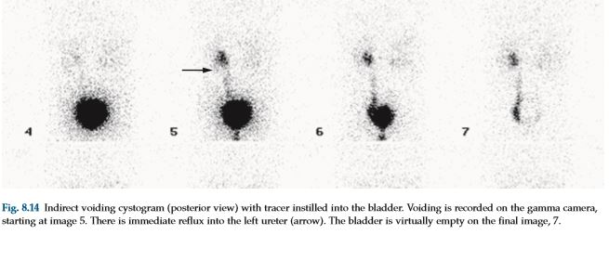

Slide 62
RETROPERITONEUM
If CT and ultrasound have been unsuccessful in locating an abscess, then some of the patient’s own white blood cells can be labelled with technetium-99m or with indium-111, which will accumulate in an abscess.

Slide 63
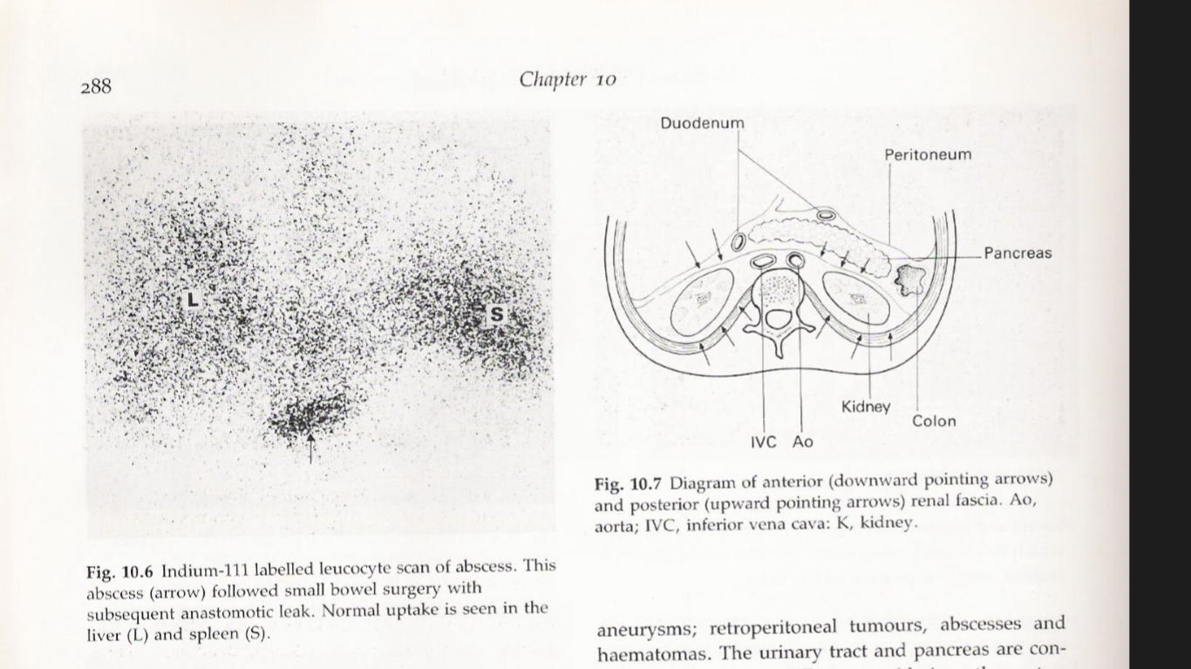

Slide 64
FDG-PET/CT in a patient with esophageal carcinoma.
The PET component of the study demonstrates the primary tumor (short arrow) at the lower esophagus. In addition, there is a hot spot over the liver (long arrow).

Slide 65
Spleen scan
⁹⁹m-Tc- Sulfur Colloid Is The Agent Of choice.
Used To Detect Space Occupying Lesion (Metastases, Cyst Or Abscesses) , USS is often requested to characterize a focal defect seen in spleen. .
In Cirrhosis Produces Patchy Uptake With Enlarged Spleen.

Slide 66
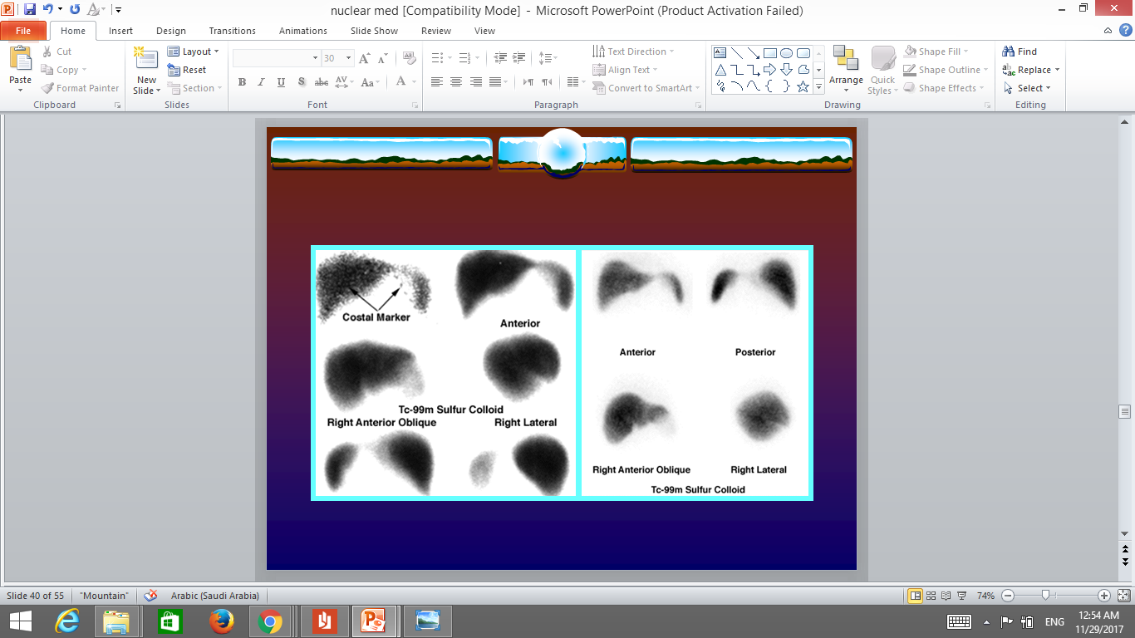
Normal uniform both liver and spleen Tc-99m sulfer colloid distribution

Slide 67
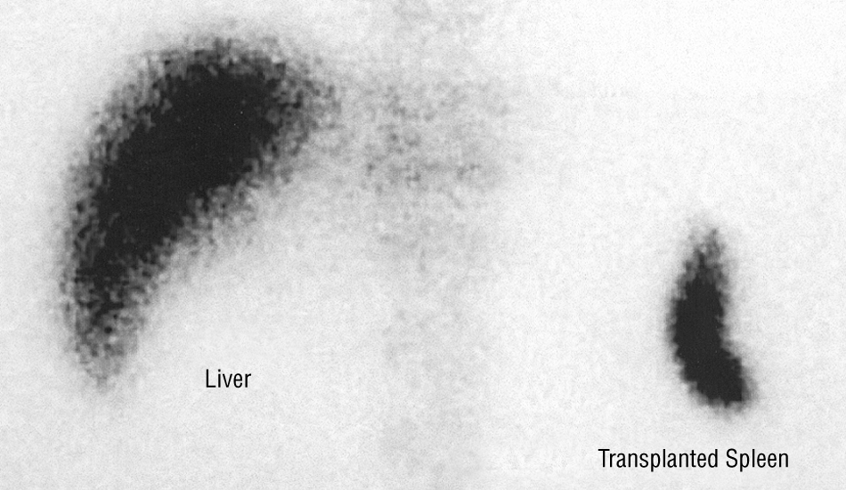
Pt. underwent surgical spleenectomy
Tc-99m sulfer colloid shows splenic auto-transplantation

Slide 68
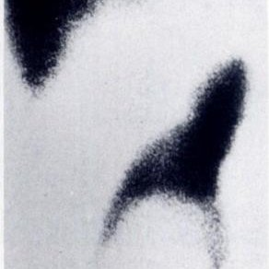
splenic cyst appears as defect without up take “ uss confirm simple cyst”

Slide 69
Good luck

