Slide 1
viral hepatitis

Slide 2
A viral systemic disease with primary inflammation of the liver

Slide 3
Aetiology
Viral hepatitis may be divided into 5 types according to etiology, that is hepatitis A, B, C, D and E.
other viruses
that can also cause liver inflammation include Herpes simplex, Cytomegalovirus, and Epstein–Barr virus.

Slide 4
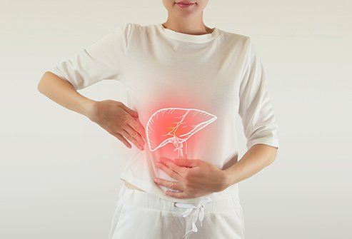
Clinical features
Fever,fatigue.
Rt upper qudrant Abdominal pain(60%).
Nausea,Vomiting,and Loss of appetite (90%).
Jaundice.
Dark urine.
Clay-colored stool.
Joint pain,itching.and skin rash(upto 15%).

Slide 5
Viral Hepatitis

Slide 6
Subclinical infection is common
hepatitis B, C and D predispose to a chronic hepatitis and is related to liver cirrhosis and hepatic cancer

Slide 7
Hepatitis A virus (HAV)
HAV is RNA virus.
During acute stage of infection, HAV can be found in blood and feces of infected person.

Slide 8
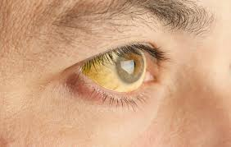
Hepatitis A
Acute onset.
Fever
Malaise
Anorexia
Abdominal discomfort
Jaundice

Slide 9
90% are asymptomatic
At age 15, 95% are seropositive.

Slide 10
Reservior : Human
Incubation period: 15-30 days

Slide 11
Period of communicability : two weeks before + one week after illness(jaundice).
Modes of transmission:
most common is Fecal-oral route.

Slide 12
Diagnosis
Diagnosis: Anti-IgM detectable 7 10 days before
symptoms; disappears by six months
Anti-IgG – convalescent, life-long,confers protection
Treatment: Supportive

Slide 13
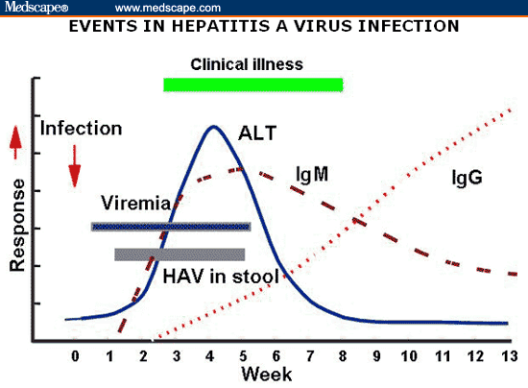

Slide 14
Prevention and Control
Good sanitation & personal hygiene.
hand washing”
Shellfish
heat 85-90C 4 minutes.
steam 90 seconds.
The virus is inactivated by ultraviolet rays and by boiling for 5 minutes or autoclaving.

Slide 15
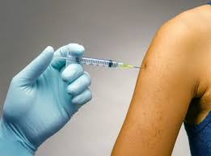
Inactivated hepatitis A vaccine
0 -1 - 6 months.
Protection after one month.
immunity at least 10 years.
Hepatitis A patient:
Enteric precaution.

Slide 16
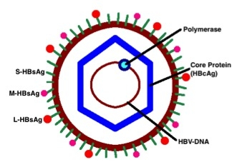
Hepatitis B

Slide 17
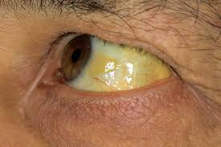
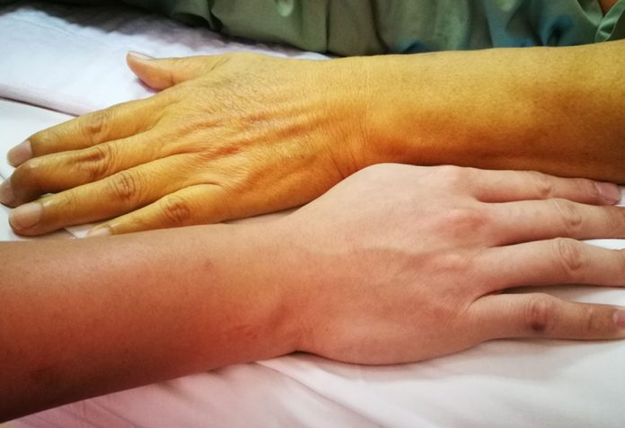
Hepatitis B
Incidous onset.
Anorexia.
Abdominal pain.
Nausia.
Vomiting.
Arthralgia.
Jaundice.

Slide 18
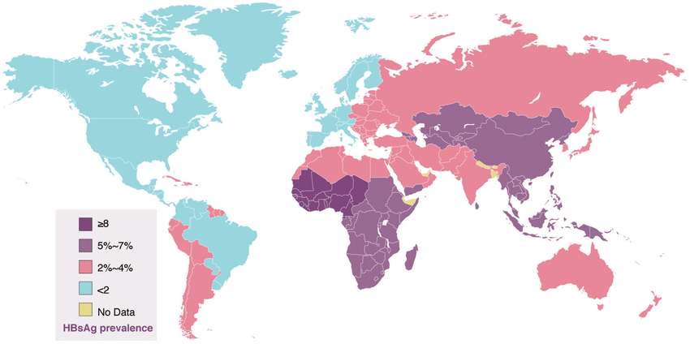

Slide 19
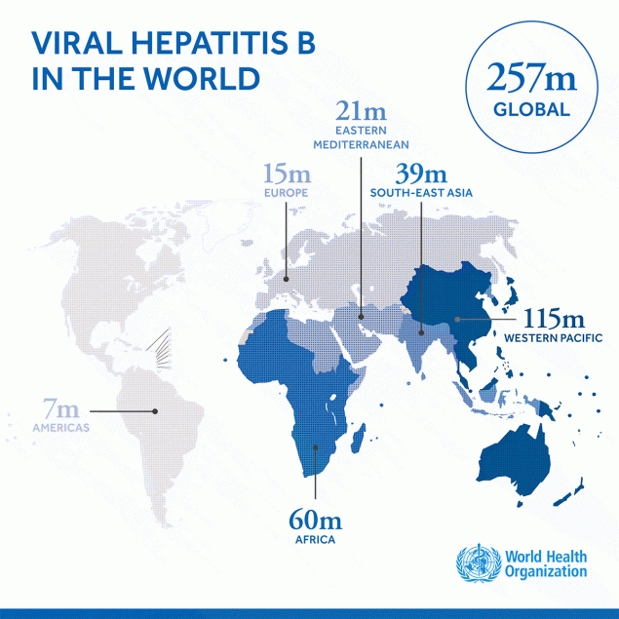

Slide 20
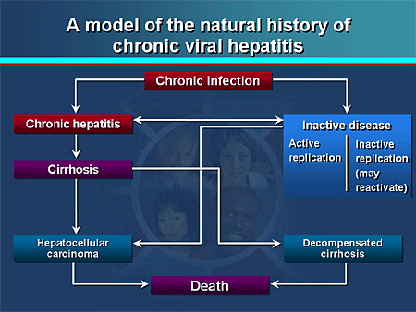

Slide 21
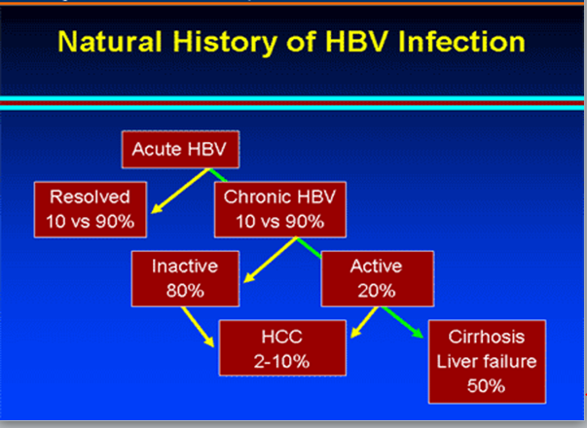

Slide 22
Double strand DNA.
Reservior: Human (case + carrier).
I.P. 2-3 months.
P.C. One week of I.P. + illness period + carriage.

Slide 25
Modes of transmission:
Percutaneous and permucosal exposure
to infective body fluids.
Blood transfusion / Haemodialysis
Organs transplants.
Sharing needles / Needlestick /Tattooing.
Razors / toothbrushes.

Slide 26
Modes of transmission:
Sexual transmission.
Perinatal transmission.

Slide 27
Hepatitis B Diagnosis
Hepatitis B is detected by looking for a number of different antigens and antibodies.

Slide 28
Hepatitis B surface antigen (HBsAg):
A protein on the surface of HBV; found in blood in acute or chronic HBV infection.
presence of HBsAg indicates that the person is infectious.

Slide 29
The body normally produces antibodies to HBsAg as part of the normal immune response to infection.
HBsAg is the antigen used to make Hepatitis B vaccine

Slide 30
Hepatitis B Diagnosis
Hepatitis B is detected by looking for a number of different antigens and antibodies:
Hepatitis B surface antibody (anti-HBs):
indicate recovery and immunity from HBV infection.
Anti-HBs also develops in a person who has been successfully vaccinated against Hepatitis B.
Total Hepatitis B core antibody (anti-HBc):
Appears at the onset of symptoms in acute Hepatitis B and persists for life.
The presence of anti-HBc indicates previous or ongoing infection with HBV in an undefined time frame.

Slide 31
Hepatitis B Diagnosis
Hepatitis B is detected by looking for a number of different antigens and antibodies:
IgM antibody to Hepatitis B core antigen (IgM anti-HBc):
Positivity indicates recent(acute) infection with HBV (≤6 months).
Hepatitis B e antigen (HBeAg):
A secreted product of the nucleocapsid gene of HBV that is found in serum during acute and chronic Hepatitis B.
Its presence indicates that the virus is replicating and the infected person has high levels of HBV.

Slide 32
Hepatitis B Diagnosis
Hepatitis B e antibody (HBeAb or anti-HBe):
Produced by the immune system temporarily
During acute HBV infection or consistently during or after a burst in viral replication.
Spontaneous conversion from e antigen to e antibody (a change known as seroconversion) is a predictor of long-term clearance of HBV in patients undergoing antiviral therapy and indicates lower levels of HBV.

Slide 33
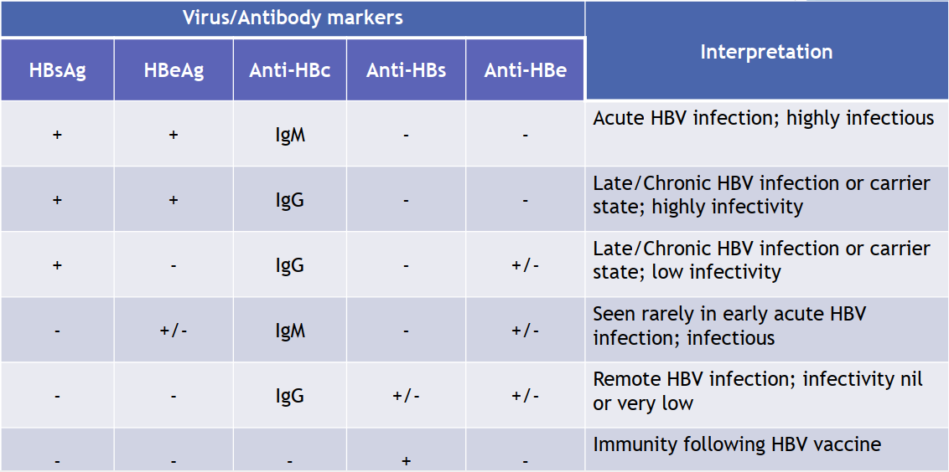
interpretation of serologic test results for hepatitis B virus infection

Slide 34
Prevention and control
immunization of infants.
Immunization of high risk persons.
Haemodialysis patients.
Bleeding disorders.
Susceptible households.
Health care personnels.
Blood banks:
avoid donors from risky groups.

Slide 35

Discourage:
Tattooing, Drug abuse,
Extramarital sexual relations.
Needle stick
Single dose of HBIG (24 hours).
Vaccine series.

Slide 36
Sexual exposure
Single dose of HBIG (14 days).
Vaccination.
Infants to HBsAg +ve mothers.
0.5 ml HBIG im.
First dose of the vaccine.
2nd & 3rd doses at 1 & 6 months later.
Health care personnel.
Universal precautions

Slide 37
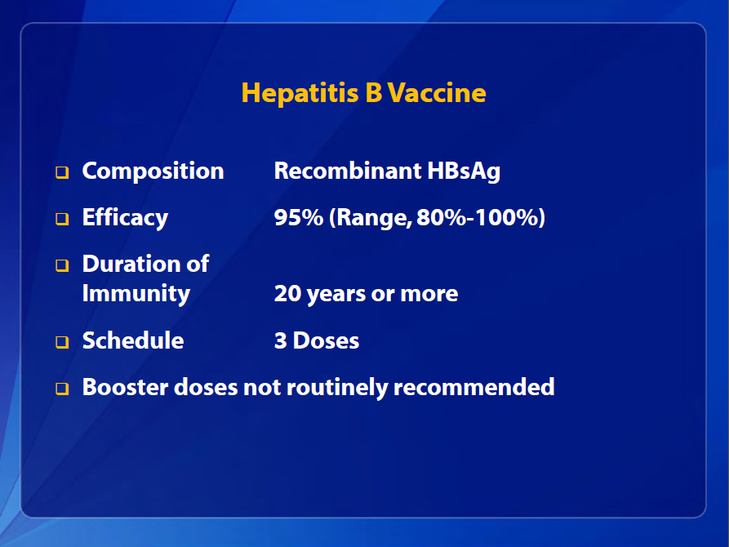

Slide 38
Hepatitis B Treatment
For acute infection, no medication is available; treatment is supportive.
For chronic infection, several antiviral drugs (adefovir dipivoxil, interferon alfa-2b, pegylated interferon alfa-2a, lamivudine, entecavir, tenofovir and telbivudine) are available.
Persons with chronic HBV infection require medical evaluation and regular monitoring to determine whether disease is progressing and to identify liver damage or hepatocellular carcinoma.

Slide 39
Hepatitis C virus (HCV)
HCV is RNA.
The genome contains 5’-non coding region, C region, E region and NS region
HCV genome may be divided into many types and subtypes.

Slide 40
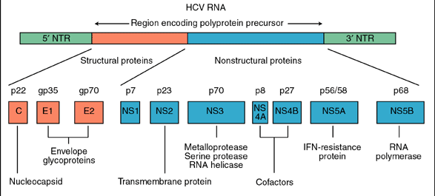
HCV genome
Cambridge University Press
Active drug targets

Slide 41
Natural History of HCV Infection
Exposure
(Acute phase)
15-25%
75-85%
HIV and
Alcohol
Resolved
Chronic
80%
20%
Stable
Cirrhosis
75%
25%
Slowly
Progressive
HCC
Transplant
Death
Notes:
Natural history of HCV Infection
The natural history of hepatitis C evolves over the course of decades and can be considered to have three distinct stages. The first is the stage of resolution of recovery. This is seen in approximately 15% of patient with viremia and acute hepatitis followed by resolution of viremia with the persistence of antibody. The second stage is the stable chronic course in which patients have viremia and acute hepatitis with subsequent decrease in ALT. The patient may experience periodic elevations of liver enzymes and persistent viremia for several years. This is the most common stage and is seen in approximately 80% of the patients. During this stage it is believed that patients may experience the emergence of quasispecies and relative ineffectiveness of neutralizing antibodies. The last stage is that of severe progression of the disease and occurs in approximately 20% of the patients. The patient will experience more persistent elevation of liver enzymes, persistent viremia, and a more rapid progression to cirrhosis and possibly even hepatocellular carcinoma.
HIV and alcohol should be considered as important cofactors in hepatitis C and the progression to cirrhosis. There is evidence to suggest a greater than 15 fold increase in the incidence of cirrhosis in alcoholic patients and a >5 fold increase with HIV.
References:
1. Alter MJ. Epidemiology of Hepatitis C in the West. Semin Liver Dis. 1995; 15: 5-14
2. Management of Hepatitis C. NIH Consensus Statement. 1997; March 24-26: 15(3).

Slide 42

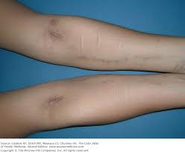
Important HCV Transmission Modes
Blood transfusion
IV drug abuse
80% infected in first year
1:100,000 in US

Slide 43
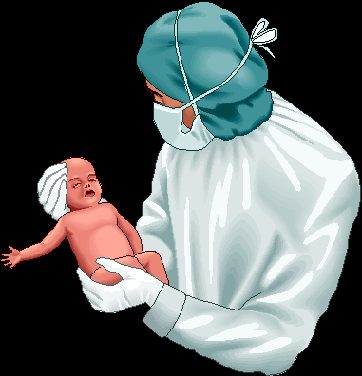





Uncommon HCV Transmission Modes
Household transmission
?
Vertical transmission mother - Child
1-5%
Needle stick injury
3%

Slide 44
Features of Hepatitis C Virus Infection
Incubation period Average 6 weeks
Range 2-24 weeks
Acute illness (jaundice) Mild (<20%)
Chronic infection 60%-85%
Chronic hepatitis 10%-70%
Cirrhosis <5%-20%
Mortality from CLD 1%-5%

Slide 45
Chronic Hepatitis C Factors Promoting Progression or Severity
Increased alcohol intake
Age > 40 years at time of infection
HIV co-infection
Other
Male gender
Chronic HBV co-infection

Slide 46
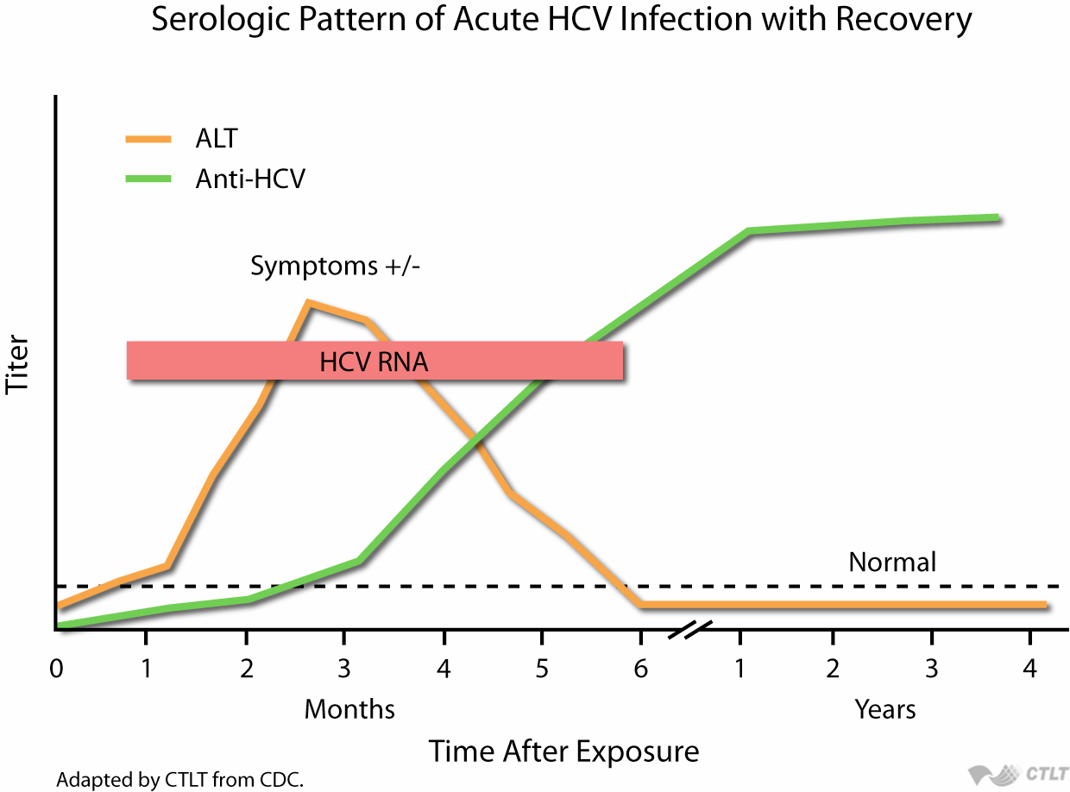
Hepatitis C Diagnosis

Slide 47

Serologic Pattern of Acute HCV Infection with Progression to Chronic Infection
anti-HCV
Symptoms +/-
HCV RNA
Titer
ALT
Normal
0
1
2
3
4
5
6
1
2
3
4
Months
Years
Time after Exposure

Slide 48
HCV genome
Cambridge University Press
Active drug targets

Slide 49
Direct Acting Antivirals (DAAs)
Core | E1 | E2 | P7 | NS2 | NS3 | NS4A | NS4B | NS5A | NS5B
NS3-4A protease
Inhibitors
~previr
Telaprevir
Boceprevir
Simeprevir
Paritaprevir
NS5A
Inhibitors
~asvir
Daclatasvir
Ledipasvir
Ombitasvir
NS5B polymerase
Inhibitors
~buvir
Sofosbuvir
Dasabuvir

Slide 50
Hepatitis D virus (HDV)
HDV (Delta hepatitis virus) is a kind of defective virus.
HDV is found in the nuclei of infected hepatocytes .
HDV genome is a circular single strand RNA .
The replication of HDV depends on HBV or other hepadnavirus, coated by HBsAg in blood.
HBV and HDV co-infection or superinfection may make the disease exacerbation and may lead to fulminant hepatitis.

Slide 51
Hepatitis E virus (HEV)
HEV is a single strand, positive –sense RNA

Slide 52
Hepatitis E - Clinical Features
Incubation period: Average 6 wks
Range 15-60 days
Case-fatality rate: Overall, 1%-3% Pregnant women, 15%-25%
Illness severity: Increased with age
Chronic sequelae: None identified
Notes:
27
27
27

Slide 53
There is no specific antiviral therapy for acute hepatitis E. Physicians should offer supportive therapy.

Slide 54
Epidemiology
Source of infection
Hepatitis A and E: patients with acute hepatitis and person with sublinical infection
Hepatitis B, C and D: patients with acute, chronic hepatitis B, C, and D and carriers
Route of transmission
Hepatitis A and E:
fecal-oral route predominantly

Slide 55
Outbreak epidemic
Due to food and water are contaminated lead to outbreak of HAV and HEV
Seasonal distribution
HAV:most cases developed in autumn and winter
HEV:most cases developed in summer and autumn

Slide 56
Type of Hepatitis
A
B
C
D
E
Source of
feces
blood/
blood/
blood/
feces
virus
blood-derived
blood-derived
blood-derived
body fluids
body fluids
body fluids
Route of
fecal-oral
percutaneous
percutaneous
percutaneous
fecal-oral
transmission
permucosal
permucosal
permucosal
Chronic
no
yes
yes
yes
no
infection
Prevention
pre/post-
pre/post-
blood donor
pre/post-
ensure safe
exposure
exposure
screening;
exposure
drinking
immunization
immunization
risk behavior
immunization;
water
modification
risk behavior
modification
Notes:
3

Slide 57
Laboratory examination
Liver function
Serum transaminase
ALT(alanine transferase) ↑
AST(aspartase transferase) ↑
ALP (Alkaline phosphatase) ↑
Serum protein
Albumin ↓
In chronic hepatitis Ig ↑↑
The ratio of A/G ↓
Bilirubin

Slide 58
Urobilinogen and urobilin ↑in icteric stage
Prothrombin time may be prolonged especially in fulminant hepatitis
Blood amonia examination

Slide 59
Ultra-sound examination
Liver biopsy
Other laboratory examination
Blood routine
Urine routine

Slide 60
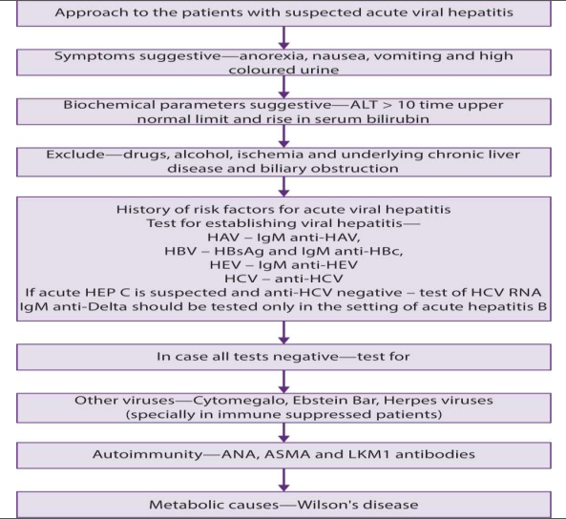

Slide 61
thanx

