Slide 1


The Importance of Ethical Behavior
Libyan International Medical University Faculty of business administration
Name: Mansour Ben Halim
ID:3813
Email: Mansour_3813@limu.edu.ly

Slide 2
Table Of Content:
Introduction.
Ethical Behavior.
Importance of Ethical Behavior.
Conclusion.
References.

Slide 3
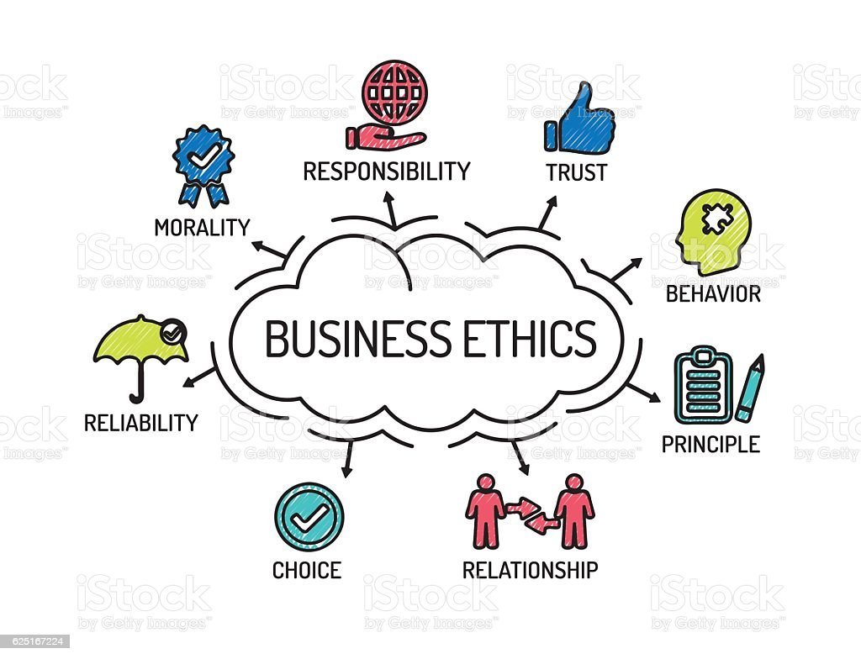
Introduction:
Ethical Behavior Is The Application of moral principles in a given situation. It means to behave according to the moral standards set by the society which we live in .

Slide 4
Ethical Behavior
This kind of behavior is not only found in the workplace .
May encompass all aspects of life .
In a business environment, a company typically expects ethical conduct from every employee, team leader, and manager, Observing ethics in the workplace can help employees act honestly and fairly in their interactions with colleagues and customers.

Slide 5
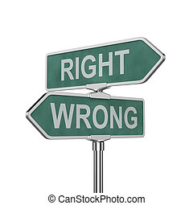
Ethical Behavior Mean:
Knowing the difference between right and wrong.
Consciously choosing to do right.
Demonstrating respect for key moral principles that include honesty, fairness, equality, dignity, diversity and individual rights(sinra, 2021).

Slide 6
Importance of Ethical Behavior:
Ethical behavior can have several beneficial impacts on society.
Business situations, behaving morally can also bring in money.
There are strong advantages to applying ethical ideals in the business.

Slide 7
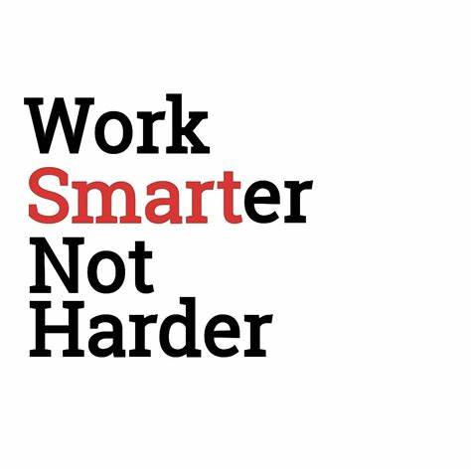
Examples Work Smarter:
Don’t Just work hard, work smarter. The reason why you see an employee promoted to the post of manager after just 2 years and a hardworking employee who has been with the company for 10 years failed to get a promotion is smart work(Blog, 2019).

Slide 8
Conclusion:
Ethical behavior involves the use of moral principles in individual and professional relationships.

Slide 9
References:
Sinra. (2021, December 11). What is ethical behavior? (explanation). CFAJournal. Retrieved November 8, 2022, from https://www.cfajournal.org/ethical-behavior/
Blog, F. (2019, November 20). 23 ethical & unethical behavior examples in Workplace. Formplus. Retrieved November 8, 2022, from https://www.formpl.us/blog/workplace-ethics.

Slide 10
Thank you
Any Question?

