Slide 1


Diabesity
[ diabetes & obesity ]
Block: PTS
By: AbdAlMohaimen Hussain Ahdash
Student number: 3440
Date : 6/6/2022
Supervisor:Alaa ben ali
1

Slide 2
Objectives :
Define obesity.
Causes of obesity.
Define diabetes.
Talk about the relationship between diabetes and obesity.
2

Slide 3
INTRODUCTION
As many of you know, obesity and diabetes could be dangerous and maybe one of the biggest problems in our world .
3

Slide 4
What is diabesity
Is a modern epidemic, which indicates the coexistence of both diabetes and obesity .
4

Slide 5
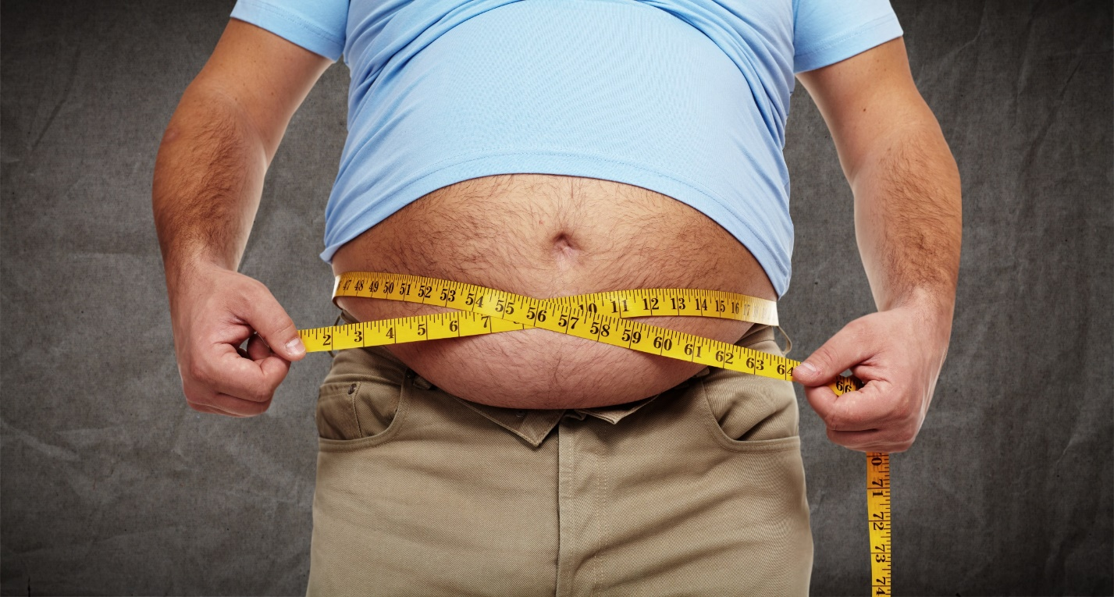
Obesity !!
Are defined as abnormal or excessive Fat accumulation that presents a risk to health, Or it is a complex disorder involving an excessive amount of body fat.
5

Slide 6
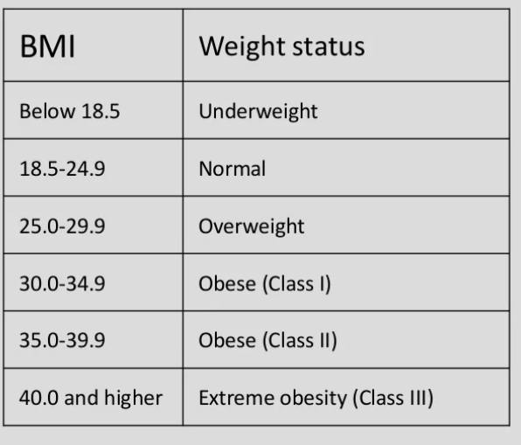
BMI: body mass index
6

Slide 7
Obesity fact :
According to the world health organization (WHO), at least 2.8 million people dying each year as a result of being overweight or obese.
7

Slide 8
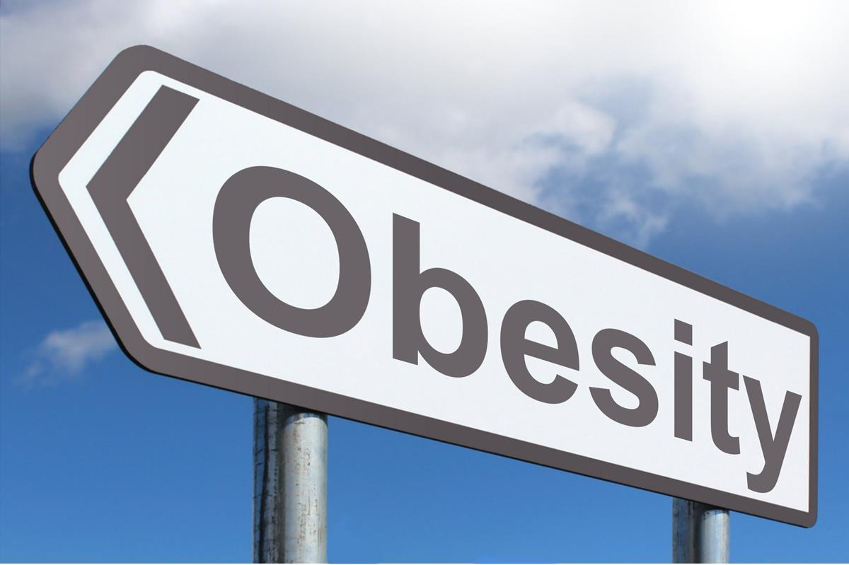
Causes of obesity
1- poor diet.
e.g eating out a lot, drinking too many sugar drinks, etc …
2- lack of physical activites.
3- calories .
4- and sometimes it could be from depression .
5- insulin !!!!!.
8

Slide 9
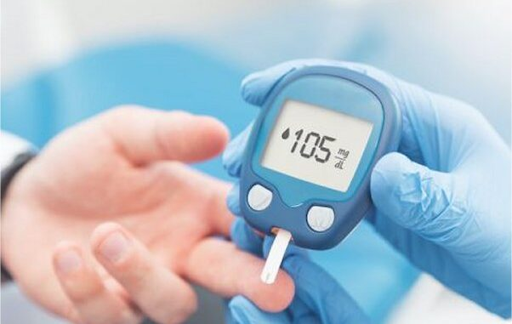
Diabetes
Is a chronic, metabolic disease characterized by elevated levels of blood glucose or (blood sugar), which may leads over time to serious damage to the heart, blood vessels, eyes, kidney and nerves.
9

Slide 10
There are two main types of diabetes
Type 1 diabetes, which often occurs in children or adolescents and is caused by the body’s inability to make insulin.
- Type 2 diabetes, which occurs as a result of the body’s inability to react properly to insulin ( insulin resistance).
10

Slide 11
The relationship of diabetes and obesity
One of the main reasons to have diabetes is obesity.
Having obesity makes you more likely to develop diabetes.
- If you have obesity, you are about six times!! More likely to develop type 2 diabetes than normal people.
11

Slide 12
People who are overweight have added pressure on their body’s ability to use insulin to properly control blood sugar levels.
Almost 90% of people living with type 2 diabetes are overweight or have obesity.
12

Slide 13
Conclusion :
It is quite evident that diabetes and obesity has already become a worldwide epidemics with a significant health and economic burden affecting both developed and developing countries.
13

Slide 14
Reference
- Pubmed, articles for (obesity, diabetes and the relationship of them)
- world health organization (WHO) website

Slide 15


