Slide 1


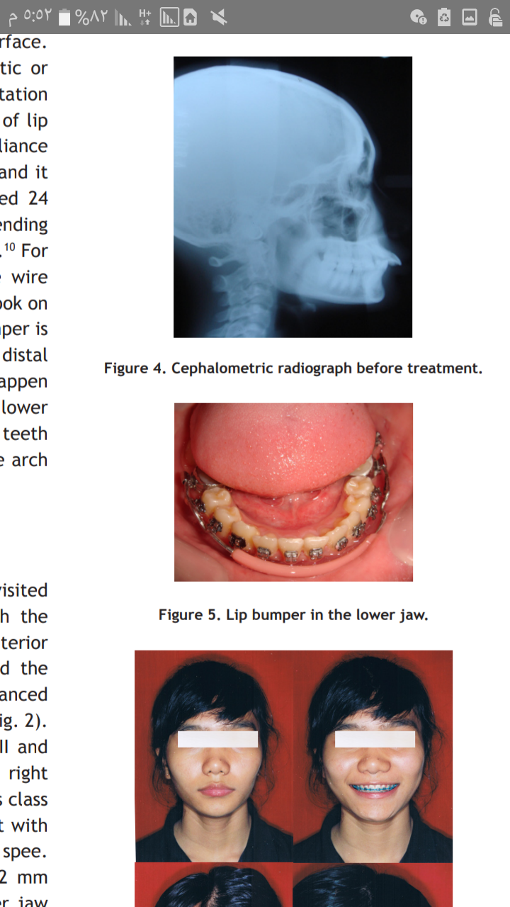
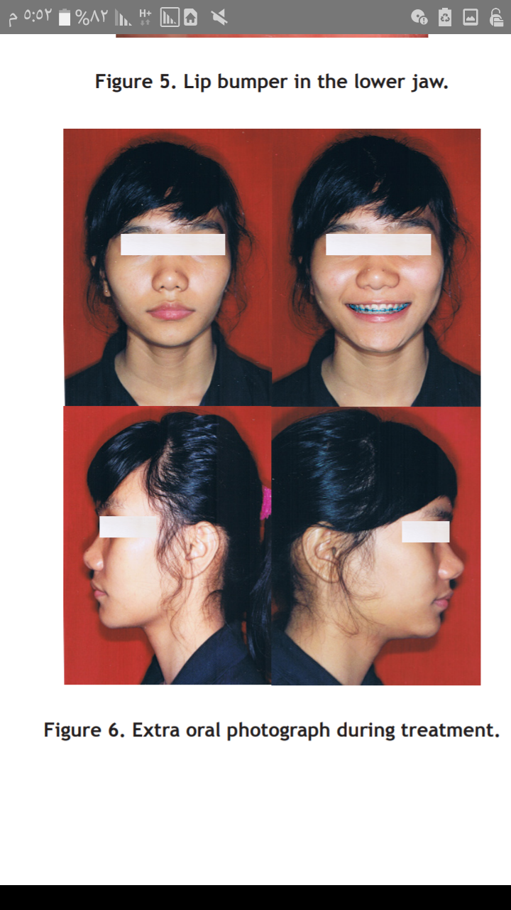
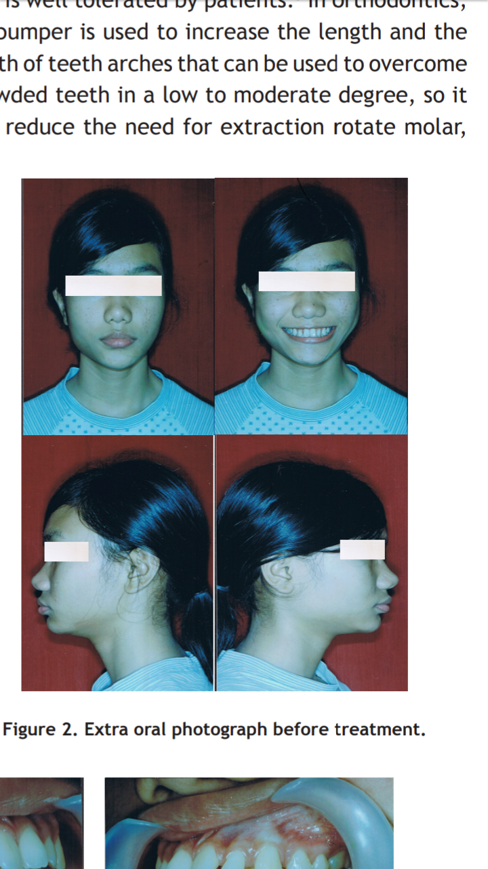
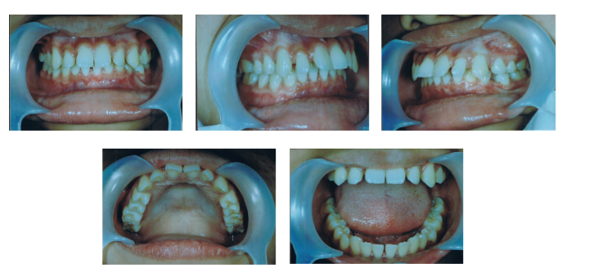
The use of lip bumper to overcome
lower lip sucking habit
Nour Alhouda Buhdeima / 2716
INTRODUCTION
Treatement plan
- The treatment objectives were to eliminate the lip sucking habit, multiple diastema, protrusion and palatal bite.
- Correct the deep curve of spee, coincide the upper and lower midline parallel with the face.
- Space excess would be corrected by posterior teeth mesial movement.
- The appliance used was a bumper and fixed appliance with standard bracket edgewise slot.022’’.
Dental position and stability are much affected by the balance of the surrounding muscles. The force of orbicularis oris and buccinators muscles is balanced by the opposing force from tongue.
When there is a balance alteration in those muscles, like in lip sucking habit, lip biting, tongue thrusting, the morphology change in normal configuration of teeth and their supporting bones may cause malocclusion.
The manifestation of malocclusion varies, depending on the type, location, severity, frequency, and the habit period. The elimination of an abnormal habit is the basis of long term treatment and stability. In a patient with lip sucking or lip biting, lip bumper is a good treatment alternative in overcoming the bad habit and repairing malocclusion.
CASE REPORT
A sixteen year old female patient visited the Orthodontic RSGMP FKG UI Clinic ,complaint labioversion and diastema of anterior upper teeth.
The extra oral check showed the patient has a mesofacial, symmetric, and balanced face with straight chin and convex profile .
The relation of the right molar was class II and the left molar class I.
The relation of the right canines was class II and the left canines was class I.
Patient had 9 mm anterior teeth over jet with 5 mm overbite (palatal bite).
Deep curve of spee. Lower teeth midline shifted to the right 2 mm with an oval shape of the upper and lower jaw
Fig 4 - Lip bumper in the lower jaw.
Fig 5- Extra oral photograph during treatment
Fig 1 -Extra oral photograph before treatment
DISCUSSION & CONCLUSION
-The patient had protrusive upper teeth. caused by the lower lip trapped between the upper and lower anterior teeth related to lower lip sucking habit. This habit was regarded as the primary factor, since
there was a big over jet with the upper anterior teeth tipped to the labial.
The use of lip bumper would reduce mental muscles hyperactivity
The soft tissues around the teeth would adapt and they were expected to get their stability in their new positions.
-The elimination of the bad habit is the basis of the treatment and long term stabilization. In this patient’s case, lip bumper was chosen in order to overcome the bad habit of sucking the lower lip, so it was no longer trapped between the upper and lower anterior teeth. It is expected that after the treatment, there will be a normal occlusion and the long term stabilization of the treatment result will be obtained
Fig 2- Intra oral photograph before treatment.
REFERANCE
Budhiawan M, Krisnawati K. The use of lip bumper to overcome lower lip sucking habit. Padjadjaran Journal of Dentistry. 2010;22(1). doi:10.24198/pjd.vol22no1.14076
Akwan Y, Paramita A, Juniar E. The Use of Lip Bumper in Lip Sucking Treatment. DENTA. 2019;11(2):104. doi:10.30649/denta.v11i2.104
Yuniarsih E, Soenawan H. THE TREATMENT OF LIP SUCKING WITH LIP BUMPER (CASE REPORT). Journal of Dentistry Indonesia. 2008;13(3). doi:10.14693/jdi.v13i3.362
Fig3- The cephalometric radiograph before treatment

