Slide 1


Maternal smoking
Presented by/Wala EL-Gtani, 3550
4 \ 6\ 2022
PTS | Block , First year Medical Student
Supervised by/Dr. Fatma Eltrhouni

Slide 2
Objectives
Introduction to maternal smoking.
Define second hand smoking.
Pregnancy complications from smoking.
Effects of second hand smoking.
Comparation of normal fetal growth and abnormal fetal growth due to smoking.
The importance of awareness/Quit smoking.

Slide 3
Introduction to Maternal smoking
Smoking or using tobacco in any way or form is deadly serious. It is unallowable that many pregnant women are exposed to tobacco either because they smoke or being close to someone that does (SHS).
Smoking doesn’t not only effect their lives but their children`s, and the growth of their unborn fetus.
Smoking during pregnancy results in more than 1,000 infant deaths annually.

Slide 4
Second hand smoking
There are two types of tobacco smoke, mainstream smoke which is directly inhaled by the mouth of a smoker and side stream smoke or second-hand smoke or passive smoking which comes from burning tip of cigarette mixed with surrounded air.
It is a combination of the smoke exhaled by a smoker and the smoke that comes from the end of a burning cigarette. When someone breathes in this smoke, it is often referred to as passive smoking.

Slide 5
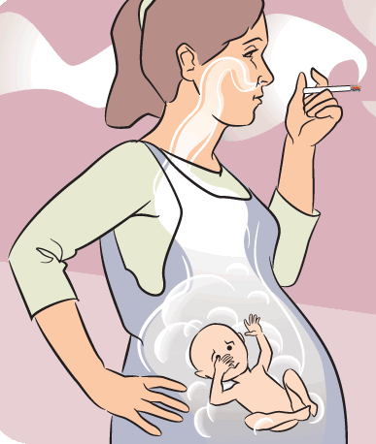
Pregnancy complications from smoking
Ectopic pregnancy this is pregnancy outside the uterus.
Fetal death.
Problems with the placenta including early detachment from the uterine (placenta previa).
Miscarriage.
Premature births/Low birth weight.
Nicotine can be passed from your breast milk to your newborn.

Slide 6
Effects of Second hand smoking
Second hand smoking is a serious health issue causing more than 41,000 deaths per year , people who breath in second hand smoking are more likely to get the same disease as smokers, including lung cancer and heart disease.

Slide 7
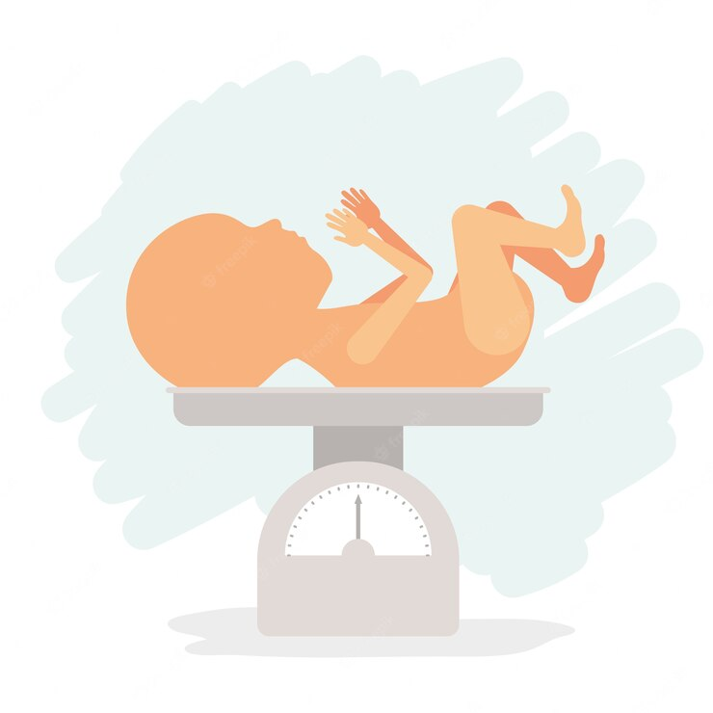
Pregnant women exposed to smoke passively are more at risk of premature birth.
Women exposed to secondhand smoke during pregnancy are more likely to birth newborns with lower birth weight and have a higher risk of sudden infant death SIDS.

Slide 8
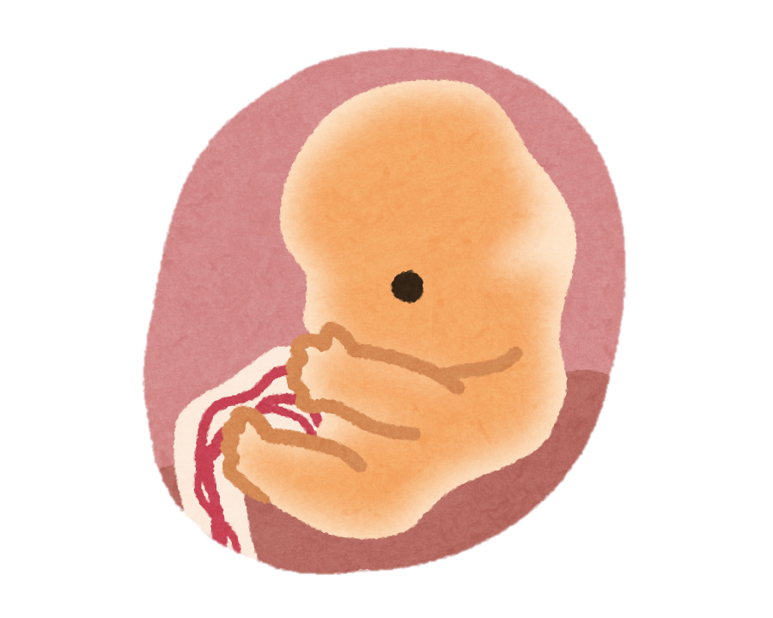
Chemicals in secondhand smoking appear to affect the brain as it interfere with its regulation of infants breathing.

Slide 9
How dangerous is second hand smoking during pregnancy
Second hand smoke is extremely dangerous for you and your baby, There are approximately 4000 chemicals present in second hand smoke, many of which have been determined to be related to cancer. Being exposed to second hand smoking during pregnancy puts you and your baby at risk.
The health conditions that you put yourself at risk at are the same as active smoking.

Slide 10
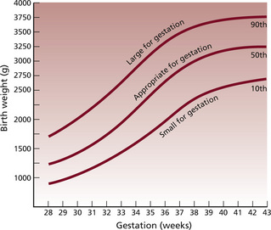
Comparation between normal fetal growth and abnormal fetal growth due to smoking

Slide 11

The importance of spreading awareness / quit smoking
Quitting smoking is one of the most important actions people can take to improve their health. This is true regardless of their age or how long they have been smoking, so for pregnant women quitting does not only benefit her but her unborn child.
There are many ways to help women quit like being educated, receiving support and nicotine replacement therapy NRT.

Slide 12
conclusion
In our place of being and the environment we live in we thankfully don’t have as much or any at all of smoking pregnant women but they are given nicotine passively which we should change.
Spreading awareness to those who smoke by presenting the damage they cause not only to their selves but to the people around them is something we should work on doing.

Slide 13
reference
http://Geirsson RT, Tolosa JE. Smoking, tobacco exposure and pregnancy. Acta Obstet Gynecol Scand. 2010;89(4):414-415. doi: 10.3109/00016341003784043. PMID: 20367424.
https://www.cdc.gov/tobacco/data_statistics/fact_sheets/secondhand_smoke/health_effects/index.htm
https://www.cdc.gov/tobacco/data_statistics/fact_sheets/secondhand_smoke/health_effects/index.htm
Ethical issues in Nursing and Midwifery practice. Win Tadd; 1998.
(From Simpson 1997, with permission of Baillière Tindall.)
https://www.cdc.gov/tobacco/data_statistics/fact_sheets/secondhand_smoke/health_effects/index.htm.

Slide 14
THANK YOU !

