Slide 1
Infective Endocarditis
Dr. Zak Bettamer
Zikoecho@yahoo.com

Slide 2
Case
22 years old female patient with previous history of infected endocarditis before and recent dental procedure admitted to the hospital with history of High grade fever and chills, Shortness Of Breath Arthralgia 3 days duration .
On Examination BP: 100/70, Pulse : 110 beat/minute, Temperature : 40 C
Cardiovascular examination : pan systolic Murmur and tachycardia.
Chest : clear
Abdominal Examination : Normal
White Blood Cells is high and ECG show Sinus Tachycardia.
Echocardiography show Mitral regurgitation with Vegetation on top of the Mitral Valve.

Slide 3
Definition
• Infectious Endocarditis (IE): an infection of the heart’s endocardial surface
• Classified into:
– Native Valve IE
– Prosthetic Valve IE

Slide 4
Pathophysiology
1. Turbulent blood flow disrupts the
endocardium making it “sticky”
2. Bacteremia delivers the organisms to the
endocardial surface
3. Adherence of the organisms to the
endocardial surface
4. Eventual invasion of the valvular leaflets

Slide 5
Epidemiology
• Incidence difficult to ascertain and varies
according to location
• Much more common in males than in females
• May occur in persons of any age and increasingly common in elderly
• Mortality ranges from 20-30%
• Icidence: 2 -5 caese/ 100 000.

Slide 6
Risk Factors
• Intravenous drug abuse
• Artificial heart valves and pacemakers
• Acquired heart defects
– Calcific aortic stenosis
– Mitral valve prolapse with regurgitation
• Congenital heart defects
• Intravascular catheters

Slide 7
Infecting Organisms
• Common bacteria
– S. aureus
– Streptococci
– Enterococci
• Not so common bacteria
– Fungi
– Pseudomonas

Slide 8
Symptoms
Acute
High grade fever and chills
SOB
Arthralgias/myalgias
Abdominal pain
Pleuritic chest pain
Back pain
Subacute
– Low grade fever
– Anorexia
– Weight loss
– Fatigue
– Arthralgias/ myalgias
– Abdominal pain
– N/V
The onset of symptoms is usually 2 weeks or less from the initiating bacteremia

Slide 9
Signs
• Fever
• Heart murmur
• Nonspecific signs – petechiae, subungal or
“splinter” hemorrhages, clubbing,
splenomegaly, neurologic changes
• More specific signs - Osler’s Nodes, Janeway
lesions, and Roth Spots

Slide 10
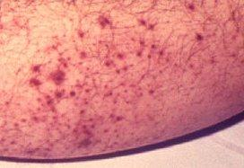
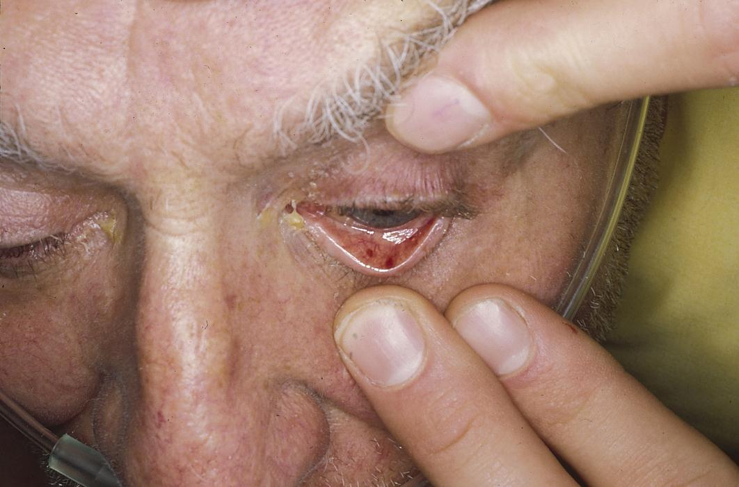
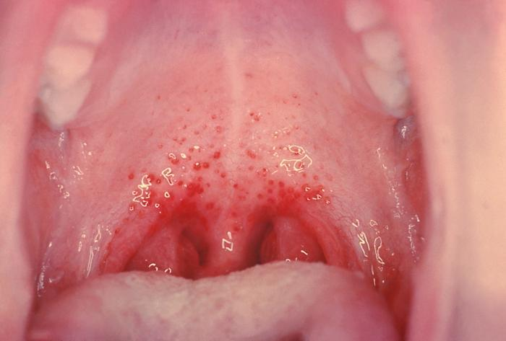
Petechiae
1.Nonspecific
2.Often located on extremities or mucous membranes

Slide 11
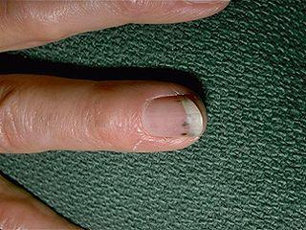
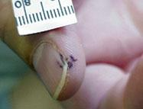
Splinter Hemorrhages
1. Nonspecific
2. Nonblanching
3. Linear reddish-brown lesions found under the nail bed
4. Usually do NOT extend the entire length of the nail

Slide 12
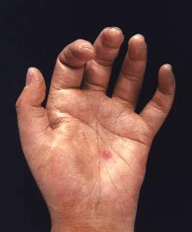
Osler’s Nodes
1. More specific
2. Painful and erythematous nodules
3. Located on pulp of fingers and toes
4. More common in subacute IE

Slide 13
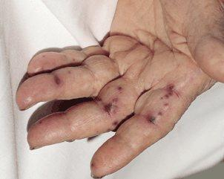
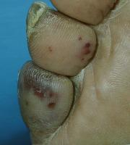
Janeway Lesions
1. More specific
2. Erythematous, blanching macules
3. Painless.
4. Located on palms and soles

Slide 14
The Essential Blood Test
Blood Cultures
– Minimum of three blood cultures
– Three separate venipuncture sites
– Obtain 10-20 mL in adults and 0.5-5 mL in children
• Positive Result
– Typical organisms present in at least 2 separate samples
– Persistently positive blood culture (atypical organisms)
• Two positive blood cultures obtained at least 12 hours apart
• Three or a more positive blood cultures in which the first and last samples were collected at least one hour apart

Slide 15
Additional Labs
• CBC
• ESR and CRP
• Complement levels (C3, C4, CH50)
• Rhematoid factor.
• Urinalysis: microscopic hematuria.
• Baseline chemistries and coags

Slide 16
Imaging
• Chest x-ray
– Look for multiple focal infiltrates and calcification of heart valves
• ECG
– Rarely diagnostic
– Look for evidence of ischemia, conduction delay, and arrhythmias
• Echocardiography

Slide 17
Indications for Echocardiography
Transthoracic echocardiography (TTE)
– First line if suspected IE
– Native valves
Transesophageal echocardiography (TEE)
– Prosthetic valves
– Intracardiac complications
– Inadequate TTE
– Fungal or S. aureus or bacteremia

Slide 18
Modified Duke Criteria
Definitive diagnosis:
• 2 major
• 1 major and 3 minor criteria.
• All 5 minor criteria.
Major criteria:
• Positive blood culture.
• Endocardium involved:
• +ve Echo (vegatation, abcess).
• New valvular regurgitation.

Slide 19
Modified Duke Criteria
Minor criteria:
• Predisposition (cardiac lesion, IV drug abuser).
• Fever >38
• Vascular/ immunological signs.
• +ve blood culture that do not meet major criteria.
• +ve Echo that doesn’t meet major criteria.

Slide 20
Treatment
• Parenteral antibiotics
– High serum concentrations to penetrate
vegetations
– Prolonged treatment to kill dormant bacteria
clustered in vegetations
Acute: flucloxacillin and gentamicin .
Subacute : benzyl penicillin and gentamicin .
penicillin allergy, a prosthetic valve or suspected meticillin-resistant Staph. aureus (MRSA) infection, triple therapy with vancomycin, gentamicinnand oral rifampicin should be considered
• Surgery
– Intracardiac complications
• Surveillance blood cultures

Slide 21
Indications for cardiac surgery in infective endocarditis
• Heart failure due to valve damage
• Failure of antibiotic therapy (persistent/uncontrolled infection)
• Large vegetations on left-sided heart valves with evidence or ‘high risk’ of systemic emboli
• Abscess formation
*Patients with prosthetic valve endocarditis or fungal endocarditis often require cardiac surgery.

Slide 22
Complications
• Four etiologies
– Embolic
– Local spread of infection
– Metastatic spread of infection
– Formation of immune complexes glomerulonephritis and arthritis

Slide 23
Embolic Complications
• Occur in up to 40% of patients with IE
• Incidence decreases significantly after
initiation of effective antibiotics
Stroke
Myocardial Infarction
Ischemic limbs
Hypoxia from pulmonary emboli
Abdominal pain (splenic or renal infarction)

Slide 24
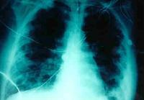
Septic Pulmonary Emboli

Slide 25
Local Spread of Infection
• Heart failure
– Extensive valvular damage
• Paravalvular abscess (30-40%)
– Most common in aortic valve, IVDA, and S. aureus
– May extend into adjacent conduction tissue causing
arrythmias
– Higher rates of embolization and mortality
• Pericarditis
• Fistulous intracardiac connections

Slide 26
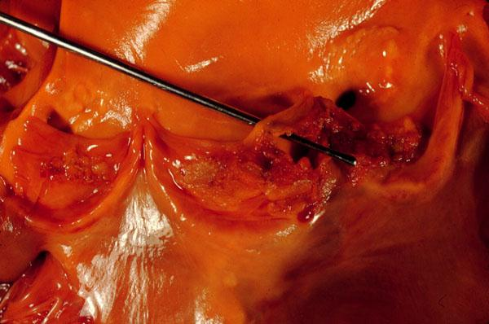
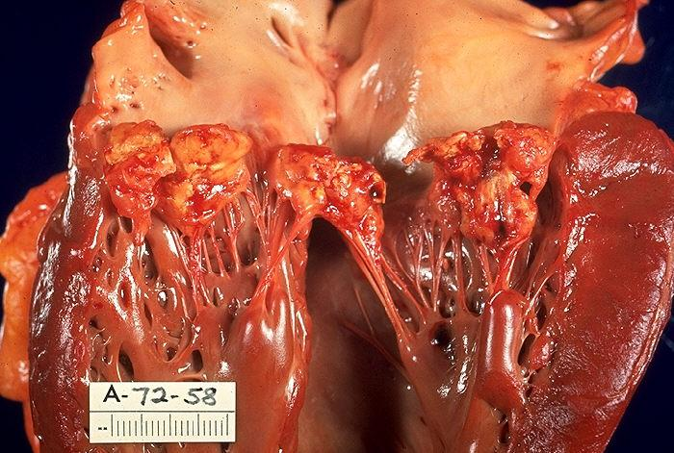
Local Spread of Infection
Acute S. aureus IE with perforation of the aortic valve and aortic valve vegetations.
Acute S. aureus IE with mitral valve ring abscess extending into myocardium.

Slide 27
Metastatic Spread of Infection
• Metastatic abscess
– Kidneys, spleen, brain, soft tissues
• Meningitis and/or encephalitis
• Vertebral osteomyelitis
• Septic arthritis

Slide 28
Prevention of I.E
Which condition?
Heart transplantation
Cyanotic congenital Heart Disease
Prosthetic Valve
Previous History of IE

Slide 29
Prevention
Until recently, antibiotic prophylaxis was routinely given to people at risk of infective endocarditis undergoing interventional procedures.
However, as this has not been proven to be effective and the link between episodes of infective endocarditis and interventional procedures has not been demonstrated, antibiotic prophylaxis is no longer offered routinely for defined interventional procedures.

Slide 30
Which procedure?
• Dental procedures involving extractions, scaling, polishing or gingival surgery.
• Upper respiratory tract surgery.
• Esophageal dilatation.
• Surgery of lower bowel, gall bladder, or GU tract.

Slide 31
Prophylaxis of dental procedures
 Local or no anesthesia: Amoxycillin 3 g orally 1 hour before.
If allergic to peniciilin – Clindamycin 600 mg.
• General anesthesia, no special risk: Amoxycillin 1 g I.V. at induction, followed by 500 mg 6 hours later.
• Gn. Anesthesia, special risk (prosthetic valve, previous I.E):Amoxycillin IV 1 g + gentamacin 120 mg at induction, followed by 500 mg
amoxycillin 6 hours later.
If allergic to peniciliin: IV vancomycin or clindamycin.

Slide 32
THANKS

