Slide 1



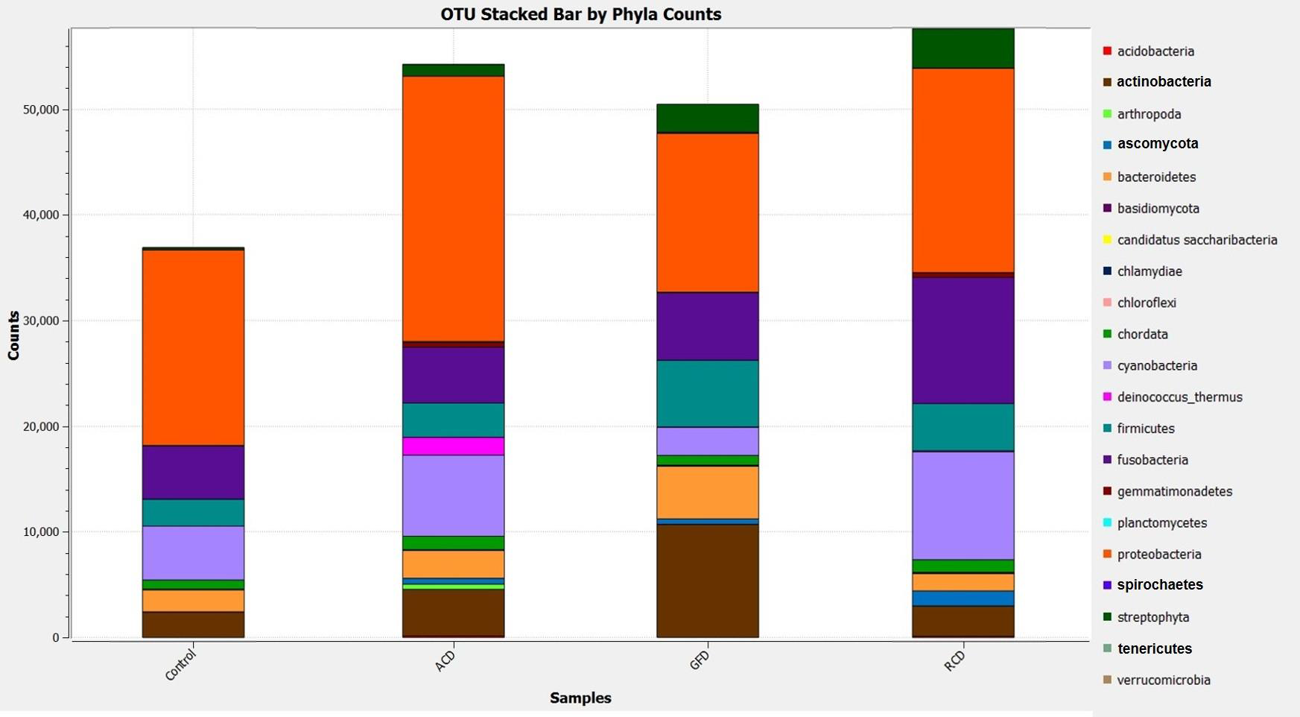
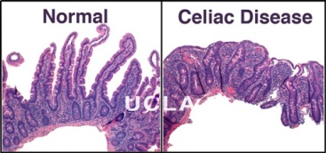
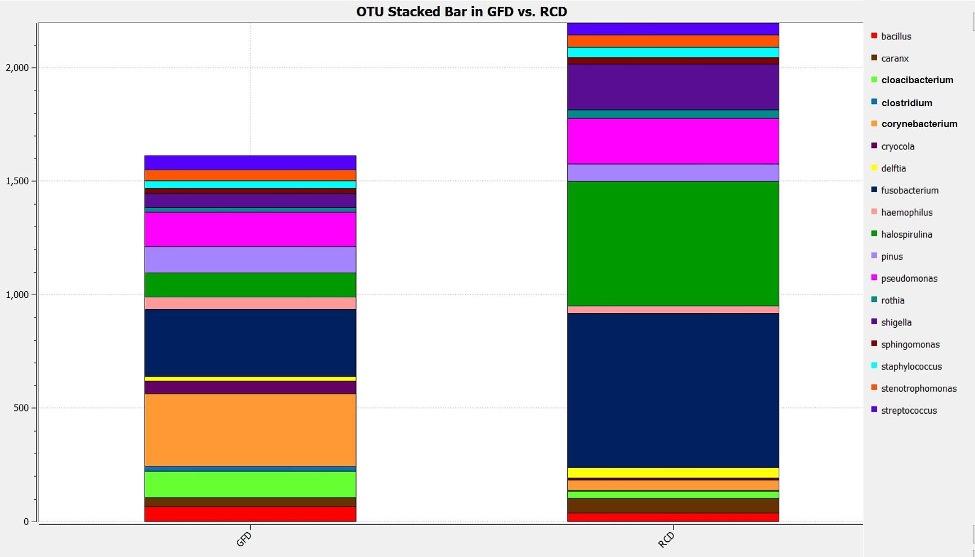
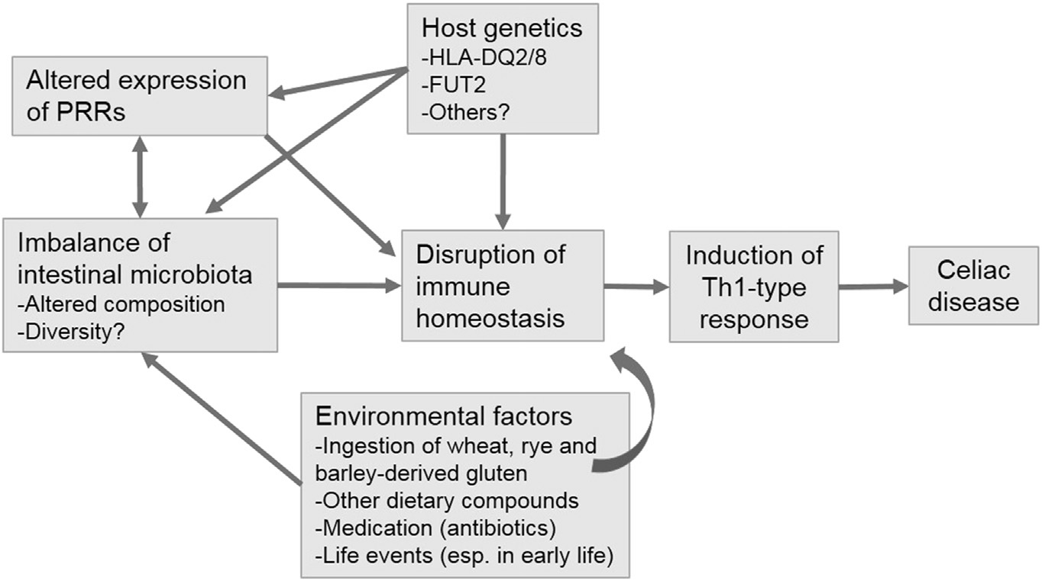
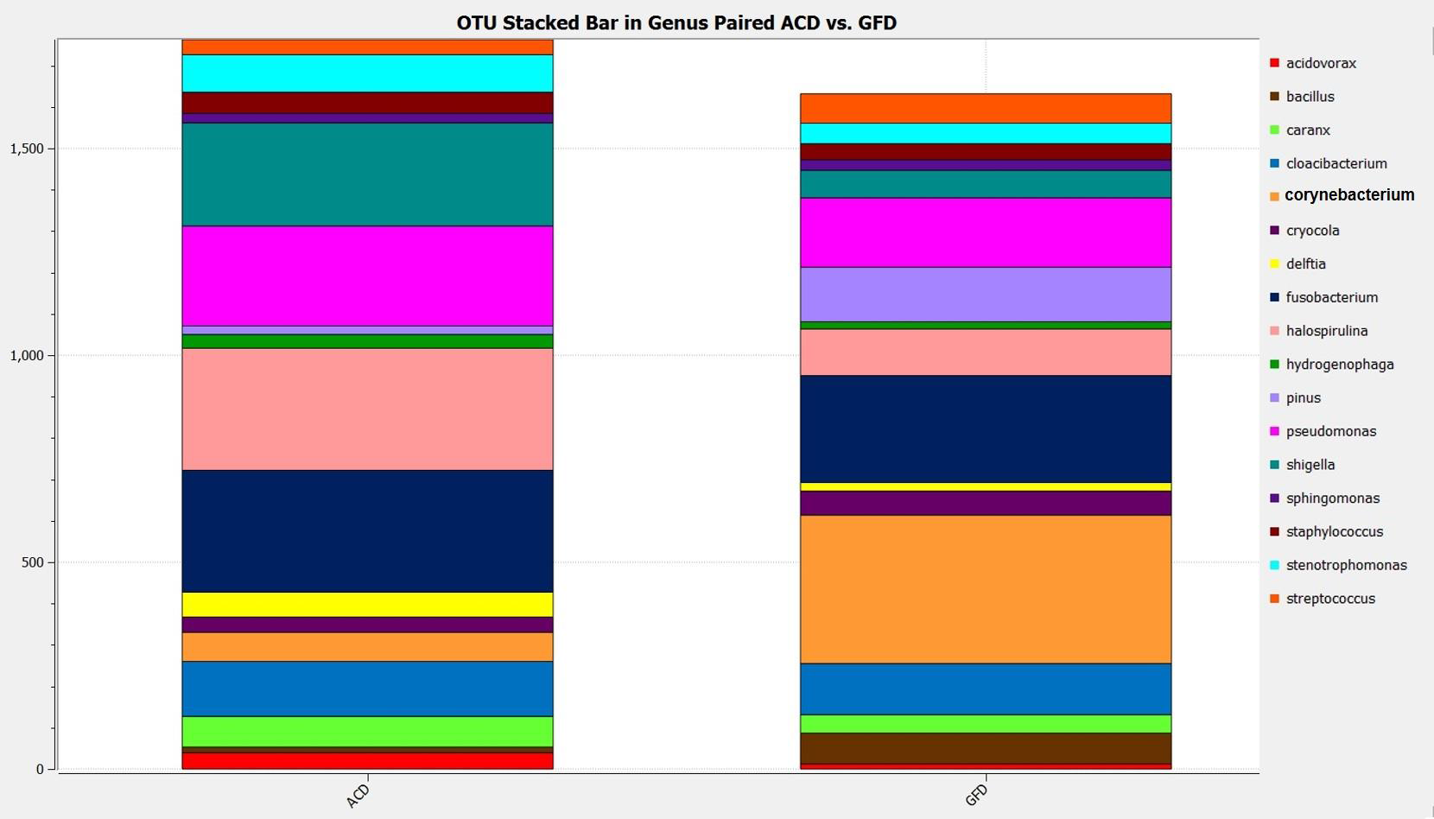
Gut Microbiota in Different Stage of Celiac Disease Libyan International Medical University Faculty Of Basic Medical Science
Aya Faroug
Introduction
Result
New Research Gives Hope to celiac sufferrs
CD is an autoimmune disease of the small intestine characterized by permanent intolerance to dietary gluten occurring in genetically susceptible individuals (HLA)-DQ2 o rDQ8 haplotype (1) When gluten is ingested the intestine is attacked by body’s immune The attack intestine causes the villi become flat CD is a multifactorial disorder this is a complex disorder involving both environmental and immune-genetic factor (2)
Researchers found that gluten, which is not well digested by the gut enzymes, could be metabolized by bacteria
The scientists of discovered that mice that harboured in their gut the (Psa) isolated from celiac patients, metabolized gluten differently than mice treated with Lactobacillus,
More interestingly, when the chemistry of gluten metabolism , the researchers found that Psa produced gluten sequences that stimulated inflammation , while Lactobacillus was able to detoxify gluten. These bacteria could have an important role in gluten metabolism and could offer promising new treatment modalities for CD (5)
the
.
Environmental factor
Mean bacterial burden in different disease states differed significantly among the three groups (P<0.05,) Microbial composition also differs. Bold indicates significant differences among phyla. Note low actinobacteria levels (commensal organisms) in RCD
Although gluten is the main environmental , the timing of disease onset following gluten exposure varies greatly , Suggeting that other factors are involveds . Fig1 The pathogenic mechanisms that contribute towards CD may be triggered by Environmental factors include that could amplify the response to gluten in (2) predisposed individuals Fig. 1. Factors contributing to the onset of celiac disease. Both genetic and environmental factors contribute to the development of CD
Conclusion
Celiac disease patients with active inflammation (ACD, RCD1) show an increased bacterial burden and alterations of the duodenal than controls, indicating dysbiosis. Differences in the duodenal microbial composition of RCD patients compared to those on a GFD ( and similarities to those with active disease) suggests a link between certain bacteria and
inflammation; cause or effect await further studies
The microbiome of RCD differs from GFD and more closely resembles composition of ACD This graph shows the most abundant genera in GFD vs. RCD A significant difference in Corynebacterium levels is seen; low in RCD and high in GFD. Levels of Fusobacterium and Cloacibacteriumare higher in RCD compared to GFD
Reference
Microbiome alteration
1 Ludvigsson JF, Leffler DA, Bai JC, Biagi F, Fasano A, Green PH, et al. The Oslo definitions for coeliac disease and related terms. Gut 2013;62(1):43e52 2 Dubois PC, Trynka G, Franke L, Hunt KA, Romanos J, Curtotti A, et al. Multiple common variants for celiac disease influencing immune gene expression. Nat Genet 2010;42(4):295e302 3 Cheng J, Kalliomaki M, Heilig HG, et al. Duodenal microbiota composition and mucosal homeostasis in pediatric celiac disease. BMC gastroenterology. 2013;13:113 4 Leonard MM, Camhi S, Huedo-Medina TB, Fasano A. Celiac Disease Genomic, Environmental,Microbiome, andMetabolomic (CDGEMM) Study Design: Approach to the Future of Personalized Prevention of Celiac Disease. Nutrients. 2015;7(11):9325-9336 5 Mamone, G., Ferranti, P., Rossi, M., Roepstorff, P., Fierro, O., Malorni, A., & Addeo, F. (2007). Identification of a peptide from α-gliadin resistant to digestive enzymes: Implications for celiac disease. Journal of Chromatography B, 855(2), 236-24
Refrance
Individuals with CD have perturbations in the gut microbial signature the purpose of study was to compare duodenal microbiome of adulth CD Methods: Microbiota in duodenal biopsy samples obtained from 30 patients with active CD (ACD, n=30), those on a gluten free diet (GFD, n=24) patients with refractory to a gluten free diet, (RCD1, n=26) and controls (n=23) were analyzed using PCR denaturing gradient gel electrophoresis and a subset of samples additionally by the 16S ribosomal RNA gene sequencing. (3)(4)
.
The most abundantly identified genera (matched pairs n=4). . The only significant difference is the lower levels of Corynebacterium sp. in ACD compared to GFD

