Slide 1

Polio virus vaccine
IMMUNOZATION
Haitham esgair alzahra
2932
AMS
PTS BLOCK
1

Slide 2
INTRODUCTION
2

Slide 3
OBJECTIVE
Type of polio vaccine
History of polio vaccine
How does the polio vaccine work
Disadvantages of polio vaccine
3

Slide 4
POLIO VACCINE TYPES
IPV
OPV
Salk, inactivated or killed vaccine
Sabin, attenuated or oral vaccine
4

Slide 5
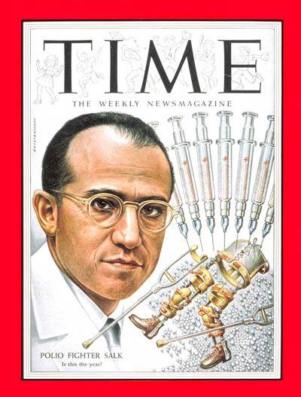
HISTORY OF POLIO VACCINE
IPV
The first inactivated polio vaccine was produced by Jonas Salk using virus grown on monkey kidney cells
The incidence of paralytic poliomyelitis in the United States decreased
5

Slide 6
13.9 cases
0.8 cases
In 1961
In 1954
6

Slide 7
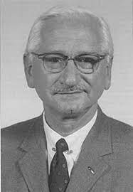
HISTORY OF POLIO VACCINE
OPV
The development of the attenuated PV vaccine starts with passages of PV strains in rats and mice followed by passages in the cell culture
In 1960 the strains developed by Albert Sabin provided good antibody levels
7

Slide 8
Mechanism of polio vaccine
IPV
The virus particles are destroyed and cannot infect the cell, but the virus maintains some of its antigens to be recognized by the immune system
8

Slide 9
Mechanism of polio vaccine
OPV
Is a vaccine created by reducing the virulence of a pathogen
Attenuation takes an infectious agent and alters it so that it becomes harmless or less virulent
9

Slide 10
Disadvantages
OPV
In extremely rare cases the live attenuated can cause paralysis
Vaccine-virus may be able to circulate, mutate and, over the course of 12 to 18 months, reacquire neurovirulenc
IPV
Induces very low levels of immunity in the intestine
The virus can still multiply inside the intestines
10

Slide 11
Conclusion
Story of poliomyelitis Is a story of death and fear then of victory and hope and to this Day there are still efforts to eradicate this disease But these efforts are slowed down by anti-vaxxers who cause poliomyelitis and many other old diseases to reappear ,So we need spread awareness of the importance of vaccine
11

Slide 12
References
Patel M, Zipursky S, Orenstein W, Garon J, Zaffran M. Polio endgame: the global introduction of inactivated polio vaccine. Expert review of vaccines. 2015 May 4;14(5):749-62
Chumakov K, Ehrenfeld E, Wimmer E, Agol VI. Vaccination against polio should not be stopped. Nature Reviews Microbiology. 2007 Dec;5(12):952-8.
Levinson W. Review Of Medical Microbiology And Immunology. 13th ed. new york; 2014.
12

Slide 13
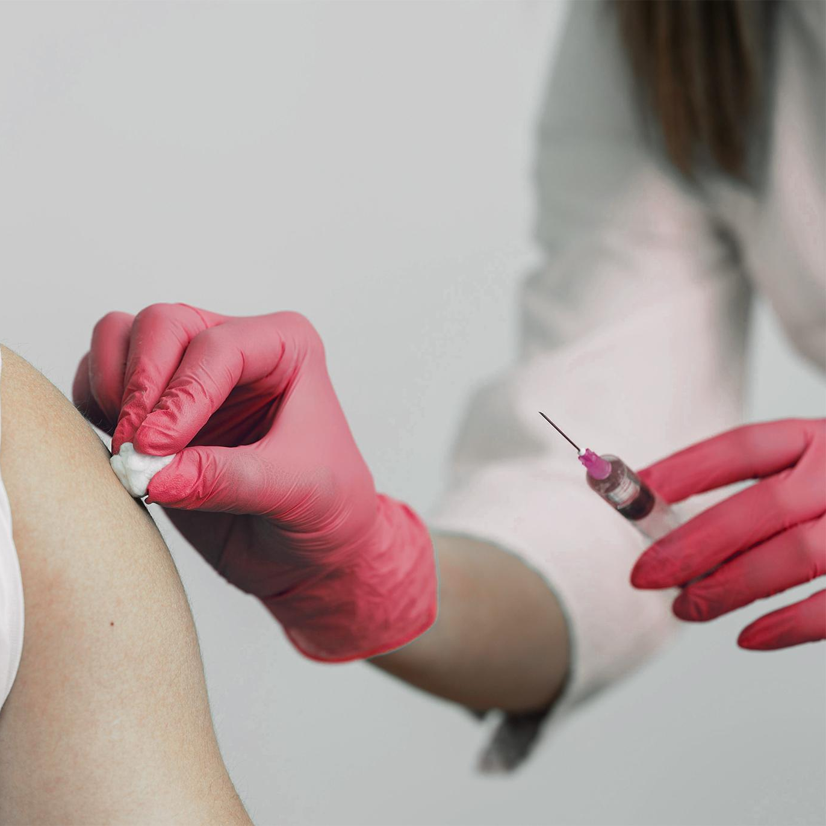
THE END
13

