Slide 1
BASIC SURGICAL INSTRUMENTS
Dr. Othman Tajoury
MD,MRCS(Eng.),FEBS(Euro. Board)
Vice dean Faculty of Medicine LIMU

Slide 2
BASIC SURGICAL INSTRUMENTS
Dr. Othman Tajoury
MD,MRCS(Eng.),FEBS(Euro. Board)
Vice dean Faculty of Medicine LIMU

Slide 3
Learning Objectives
After this lecture you will :
identify the different types of surgical instruments
uses according to the type of surgery

Slide 4
Principles of instruments handling
Economy of movements
Relaxed handling.
Avoidance of awkward movements.
Safety (patient and staff)

Slide 5
BASIC SURGICAL INSTRUMENTS
Basic laparotomy instruments are essential to accomplish most types of general surgery. Each instrument can be placed into one of the four following basic categories:
Retracting and Occluding Instruments
Cutting and Dissecting Instruments
Clamping and Occluding Instruments
Grasping and Holding Instruments

Slide 6
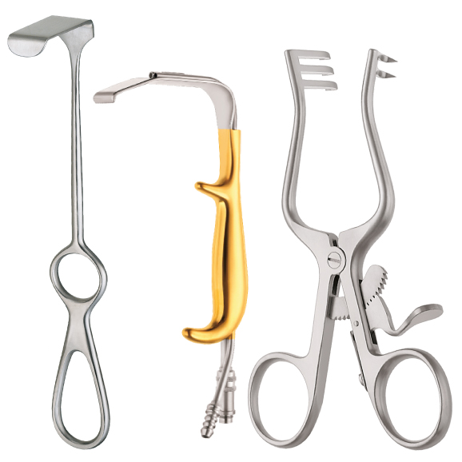
Retracting and Exposing Instruments
used to hold back or retract organs or tissue to gain exposure to the operative site. They are either "self-retaining" (stay open on their own) or "manual" (held by hand). When identifying retractors, look at the blade, not the handle.

Slide 7
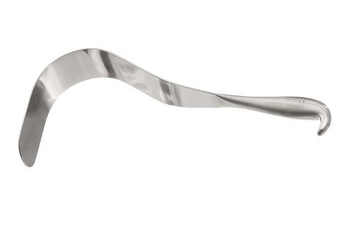
Deaver’s Retractor
Used in Cholecystectomy for retraction of right lobe of liver.
Used in Truncal vagotomy for retraction of left lobe of liver.
Used in kidney operations to retract the anterior abdominal wall.

Slide 8
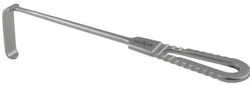
Lange beck's Retractor
 They are used to help better visualization of the operative
field, tissue handling is minimized and bleeding better seen and controlled.

Slide 9
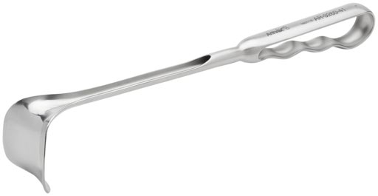
Retracting and Exposing Instruments
A Richardson retractor (manual) is used to retract deep abdominal or chest incisions

Slide 10
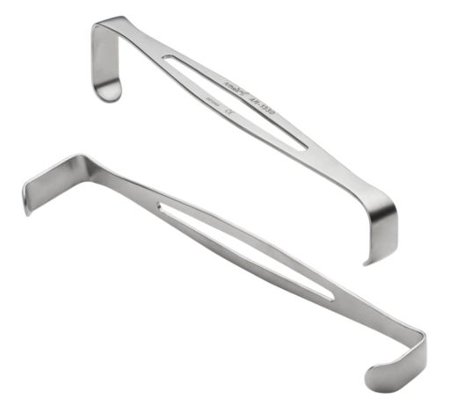
Retracting and Exposing Instruments
An Army-Navy retractor (manual) is used to retract shallow or superficial incisions. Other names: USA, US Army.

Slide 11
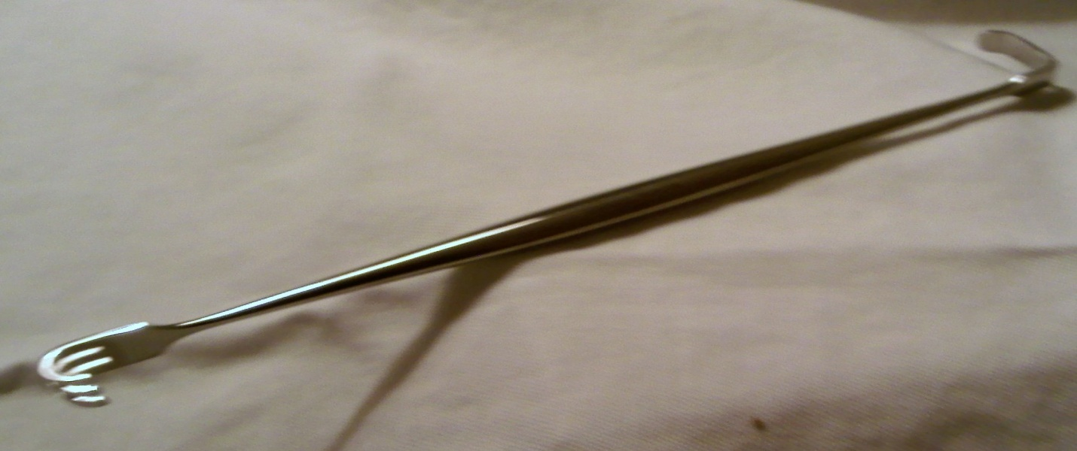
Skin Hook
Flat end is a blunt retractor
Three-prong end may be sharp to dull
Used to retract small incisions or secure a skin edge for suturing

Slide 12
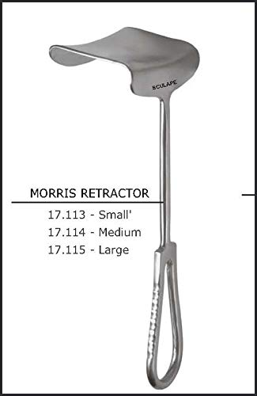
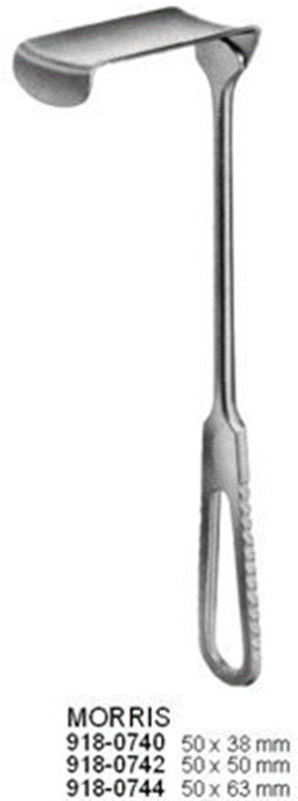
Morris Retractor
Used while making and closing abdominal incisions for ease of working in the deeper layers.
Used to retract Pectoralis major in MRM for better visualization during axillary dissection.

Slide 13
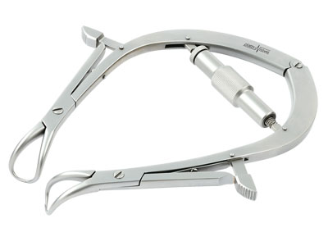
Joll’s Thyroid Retractor
 It is a self retaining retractor used in thyroid surgeries to retract the skin.

Slide 14
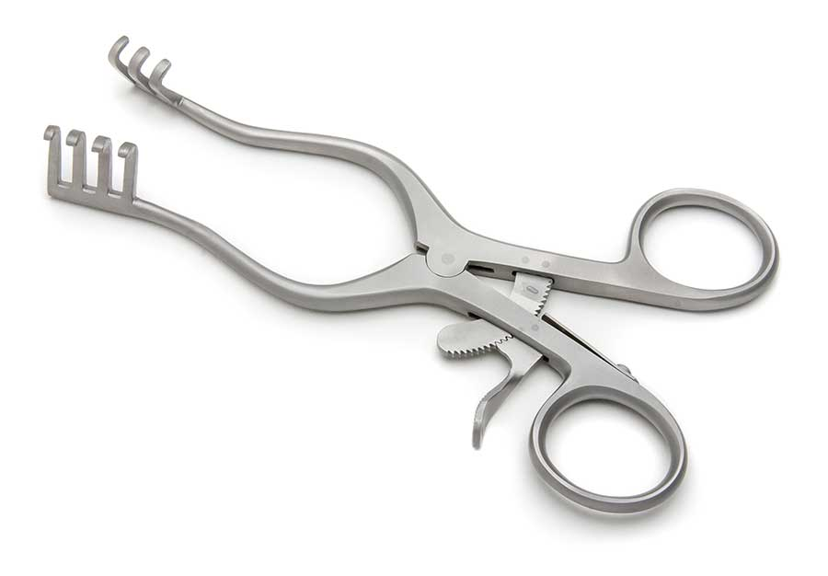
Retracting and Exposing Instruments
A Weitlaner retractor (self-retaining) is used to retract shallow incisions.

Slide 15
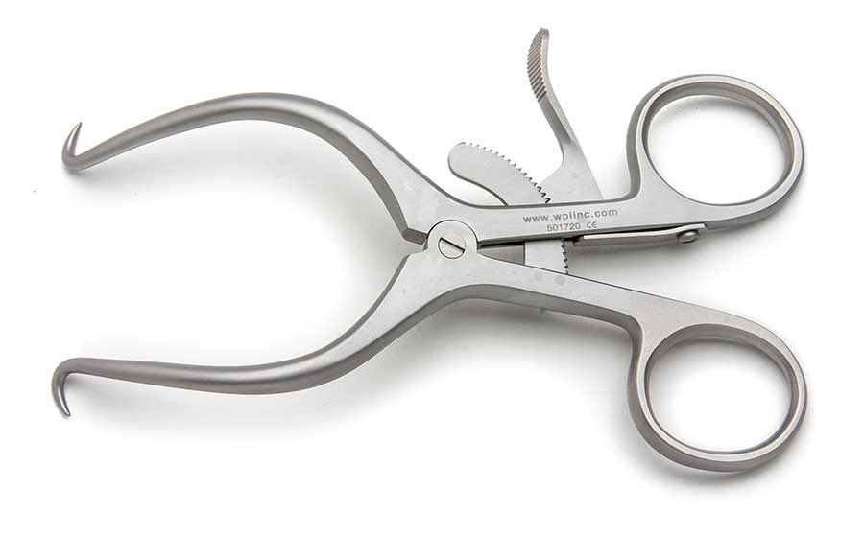
Retracting and Exposing Instruments
A Gelpi retractor (self-retaining) is used to retract shallow incisions.

Slide 16
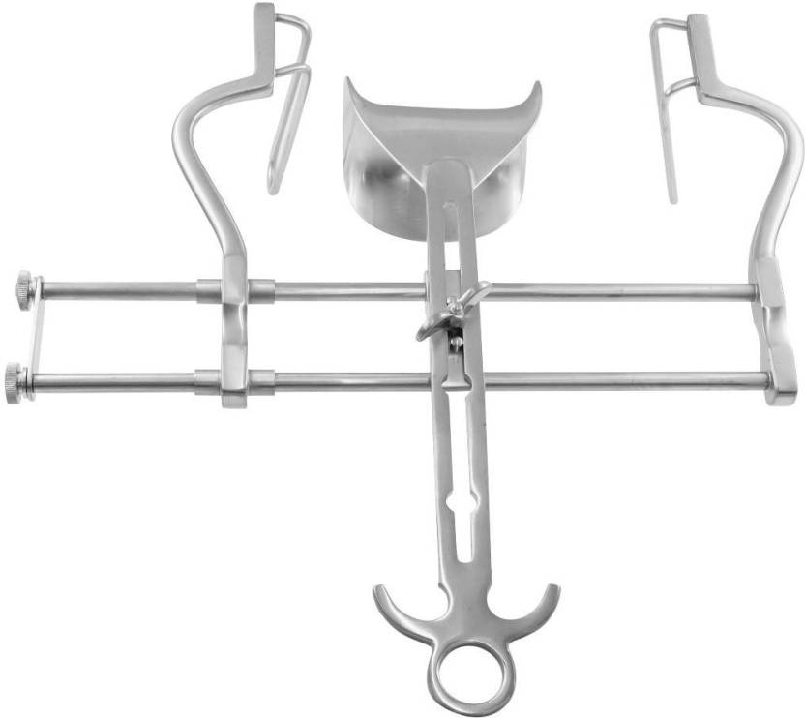
A Balfour with bladder blade (self-retaining) is used to retract wound edges during deep abdominal procedures.

Slide 17
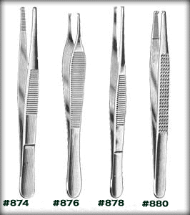
Grasping and Holding Instruments
Pick ups, thumb forceps and tissue forceps are available in various lengths, with or without teeth, and smooth or serrated jaws.

Slide 18
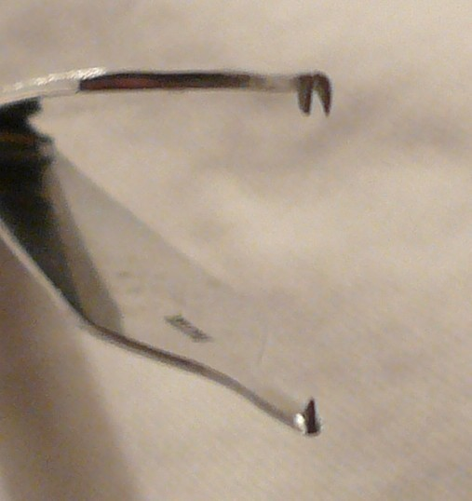
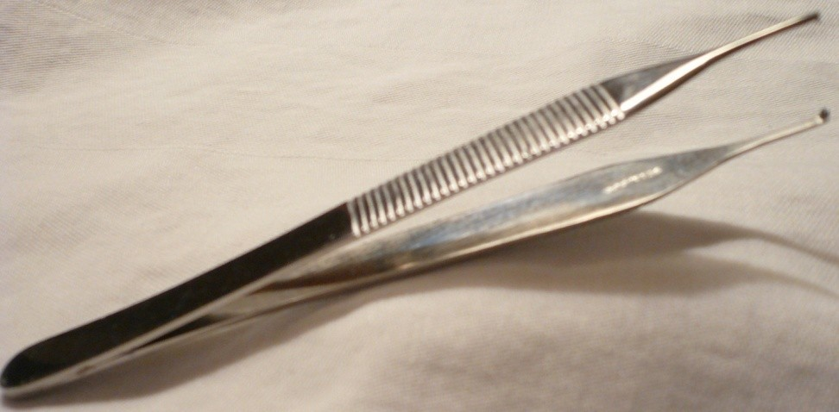
Toothed Tissue Forceps
Used for grasping and holding tissue, muscle or skin surrounding a wound
Single toothed on one side; fits between two teeth on the other side
Available as 1x2 or 2x3 or 3x4

Slide 19
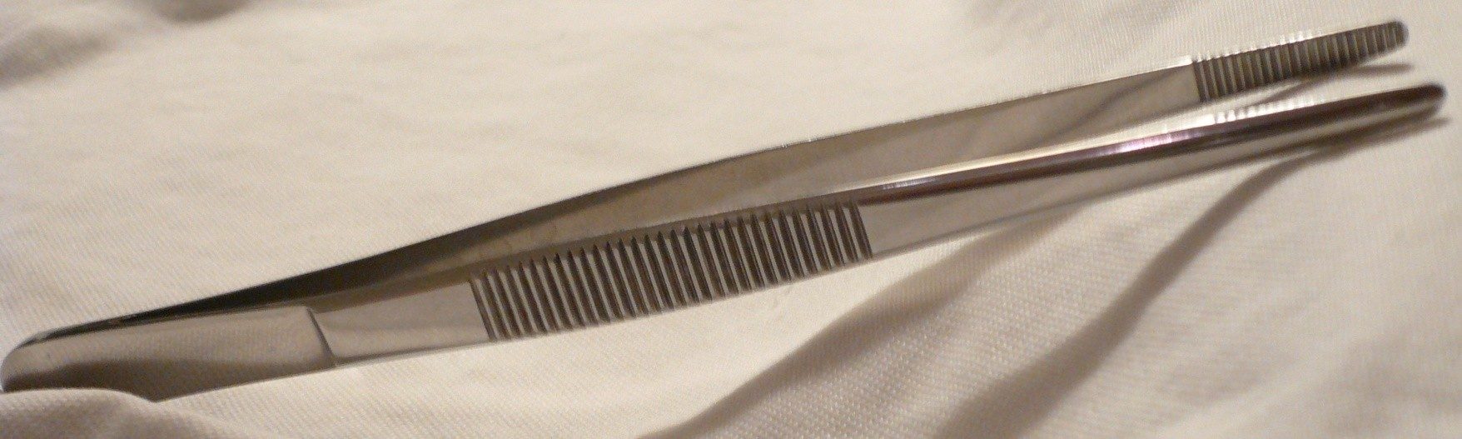
Plain Thumb Forceps
Used to hold tissue in place when applying sutures
Used to gently move tissues out of the way during exploratory surgery
Used to insert packing into or remove objects from deep cavities
Used to hold delicate visceral organs
Used to hold the Hernial sac in hernia repair.
Used to hold blood vessels and nerves while dissecting.

Slide 20
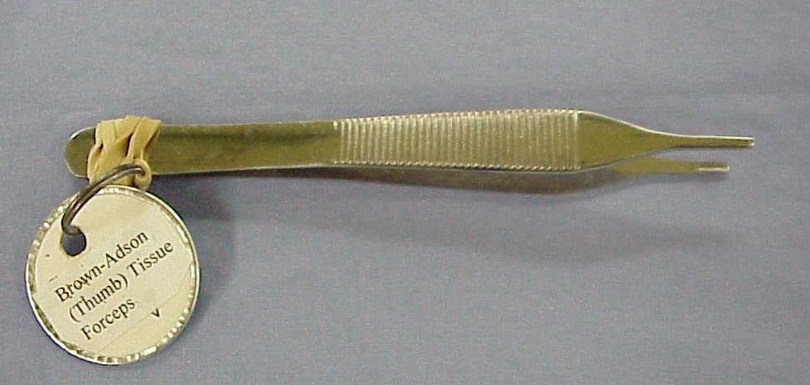
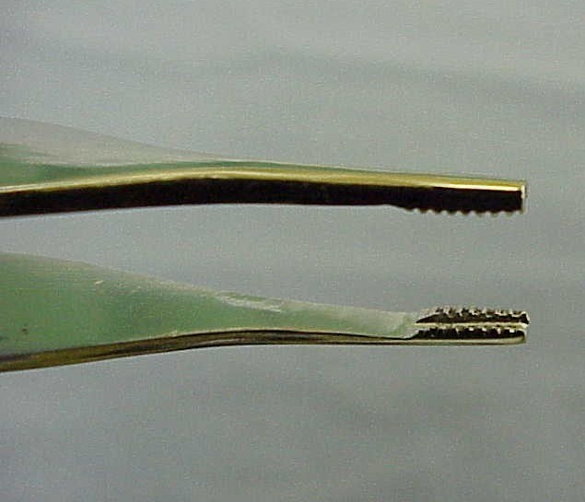
BROWN-ADSON (THUMB) TISSUE FORCEPS

Slide 21
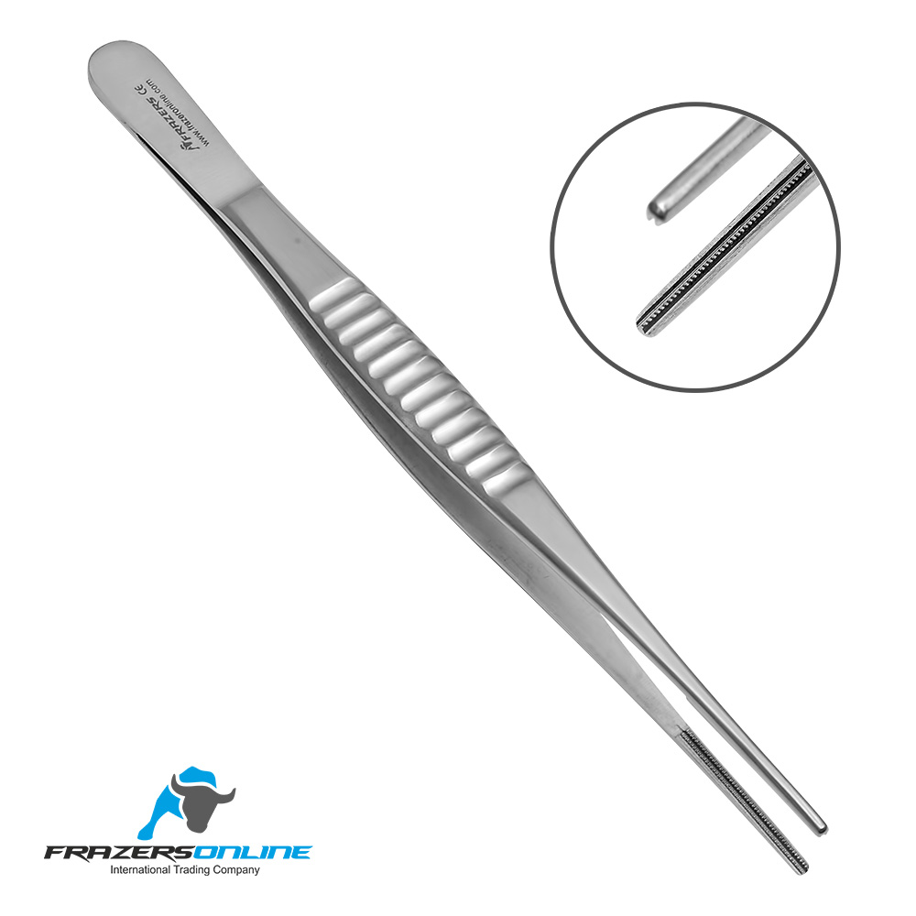
Grasping and Holding Instruments
DeBakey forceps are used to grasp delicate tissue, particularly in cardiovascular surgery.

Slide 22
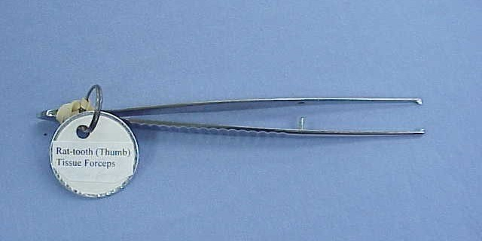
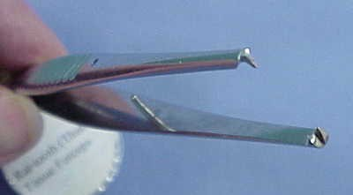
Toothed Dissecting Forceps
Used to hold tough structures like skin while suturing.
Used to hold scalp while scalp suturing.
Used to hold rectus sheath while closure of abdomen.

Slide 23
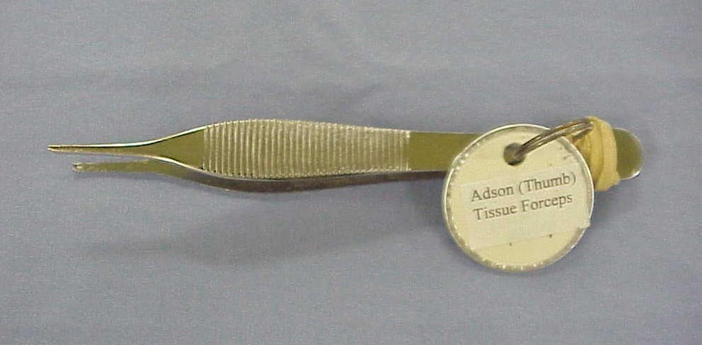
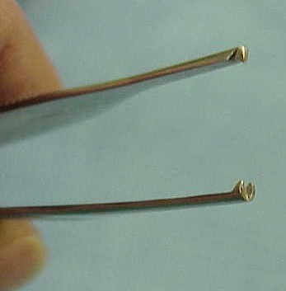
Adson (thumb) tissue forceps

Slide 24
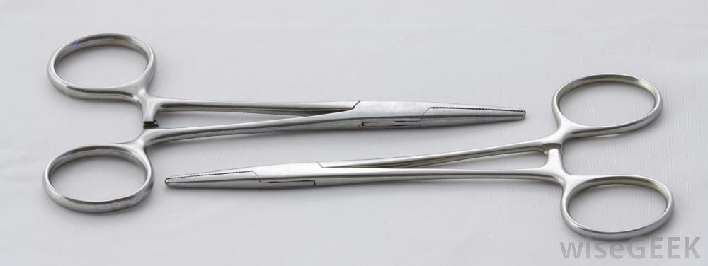
Clamping and Occluding Instruments
A hemostat is used to clamp blood vessels or tag sutures. Its jaws may be straight or curved. Other names: crile, snap or stat.

Slide 25
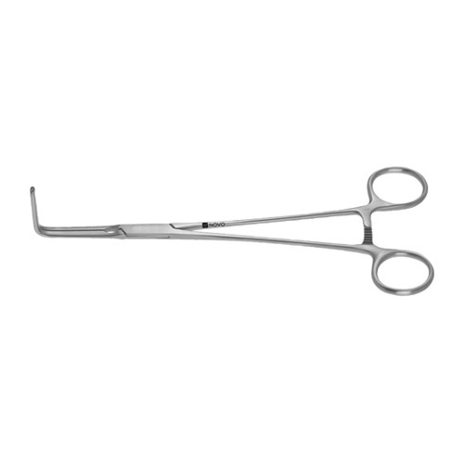
Clamping and Occluding Instruments
A right angle is used to clamp hard-to-reach vessels and to place sutures behind or around a vessel. A right angle with a suture attached is called a "tie on a passer." Other names: Mixter.

Slide 26
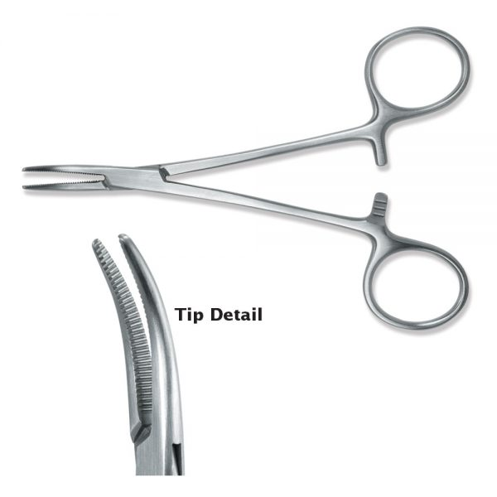
Curved Mosquito Hemostat
Used to hold delicate tissue
Used to compress bleeding vessels
Jaws are fully serrated

Slide 27
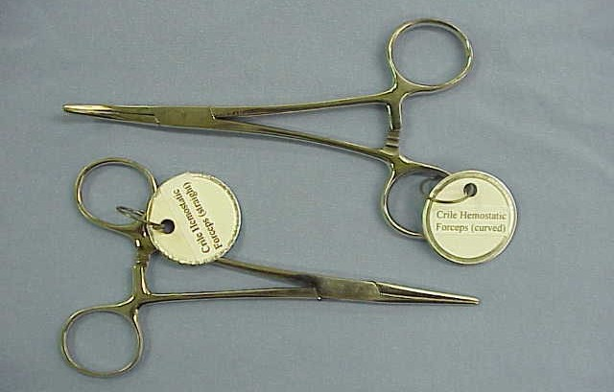
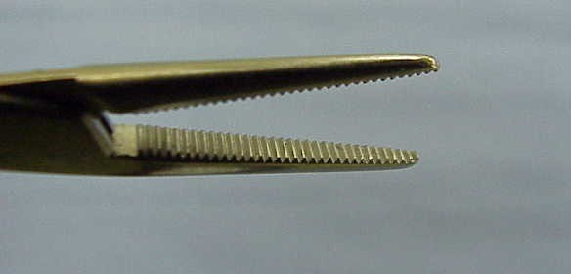
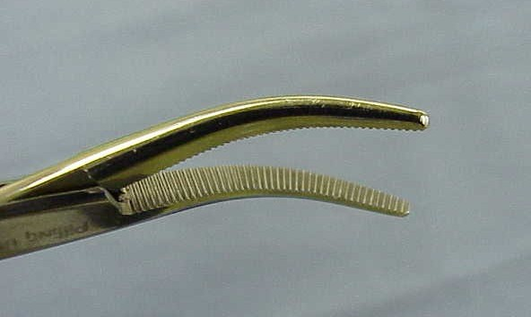
Crile hemostatic forceps

Slide 28
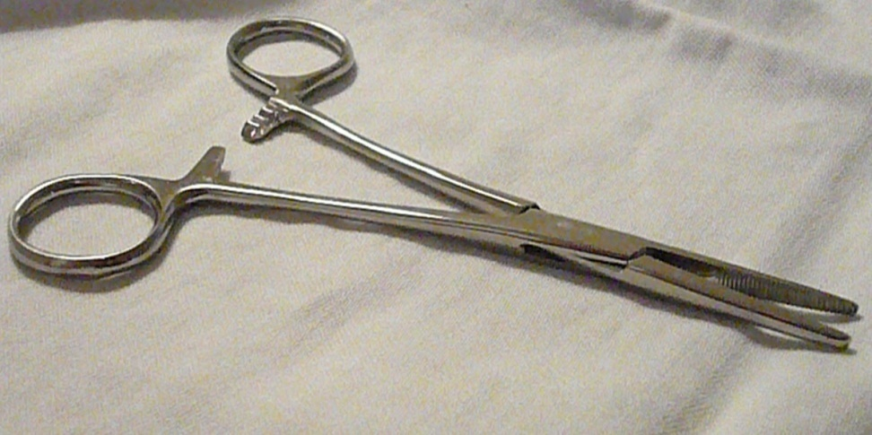
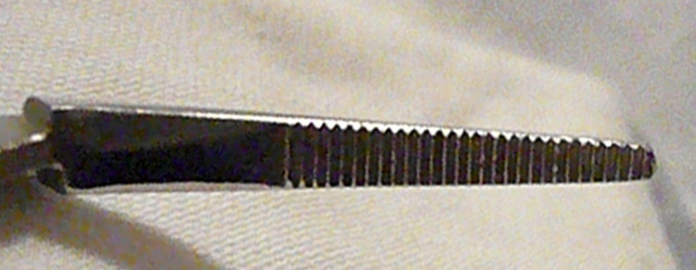
Kelly Hemostat
Used to clamp small vessels or hold tissue
Jaws are partially serrated
Curved or straight

Slide 29
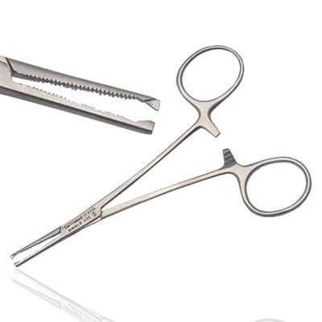
Kocher’s Haemostatic Forceps
Grasping and Holding Instruments
Used to crush the base of the appendix during appendectomy.
Used to hold meniscus during menisectomy.
Used to do sub total thyroidectomy.

Slide 30
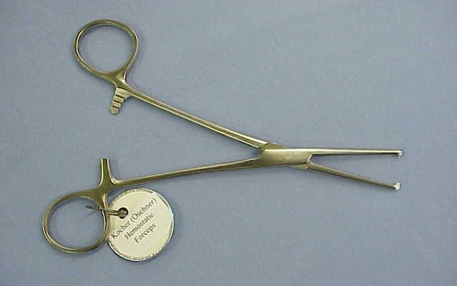
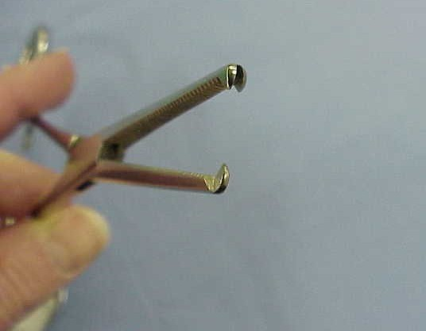
KOCHER (OSCHNER) HEMOSTATIC FORCEPS

Slide 31
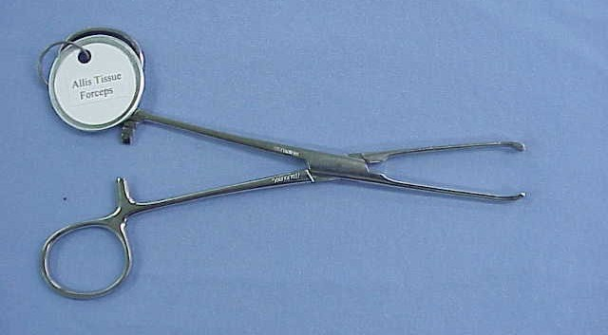
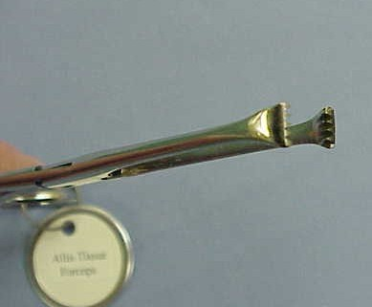
Allis’ Tissue Forceps
Used to hold skin while raising skin flaps.
Used to pick up a fold of peritoneum during laparotomy.
Used to hold linea alba while closing midline incisions.

Slide 32
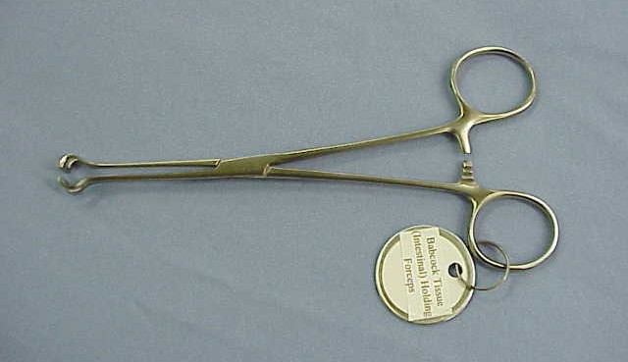
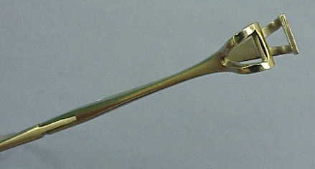
Grasping and Holding Instruments
A Babcock is used to grasp delicate tissue (intestine, fallopian tube, ovary). Available in short and long sizes.

Slide 33
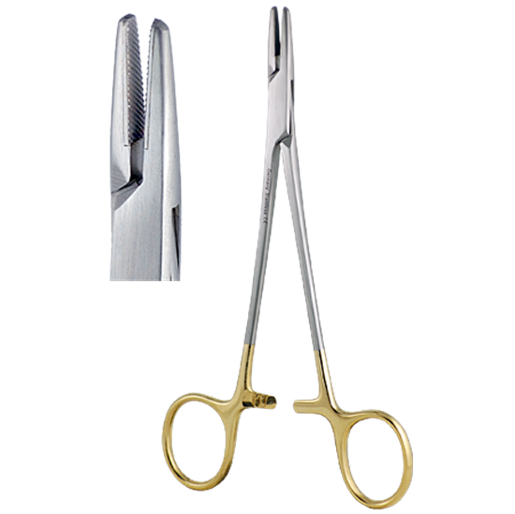
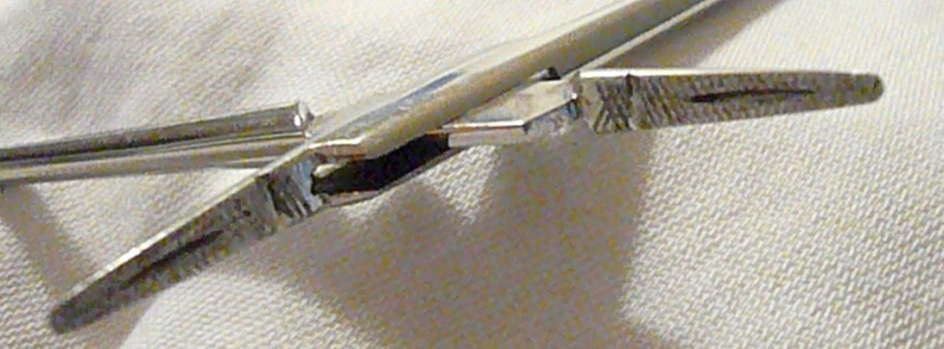
Needle Holder
Used to hold and pass a suturing needle through tissue
Has groove to hold needle within jaws

Slide 34
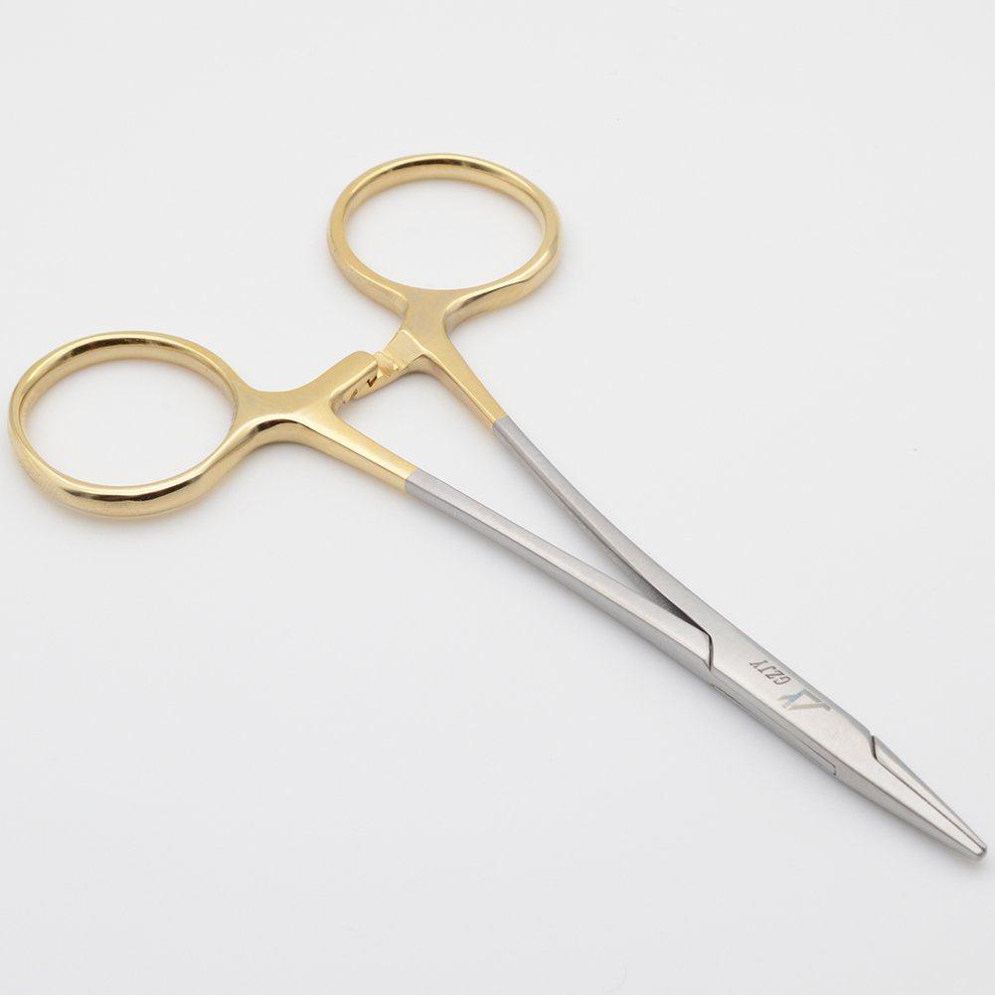

Slide 35
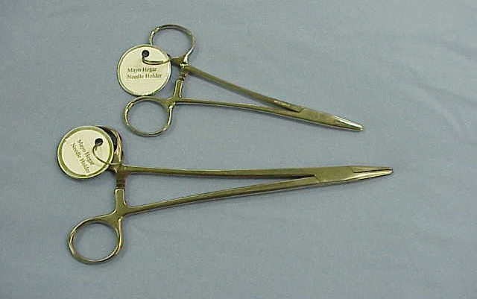
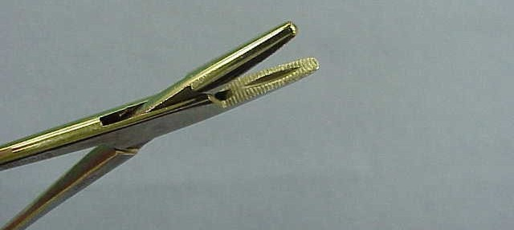
Mayo-Hegar needle holders

Slide 36
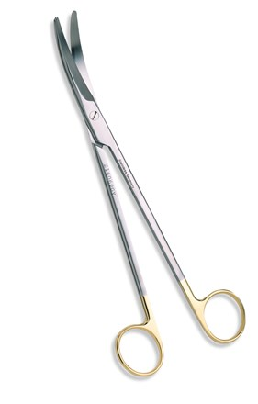
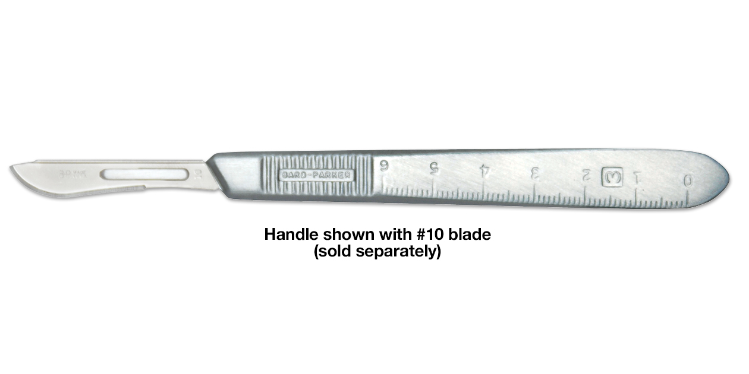
Cutting and Dissecting Instruments
are sharp and are used to cut body tissue or surgical supplies.
Knife Handle, Scissors (left to right)

Slide 37
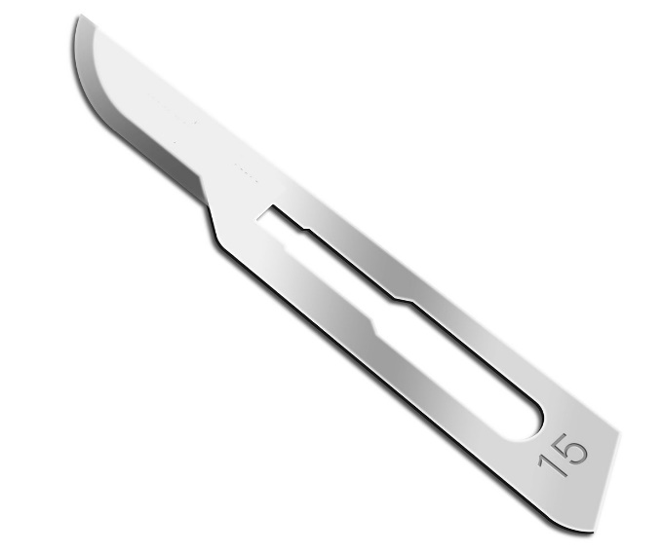
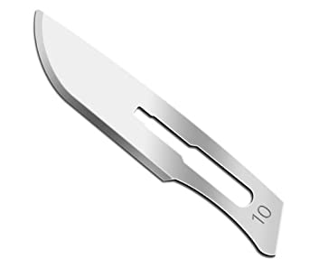
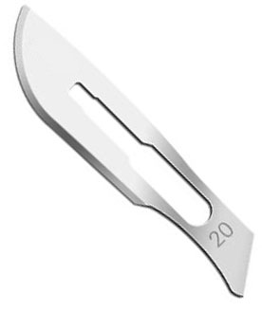
Cutting Instruments
7 handle with 15 blade (deep knife) - Used to cut deep, delicate tissue.
3 handle with 10 blade (inside knife) – Used to cut superficial tissue.
4 handle with 20 blade (skin knife) - Used to cut skin.

Slide 38
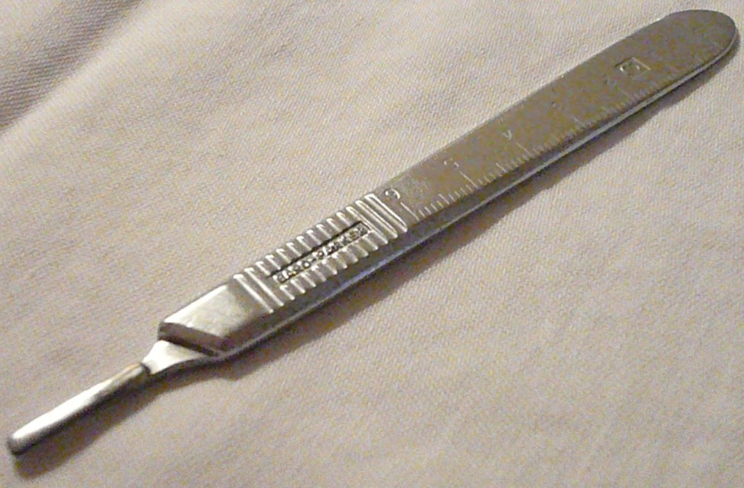
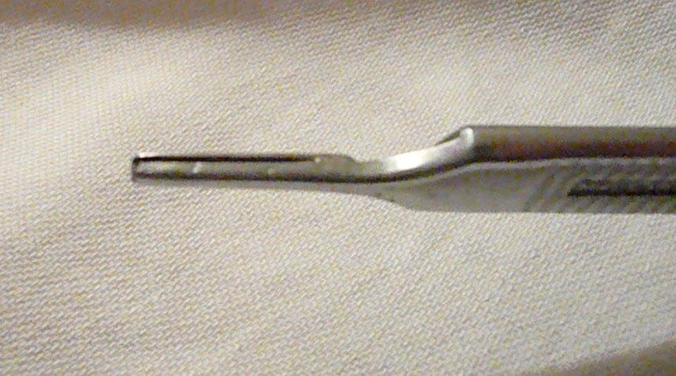
Scalpel Holder
Holds scalpel blade
Acts as a handle

Slide 39



3 handle
4 handle
7 handle

Slide 40

Cutting and Dissecting Instruments
Metzenbaum scissors - Used to cut delicate tissue. Available in regular and long sizes.

Slide 41

MAYO DISSECTING SCISSOR (TOP) METZENBAUM SCISSOR (BOTTOM)

Slide 42



Slide 43


Curved Blunt/Blunt Scissors
Both blade tips are blunt
Can be curved or straight

Slide 44

Sharp/Blunt Scissors
Used to cut and dissect fascia and muscle
One blunt tip and one sharp tip

Slide 45

Suture scissors (blunt blunt)

Slide 46

Lister Bandage Scissors
Used to remove bandages and dressings
Probe tip is blunt; inserted under bandages with relative safety

Slide 47

Iris Suture Scissors
Used to remove sutures
Blade has beak or hook to slide under sutures

Slide 48

Grasping and Holding Instruments
A Backhaus towel clip is used to hold towels and drapes in place. Other name: towel clamp.

Slide 49

Backhaus towel clamps

Slide 50


Sponge Forceps
Grasping and Holding Instruments
Used to hold gauze squares or sponge to “mop up” the surgical site
Jaws are serrated

Slide 51


Slide 52


Transfer Forceps
When sterile, transfer forceps;
arrange items on sterile tray
transfer items to sterile field

Slide 53

Doyen Intestinal Forceps

Slide 54


Debakey Satinsky Clamp
DeBAKEY Curved Peripheral Vascular Clamp

Slide 55

Duval Lung Tissue Forceps

Slide 56


Bulldog vascular clamp

Slide 57


Metallic Probe
Used in fistulectomies.
Used to assess the depth of penetrating injuries.
Used to assess the length of sinus.

Slide 58

Kelly’s rectal Speculum
Used to diagnose haemorroids,anal polyps, internal opening of the perianal fistula.
Used to take biopsy from anal, rectal growth.
Used in polypectomy.

Slide 59
TUBES & DRAINS
1.NGT(nasogastric tubes) for GI decompression.
2.singstaken tube – for arresting bleeding oesophageal varices.
3.chest tube for pneumothorax,hemothorax,pleural effusion and drainage of pus.
4.urine catheter (Foleys catheter)
5.central venous line catheter.

Slide 60


NGT(nasogastric tubes
singstaken tube

Slide 61




chest tube
urine catheter
central venous line catheter

Slide 62


Types of drains
Open system
1- corrugated tubes
Closed system
1-passive: tube drain.
2-Active: radivac drain (-ve pressure)

Slide 63

Flatus tube
Used to relieve gaseous distension of large gut due to paralytic ileus.
Used to decompress sigmoid volvulus non operatively.

Slide 64


Mayo’s Vein stripper
 Used to do stripping of varicose veins.

Slide 65


DISPOSABLE CORE BIOPSY TROCAR AND NEEDLE
 Used to take core biopsy from
breast, liver for tissue diagnosis.

Slide 66


Bone Saw
Used to cut bone in case amputation.
To cut casts.

Slide 67

Giglie’s Saw
Used to cut bones in amputations.
Used to do craniotomies.

Slide 68

Bone cutter
 Used to reshape the bone during osteotomies, amputati ons.

Slide 69


Bone curette

Slide 70


Periosteum Elevator
 Used to elevate the periosteum during amputations.

Slide 71

Kidney Tray
Used to collect specimens.
Used to safely transfer sharp instruments.

Slide 72
THANK YOU

