Slide 1


ABDULAZIZ HMAD ALFERJANI 3386 year 1
GBMS 2
2022.6.4
Tobacco control

Slide 2

Objectives:
Define
smoking
Describe
the reasons for why people smoke
Describe
the disadvantages of smoking
Outline
the steps to stop the urge to smoke
Define
second hand smoking

Slide 3
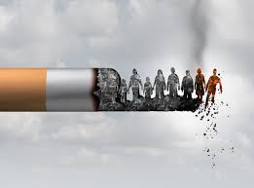
Define Smoking
Smoking is practice in which a substance is burned and the resulting smoke is typically breathed in to be tasted and absorbed into the bloodstream

Slide 4
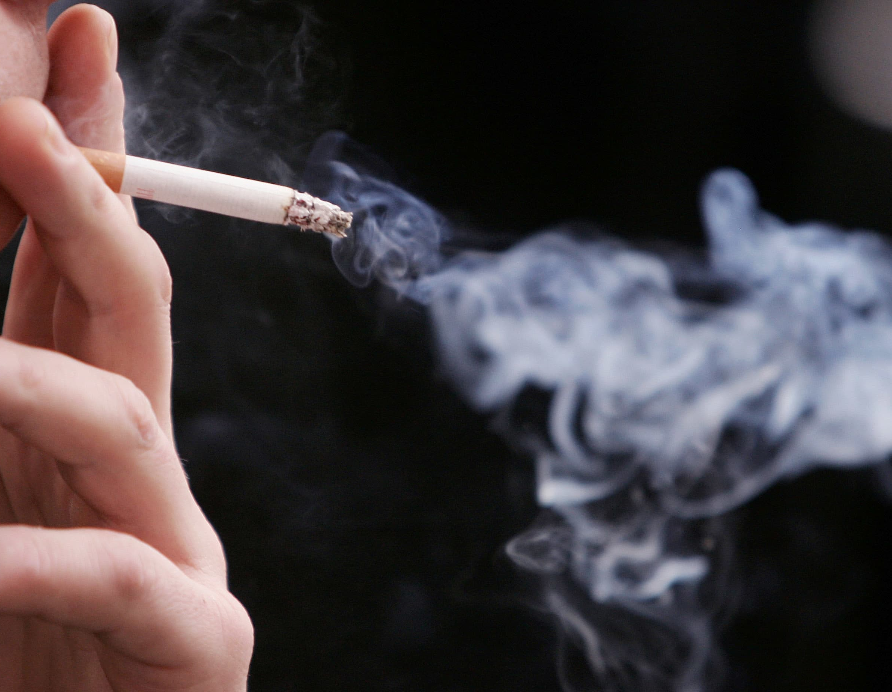
Reasons of smoking
Due to family’s smoking
Due to friend’s smoking
Stress of exam
Other

Slide 5
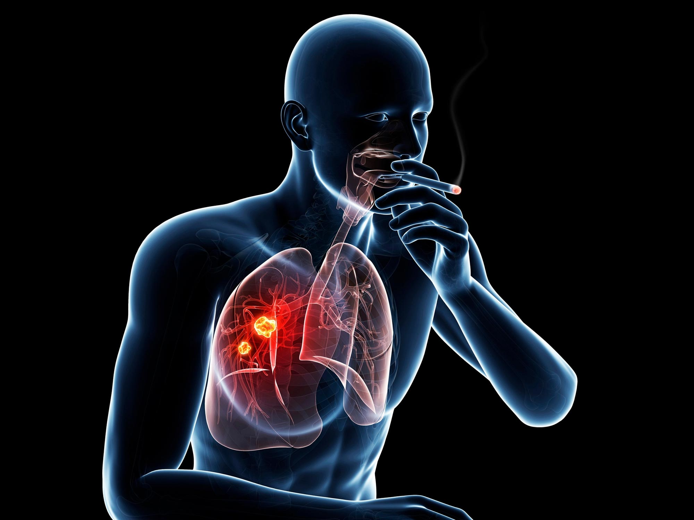
Disadvantages of smoking
1. lung cancer
More people die from lung cancer than any other type of cancer

Slide 6
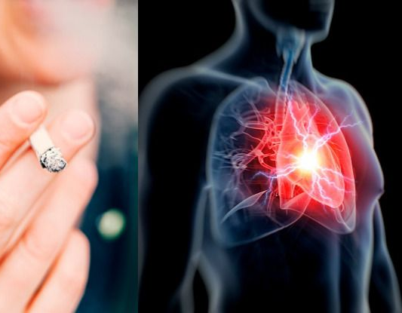
Disadvantages of smoking
2.Heart disease
Smoking can cause blockages and narrowing in your arteries, which means less blood and oxygen flow to your heart

Slide 7
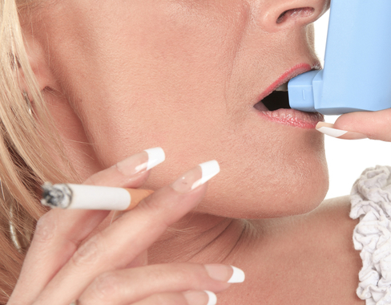
Disadvantages of smoking
3.Asthma
Is chronic lung disease that makes it harder to move air in and out of your lungs

Slide 8
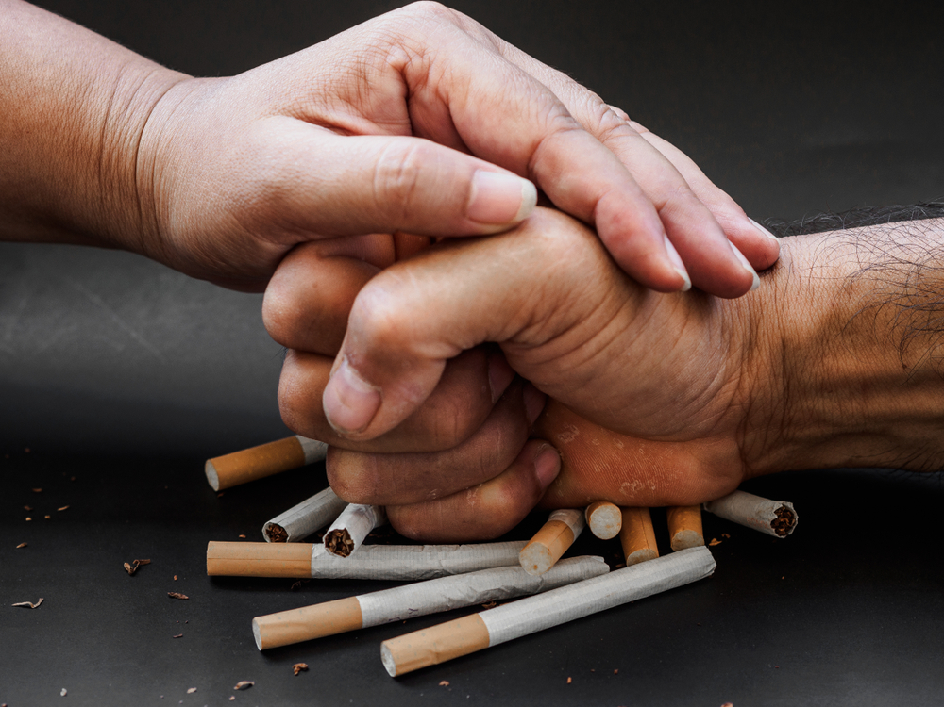
Steps to stop smoking
1. Set quit date, and be strategic
2. beat your triggers
3. get smart about your smoking addiction
4. choose a quit smoking aid

Slide 9
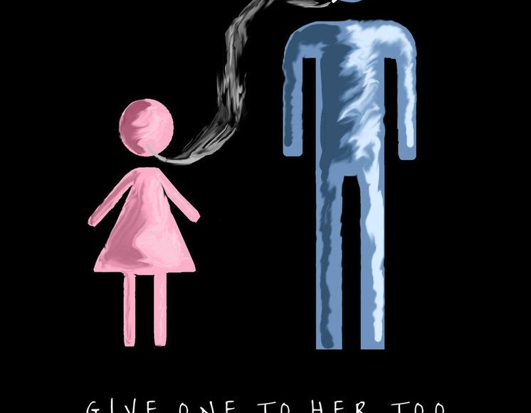
Secondhand smoking
Smoke that come from the burning of tobacco product and smoke that is exhaled by smokers inhaling secondhand smoke is called involuntary or passive smoking. Also called environmental tobacco smoke

Slide 10
Conclusion
There's no way around it; smoking is bad for your health. It harms nearly every organ of the body, some that you would not expect. Cigarette smoking causes nearly one in five deaths in the United States. It can also cause many other cancers and health problems.

Slide 11
References
https://www.lung.org/research/sotc/by-the-numbers/10-worst-diseases-smoking-causes
https://truthinitiative.org/research-resources/quitting-smoking-vaping/10-steps-successfully-make-plan-quit-smoking
https://www.cancer.gov/publications/dictionaries/cancer-terms/def/secondhand-smoke

Slide 12

Thanks for your attention

