Slide 1



Dyslipidemia and Vitamin D Status in Diabetic Patients
Presented by: Mariam Osama 3628
Ameen Ali 3415
Aisha Jamal 3705
Alaa Ramadan 3338
nada yusef 3432
Nadia Benghrbia 3537
Shahed Mohammed 3706

Slide 2
01
INTRODUCTION

Slide 3

•Dyslipidemia is most common metabolic syndrome among diabetic patients due to insulin insufficiency, resistance, and central obesity.
•It affects all ages, races, and geographical regions.
•Recently vitamin D deficiency considered one of intense interest topics it has been broved that vitamin D deficiency are associated with many chronic diseases including cancers, cardiovascular diseases, autoimmune diseases.
•Vitamin D receptor and its inactive form (1 alpha hydroxylase) is essential for the synthesis of the active form of the hormone (1, 25 OH)2D.
•Which subsequently activate pancreatic B cells insulin receptor, to induce insulin and increase insulin sensitivity.
•Also directly regulate fatty acid metabolism in skeletal muscle, and adipose tissue.
•It was suggested that vitamin D has both direct and indirect effects on modifying the lipid profile and that is one of the proposed mechanisms for the relationship between vitamin D deficiency and CVD.

Slide 4
02
MATERIALS AND METHODS

Slide 5
MATERIALS AND METHODS
Study design and sample size
This is a cross-sectional study on diabetes patients conducted from November 2020 to April 2021. The study included 165 patients randomly selected from a diabetic center with a target group of patients having either vitamin D deficiency and dyslipidemia, vitamin D deficiency and no dyslipidemia, or dyslipidemia with no vitamin D deficiency.
Study procedures
The study procedures involved categorizing the patients into three groups and following them for 6 months without any treated initiated.

Slide 6
MATERIALS AND METHODS
Biochemical investigation
Serum lipid profile, vitamin D levels, Fasting blood glucose (FBG or FPG), and HbA1C were measured at the beginning and end of the study.
Questionnaires
A pre-design questionnaire was validated and administered to participants.
Ethical consideration
The study was approved by the local Ethics Committee of the Libyan international medical university, and written consent was obtained from participants.

Slide 7
03
RESULT

Slide 8
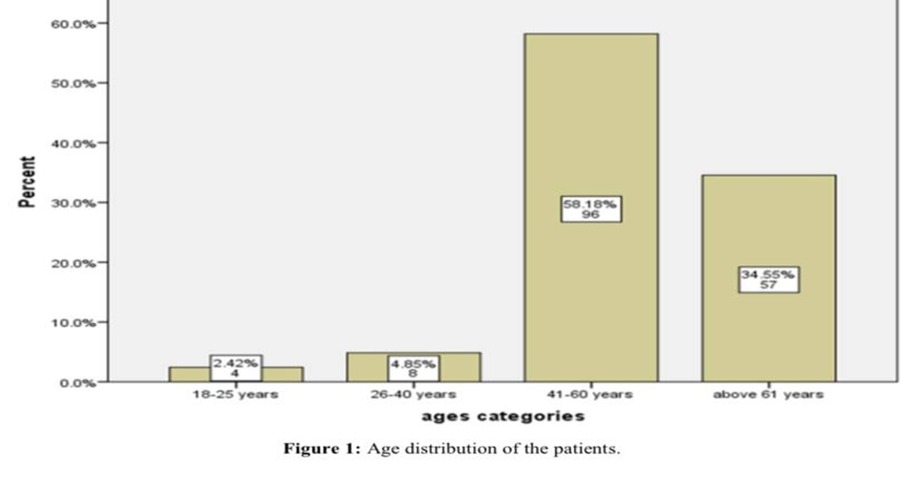
RESULT
The data collected on 165 diabetic patients either have vitamin D deficiency and dyslipidemia, 61, 33 and 71 respectively. The average age of the patients were 45± 6 years old with the significant predominant ages found 41-60 years old 58.2% (P =0.001) followed by age groups above 60 years old 34.5%, and the age groups between 18-25 years old being the least 2.42% (Figure 1).

Slide 9
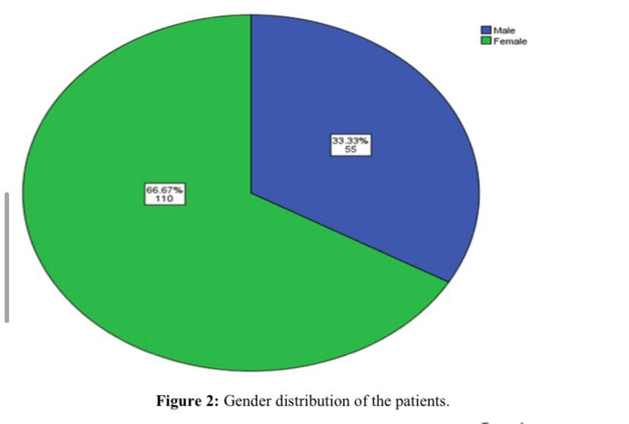
In regarding the gender distribution as shown in the figure 2.

Slide 10
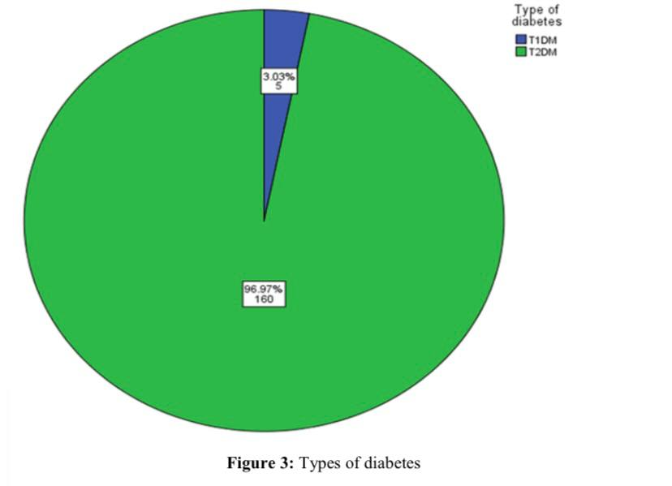
female were shown significant twice than male 66.7% and 33.3% respectively. Based on the categorized of patients according to types of diabetes found that majorities of patients have type 2 diabetes mellitus (T2DM) 97% and approximately 3% have type 1 diabetes mellitus (T1DM) (Figure 3).

Slide 11
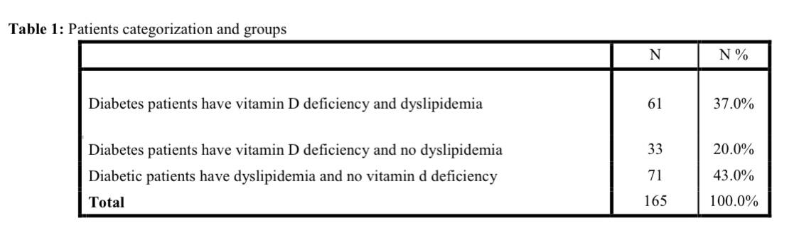
61 (37%) of patients were diabetes patients have vitamin D deficiency and dyslipidemia, 71 (43%) of patients were diabetic patients have dyslipidemia and no vitamin D deficiency and the last group was diabetes patients have vitamin D deficiency and no dyslipidemia which represent about 20% (33) (Table 1).

Slide 12
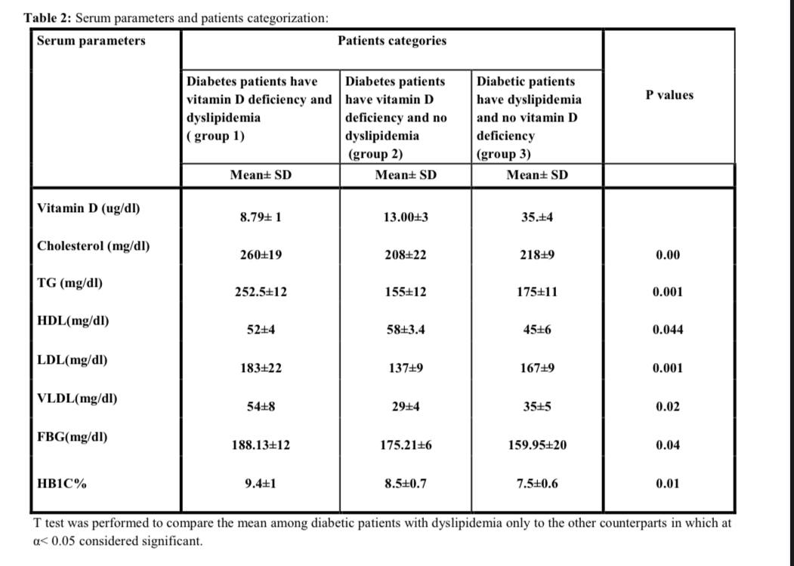
Furthermore, serum parameters were investigated as shown in table 2, Vitamin D deficiency implicated dyslipidemia include elevated Serum level of cholesterol, TG, LDL and VLDL even in the diabetic patients with no dyslipidemia.

Slide 13
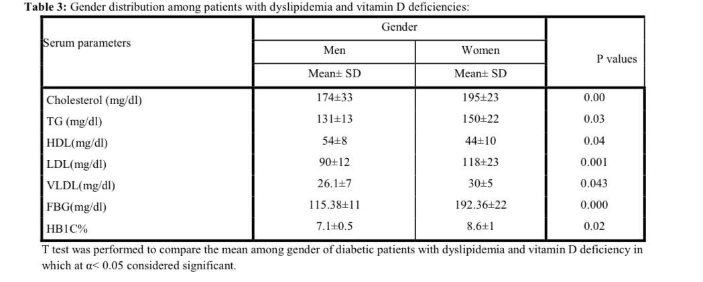
Regarding gender distribution among dyslipidemic and vitamin D deficiency diabetes patients revealed that female patients significantly have higher serum parameters of lipid profile, fasting blood glucose and HbA1C than male (P< 0.05) (Table 3).

Slide 14
04
DISCUSSION

Slide 15
DISCUSSION
Dyslipidemia is most common metabolic syndrome among diabetic patients due to insulin insufficiency.
The present study revealed that vitamin D deficiency and dyslipidemia are most common among diabetic patients.
In the study conducted by Yang et al found that vitamin D was negatively correlated with FPG,TG and TC [ 17].
The previous studies have shown that a close relationship between vitamin D levels and glycolipid metabolism in which the most observational studies confirmed that vitamin D was negatively correlated with FPG [18] TG [19] TC [20] LDL-C [21] , and these studies were consistent with the present work.

Slide 16
DISCUSSION
In the present work increased serum level of HDL was associated with vitamin D deficiency even in diabetic patients, this result was disagreed with the previous work, which in their finding shown that vitamin D deficiency has positively associated with HDL levels.
The previous studies indicated that HDL positively correlated with HDL cholesterol level and this finding were disagree with the present result in which deficiency led to slight increase in serum HDL.
Study conducted in Saudi Arabia [28] found that women with vitamin D deficiency has
higher levels of TG than man and man has higher HDL than women and this finding was on non-diabetic patients, that could explain in part due to adiposity in the women, in which sedentary lifestyle, increased body fat, might led to more insulin resistant which eventually implicated in higher levels of lipid profile, FPG and HbA1C.

Slide 17
05
CONCLUSION

Slide 18
Dyslipidemia is the most common metabolic syndrome among diabetic patients. Vitamin D deficiency involved in elevation Serum cholesterol, TG , LDL and VLDL and inversely relationship with HDL in which vitamin D deficiency may slightly increase HDL levels in both diabetic patients have dyslipidemia and non.
Furthermore, Vitamin D deficiency in diabetic patients have significant impact on lipid profile even in diabetic patients with no dyslipidemia in which elevated levels of lipid profile but not to the borderline levels.
Furthermore, patients with vitamin D deficiency and dyslipidemia or vitamin D deficiency alone have linked to elevated levels of fasting blood sugar, HbA1C, and the serum lipid profile which were primarily found in females.
The levels of vitamin D are closely related to serum lipids in diabetic patients. Although vitamin D deficiency may also be associated with the increased risk of dyslipidemias, especially in women. The results of this study indicated that vitamin D supplementation may help diabetic patients with dyslipidemia improve their lipid profile and glucose hemostasis.
.

Slide 19
06
REFERENCES

Slide 20
REFERENCES
.
Sassi, M., Al'asmae, Y., Addal, N.E., Ateia Elmabsout, A., Hussin, H., Mohamed, I. E., & Bukhatwa, S. (2022). Dyslipidemia and Vitamin D Status in Diabetic Patients. IJCSRR. 05(1), 50-57. https://doi.org/10.47191/ijcsrr/V5-i1-07

Slide 21


