Slide 1


The Ethics in Business Research
Libyan International Medical University
Faculty of Business Administration
By :Fatima Alzhraa Almkhal
ID :3190
EMAIL: fatimaalzhra_3190@limu.edu.ly

Slide 2
Table of Content
Introduction
The Importance of Ethics in Business Research
What is Citation Style
Different Citation Style
Conclusion
References

Slide 3
1. Introduction

Slide 4
What is the ethics?
Introduction
Ethics are rules or standards of conduct that guide us in making moral decisions about our behavior and experiences with others. All parties engaged in research should act ethically , like in other facets of business. The purpose of research ethics is to ensure that no one is hurt or suffers negative affects as a result of research.

Slide 5
The Importance of Ethics in Business Research
Research ethics establishes rules for conducting research in a responsible way. It also teaches and monitors scientists who do research to ensure that they adhere to a high ethical standard

Slide 6
A general summary of ethical principles is as follows:
You're reporting with a bias
Using private information
bringing them embarrassment
Information that is secret is shared.

Slide 7
What is Citation Style
A citation style dictates the information necessary for a citation and how the information is ordered, as well as punctuation and other formatting.

Slide 8

Different Citation Style
APA
(American Psychological Association) is used by Education, Psychology, and Sciences
MLA
(Modern Language Association) style is used by the Humanities
Chicago
style is generally used by Business, History, and the Fine Arts
Harvard
style is another popular style using the author-date system for in-text citations.

Slide 9
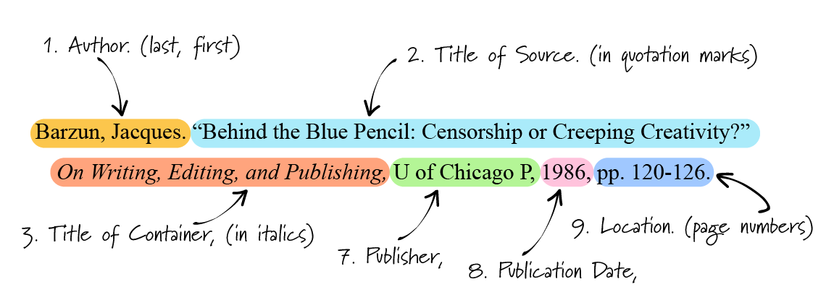
MLA

Slide 10

APA

Slide 11
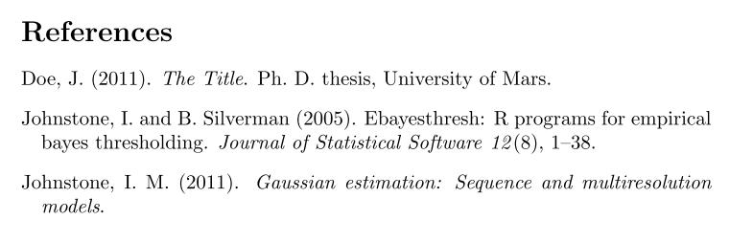
Chicago

Slide 12
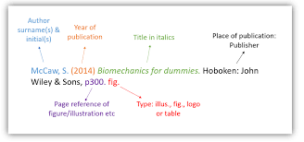
Harvard

Slide 13
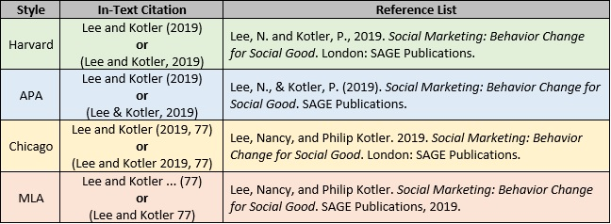

Slide 14
Conclusion
The researcher is responsible for the safety of the study team. Just as sponsors expect ethical behavior from the researcher, the researcher should need affects the stability from team members in following the research plan.
Citation of an article implies that you have personally read the cited work.

Slide 15
References
Hamidzay, A. (2018, March 28). Ethics in business research. Retrieved April 20, 2022, from https://www.linkedin.com/pulse/ethics-business-research-abdulmarof-hamidzay
Citation styles: APA, MLA, Chicago, Turabian, IEEE: Overview. (n.d.). Retrieved April 20, 2022, from https://pitt.libguides.com/citationhelp
Referencing : Harvard. (n.d.). Retrieved April 20, 2022, from https://libguides.mq.edu.au/referencing/Harvard

Slide 16
Thanks!
Any questions?

