Slide 1








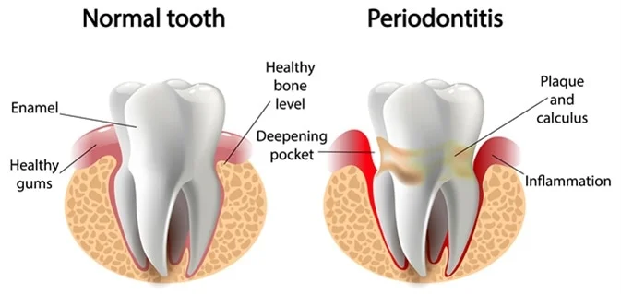
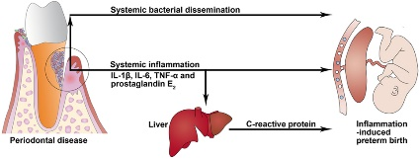
What is the relation between periodontitis and pregnancy!
Student name: Nora Almahjuob 2nd year dentistry
Student number: 2997
Supervised by: Dr. Asma Alshiky
Introduction:
Results:
Conclusion:
Periodontitis is an inflammatory condition caused by bacteria that invade the connective tissues surrounding the teeth, such as the gums and bone . In the early stages of the disease, it can cause symptoms such as tender, red and swollen gums. In severe cases, the gums can pull away from the teeth and the connective tissues loosen, which can cause the teeth to fall out.
It has been suggested that the hormonal changes during pregnancy, particularly the marked increases in estrogen and progesterone, may be in part responsible for the increased risk of developing periodontitis.
Women with adverse pregnancy outcomes were more likely to report history of periodontitis when compared with women with normal pregnancy.
In this study, maternal periodontitis was associated with a two-fold increased risk of poor pregnancy outcome (either preterm birth or SGA birth).
The association between maternal periodontitis and adverse pregnancy outcomes is biologically plausible. Periodontitis induces the release of inflammatory cytokines such as interleukins and tumor necrotic factor-alpha. Circulating cytokines may stimulate Prostaglandin E2 production, resulting in preterm labor.
[2]
[1]
Figure.1
Methods:
there was a significant association between periodontitis and poor pregnancy outcome.
In the present study, we included women with live births who also completed a dental questionnaire in the second trimester of pregnancy. Periodontitis was determined by a question ‘Have you ever been told by a dentist or dental hygienist that you have periodontal disease (gum disease with bone loss)?’ Of the 1666 responders, 62 (3.7%) reported yes, 1573 (94.4%) no, and 31 (1.9%) did not know. We limited our analysis to the 1635 women who reported their periodontal status. Of these women, 72.7% were white, 12.7% black,5.5% Asian, 5.5% Hispanic and 3.6% other race.
Figure.3
References:
1.https://www.news-medical.net/health/Periodontitis-and-Pregnancy.aspx.
2.https://onlinelibrary.wiley.com/share/BTDUVZ4NAR2WMJVNCPUV?target=10.1111/j.1600-0528.2006.00363.x.
3.https://www.frontiersin.org/articles/10.3389/fimmu.2017.00139/full.

