Slide 1


Verbal and non-verbal communication
Interpersonal Communication (7027)
By:
Fatema Alzahraa 3212
Shahed Abdeljawad, 3150
Mahmoud Ahdash 3252
Joumanah Alarifi 3172
Submitted To:
Mr. Farag Elmegresi

Slide 2
TABLE OF CONTENTS
01
02
03
04
How to improve your verbal communication.
Types of verbal communication.
Types of non-verbal communication
Definition of verbal and non-verbal communication.
05
How to improve your non-verbal communication
06
07
conclusion
References
1

Slide 3
Definition
Verbal communication: verbal communication is any communication that uses words to share information with others. These words may be both spoken and written.
Non-verbal communication: any communication made between two or more persons through the use of facial expressions, hand movements, body language, postures, and gestures is called as non-verbal communication.

Slide 4
Types of verbal communication
Interpersonal Communication
Small Group Communication
It is a one-to-one situation. Examples are a casual conversation, a job interview or a phone call. There is a transmission of information that occurs between two people using language.
small group communications is not the verbal communication between large groups but rather small groups of people. Examples are a board meeting, and a presentation for colleagues.
3

Slide 5
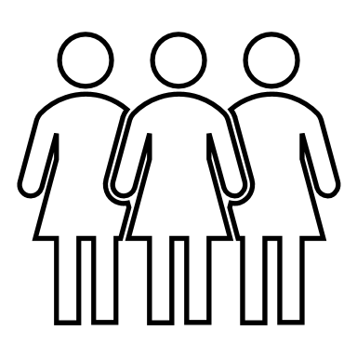

Public Communication
when an individual or groups of people project verbal information to a large group. Examples of this form of verbal communication are large seminars, a news report on television and a speech in front of a large crowd of people.
4

Slide 6




4 points on improving your verbal communication
Think before speaking
Understand your audience
Be mindful of your tone
Pay attention to your body language
5

Slide 7


Types of non-verbal communication
FACIAL EXPRESSIONS
EYE CONTACT
Eyes are an effective communication tool to convey messages without saying a word. Eye contact says a lot about a person. For instance, those who avoid eye contact are often perceived as shy or less confident.
our facial expressions convey a wide range of emotions. Some facial expressions are very powerful. For instance, a smile makes any situation easier to handle.
6

Slide 8


GESTURES:
Different gestures could mean different things in different situations.
Have you seen people communicate using sign language? Every hand gesture means something. Even during regular conversations, most of us knowingly or unknowingly use certain gestures such as nodding or giving a thumbs-up or high five.
7

Slide 9



4 points on improving your non-verbal communication
Pay Attention to Nonverbal Signals
Look for Incongruent Behaviors
Use Good Eye Contact
Ask Questions
8

Slide 10

conclusion
We believe that Verbal communication and non-verbal communication stand side by side together and are very important skills that we use everyday.
9

Slide 11
References
Gaid, A. (2021, January 18). 20 Ways to Improve Your Communication Skills. Fatima. Retrieved December 9, 2021, from https://www.oberlo.com/blog/communication-skills#:%7E:text=%20How%20to%20Improve%20Communication%20Skills%3A%20Non-verbal%20,tips%20that%20seems%20obvious%2C%20but%20is. . .%20More%20
Kishore, K. (2021, August 3). Nonverbal Communication: Types, Importance And Examples. Harappa. Retrieved December 9, 2021, from https://harappa.education/harappa-diaries/nonverbal-communication-types-importance-and-examples/
10 Ways to Master the Art of Nonverbal Communication. (2020, January 28). Verywell Mind. Retrieved December 9, 2021, from https://www.verywellmind.com/top-nonverbal-communication-tips-2795400
10

Slide 12

Any questions?
11

