Slide 1







Leukemia and its association with periodontal disease
Student name:Esra Adel
Student number:2943
Block: PTC
Date: 2022/4/4
1

Slide 2


Introduction:
a dentist may be the first doctor to detect the cancer.
Systemic dieses can manifest oral signs at an early phase and it can be crucial for diagnosis and timing of treatment
Gingival enlargement is one of signs of acute myleobalstic leukemia
3

Slide 3

Objectives:
Outline Oral signs of acute leukemia
Discuss the associated between periodontitis and leukemia
Discuss the management of the oral complications of leukemia
2

Slide 4

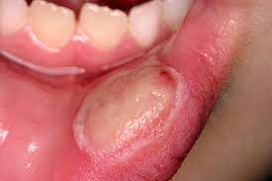
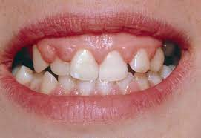
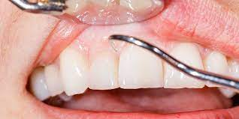
Oral signs of acute leukemia:
Oral ulceration
Gingival hyperplasia
Pale Gum
4

Slide 5
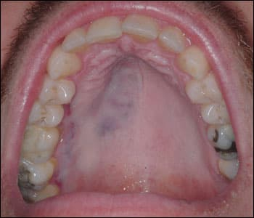
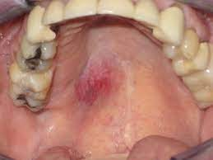
Blue gray lesion on palate
Metastatic clear area
5

Slide 6
Question:
Can leukemia causes periodontal disease?
6

Slide 7
Association between periodontitis and leukemia
Oral lesions arise in both acute and chronic forms of all types of leukemia.
people with leukemia may have bleeding gums even if they don't have gum disease. One reason is because some forms of leukemia may cause the gums to swell.
The shape and size of the teeth can also change due to leukemia
6

Slide 8

Management:
Before beginning chemotherapy, some dentists recommend filling any cavities or treating severe gum disease. These measures may prevent these conditions from getting worse when chemotherapy weakens the immune system.
7

Slide 9
Management:
The following strategies may help reduce the risk of oral health issues in people with leukemia:
During treatment, ask a dentist to temporarily stop brushing the teeth if painful.
Ask a dentist about chlorhexidine mouthwash, which may reduce the risk of dental issues.
Try using numbing gels on mouth sores.
8

Slide 10
Conclusion:
It is importance of visiting the doctor when we see any abnormal sign in our oral cavity.
9

Slide 11
References
:
Albandar J, Susin C, Hughes F. Manifestations of systemic diseases and conditions that affect the periodontal at.
2. [Internet]. 2022 [cited 4 April 2022]. Available from: https://www.semanticscholar.org/paper/Periodontal-disease-and-periodontal-management-in-Epstein-Stevenson-
3. Ramfjord S. Indices for Prevalence and Incidence of Periodontal Disease [Internet]. Deepblue.lib.umich.edu. 2022 [cited 4 April 2022]. Available from: https://deepblue.lib.umich.edu/handle/2027.42/141307
10

Slide 12

11

