Slide 1


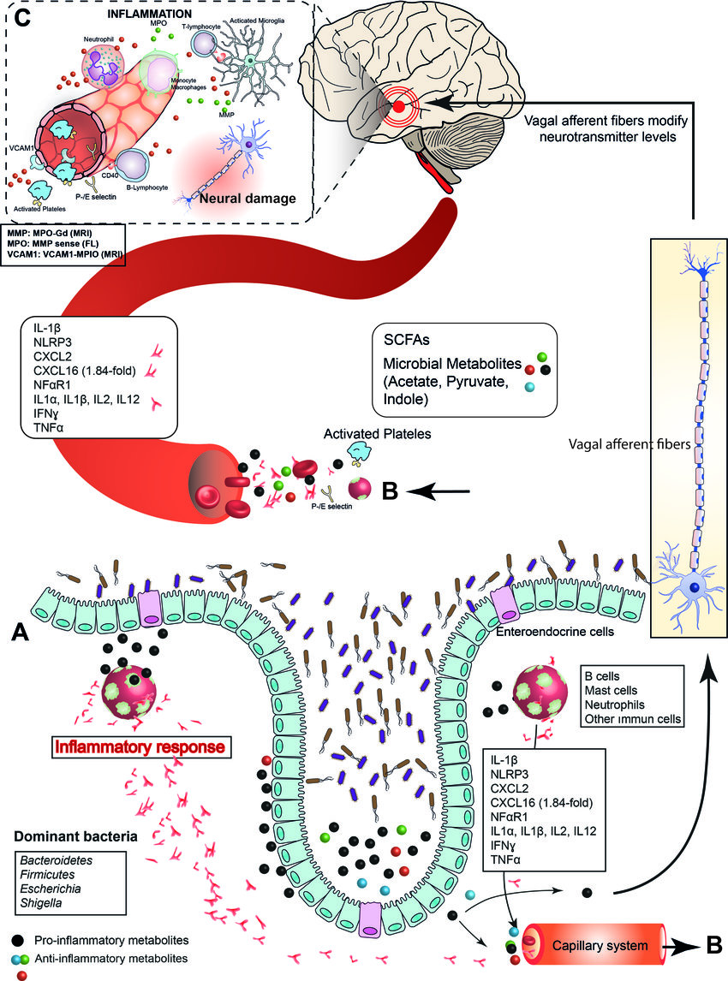
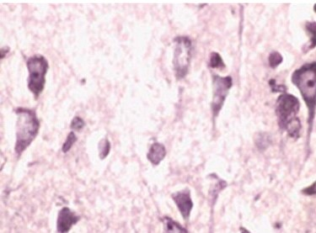
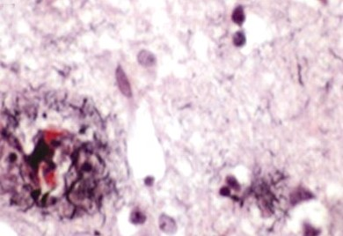
Intestinal Bacterial Flora and Al-zheimer’s Disease
Authors: Al-Tajouri M*, Jaweesh R**
Faculty of Basic Medical Science
Libyan International Medical University
Intestinal flora ,which is the most complex
micro ecosystem in mammals, it’s play a kay role in the regulation of inflammation in the brain tissue.
when the intestinal flora impaired can induce systemic
inflammation , which is the main trigger of many
illnesses including (obesity, anxiety, diabetes type2) particularly of neurodegenerative disease such as
Alzheimer's disease (AD) .
AD is a multifactorial pathology and many biological
pathways play noticeable roles in its pathogenesis. but
the pathogenesis of this disease remains unclear.(1)
RESULT
INTRODUCTION
Fecal microbiota therapy (FMT) can promote the re-establishment of the immune network, microbial communities, and the mucosal barrier of the intestine also FMT might be a good therapeutic approach in neurodegenerative diseases, such as AD triggered by intestinal inflammation, because it can decrease activation of the mucosal immune reaction .(9)
CONCLUSION
There is no doubt with respect to the significant bidirectional interactions between the GIT and CNS provided by lymphatic and blood circulation .
The normal intestinal flora of microorganisms is required for normal cognitive functions under certain conditions, such as AD .
The intestinal membrane permeability increases with age and the rate of transmission of bacterial, viral, and fungal toxins, chemokines, and cytokines to the lymph and blood circulations also increases .Therefore , modifying the GIT flora by (FMT) may be a promising way to suppress increased brain and systemic inflammations.
a
b
Figure1: Interaction between intestinal bacterial flora and brain. (4)
ROLE OF NORMAL FLORA RELATED TO
AL ZHEIMER’S DISEASE
-The gut microorganisms and intestinal microbiota-generated molecules, which are absorbed into the systemic circulation for transport to the CNS are strongly affected by diet.(5)
-Bifidobacterium and lactobacillus species utilizing some of the neurotransmitter like gamma-aminobutyric acid (GABA) which is significantly influences brain metabolism through the system of the vagal nerve.(6)
-The human microbiota release powerful inflammatory activators that may cause CNS amyloidosis.(7)
-Intestinal microorganisms secrete IGM and IGA that are necessary for the normal development of the mucosa-associated lymphoid tissue and epithelial barrier.(8)
Figure2: shows human autopsy tissues between the normal and AD. (2)
GUT-BRAIN AXIS
REFERENCES
Bidirectional axis plays a kay role in the coordination of metabolism and maintenance of homeostasis of the brain and GIT.
It is composed of the autonomic nervous system (ANS) , enteric nervous system (ENS) ,immune system , lymphatic system and neuroendocrine system .
-Germ free mice (GF) :
The level of brain derived neurotrophic factor (BDNF) was reduced in the hippocampus and cortex in GF mice and in infection models in which the MB profile has been experimentally altered, as in the case of neurodegenerative diseases .(3)
1. Hill, J. and Lukiw, W. (2015). Microbial-generated amyloids and Alzheimer's disease (AD). Frontiers in Aging Neuroscience, 7.
2. Rajendran, L., Honsho, M., Zahn, T., Keller, P., Geiger, K., Verkade, P. and Simons, K. (2018). Alzheimer's disease beta-amyloid peptides are released in association with exosomes.
3,5,7. Guivarch, C. and Hallegatte, S. (2012). 2C or Not 2C?. SSRN Electronic Journal.
4. Chui, H. (1996). Alzheimer Disease. Alzheimer Disease & Associated Disorders, 10(1), p.53.
6. Standard Laboratory Equipment. (2001). Current Protocols in Food Analytical Chemistry, 00(1), pp.A.2C.1-A.2C.2.
8. Brandtzaeg, P. (2010). Homeostatic impact of indigenous microbiota and secretory immunity. Beneficial Microbes, 1(3), pp.211-227.
9. Editorial Board. (2015). Endocrinology, 156(5), pp.2C-2C.
* Second year medical student, faculty of basic medical science at Libyan International Medical University
** Assistant professor of medical microbiology and immunology at Libyan International Medical University,

