Slide 1

CORONARY HEART DISEASE
OBESITY
Mohamed algahyme
3499
PTS BLOCK
6.6.2022
1

Slide 2
OBJECTIVE
Define coronary heart disease
Discuss the relation between the obesity and CHD
Describe the effect of Weight loss and physical activity on CHD
2

Slide 3
INTRODUCTION
prevalence of obesity has increased greatly in the last fifty years.
important risk factor for many diseases.
3

Slide 4
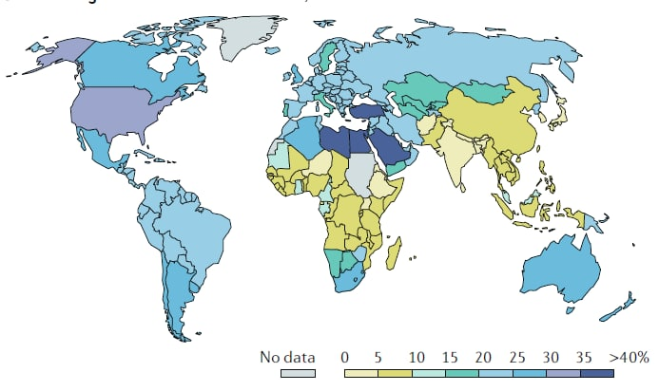
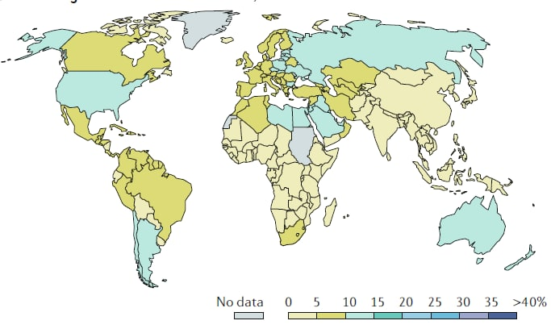
1975
2014
Percentage of obese adults in
4

Slide 5
heart disease
Coronary
Coronary heart disease(CHD) sometimes called coronary artery disease is caused by occlusion of the coronary artery which supplies the heart muscle
5

Slide 6
RISK FACTOR
Hypertension
Decreased physical activity
Hyperlipidaemia
Daibetes type II
6

Slide 7

How does obesity cause coronary heart disease?
7

Slide 8
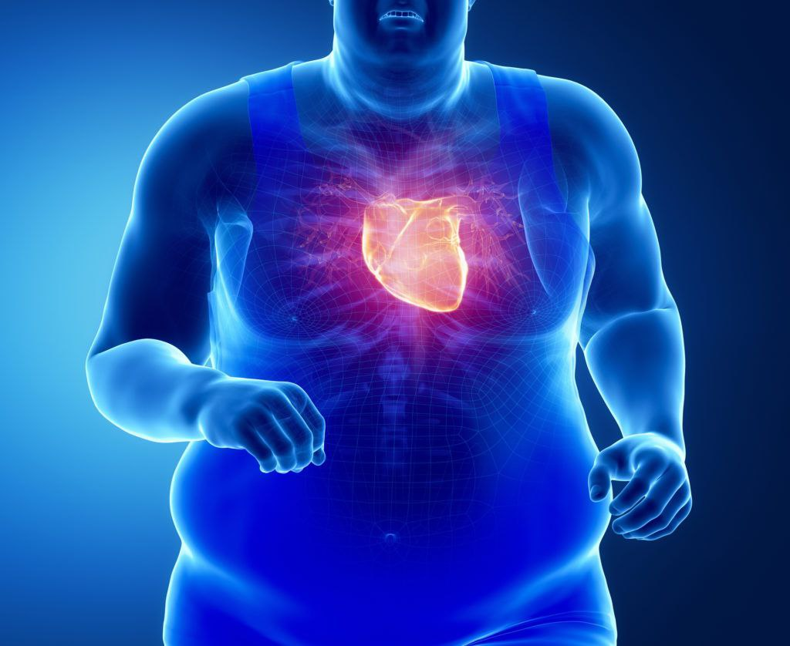
Relation between the obesity and CHD
obesity increases the risk of diabetes, hypertension, and hyperlipidemia
A high body mass index BMI increases the risk dramatically independent of any other factors
Also, fat distribution has a role.
8

Slide 9
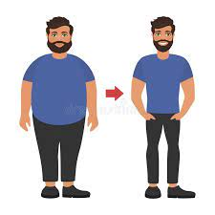
Effect of Weight loss and physical activity on CHD
Weight loss
has a solid modifying effect on many of the risk factors like hypertension, hyperlipidemia, and diabetes
Not only that but weight loss will cause a reduction of the BMI which as we mentioned contributes greatly to CHD
9

Slide 10
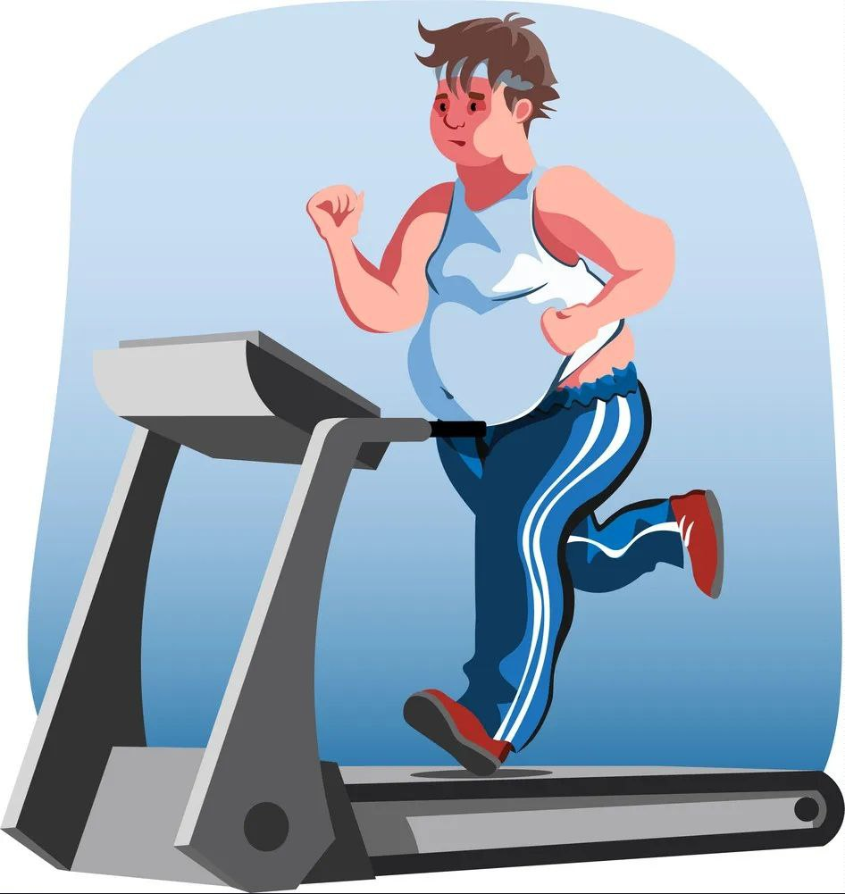
Effect of Weight loss and physical activity on CHD
Physical activity
Patients with high Physical activity and cardiorespiratory fitness have a much greater effect on prognosis than those lowering BMI
So the best non-pharmacological management for CHD is a combination of weight loss and physical activity
10

Slide 11
CONCLUSION
obesity is one of the major health problems and it's increasing even in Libya
Even though there are many ways to manage it Prevention is still better than cure
So eat healthy food and exercise more and you should be fine
11

Slide 12
REFERENCES
Katta N, Loethen T, Lavie CJ, Alpert MA. Obesity and coronary heart disease: epidemiology, pathology, and coronary artery imaging. Current Problems in Cardiology. 2021 Mar 1;46(3):100655.
Blüher M. Obesity: global epidemiology and pathogenesis. Nature Reviews Endocrinology. 2019 May;15(5):288-98.
Alexander JK. Obesity and coronary heart disease. The American journal of the medical sciences. 2001 Apr 1;321(4):215-24
12

Slide 13
THANKS!
13

