Slide 1
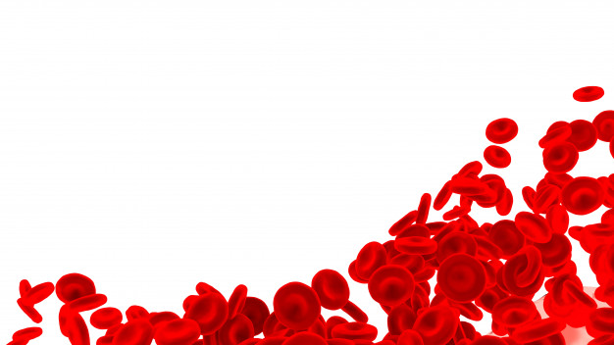


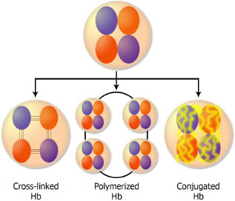
Libyan international medical university
Medicine Faculty
Artificial Blood Substitutes
By Hadil Abdnaser Azouz Altlhe 1336
Introduction
Hb-Based RBC Substitutes.
Artificial blood was highlighted after the emergence of HIV in 1980 due to the risk of its transmission by blood transfusion, which imposes higher costs due to the necessary detection tests. In addition, low blood supplies especially in developing countries )just collect less than 32% of total worlds’ blood supplies) with increased demand for blood products, short storage period, and urgent needs for blood supplies during wartime and natural disasters are other important reasons that make the development of a suitable blood substitute indispensable1.
Production of genetically modified Hb in microorganisms and plants can address several problems associated with Human Hb derived from expired RBC bags and Hb can be genetically manipulated by this approach to overcome some side effects associated with these products, for example, the affinity of Hb for NO and O2 can be changed . The Hb outside the RBCs ,cause severe complications such as kidney damage.
Hb must be modified before its application as an oxygen carrier. The Hb-based oxygen carriers (HBOCs) are divided into the following two groups: acellular and cellular HBOCs1.
RBCs Differentiated from Stem Cells
the can be used as an ideal product for injection to patients requiring chronic blood transfusion as well as patients with rare blood groups or autoantibodies.
the production of RBCs in the laboratory is performed by adjusting various production conditions such as providing optimal culture conditions for cord blood-derived hematopoietic stem cells and subsequent coculture of erythroid progenitors with human fetal liver stromal cells.
This resulted in an improved terminal erythroid maturation process and plenty of cells were obtained, which were comparable with natural RBCs in many aspects.
Exposing CD34+ cells to a short pulse of cytokines favorable for erythroid differentiation before their expansion and their subsequent expansion is another approach in this respect
RBCs Differentiated From Stem Cells Mass production and high production costs for clinical applications are the most important problems in this field1.
Per fluorochemical-based RBC substitutes
Acellular HBOCs
different modifications of Hb, only nanotechnology-based polyhemoglobin (PolyHb) and conjugated Hb are effective. However, due to their short blood half-lives and side effects, a majority of these products did not achieve required criteria in clinical trials.
This product has been used for various purposes, such as reduction of neurological damage in a mouse model, intraoperative anemia in sheep, cardiopulmonary resuscitation in pigs, and postcardiac bypass surgery to avoid allogeneic blood transfusion. However, the efficiency of diaspirin cross-linked Hb in the above-mentioned studies has been challenging1.
Per fluorochemicals (PFCs) are colorless, inert, and apparently nontoxic liquids and insoluble in aqueous phase, and in case of their clinical application, they are solubilized using an emulsifying agent, Oxygen is dissolved in PFCs at a concentration of about 40%–50%, which is 2 times higher than plasma. In addition, PFCs dissolve 130–160 mL carbon dioxide ;Their small sizes enable them to easily pass through the vessels occluded in some diseases, where RBCs cannot pass.
in the regional ischemia, per fluorochemical artificial blood is significantly better than blood at maintaining both systolic and diastolic myocardial function after a major coronary artery has been occluded.2
Perflubron and perfluorodecalin are among the second-generation PFC-based blood substitutes, which are rejected by clinical trials due to some side effects such as increased risk of stroke following administration of Oxygent™
Administration of PFC-based products can result in mild thrombocytopenia (10%-15% reduction in platelet count) as well as flu-like syndrome.1
Conclusion
in the future studies on artificial blood, substitutes would focus on real blood substitutes, ie, RBCs obtained through differentiation of stem cells. Hence, by considering the first steps that have been taken successfully toward this ideal product, it would be expected in the near future to have a source of required RBCs with minimum complications and maximum similarity to replace RBCs derived from donated blood. however it must be noted that artificial blood is still at the preliminary stages of development, and to fulfill this dream, ie, to routinely transfuse artificial blood into human vessels, we still have to strengthen our knowledge and be patient.
References
1. Moradi, S., Jahanian-Najafabadi, A., & Roudkenar, M. H. (2016). Artificial blood substitutes: first steps on the long route to clinical utility. Clinical Medicine Insights: Blood Disorders, 9, CMBD-S38461.
2. Mushlin PS, Boucek RJ, Parrish MD, Graham TP, Olson RD. Beneficial effects of perfluorochemical artificial blood on cardiac function following coronary occlusion. Life Sci. 1985;36(22):2093–2102.

