Slide 1


Mohammed Jamal Elghirani 2857 mohammed_2857@limu.edu.ly
Libyan International University Faculty of Business Administration
Definition of Verbal &
Non-verbal Message

Slide 2
Table of content
1- Definition of verbal &
Non-verbal message.
2- Example of verbal message.
3- Example of non-verbal message.
4- conclusion.
5-reference.
2

Slide 3

Definition of verbal message
Verbal messages consist of using words and sounds to communicate with another person.
3

Slide 4



Example of Verbal Message
5

Slide 5
Definition of Non-verbal Message
It is the process of communication by sending and receiving messages without words between people.
3

Slide 6

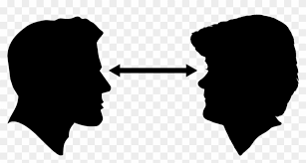
Example of Non-verbal Message
7

Slide 7
Conclusion
Verbal messages are clearer than non-verbal messages.
8
3

Slide 8
Reference
Counts, D. A., Brown, J. K., & Campbell, J. C. (1992). Sanctions and sanctuary: Cultural perspectives on the beating of wives. Boulder, CO: Westview Press.
9
3

Slide 9
Thank you

