Slide 1



An Introduction to Postmodernism and Its Implications
Libya International Medical University
Faculty of Business administration
Mohammed Alzanati 2344

Slide 2
Table of Contents
01
02
03
The modernist management practices
Negative Political Implications
Introduction
04
05
Conclusion
Applying Postmodernism to Ideologies via History
06
Reference

Slide 3

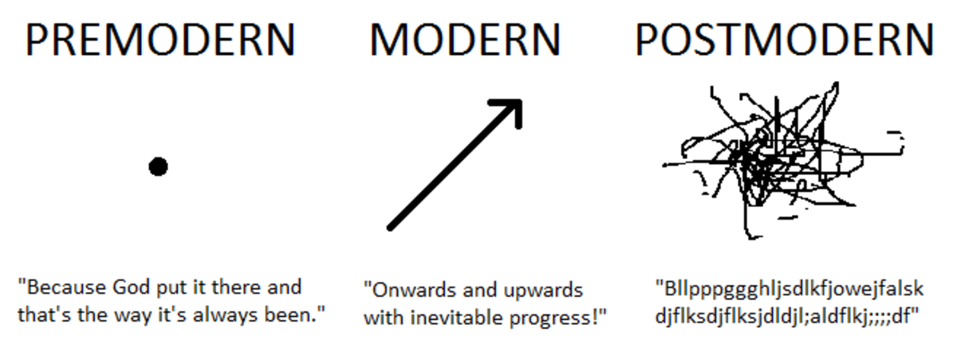
Introduction
Postmodernism is an intellectual stance or mode of discourse characterized by skepticism toward the "grand narratives" of modernism, rejection of epistemic certainty or the stability of meaning, and emphasis on ideology as a means of maintaining political power Claims to objective fact are dismissed as naïve realism, with attention drawn to the conditional nature of knowledge claims within particular historical, political, and cultural discourses.

Slide 4
The modernist management practices
utilized today in manufacturing and many industrial settings (Nixon, 2003). Additionally, these management practices are frequently used with inexperienced workers and entry-level positions. As the jobs become more complex and the workers more skilled, postmodern management theories become commonplace. Basic job functions benefit by initial scoping through the modernist theories. However,

Slide 5
Negative Political Implications
The problem with Post Modern theories is that if there is no universal Truth, how can anyone objectively criticize human acts such as the Holocaust, slavery, forced female genital mutilation…?
So on the surface, Postmodern perspectives disarm all political philosophies, including the entire basis of liberal democracies like the United States that are based on the "self evident" principles of equality and freedom.

Slide 6
Responses to These Implications
The claim that there is no universal single truth opens up the possibility of many types of useful perspectives
This "many small truths" perspective offers more opportunities to solve social problems
History suggests the One Truth method of solving social problems didn’t work anyway

Slide 7

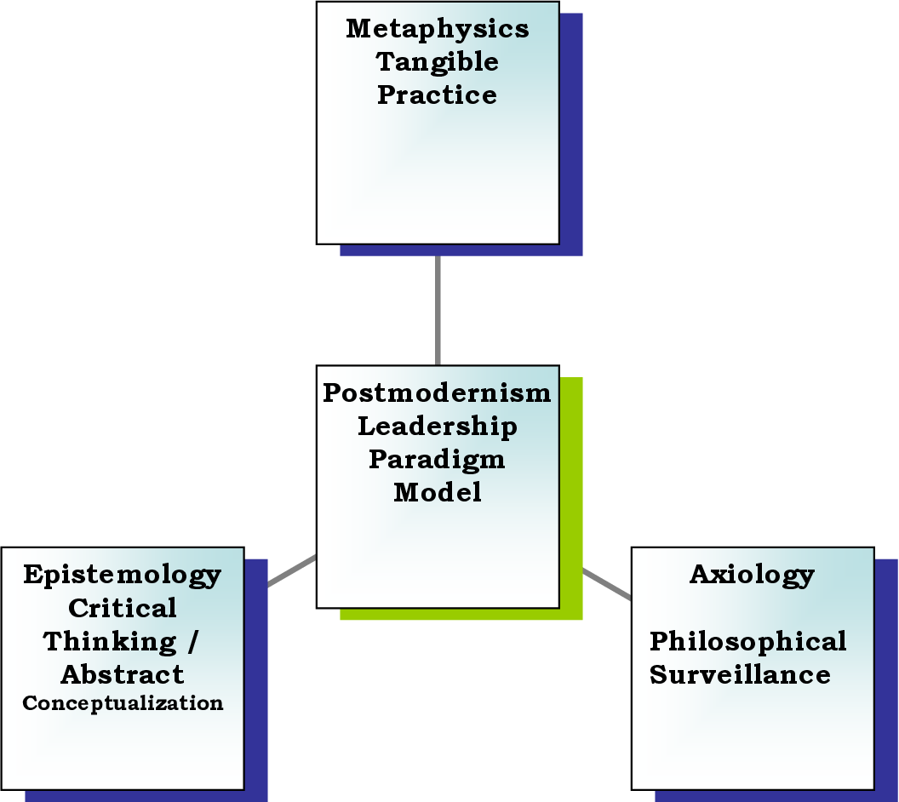

Slide 8

Applying Postmodernism to Ideologies via History
03

Slide 9
Because of these perspective on knowledge or "truth" itself, Postmodern philosophies are often less concerned with whether or not a given idea is True and instead more concerned with why a given group believes an idea to be true. Because all ideas are in this way seen as Ideology, we become more interested in the history of the Idea: how it was invented, spread, and made to appear as true.

Slide 10
Ideas vs. Facts
The most radical or extreme Postmodern philosophies assail the factual world, asserting humans really aren’t able to objectively discern factual reality from cultural fiction, down to the level of whether, scientifically, a given table or chair even exists or not. Such a blanket application of Postmodern perspectives, however, deconstructs itself as it turns Postmodern philosophy itself into mere Ideology.

Slide 11
An Unfinished Philosophical Approach
Finally: It's well worth noting that no one is working harder to work beyond the clear limits of Postmodern theory than those who are working in Postmodern theory; they clearly recognize the philosophical corner this perspective has painted itself into and are interested in developing new theories that accept the validity of the current theories and then work beyond them, or willingly critique their own philosophical perspective.
Personally, I think of this as I think of cancer or AIDS: no one is working harder to defeat cancer or AIDS etc. than those who are also normally entrusted to tell us we have it. The diagnosis, then, is the first step in working toward a cure.

Slide 12
Morality Without Truth
So a philosophy that does not locate any overarching, "Big 'T' Truth" type of reason against committing genocide is not necessarily a philosophy that advocates genocide; as with the Existentialists, nothing in Postmodern philosophy discounts the value of human suffering or human life because human suffering is not a philosophical concept; it is a direct experience.

Slide 13
Conclusion
The Implications of Postmodern Philosophies. Negative Political Implications: The problem with Post Modern theories is that if there is no universal Truth, how can anyone objectively criticize human acts such as the Holocaust, slavery, forced female genital mutilation

Slide 14
Reference
Wong, K. (2022, December 30). Post-modrism: Definition, importance, and development. Achievers. Retrieved December 16, 2022, from https://www.achievers.com/blog/organizational-culture-definition/
IMplamtions. (n.d.). Retrieved December 29,2022, from https://www.shrm.org/ResourcesAndTools/tools-and-samples/toolkits/Pages/understandinganddevelopingorganizationalculture.aspx

Slide 15

THANK YOU

