Slide 1


Hepatitis B in the dental world
Name :Mohamed Mufeed Tajouri
Student ID : 3088
Year 2 Block :PTS
Date: /28/3 2022
1

Slide 2
Objectives
2
Overview of Hepatitis B
Discuss risk factors
Illustrate Investigate clinical presentation
Outline oral Manifestations
Of hepatitis B
Discuss management of
Hepatitis B

Slide 3
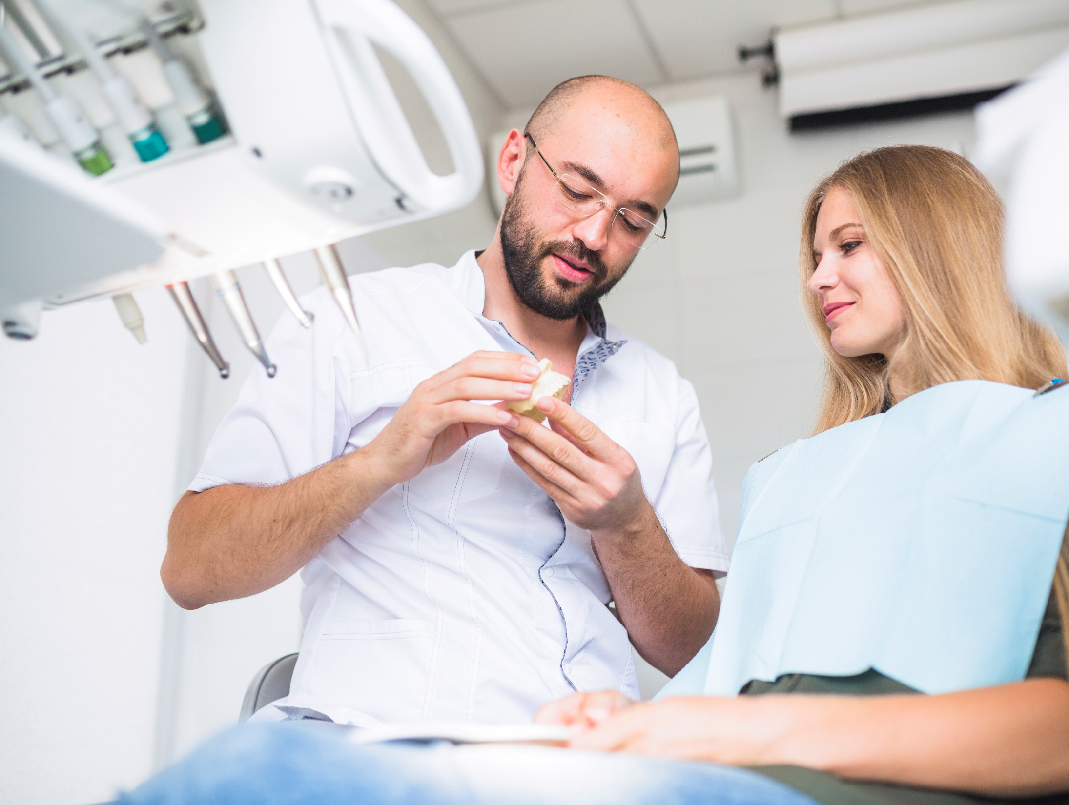
Introduction
3
Viral hepatitis has become silent epidemic worldwide
It is the causative agent of liver cirrhosis and liver carcinoma
Can be transmitted through several routes including:
Direct contact with blood or fluid or other secretions
Indirect contact with contaminated instruments.

Slide 4

What is Hepatitis B
Hepatitis B is a liver infection caused by Hepatitis B virus
There is a vaccine that protects against it
For some people it is mild & short
“acute” cases don’t always need treatment but it can be chronic
4

Slide 5
Risk Factors
Who has the highest risk
Sexually transmitted
Tattoos
Drugs
Toothbrush
sharing toothbrushes, razors, or nail clippers that have been exposed to blood
Receiving a tattoo or body piercing with equipment that has not been sterilized
abuse and sharing needles, syringes or other equipment.
Having unprotected sexual interaction
with someone
infected
5

Slide 6
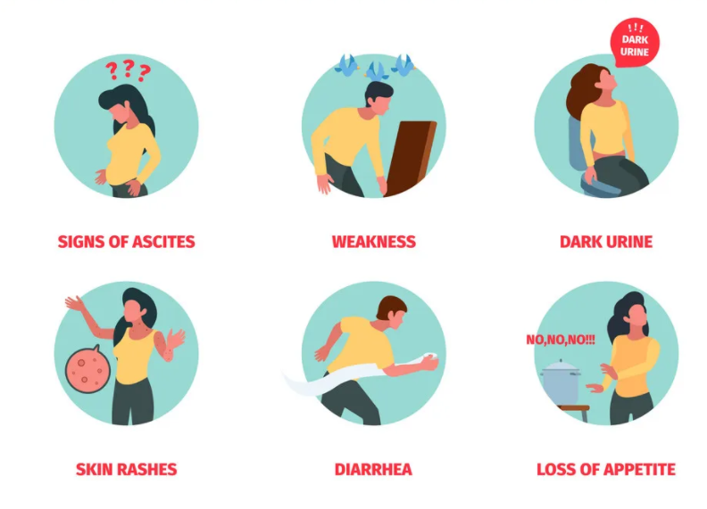
Symptoms
6

Slide 7

Clinical presentation:
Mild symptoms
Malaise, nausea, vomiting and abdominal discomfort.
Pale stools, dark urine and jaundice.
Chronicity in 70% to 80% of the cases
7

Slide 8
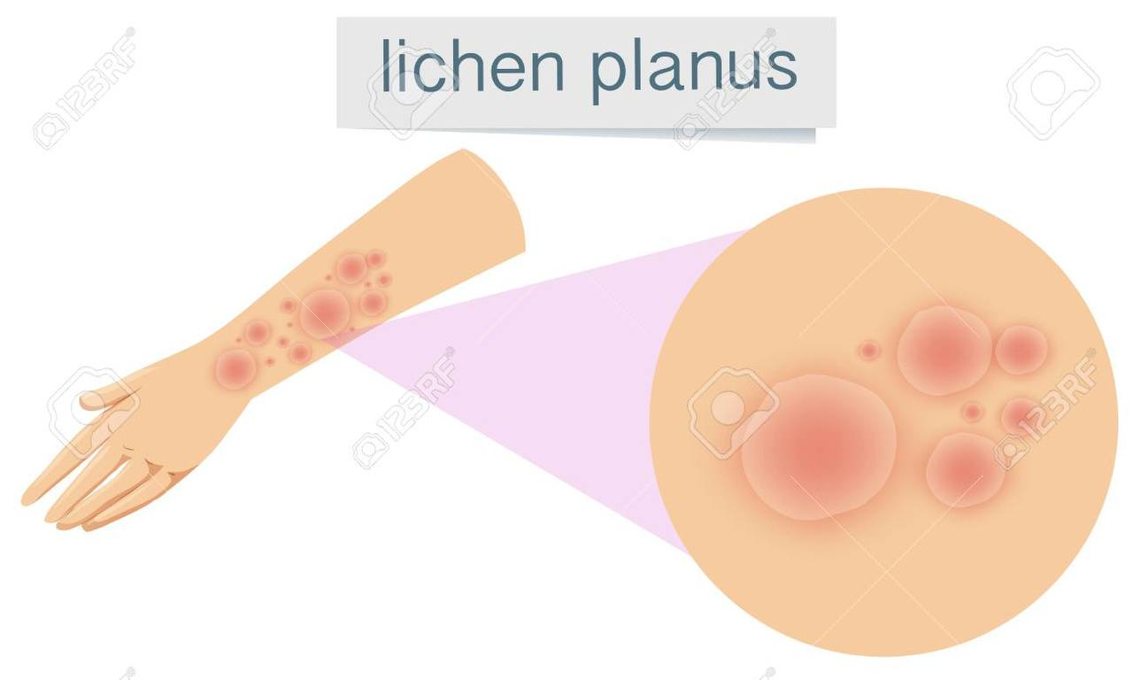
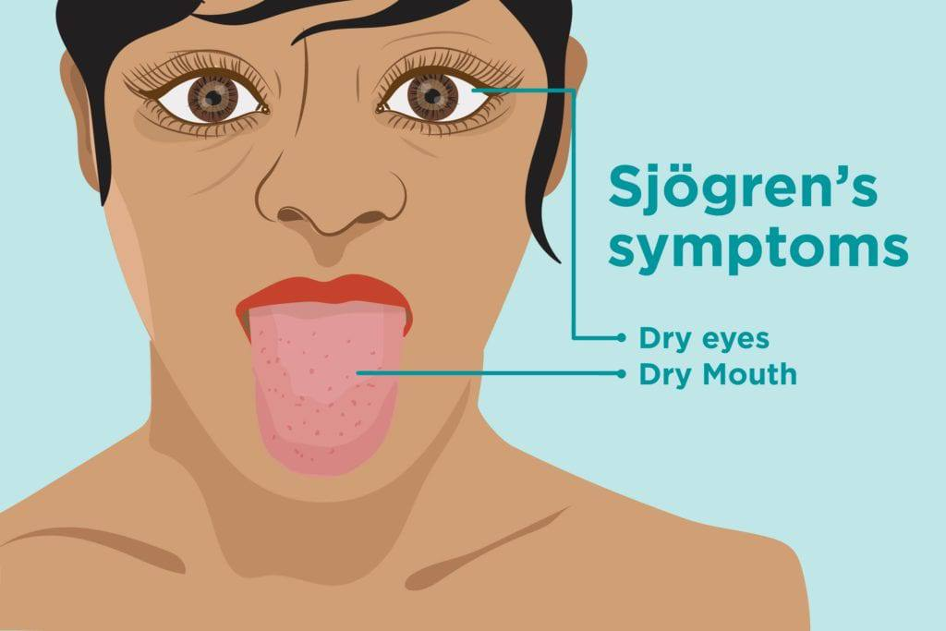
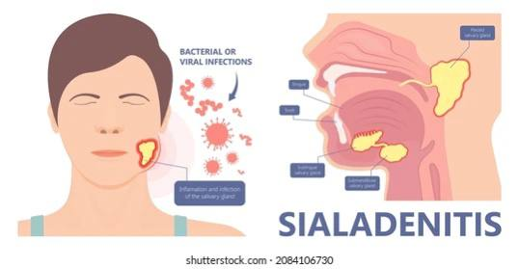
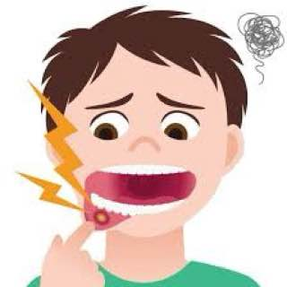
Oral manifestations:
Higher concentration of HBV are found in the gingival sulcus than in saliva.
Lichen planus
Sjogrens syndrome
Sialadenitis
Forms of oral cancers
8

Slide 9
Treatment
Acute infection:
.No medication is available; treatment is supportive.
For chronic infection:
Several antiviral drugs (adenoviral, dipivoxil, interferon alfa-2b, lamivudine) are available.
Persons with chronic HBV infection require medical evaluation and regular monitoring to determine whether disease is progressing and to identify liver damage or hepatocellular carcinoma.
9

Slide 10
General prevention
Protective garments
Screening
Use mask, eye protection, and gloves
Take a well detailed history of patient
Follow procedure
Disinfect
Proper and safe disposal of needles
Autoclaving metal objects
10

Slide 11
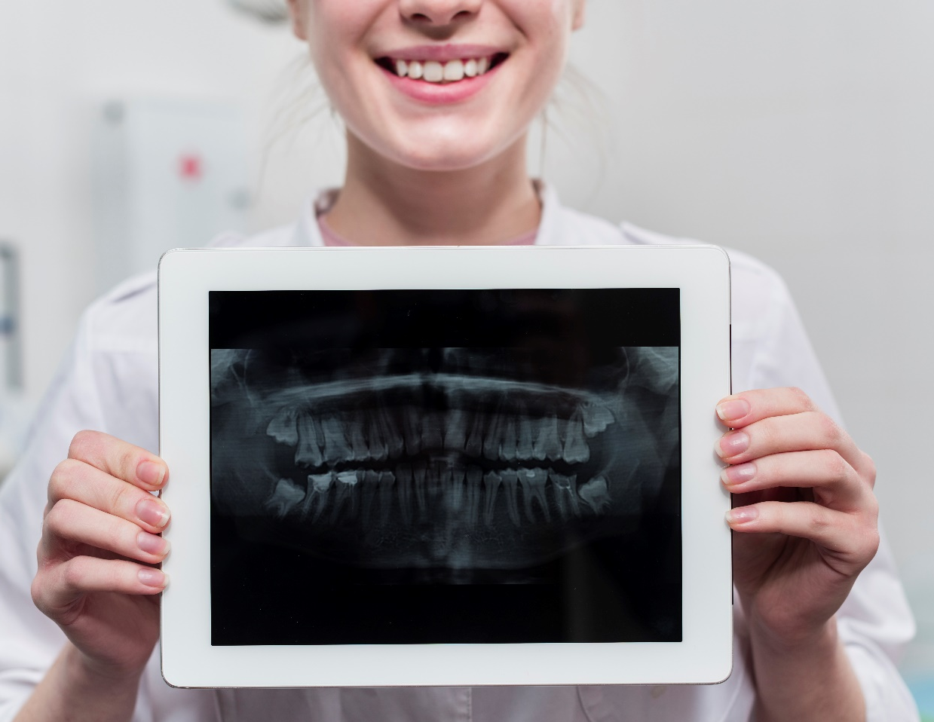
Is there a vaccine?
Yes! There is
Does it work?
The first vaccine was developed in 1981
Hepatitis b vaccine is the most effective way to prevent the infection
How does it work?
The HBV vaccine is given in 3 doses.
11

Slide 12
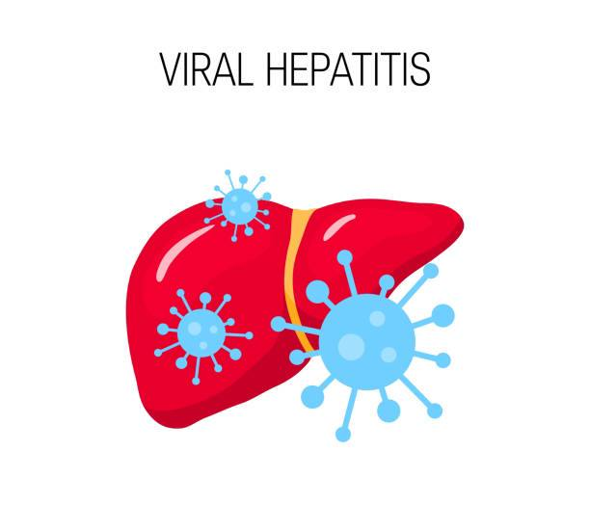
Conclusion
Today, viral hepatitis has become a silent epidemic worldwide. It is the major cause of liver cirrhosis and liver carcinoma. In a dental office, infections can be expedited through several routes, so the role that a dentist can play in prevention of hepatitis is by considering each and every patient as a potential carrier of hepatitis.
12

Slide 13
Reference
1-Scully, C., 2014. Scully's Medical Problems in Dentistry. Edinburgh: Churchill Livingstone.
2-Centers for Disease Control and Prevention. 2022. Preventing Hepatitis B. [online] Available at: <https://www.cdc.gov/globalhealth/immunization/othervpds/preventing_hepatitisb.html> [Accessed 2 March 2022].
3-Tarakji B, Ashok N, Alakeel R, et al. Hepatitis B vaccination and associated oral manifestations: a non-systematic review of literature and case reports. Ann Med Health Sci Res. 2014;4(6):829-836. doi:10.4103/2141-9248.144870
4-Buti M, Riveiro-Barciela M, Esteban R. Treatment of Chronic Hepatitis B Virus with Oral Anti-Viral Therapy. Clin Liver Dis. 2021;25(4):725-740. doi:10.1016/j.cld.2021.06.003
13

Slide 14
Thank you
Any Question?
14

