Slide 1


INSULIN,A WAY IS LIVE
Libyan International Medical University
Applied Medical science
Name: Shahd Samir Omar
Roll Number: 3581
Date: 4/6/2022
Academic year:2021/2022

Slide 2
Objective:
1. List types of diabetes .
2. Discuss the causes of diabetes .
3. Discuss symptoms for diabetes.
4. Discuss diabetes treatment.
5. Discuss complication of diabetes.

Slide 3
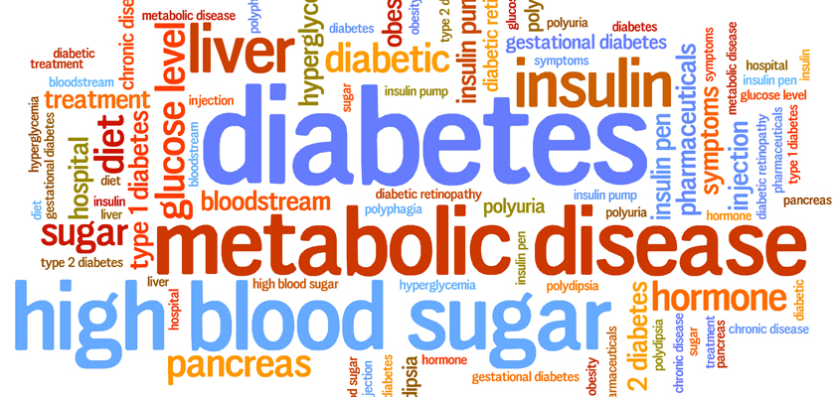

Slide 4
Introduction :
Diabetes is the group of metabolic disorders sharing the common feature of hyperglycemia caused by defects in insulin secretion , insulin action , or most commonly both , and it is characterized by abnormally high of glucose in the blood.

Slide 5
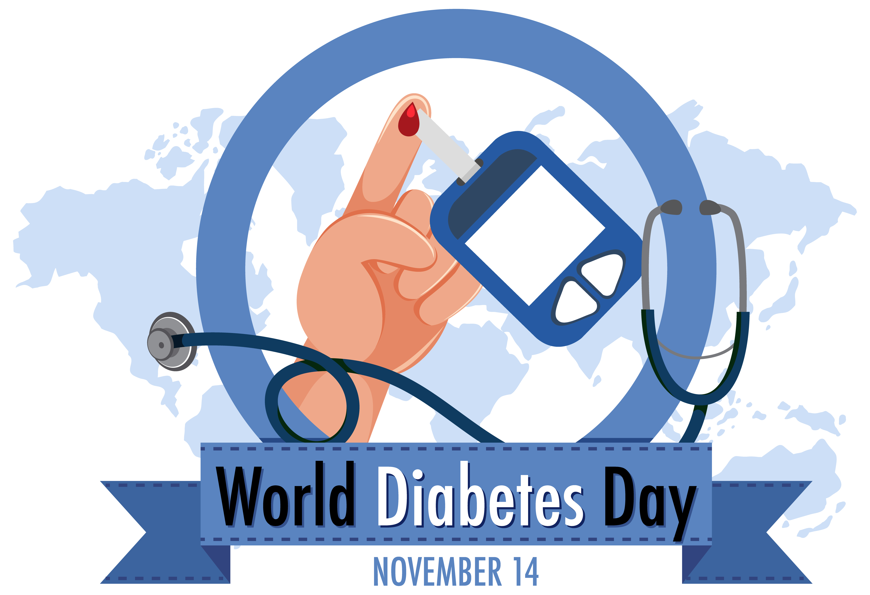
Types of diabetes:
1.Type 1: is an autoimmune disease characterized by autoreactive T cell mediated destruction of insulin producing pancreatic beta cell.
2. Type 2:is combination of insulin resistance beta cell dysfunction.

Slide 6
Causes of diabetes:
1.Type 1: scientists think is caused by
genes and environmental factor , such as
viruses , that might trigger the disease.

Slide 7
2. Type 2: is caused by several factors , including lifestyle factors and genes:
Overweight , obesity , and physical inactivity.
Insulin resistance.
Genes and family history.

Slide 8
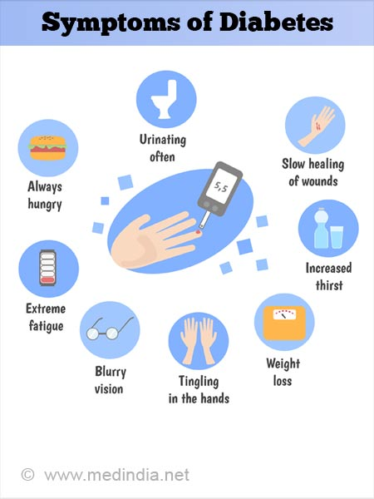
Symptoms of diabetes:
1.Increased thirst and urination.
2.Increased hunger.
3.Fatigue.
4.Blurred vision.
5.Numbness or tingling in the feet or hand.
6.Sores that do not heal .
7.Unexplained weight loss.

Slide 9
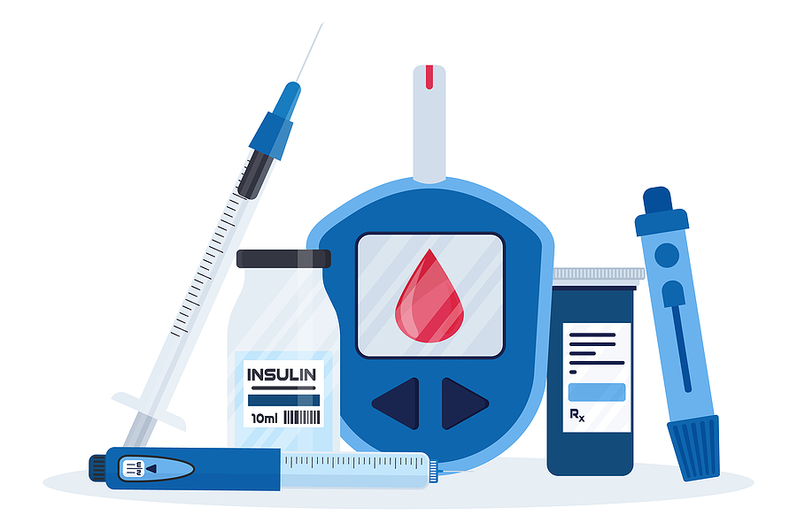
Treatment of diabetes:
1.Insulin: the different ways to take it are:
Needle and syringe.
Pen.
Pump.
Inhaler.
Injection port.
Jet injector.

Slide 10
2.Bariatric surgery (weight-loss surgery or metabolic surgery).
3.Artificial pancreas.
4.Pancreatic islet transplantation.

Slide 11
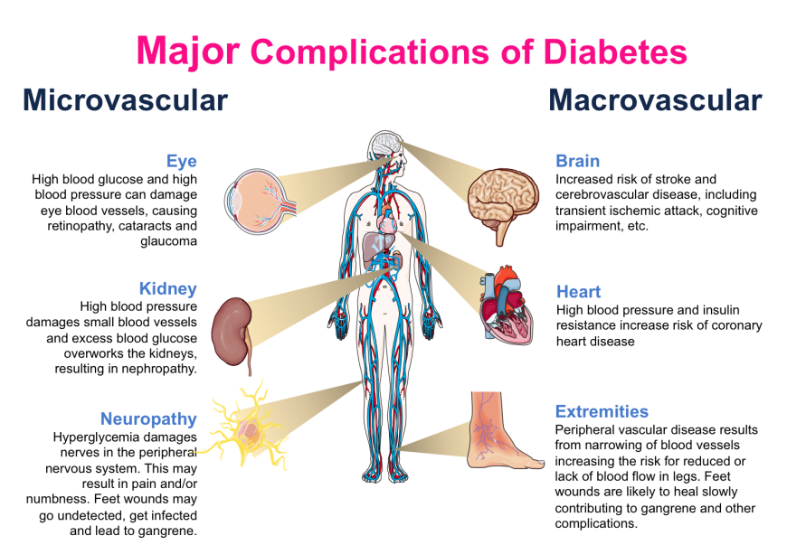
Complication of diabetes:
Eye disease.
Foot problems.
Gum disease.
Heart disease and stroke.
Kidney disease.
Nerve disease (diabetic neuropathy).
Skin conditions.

Slide 12
Conclusion:
Diabetes is serious life threatening disease and must be constantly monitored and effectively subdued with proper medication and by adapting to a healthy lifestyle , and we can control it with proper treatment.

Slide 13
References:
1.Kumar V, Abbas A, Aster J, Perkins J. Robbins Basic Pathology. 10th ed.
2.Diabetes S, Health N. Symptoms & Causes of Diabetes | NIDDK. National Institute of Diabetes and Digestive and Kidney Diseases. https://www.niddk.nih.gov/health-information/diabetes/overview/symptoms-causes. Published 2022. Accessed May 10, 2022.
3.Insulin &, Health N. Insulin, Medicines, & Other Diabetes Treatments | NIDDK. National Institute of Diabetes and Digestive and Kidney Diseases. https://www.niddk.nih.gov/health-information/diabetes/overview/insulin-medicines-treatments. Published 2022. Accessed May 14, 2022.
4.Topics H. Diabetes Complications | MedlinePlus. Medlineplus.gov. https://medlineplus.gov/diabetescomplications.html. Published 2022. Accessed May 10, 2022.

Slide 14
THANK YOU

