Slide 1


Healthy Inhale
Libyan international medical university
Applied medical science
1st year medical student
2021\2022
Mahammad wasfi Almghrbi
3385

Slide 2
1
Key facts about smoking
2
How smoke damages our bodies
3
Stop smoke suddenly and the side effects
4
The best ways to control smoking
5
The benefits of stop smoking

Slide 3

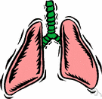
KEY FACTS
There are 1.3 billion tobacco users worldwide
Tobacco kills around 8 million people every year (more than 7 million active smokers and over 1 million non-smokers exposed to second-hand smoke), including 1 million in the Americas
The life expectancy of smokers is at least 10 years less than non-smokers
Tobacco is the only legal consumer product that kills the person
Mortality from tobacco use in the Region accounts for 15% of the deaths from cardiovascular disease, 24% of those from cancer, and 45% of those from chronic respiratory diseases

Slide 4
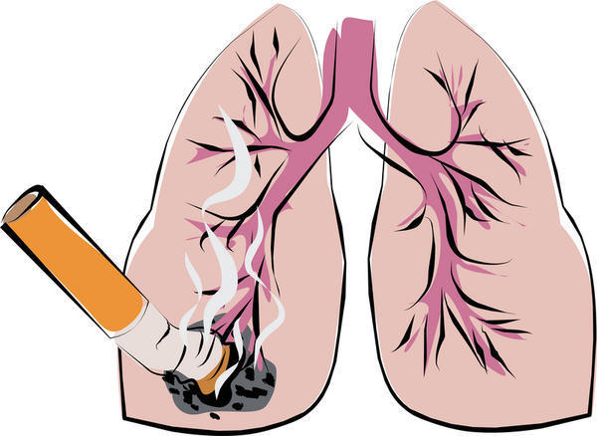
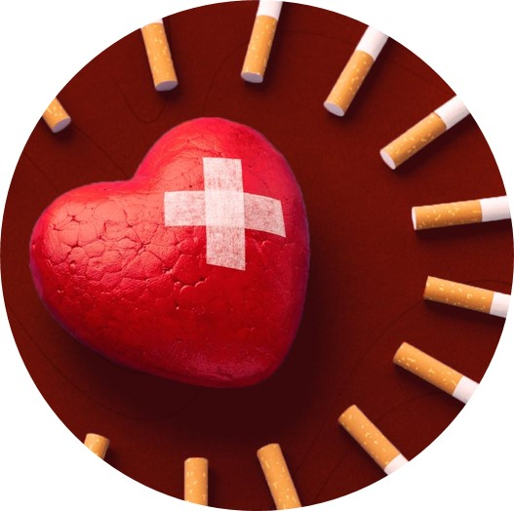
HOW SMOKE DAMAGES OUR BODISE
CANCER :
Smoking is the most common cause of lung cancer
BREATHING PROBLEM AND RESPIRATORY CONDITIONS : like chronic obstructive pulmonary disease ( COPD ) & asthma
Heart disease, stroke and blood circulation problems
Smoking increases the risk of blood clots, which block blood flow to the heart, brain or legs
DeathDeath

Slide 5

HOW SMOKE DAMAGES OUR BODISE
DIABETES :
Smoking causes DM2 , with the risk of developing diabetes is higher for active smokers than non-smokers
INFECTIONS :
Smoking weakens your immune system so you’re more likely to get viral and bacterial infections .

Slide 6
s
STOP SMOKE SUDDENLY AND THEIR SIDE EFFECTS
Insomnia
Anxiety
Depression
Tirdness & dizziness
Loss of appetite
Headache
Constipation

Slide 7
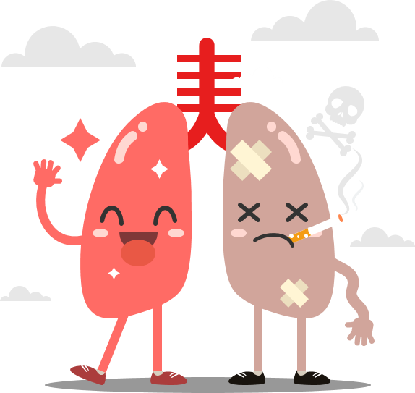
BEST WAYS TO CONTROL SMOKING
The best way is to stop it gradually .
Try nicotine replacement therapy :
* Prescription nicotine in a nasal spray or inhaler
* Nicotine patches, gum and lozenges you can buy without a
prescription
Delay :
If you feel like you're going to give in to your tobacco craving, tell
yourself that you must first wait 10 more minutes
Don't have 'just one‘
having just one leads to one more. And you may end up using
tobacco again
Remind yourself of the benefits ☺

Slide 8
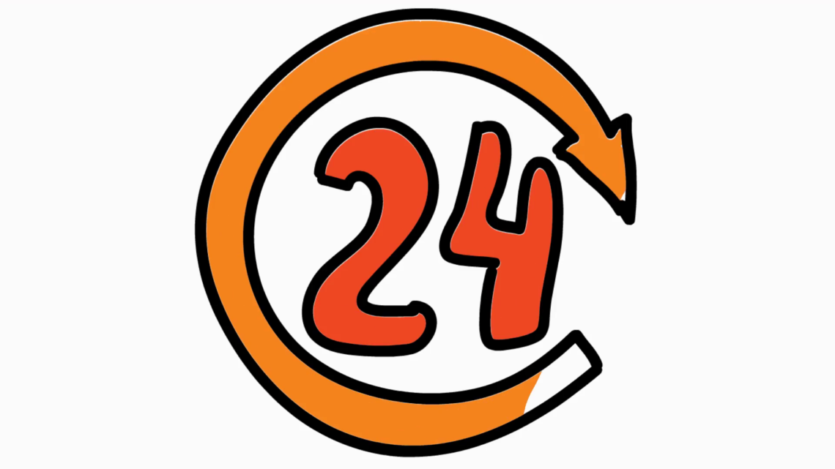
THE BENEFITS
WITHIN DAYS :
Blood pressure and heart rate return to normal. Blood circulation will improve.
Carbon monoxide levels in the blood will decrease.
The oxygen level will return to normal.
breathing may become easier.

Slide 9

THE BENEFITS
Within weeks:
Both lung function and blood circulation improve.
Within a few months:
Reduced cough and shortness of breath
Within a year or two:
The risk of heart and lung diseases is considerably reduced compared with that in a smoker.

Slide 10
SUMMARY
Key facts about smoking
How smoke damages our bodies
Stop smoke suddenly and the side effects
The best way to control smoking
The benefits of stop smoking

Slide 11

REFERENCES
https://www.paho.org/en/topics/tobacco-prevention-and-control
https://www.mayoclinic.org/healthy-lifestyle/quit-smoking/in-depth/nicotine-craving/art-20045454
https://www.medicinenet.com/what_will_happen_if_you_suddenly_stop_smoking/article.htm

Slide 12
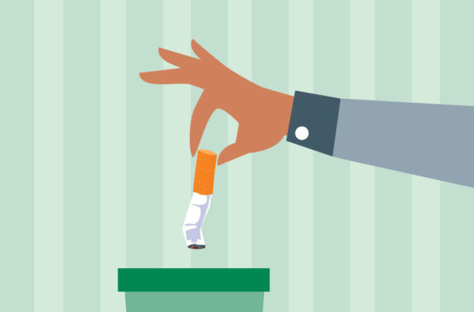
THANK YOU

